Slide 1

Polaris Acquisitions

Slide 2
Getting Started with Acquisitions
Polaris Toolbar/Polaris Shortcut Bar—Starting point and navigation tool for all Polaris activities
Workform Toolbar
Line-Item Toolbar
PO—Purchase order
POLI—Purchase order line item
IN—Invoice
INLI—Invoice line item
970—MARC tag that holds acquisition order data for Polaris
EDI—Electronic data interchange
Enriched EDI—Shelf ready materials the vendor completely processes; purchased materials delivered fully cataloged with MARC records containing embedded holdings data
POA—Purchase order acknowledgment
ASN—Advanced shipping notice

Slide 3
Getting Started with Acquisitions
Acquisitions workflow overview
Fiscal year records
Fund records
Creating funds and subfunds
Adding and transferring money in funds
Fund Explorer
Supplier records
EDI (electronic data interchange)
Web selection tools
970 grids
Linking to supplier databases
Importing order records from web selection tools
On-order item templates
Purchase order templates
On-order bibliographic templates

Slide 4
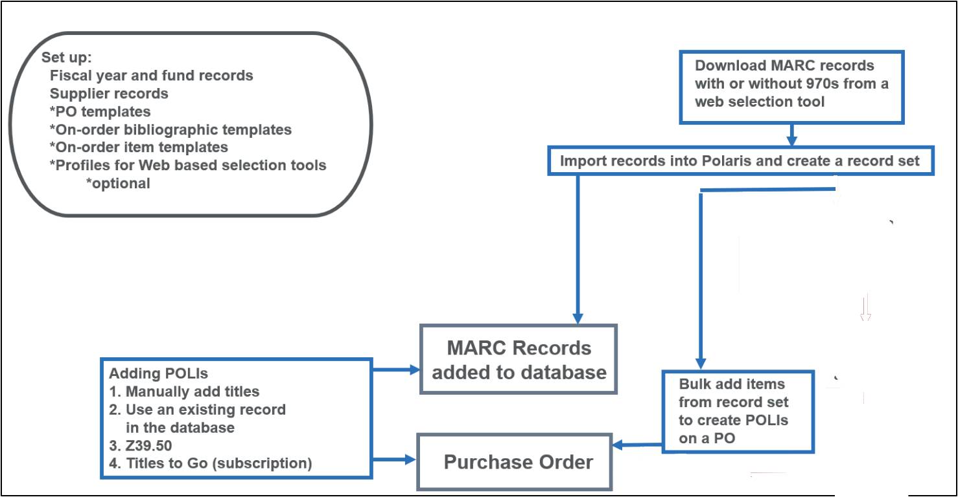
Acquisitions Workflow

Slide 5
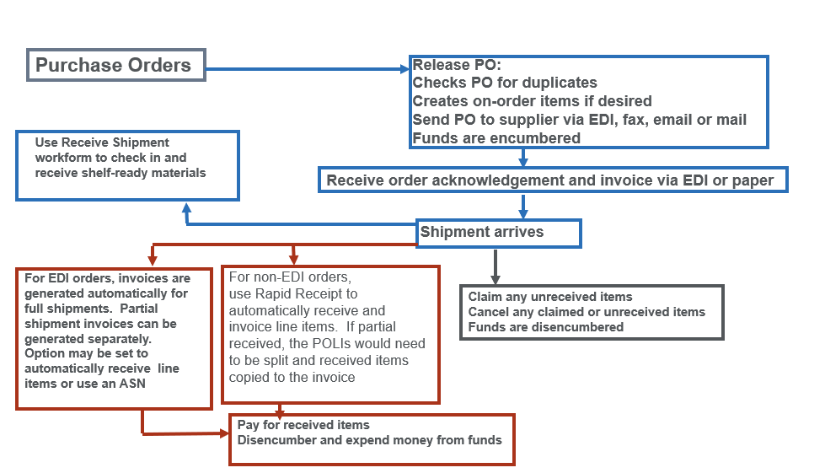
Acquisitions Workflow

Slide 6
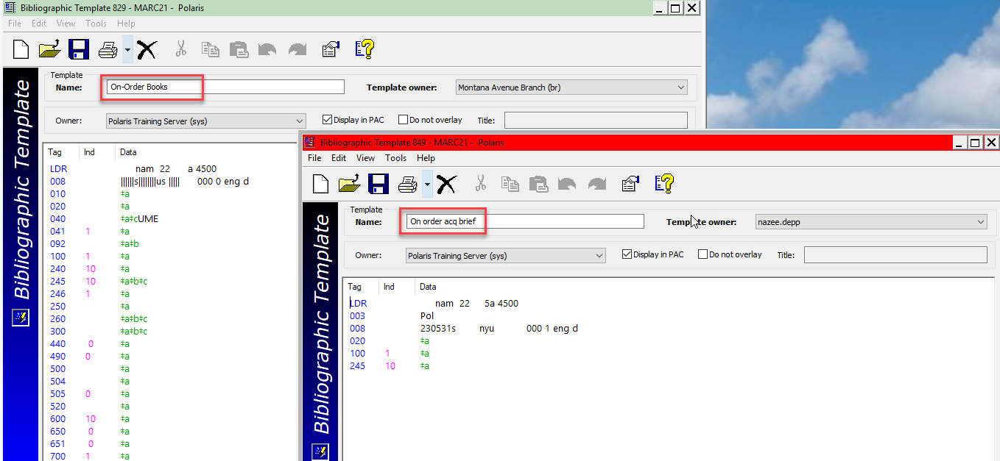
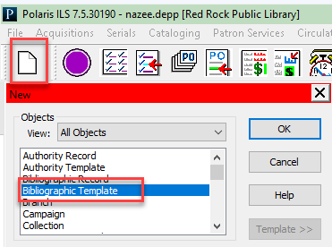
Creating an On-Order Bibliographic Template (Client)
NOTE: You can create a new on-order bib template from scratch or copy an existing bib template, changing the name to start with “on order” or “on-order.”
When typing in a title to order and the POLI is saved, Polaris will create a book format by default.
Set up on-order bibliographic templates for materials other than a regular book format so bibs will display in the catalog with the correct TOM (type of material).
On-order bib templates are only used when staff manually type a title into a POLI or INLI and the item is not a book.
The template name must begin with “on order” or “on-order.”

Slide 7
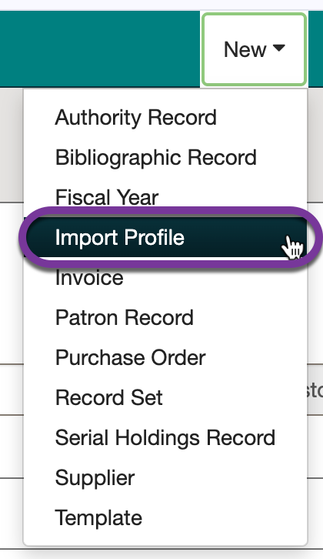
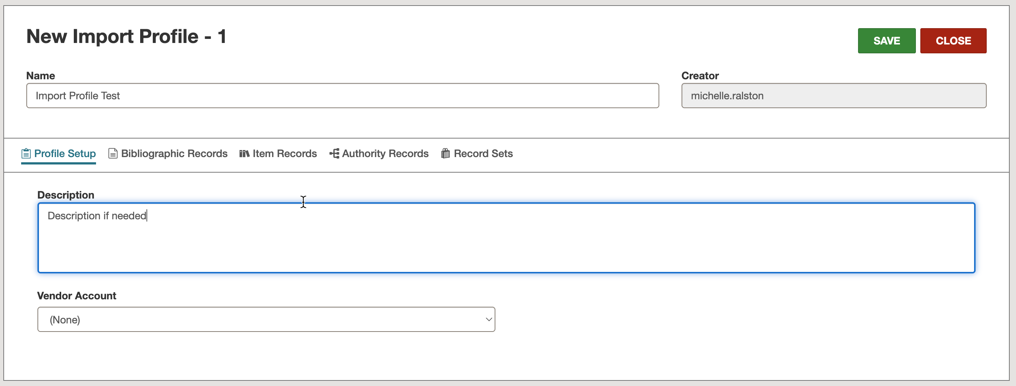
Creating an Import Profile

Slide 8
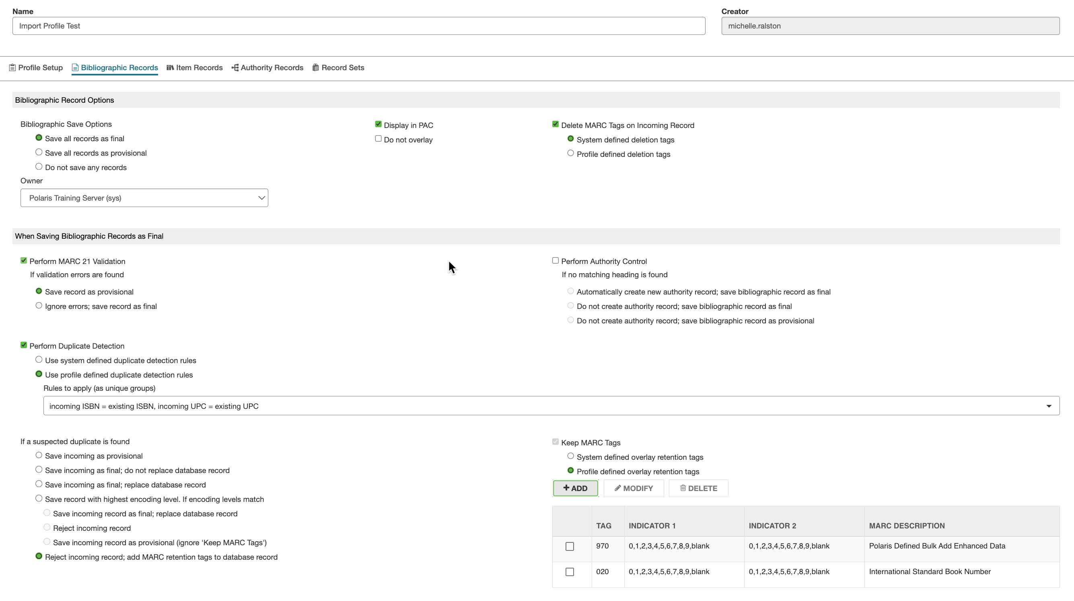
Creating an Import Profile

Slide 9
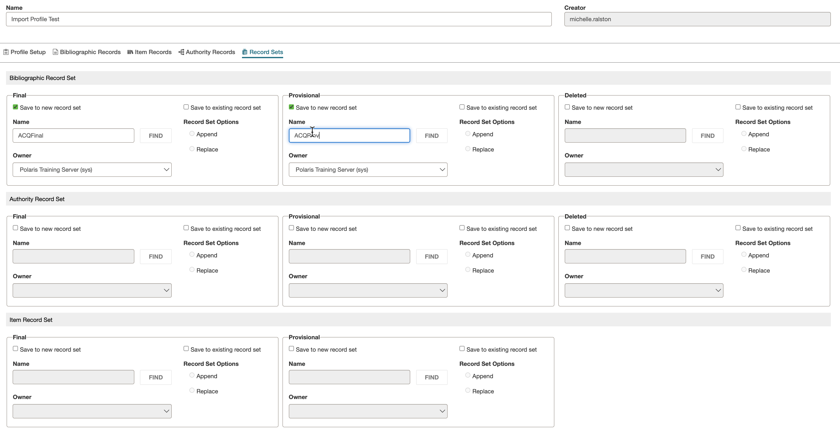
Creating an Import Profile

Slide 10
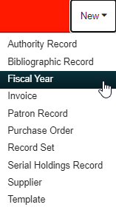
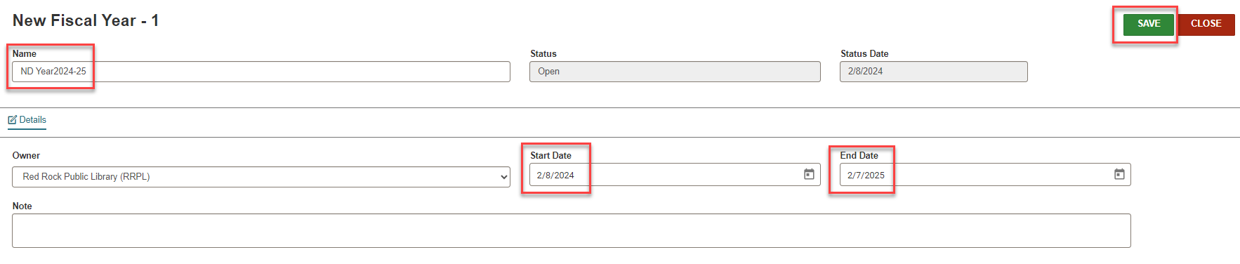
Fiscal Year: New Fiscal Year
To create a New Fiscal Year record, use New > Fiscal Year.
Fill in information and select SAVE.
An unlimited number of fiscal year records may be created.
Fiscal years may overlap.
Fiscal year processing must be performed on an individual fiscal year.
An unlimited number of funds and levels of subfunds may be linked to a fiscal year.

Slide 11
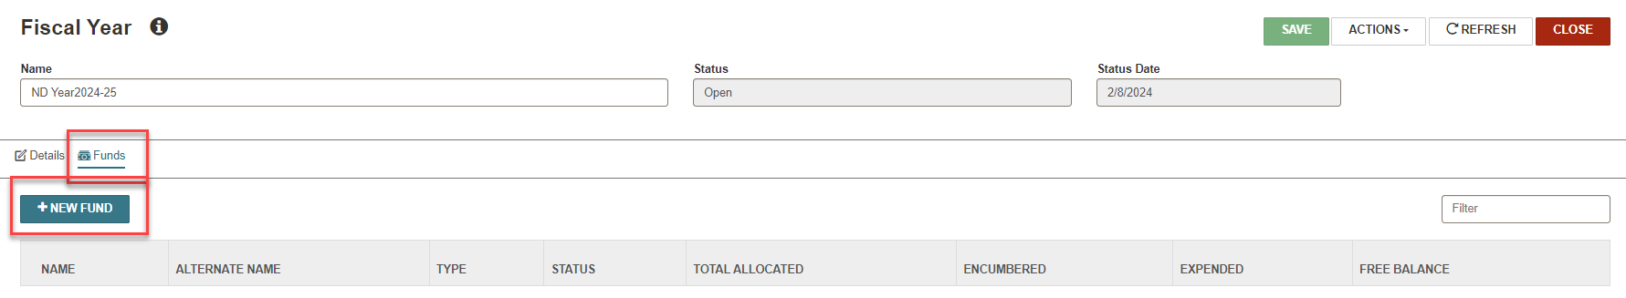
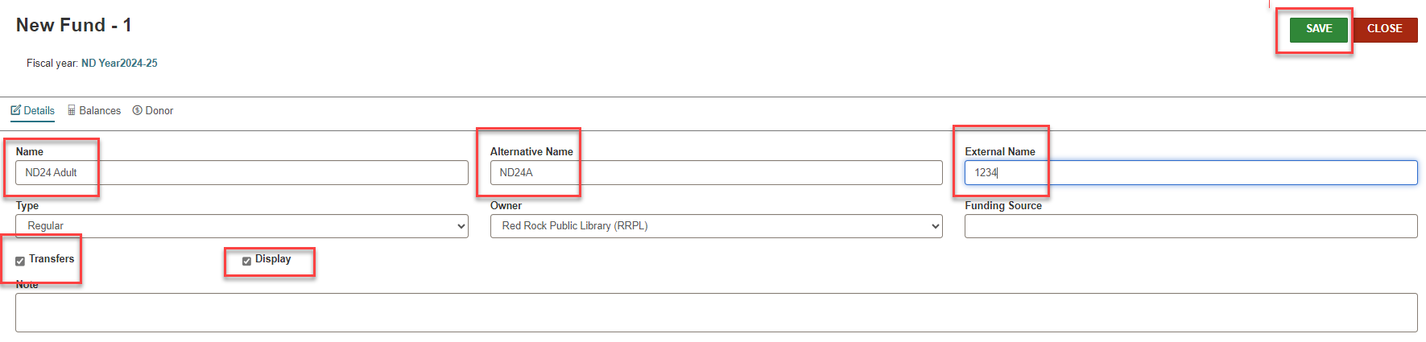
Fiscal Year: Adding a Fund
To create a New Fund record, use Fiscal Year > Funds > +NEW FUND
Fill in required information and select SAVE.
Fund records are connected to a fiscal year record.
Staff may set up an unlimited number of funds.
Fund types include Regular, Donation, and Deposit.
Be certain the fund structure is set up correctly before adding money.
The Donor view of a fund record must be filled out if a fund type of donation has been selected.

Slide 12
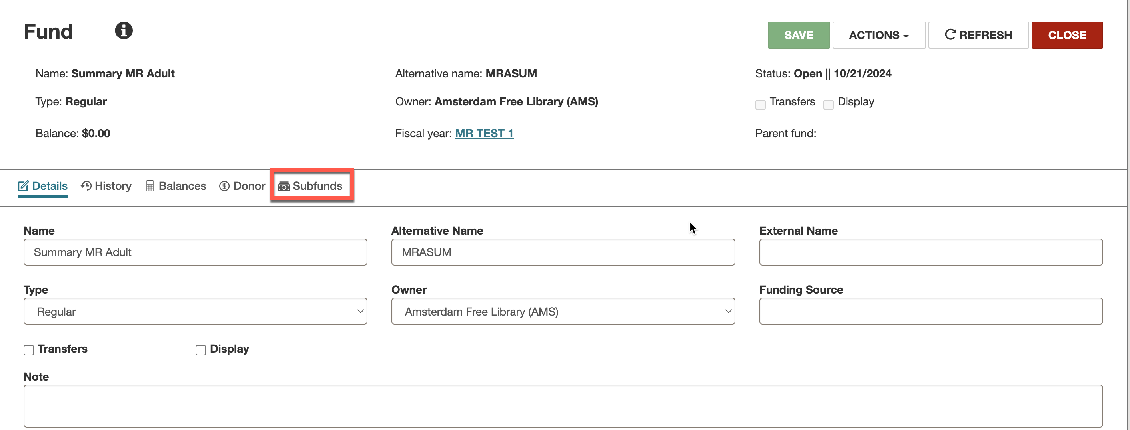
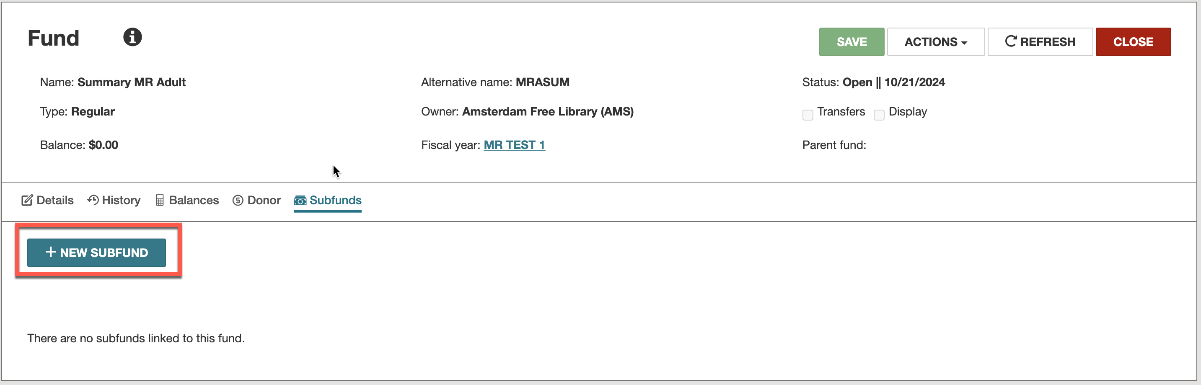
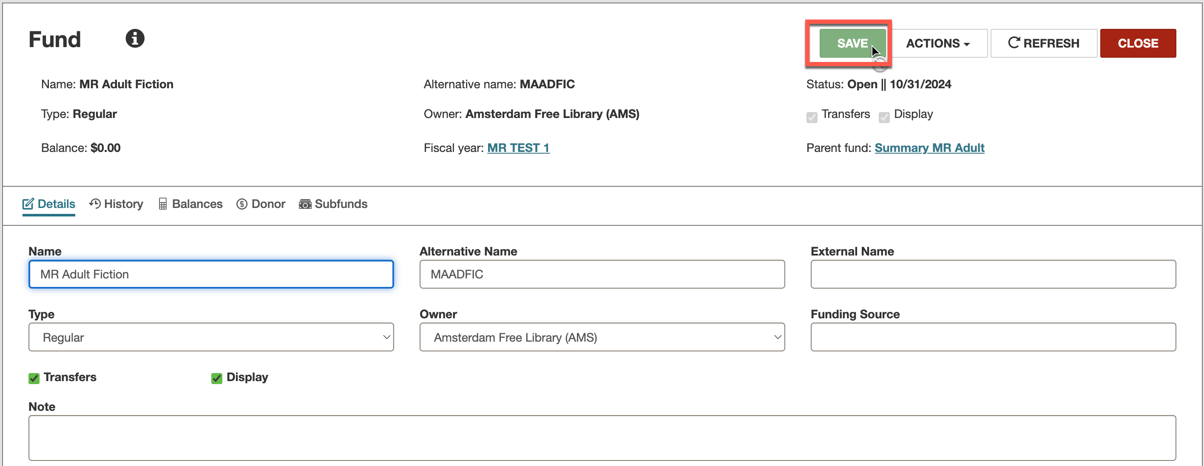
Fiscal Year: Subfunds
To create a New Subfund, start on the parent fund, and click the Subfunds button.
Then click the +NEW SUBFUND button.
Fill out the information and click SAVE. You will see the parent fund and will be able to create additional subfunds if needed.
Staff may set up an unlimited number of funds​/subfunds to create a hierarchy.

Slide 13
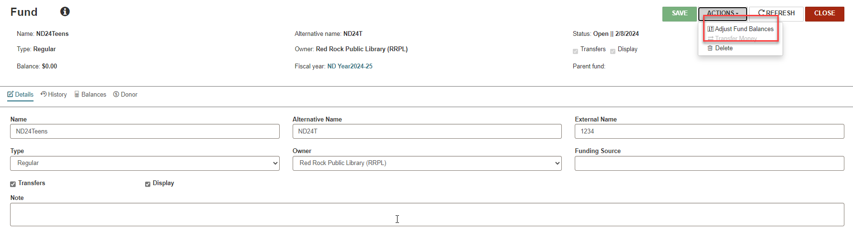
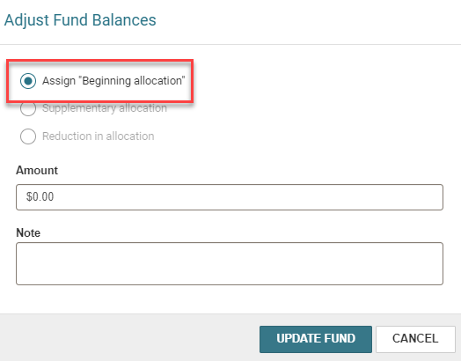
Fiscal Year: Allocating Money to a Fund
Click ACTIONS > Adjust Fund Balances to assign the beginning allocations.
All fund transactions are listed on the General Information view of a fund record.
When transferring money:
Funds must be within the same fiscal year and transfers must be allowed in the funds.
Transactions appear in the fund record for both the source and destination funds.

Slide 14
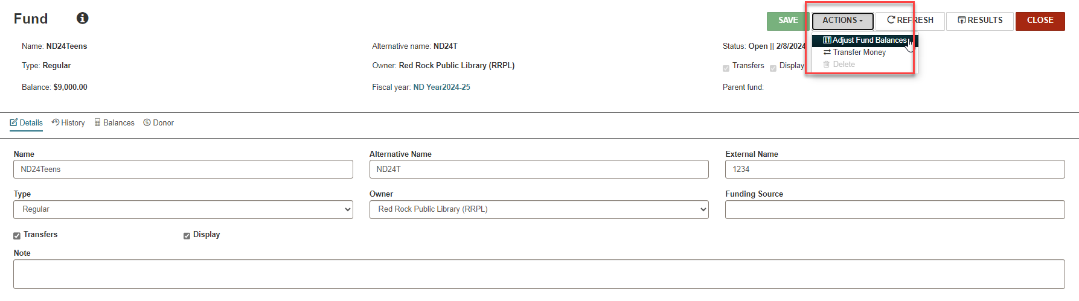
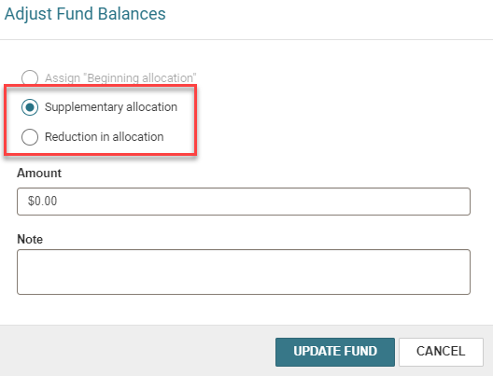
Fiscal Year: Adjusting Allocation of a Fund
Staff can adjust fund balances after the initial allocation by using ACTIONS > Adjust Fund Balances.

Slide 15
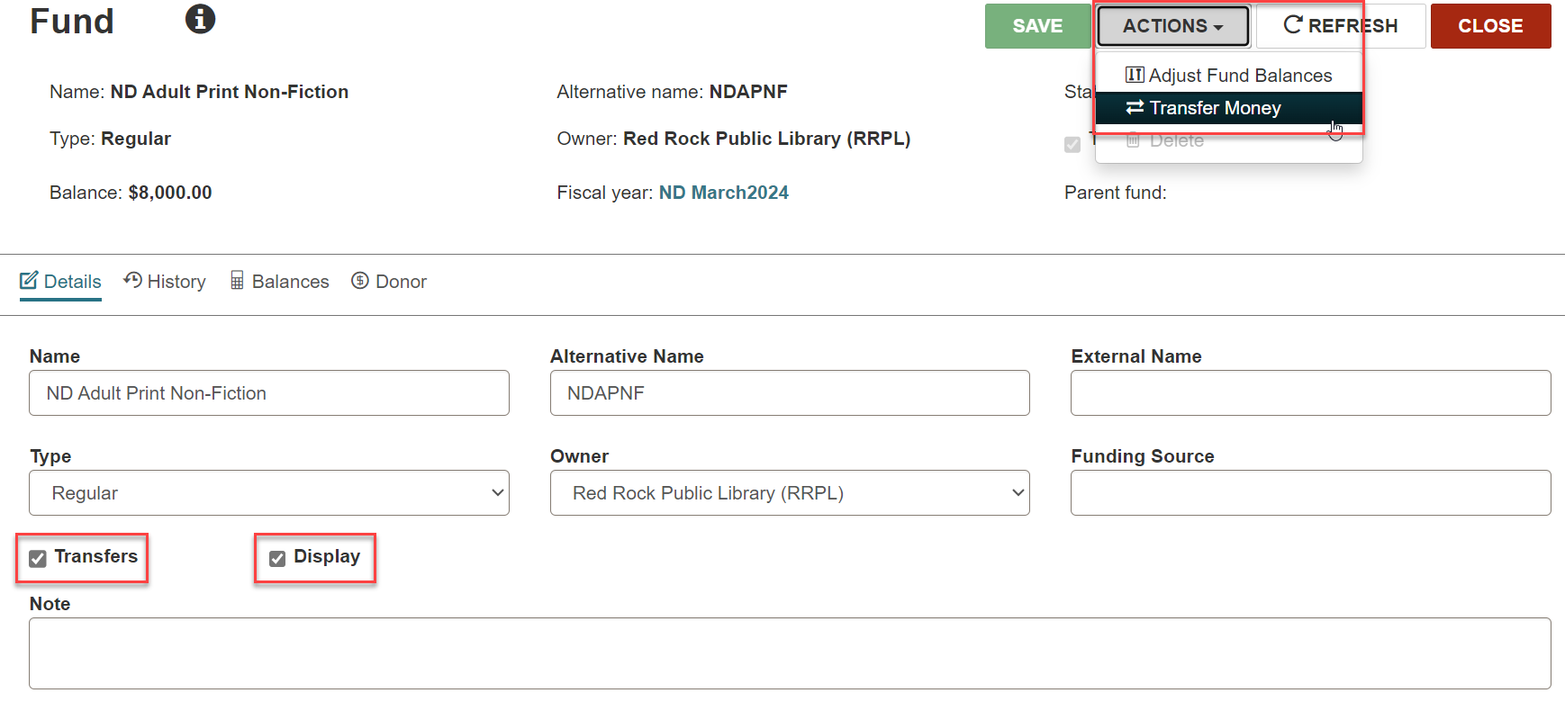
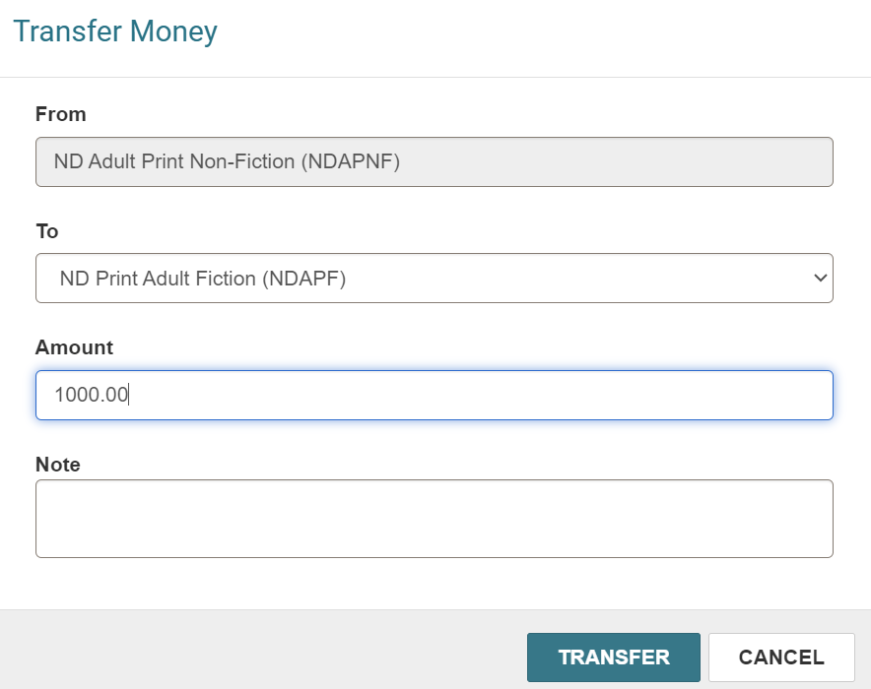
Fiscal Year: Transferring Money from One Fund to Another
Staff can transfer money from one fund to another using ACTIONS > Transfer Money.

Slide 16
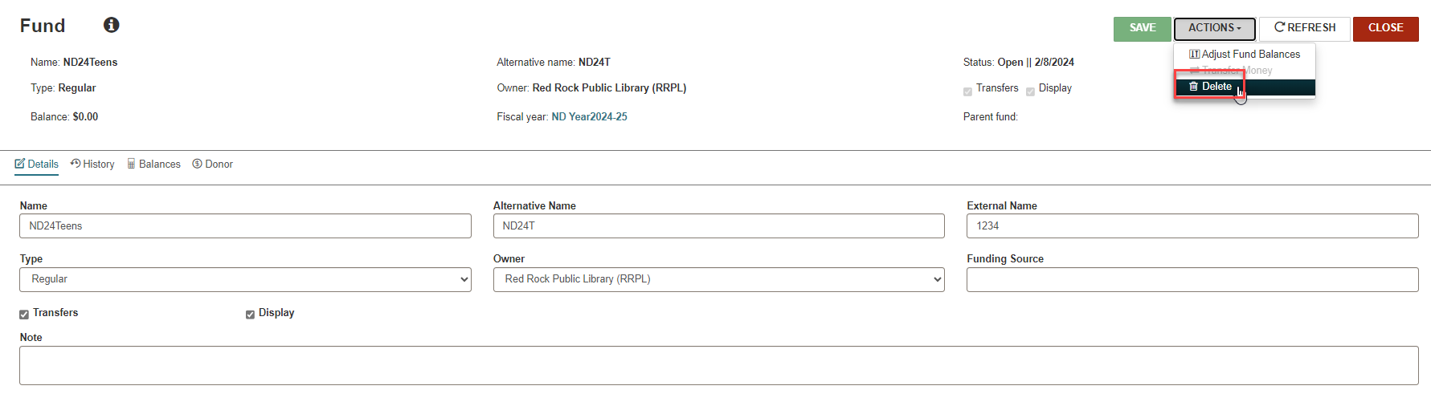
Fiscal Year: Deleting a Fund
NOTE: A fund can be deleted before it has any allocations.

Slide 17
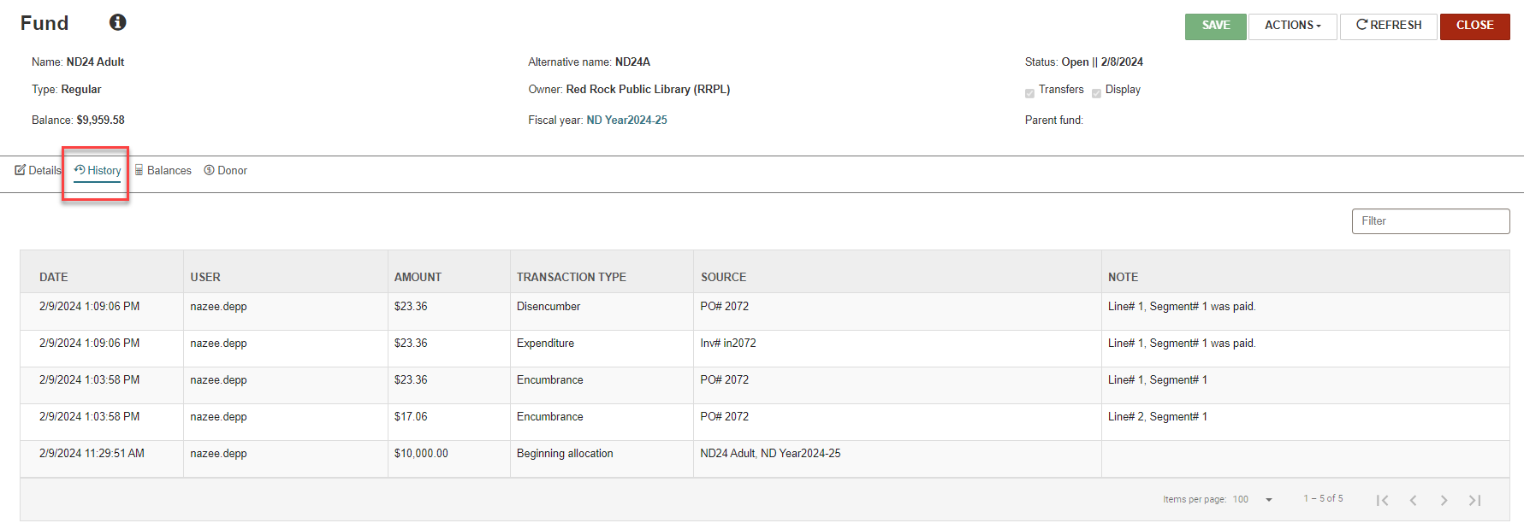
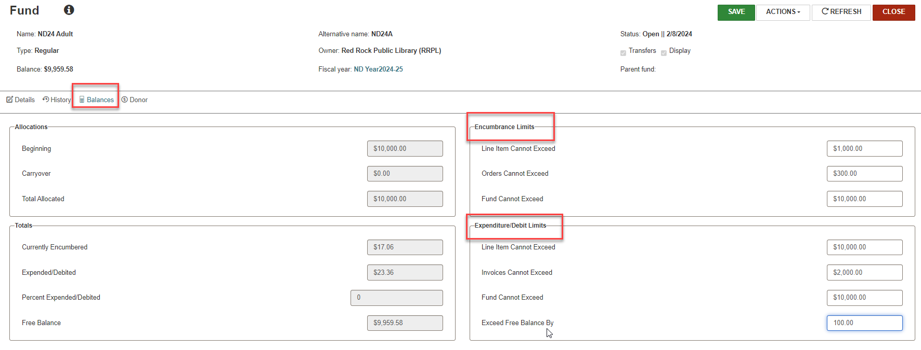
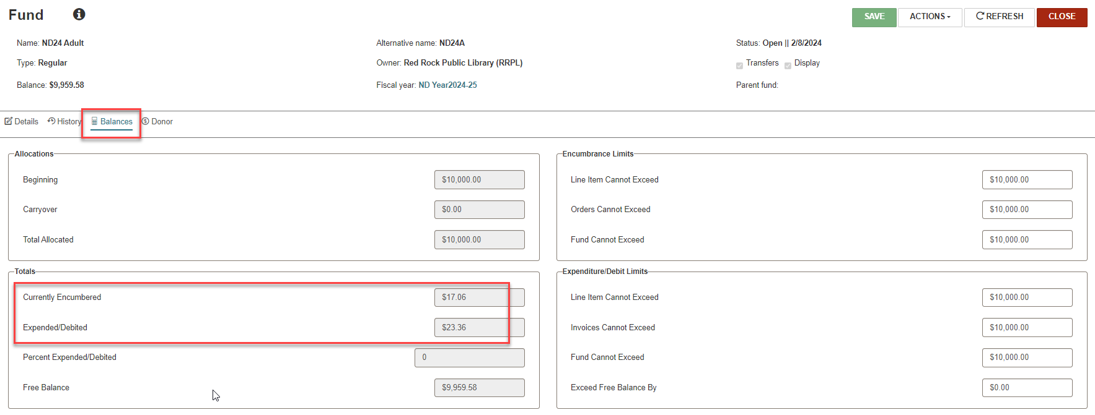
Fiscal Year: Fund Record
NOTE: You can set encumbrance and expenditure limits in Fund > Balances.

Slide 18
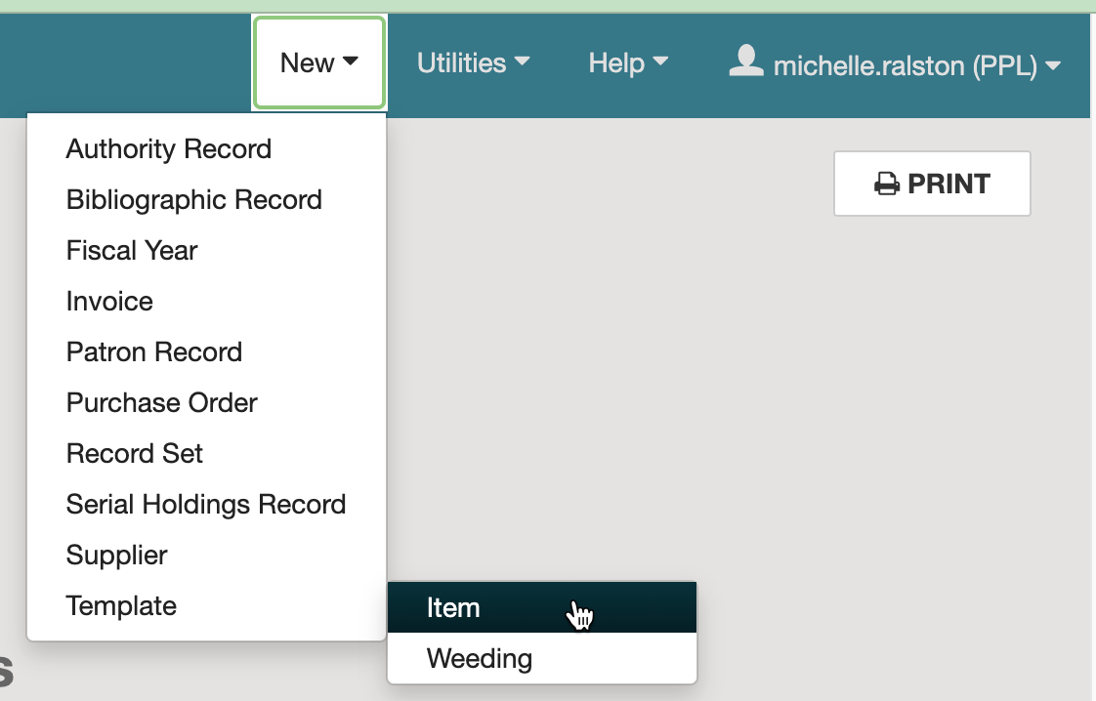
Creating Item Templates
To create a new item template, click on the New dropdown menu and select Template > Item.

Slide 19
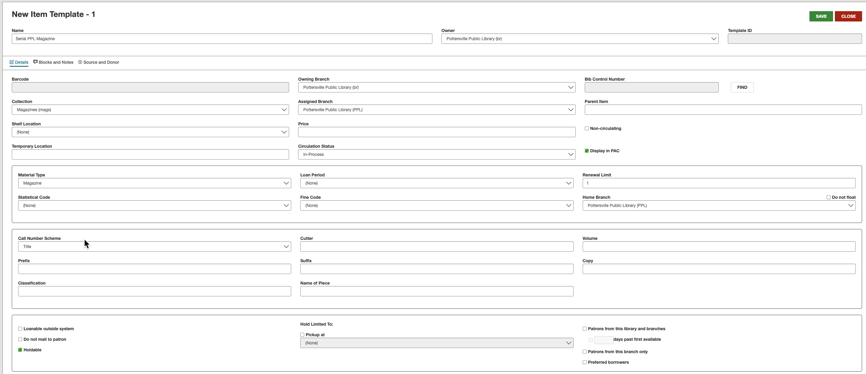
Creating Item Templates
Mandatory fields:
Name
Template owner
Owner
Assigned branch
Collection
Material type
Loan period
Fine code
Renewal limit
Home branch
Call number scheme

Slide 20
Creating Item Templates
After the first item template is created, it may be copied by selecting ACTIONS > Copy.
It is recommended you create item templates for every branch, collection, and material type combination you catalog.
A System Administration cataloging profile determines the call number to be used when new items are created (unless a different shelving scheme has been chosen in the item template).
If an item template has (None) in the shelving scheme, select the call number scheme in the New Item Record Options dialog box.

Slide 21
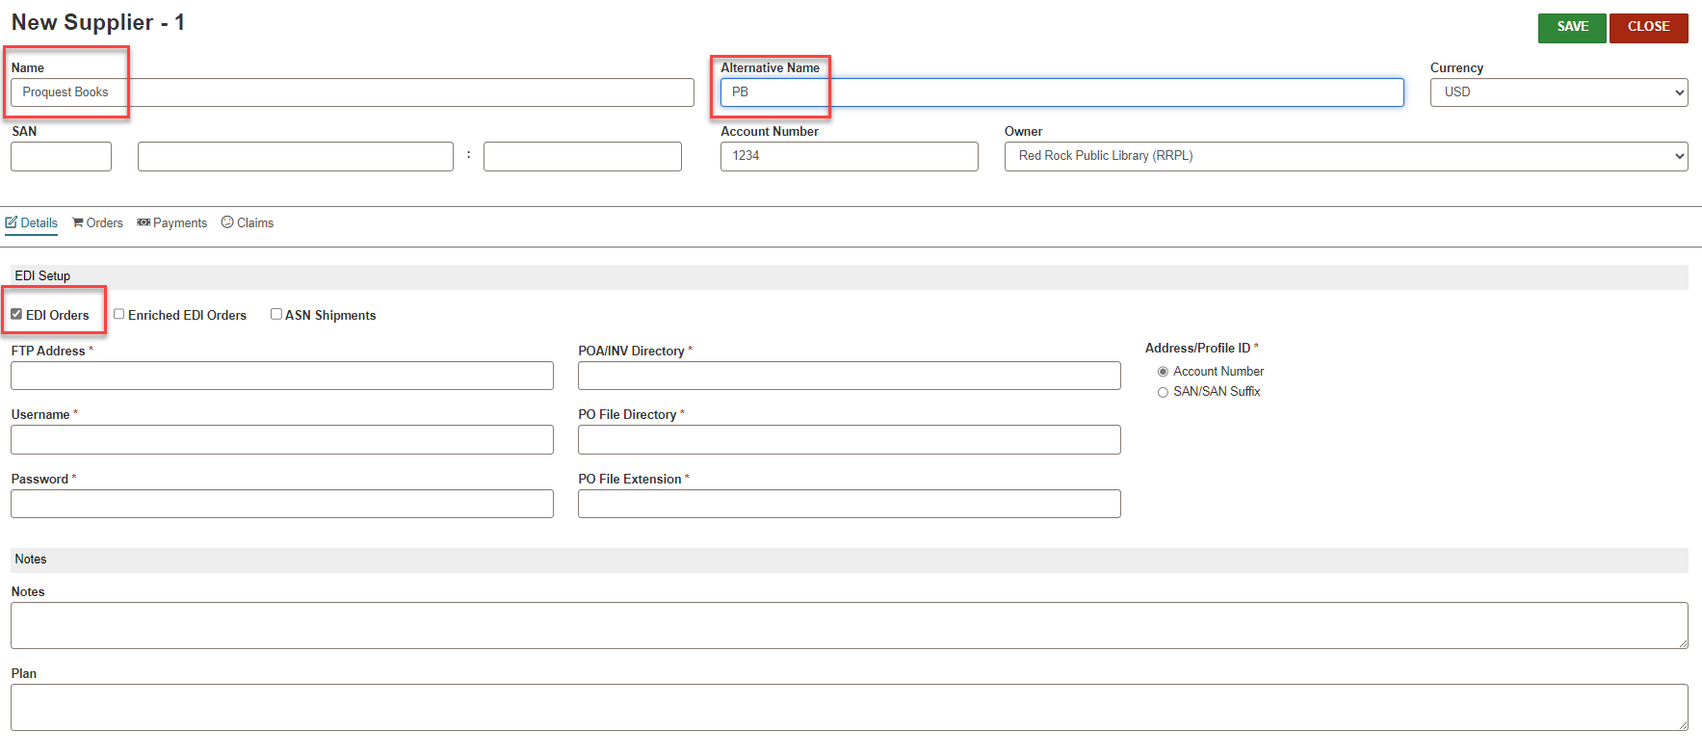
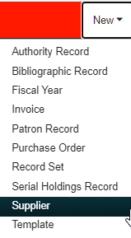
Creating a Supplier
NOTE: Select EDI Orders and/or ASN Shipments if the supplier accepts either or both.
To create a new supplier record, use New > Supplier.
The supplier record holds addresses, default currency, EDI information, and the default claiming cycles for a vendor.
If there are multiple accounts for one supplier, there must be a separate supplier record for each account number.

Slide 22
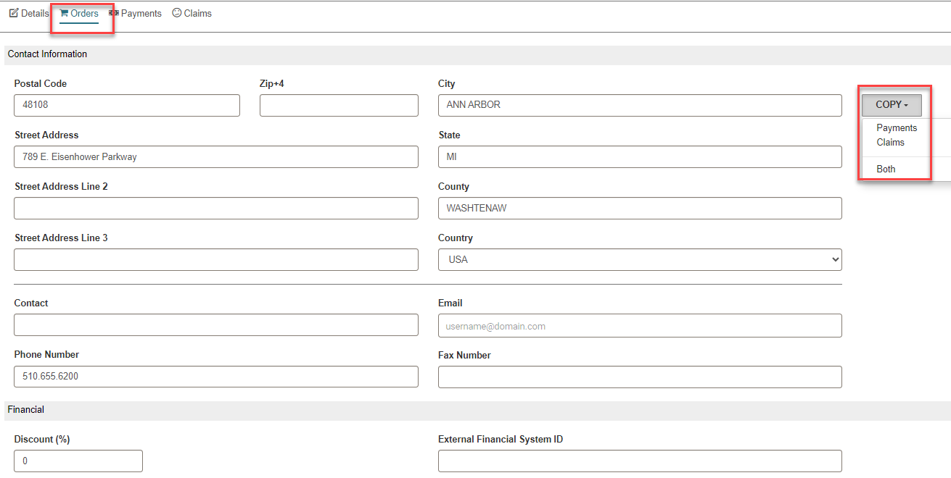
Creating a Supplier: Orders

Slide 23
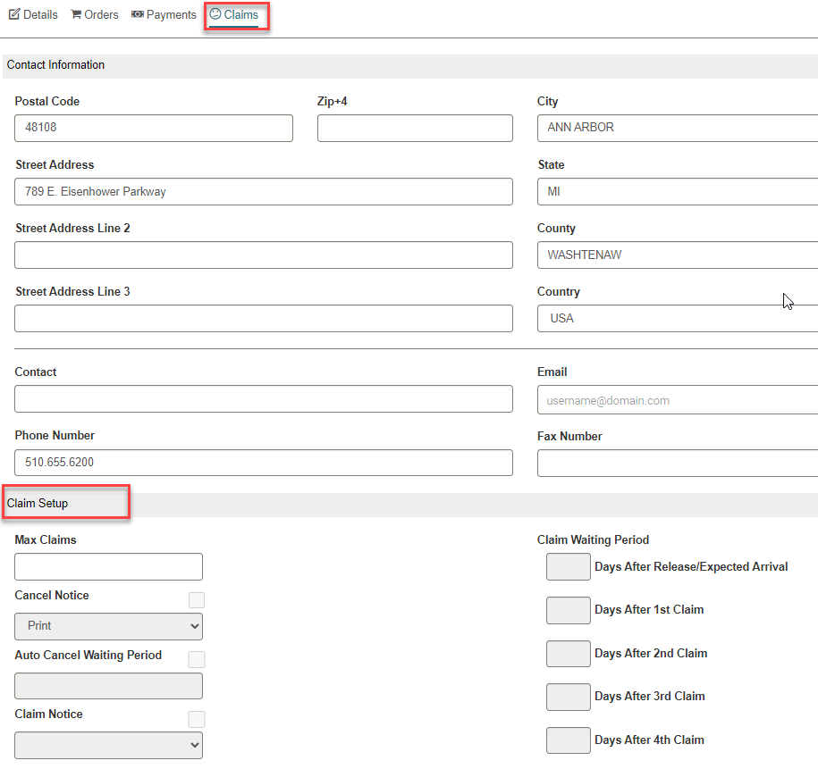
Creating a Supplier: Claims
Monographs may be claimed up to five times with differing claim wait periods.
Be sure to check the Cancel Notice and Claim Notice boxes if you would like to get a paper notice from Polaris—Cancelling and claiming will work even with the boxes unchecked if you do not want the paper notices.
Claiming for subscriptions and standing order PO types are set up in the Serial Holdings Record for that title.

Slide 24
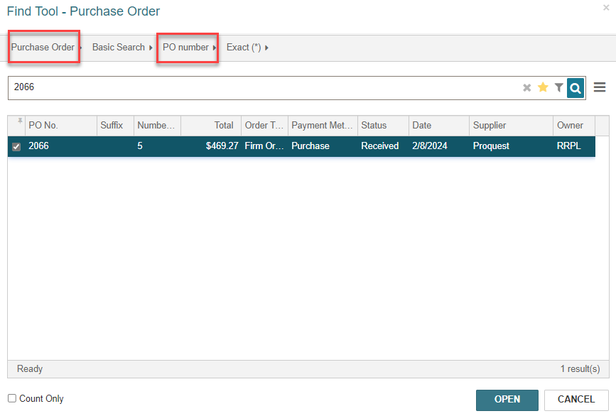
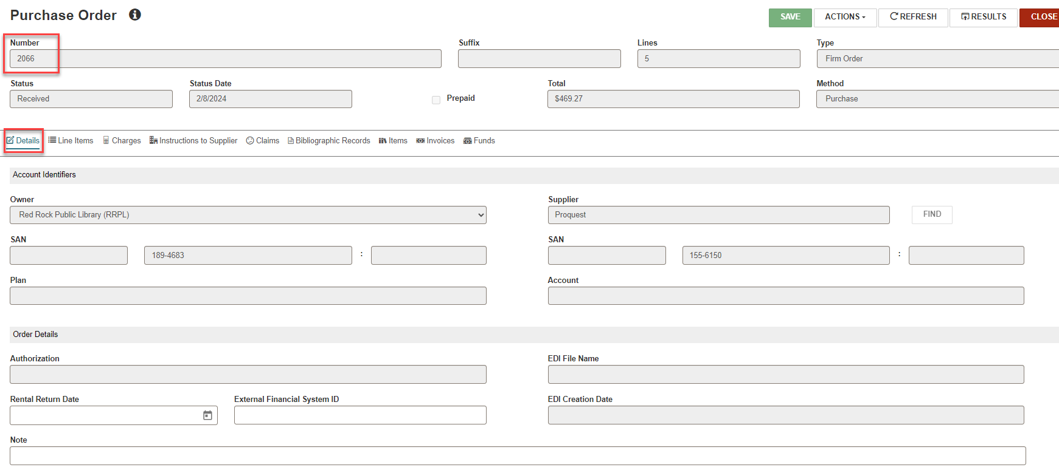
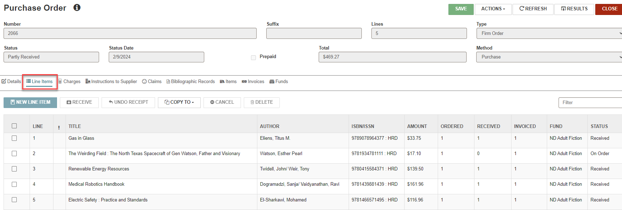
Finding a Purchase Order

Slide 25
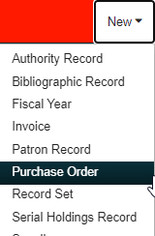
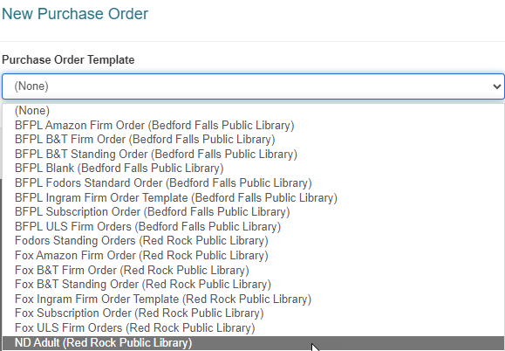
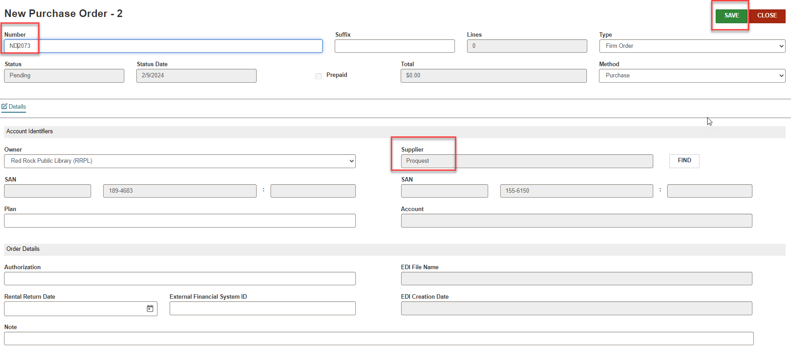
Creating a Manual Purchase Order
NOTE: You can create a PO with or without a template.
To create a New Purchase Order, use New > Purchase Order.
If PO templates have been created, select the appropriate template.
Attach a supplier if you are not using a PO template.
You may define your own PO number or have numbers automatically assigned per settings in System Administration.

Slide 26
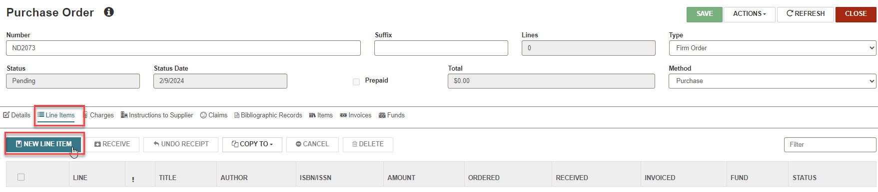
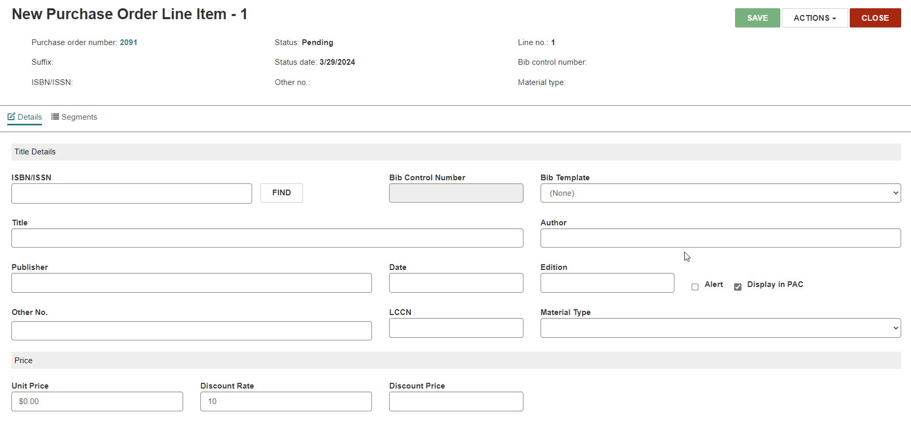
Adding a Purchase Order Line Item
To create a New POLI, click Line Items tab > NEW LINE ITEM
The Details tab will hold the title and its distribution information.

Slide 27
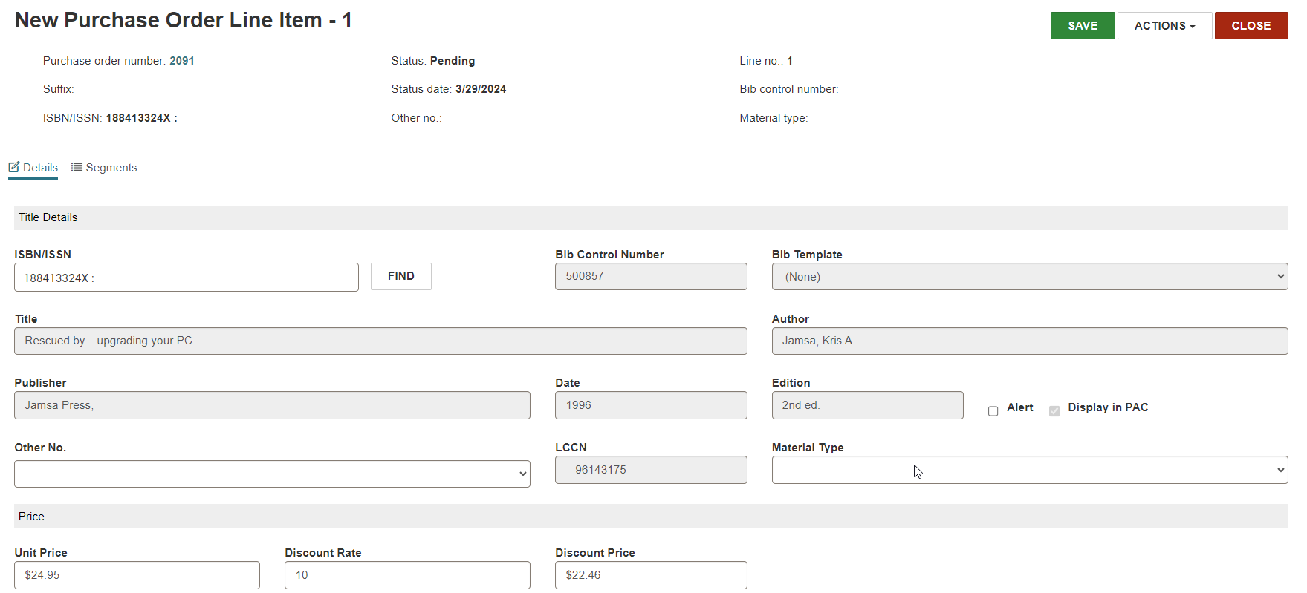
Adding a Purchase Order Line Item
There are multiple ways to add a title to a manual POLI:
Type in the ISBN and hit enter.
Use the FIND button to go to the Find Tool and search for a record that exists in the database.
Type in the title.
When typing in a brief title and the POLI is saved, by default Polaris creates a book—use the correct on-order bibliographic template to ensure the title will display correctly to patrons.

Slide 28
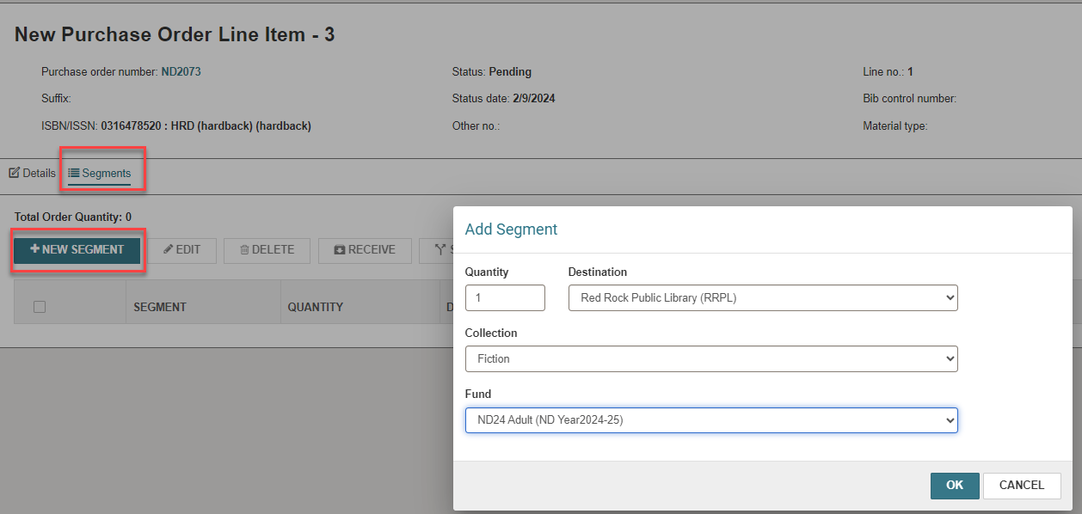
Creating a Manual Purchase Order
Use +NEW SEGMENT to add a segment before saving the PO (required).
The segment information specifies quantity, destination, collection, and funding for copies ordered.

Slide 29
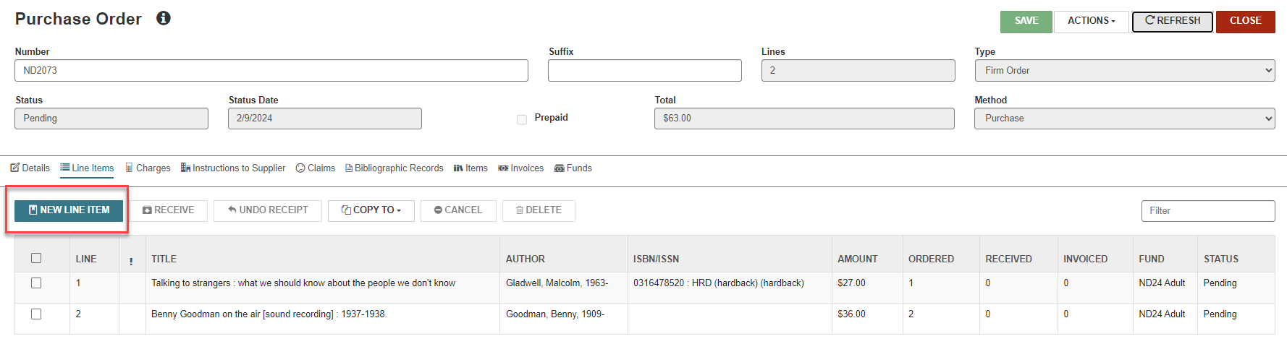
Creating a Manual Purchase Order
Click NEW LINE ITEM to add additional line items to the PO.

Slide 30
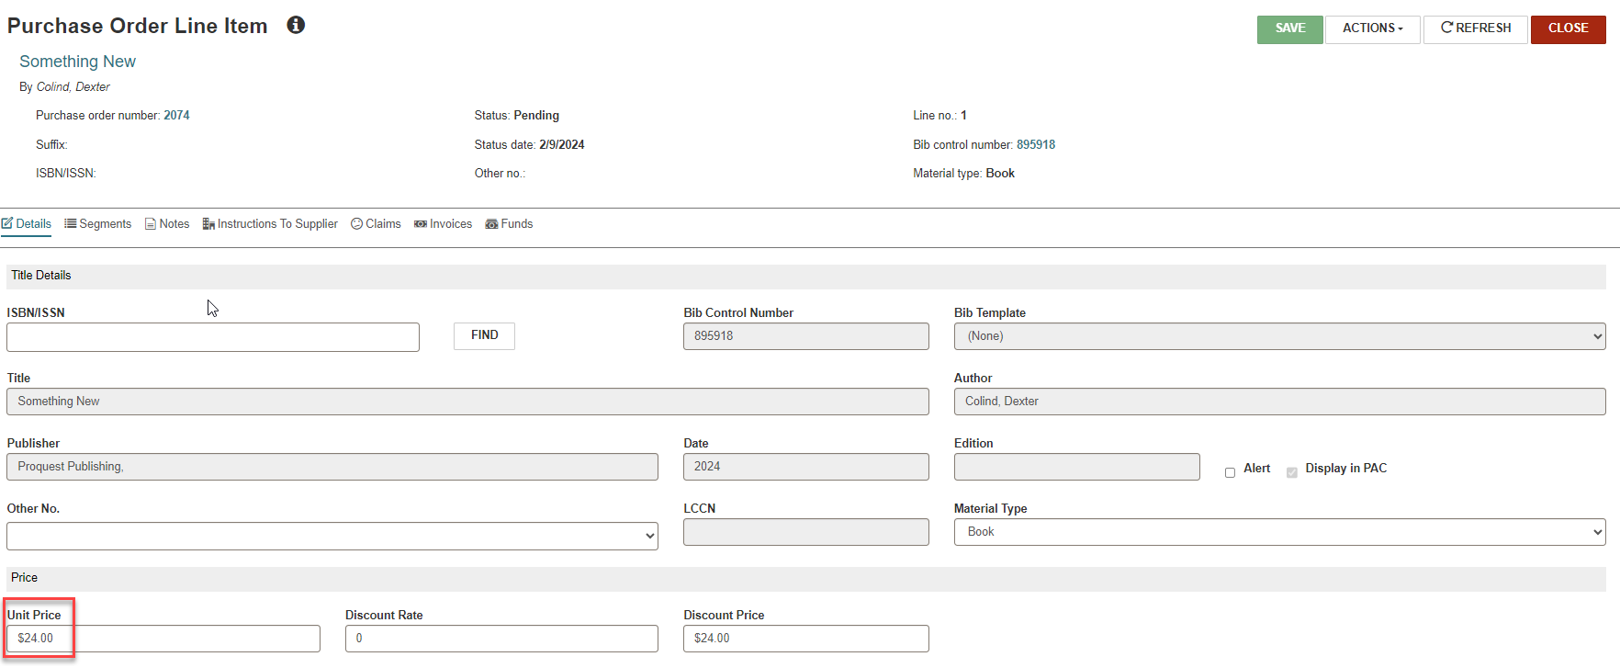
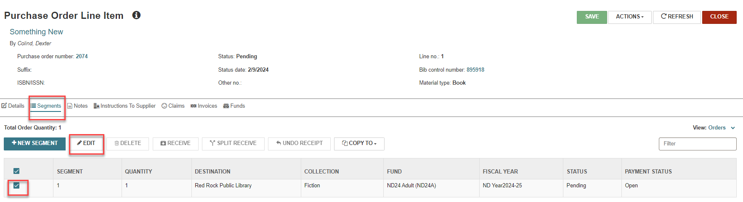
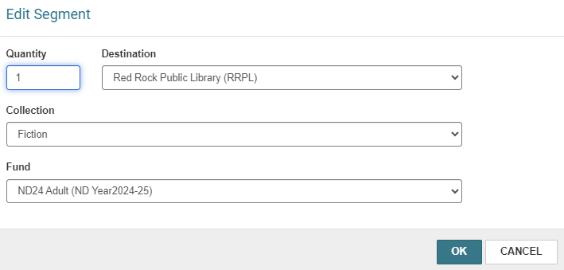
Editing a Purchase Order
NOTE: The segment can be edited if the PO has not been released.

Slide 31
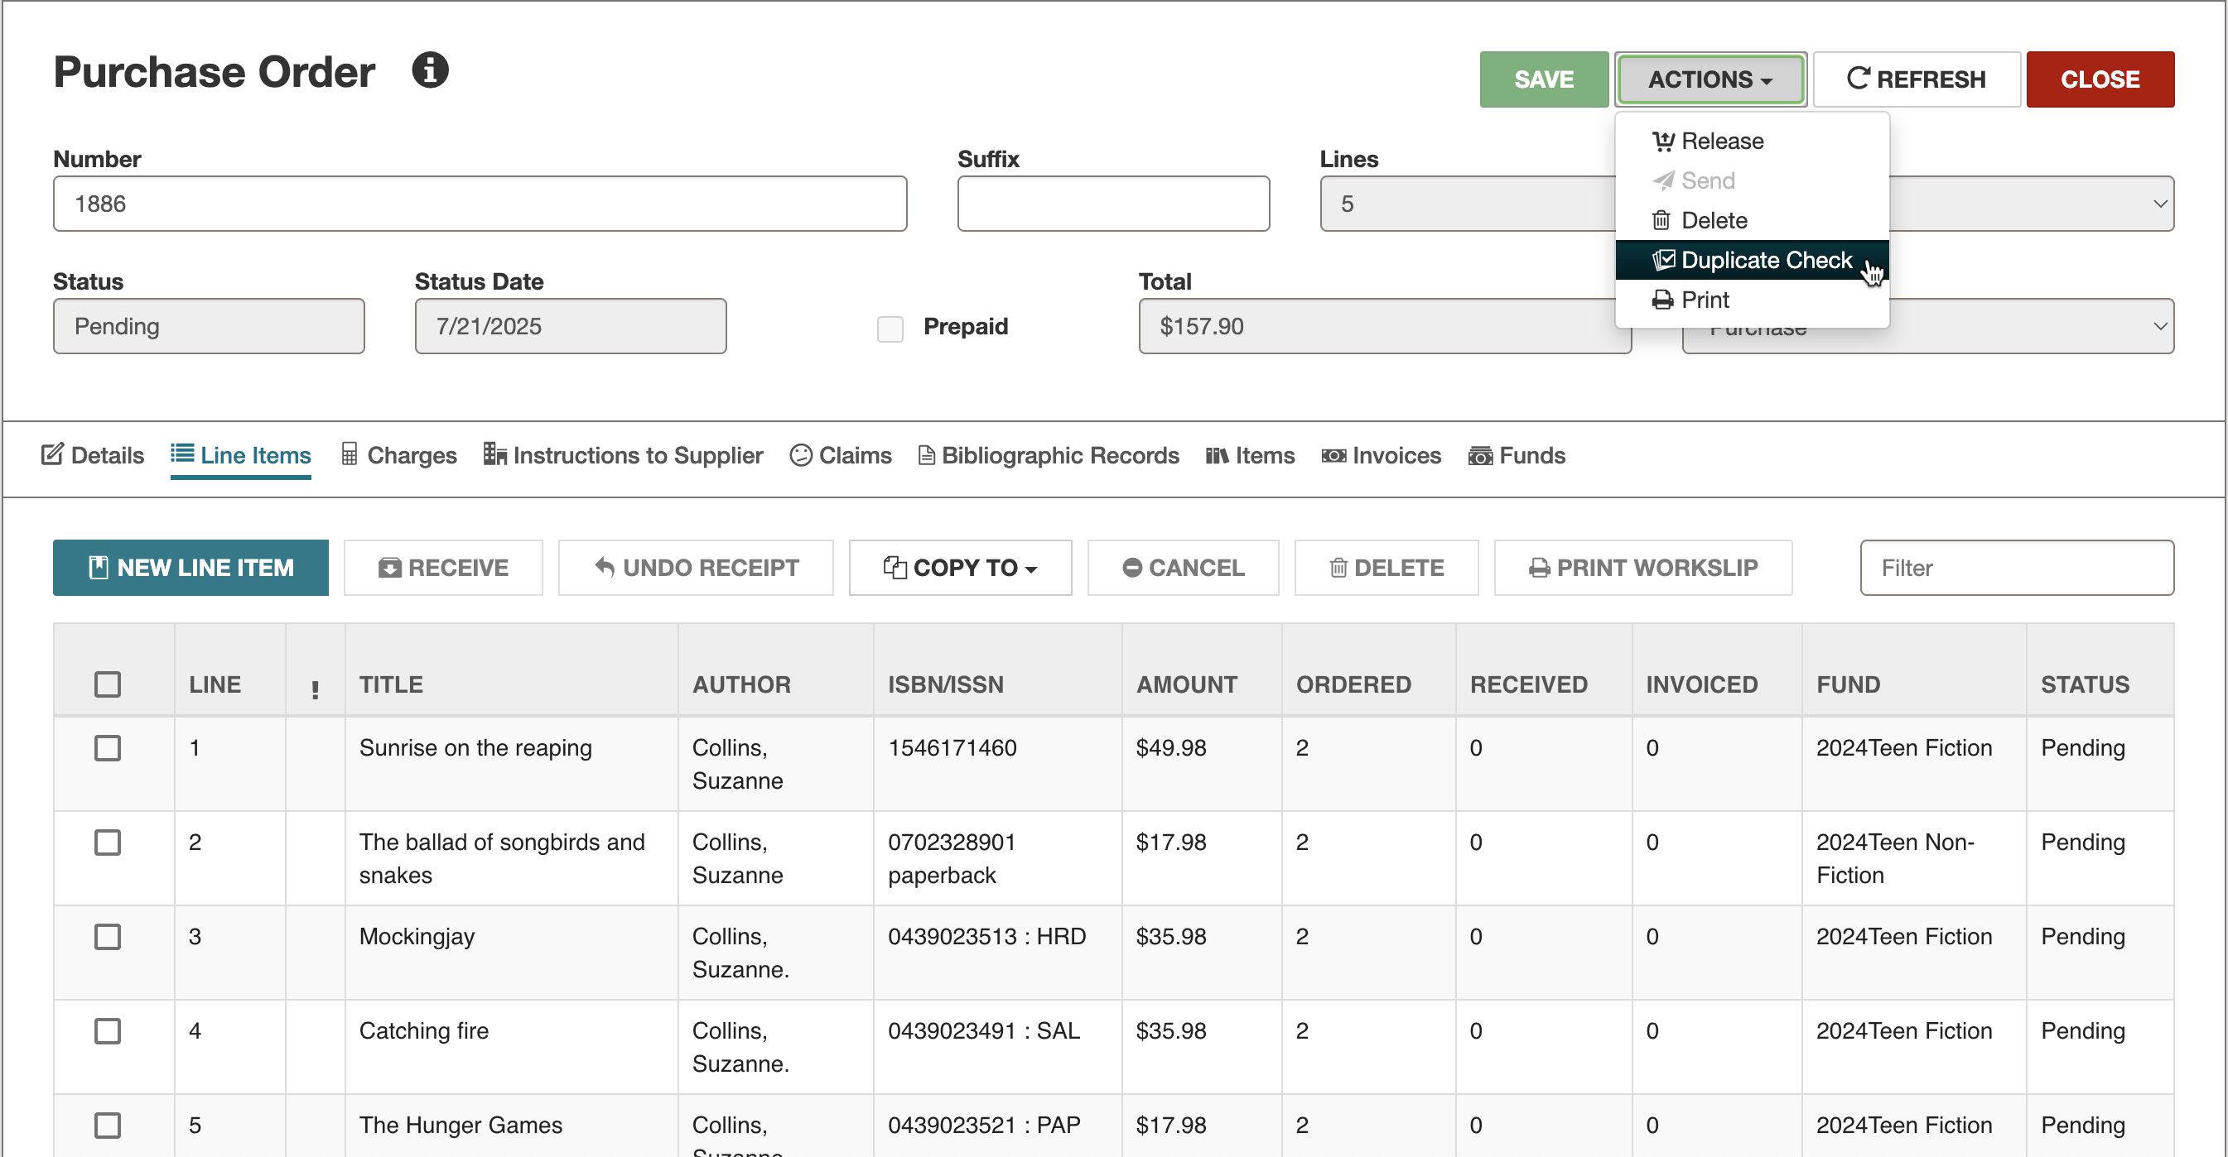
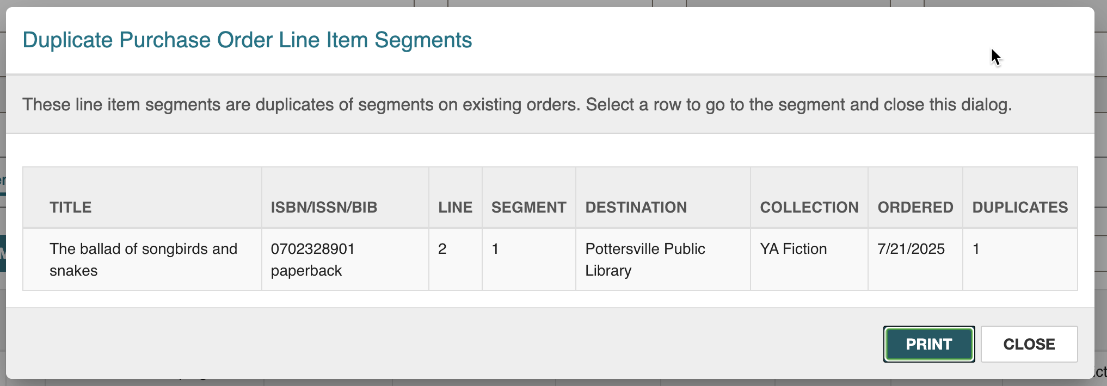
Checking for Duplicate Segments

Slide 32
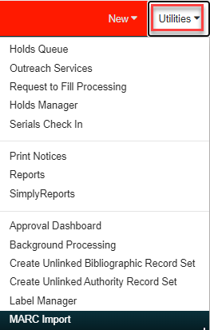
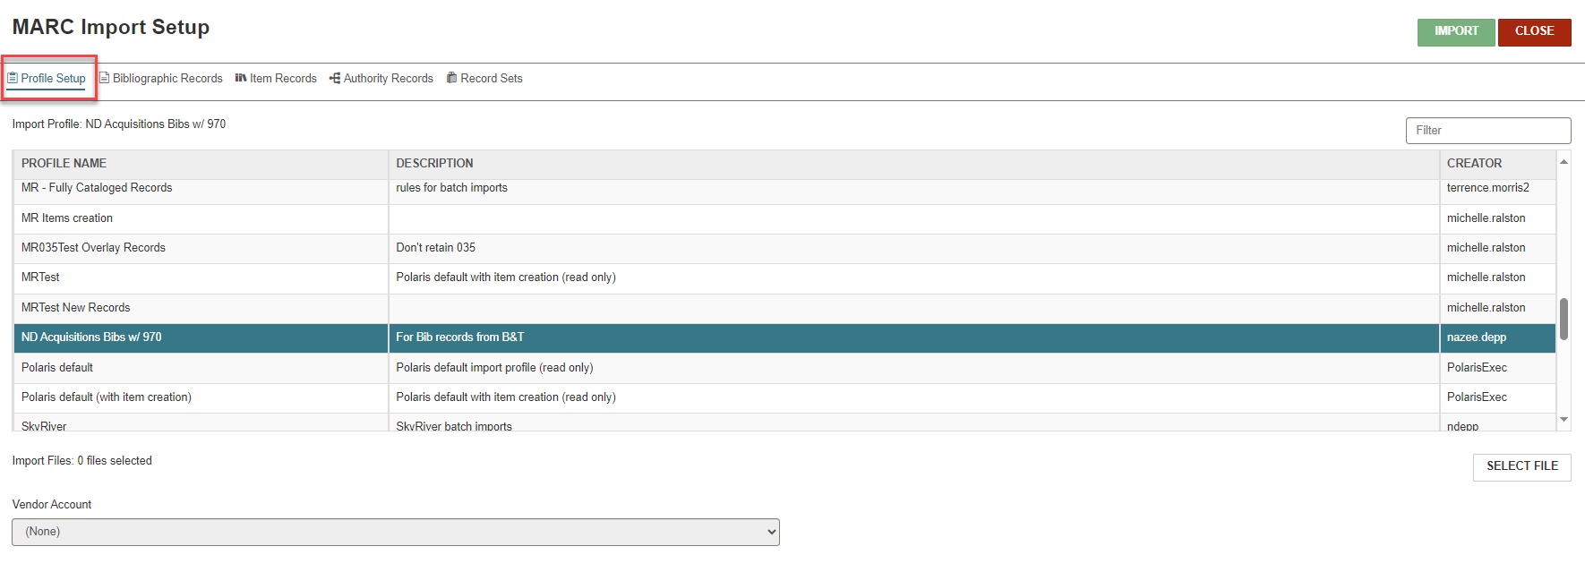
Importing Records from a Vendor MARC File
NOTE: The import profiles are created in the client.

Slide 33
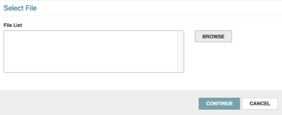

Importing Records from a Vendor MARC File

Slide 34

Importing Records from a Vendor MARC File

Slide 35


Importing Records from a Vendor MARC File

Slide 36


Creating a PO from a Record Set
After importing order records from a vendor site, be sure to use the correct import profile when bringing the records into Polaris.
To search for the bibliographic record set, use FIND > Record Set (you will need the name of the record set defined in the import profile).
A date and time stamp will be added to the end of the record set.

Slide 37


Creating a PO from a Record Set
To copy a bibliographic record set to a PO, from the record set click ACTIONS > Bulk Add to New (or Existing) PO, then fill in details in popup.
If 970s were not added to the bib records, one default POLI segment may be created when titles are added to a PO by filling in the Line Default Data area.

Slide 38

Creating a PO from a Record Set
If 970s are used, the purchase order is ready to release.
If problems are encountered, review the Bulk Add to PO report.
If 970s are not used, POLIs may need to be individually updated.
The Subfield 9 Cleanup Utility may be used to delete embedded fields (970, 949, 852) from bib records.

Slide 39
970 Grids
The following subfields can be used when creating 970 grids:
$l – location
$q – quantity
$f – fund
$c – collection
$p – price
$m – material type
$n – non-public note
Gather the following information to set up your grids:
Branch abbreviations
Fund full names or alternative names
Collection abbreviations
Material type names or codes

Slide 40


970 Grids
An alternative to the previous grid set up is available: Use a $h, a copy level code.
The copy level code will match to a specific on-order item template allowing the library to be more granular when creating on-order item records.
The $h must match the name in the on-order item template.
If using a $h, collection and material type, subfields do not have to be used ($c and $m)

Slide 41


Releasing/Sending Purchase Order
To release a PO, from the PO, click ACTIONS > Release.
The following events occur when a PO is released:
The PO’s Pending status changes to Released for Firm, Gift, and Donation PO types.
Funds are expended if the PO is prepaid or depository funds are used.
An invoice is created if the PO is prepaid or depository funds are used.
Funds are encumbered if the materials will be paid upon receipt.
On-order items are generated if staff respond Yes to the prompt.
A claim alert date is calculated if claiming has been set up.
A duplicate check is performed for matching POLI segments on other POs—duplicate ISBN, destination, and collection.

Slide 42



Releasing/Sending Purchase Order
The Purchase Order Release Alert box pops up if ISBNs are missing or the display in PAC is turned off.
Staff will be reminded if the supplier accepts EDI orders.
On-order item records can be created.
Materials can be paid for upon receipt of invoice or prepaid.
The PO may be printed and/or transmitted to the supplier via EDI.
.

Slide 43




Legacy Ordering Workflow (Baker & Taylor)
Library Selects Titles & Enters Pre-Order
Details in Vendor System
TS360
Generate MARC
Orders & Bibs
MARC
EXPORT
FTP
EDI PO
Polaris
B&T
Polaris
(Import Bibs & Create PO)
Purchase Order Acknowledgement
Notes:
Pre-Order details in step one reference the work to setup the grids in B&T for transmitting library specific data (e.g. locations, funds, collections).
Steps:
Library selects titles to order and submits through TS360 interface.
The order details are processed by B&T and used to generate MARC files.
The MARC Export is placed on a server, emailed or FTP’d to the library staff.
Library staff manually load the MARC export into the ILS.
Using ILS tools, the staff member imports the MARC records and creates a purchase order (keying off 9XX tags in the MARC data).
The staff member then transmits the order BACK to the vendor and the vendor sends a Purchase order acknowledgement.
The last step is also the first two-way communication.
Note: There are two vendors because there are two parts to B&T. The vendor box represents the interface the library interacts with (TS360). The second represents the warehouse that fills the orders. Since B&T offers EDI ordering without TS360, these are two different divisions of B&T.

Slide 44
Modern Ordering Workflow (Baker & Taylor API)
Library Selects Titles
& Enters Order
Details in Vendor System
TS360
Orders & Bibs
Orders & Bibs
sent via API
Order Details
PO Details (EDI)
Polaris
(Import Bibs & Create PO)
Polaris
B&T
Purchase Order Acknowledgement
Notes:
Once the user clicks submit, two-way communication occurs between the vendor and the ILS.
Steps:
Library selects titles to order and submits through TS360 interface.
The order details transmitted via API from TS360 to Polaris.
Polaris processes the order details and automatically creates MARC records and a purchase order. Then Polaris responds with all details needed to complete the EDI process (e.g., line-item IDs; segment numbers).
TS360 will relay this data internally so the EDI processing can continue. The vendor will send a purchase order acknowledgement.
This automates the process of creating bib records and purchase orders in the ILS; it eliminates the need for the user to transmit the order data a second time (back to the vendor). Instead, the user can click submit on their cart and then wait for the invoice.

Slide 45

POA – Purchase Order Acknowledgement
If an order is sent via EDI, an Electronic Purchase Order Acknowledgement (ePOA) may be received, depending on the supplier.
To view an ePOA report, go to Utilities > Reports and Notices > Acquisitions > Electronic PO Acknowledgement or <yourURL/reports>
Select an organization, enter a date range, and enter the supplier’s SAN (without the hyphen).
POLI statuses may be updated per this report.
Staff must manually cancel any POLIs reported cancelled by the supplier.
.

Slide 46



Receiving a PO
Materials can be received on a PO or an invoice.
The POLI’s status changes from On-Order to Received in Leap; linked on-order items are updated to In-Process in the PAC.
It is possible to receive:
An entire PO
Whole line items
Part of a line item
Part of a line item segment
To receive all copies ordered on a POLI, from the Line Items tab, select the box on the label line.

Slide 47

Receiving a PO and Copying to an Invoice
To receive part of a POLI segment, click on the desired segment of the POLI, then select Receive.
After receiving the correct number of copies, the segment is split between the copies received and the ones that remain on order.
It is also possible to undo receipt of a POLI received in error from the PO or POLI.
Once received, the POLI should be copied to a new or an existing invoice.

Slide 48



Split Receiving POLIs (Partial Receiving)
NOTE: When not all ordered copies are received, select the segment and click Split Receive.

Slide 49

Split Receiving POLIs (Partial Receiving)
NOTE: The POLI displays the number of items received along with any outstanding items.

Slide 50


Finding an Invoice

Slide 51


Creating a New Invoice
NOTE: Fill in the appropriate fields. Select SAVE.

Slide 52


Creating a New Invoice
NOTE: To pay for an item without a PO, create the invoice in Leap but must be received in the Client.

Slide 53


Copying to a New Invoice
Fill in the New Invoice dialog box if creating a new invoice.

Slide 54


Copying a PO to a New Invoice
Search for the invoice (Find Tool) or type in the invoice number when copying to an existing invoice.

Slide 55


Balancing Invoices: Header Charges
If funds have been defined for charges such as cataloging services, header charges can be applied from the Charges tab using Header Charges > ADD CHARGE.
Select an individual charge type, dollar amount, and fund for each charge; click OK to apply the charge.
The Other charge type may be renamed in System Administration per the library’s needs.

Slide 56


Balancing Invoices: Distributing Charges
To distribute charges across all line items of an invoice, use ACTIONS > Distribute Charges.
The adjusted amount is added to the charges tab of each invoice line item.
Additional charges must be distributed individually.
The money will come out of the fund(s) attached to the title.

Slide 57



Editing an Invoice
NOTE: Details tab to change price.
Segments tab to edit information.

Slide 58


Copying an Invoice
NOTE: Only the Type, Method, and Supplier are copied.

Slide 59



Receiving on an Invoice

Slide 60




Paying an Invoice
To pay an Invoice use ACTIONS > Pay.
The invoice number and suffix may be edited prior to paying the invoice.
The status of the invoice changes from Open to Paid.
All linked funds are disencumbered and expended.
All line items on the invoice must be received to pay an invoice.

Slide 61


Unpaying an Invoice
To undo payment, use ACTIONS > Undo Payment.
Undo Payment reverses the expenditures in any linked funds, re-encumbers the amounts in the linked funds, and resets the invoice status to Open.
After corrections are made, the invoice can be repaid.
The History view will list all transactions associated with the invoice.

Slide 62



Processing EDI Invoices
EDI Invoices need to be processed if:
Hold partial shipment invoices is selected in System Administration
ASN Shipment option is selected in supplier record
Enter the date range.
Hitting REFRESH will load any invoices waiting to be generated.

Slide 63

Access Other Information from an Invoice: Payment History

Slide 64

Access Other Information from an Invoice: Purchase Orders

Slide 65


Access Other Information from an Invoice: Funds

Slide 66



Crediting
Credits can be applied to:
An entire invoice
A single or multiple line items within an invoice
A segment within an invoice line item
The credit is tied to a specific title and the money is credited back to the attached fund.
Credits may also be distributed across an invoice that needs to be paid.
Misc. invoices may also be used to apply credits.

Slide 67

Looking for Pending Purchase Orders

Slide 68

Looking for Partially Received Purchase Orders

Slide 69

Looking for Partially Paid Invoices

Slide 70


Cancelling Orders
When an item is canceled:
Funds are disencumbered.
The status is changed to Canceled.
Related on-order items are deleted.
The display in PAC box is unchecked if there are no other associated items of bib level holds.
If prepaid, the INLIs are credited and an un-expend transaction occurs in the funds.

Slide 71


Forename Surname
forename.surname@clarivate.com
+000 0000 0000
About Clarivate
Clarivate is a leading global provider of transformative intelligence. We offer enriched data, insights & analytics, workflow solutions and expert services in the areas of Academia & Government, Intellectual Property and Life Sciences & Healthcare. For more information, please visit clarivate.com.
© 2025 Clarivate. All rights reserved
Clarivate and its logo, as well as all other trademarks used herein are trademarks of their respective owners and used under license.

