Slide 1

Polaris Authority Control

Slide 2
Questions
What are you doing for authority control now?
Have you used any third-party resource?
What are your needs?
What are your plans?

Slide 3
Who Creates Authority Records?
Library of Congress (LC) is considered the national authority file for the United States.
Participants in LC’s Name Authority Cooperative Program (NACO) contribute authority records for personal, corporate, and jurisdictional names; uniform titles; and series.
Member institutions that are a part of LC’s Subject Authority Cooperative Program (SACO) submit subject heading proposals for inclusion in Library of Congress Subject Headings (LCSH) and classification number proposals for inclusion in Library of Congress Classification (LCC) schedules.
Library and Archives Canada (LAC) is the authority for Canada.
Individual institutions willing to support their staff through a process of training, review, and direct contributions of records.

Slide 4
An Authority Record Structure
An authority record structure contains:
A leader
A directory
Variable fields

Slide 5
Name Authority Record
Headings refer to:
Main entry—Personal, corporate, meeting, or jurisdiction names, uniform titles, or name/title combinations
First character identifies function of the tag:
1XX is the authorized heading
4XX is the see from tracing
5XX is the see also from tracing
Remaining two tags identify the type of information:
00—Personal name
10—Corporate name
30—Uniform title or series

Slide 6
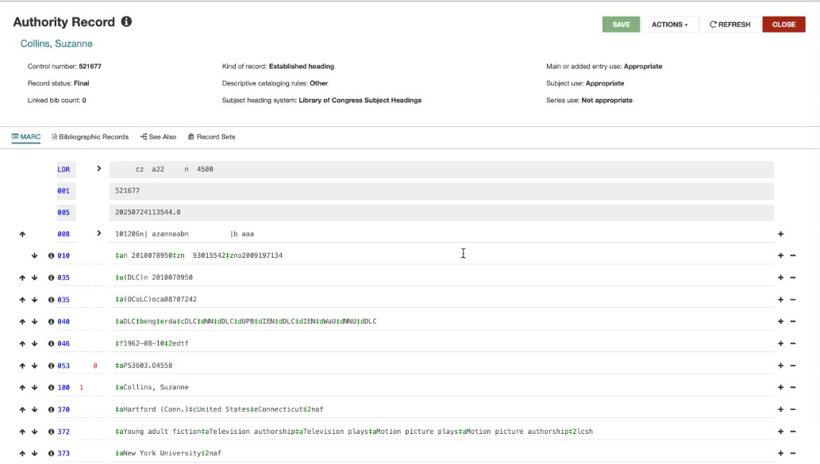
Name Authority Record

Slide 7
Subject Authority Record
Headings refer to the subject added entry and are only used in the subject added entry of a bibliographic record.
First and the second characters identify function of the tag:
15X is the authorized heading
45X is the see from tracing
55X is the see also from tracing
The third tag identifies the type of information:
1—Geographical subject term
3—Uniform title or series
5—Genre/Form term

Slide 8
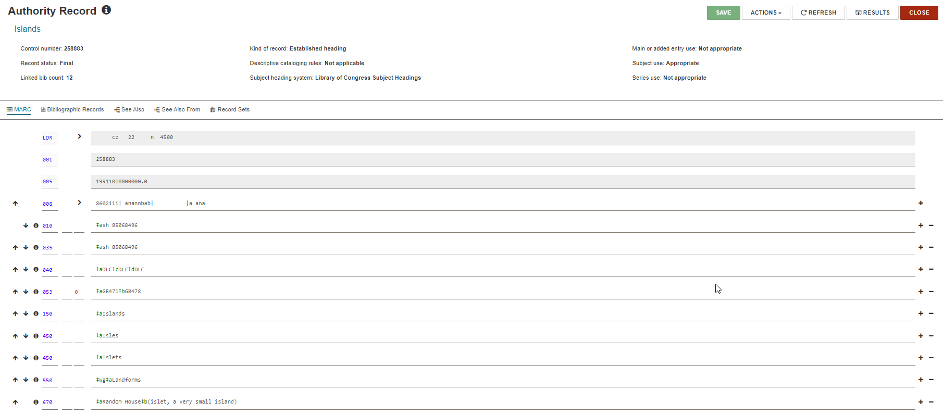
Subject Authority Record

Slide 9
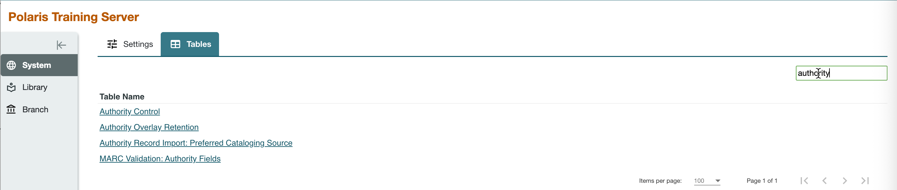
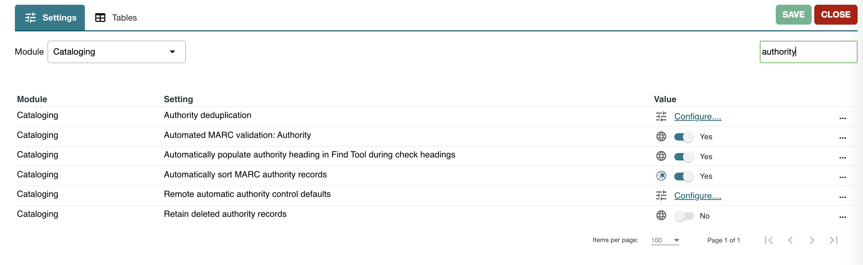
System Administration: Authority Settings/Tables

Slide 10
System Administration: Automated MARC Validation Authority
MARC format checking ensures the consistency and the quality of your MARC records.​
Polaris automatically checks MARC 21 tags when you save a record as final, but you can also check the MARC format before you save a record. When invalid tags and headings are detected, a list of the formatting problems appears. ​
Polaris MARC validation uses the rules set MARC Validation Authority profile. ​
The validation tables are based on rules outlined by the Library of Congress in the MARC 21 Standard Format For Bibliographic/Authority Data.

Slide 11
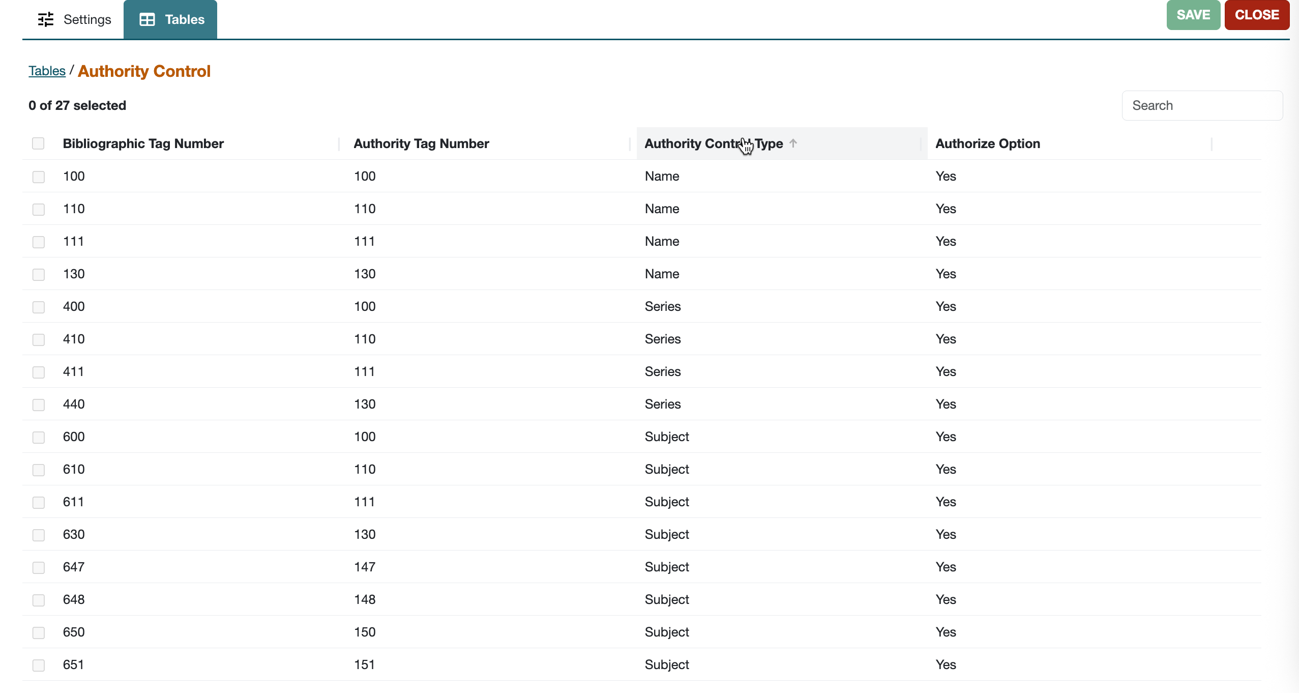
System Administration: MARC Validation Authority Setup

Slide 12
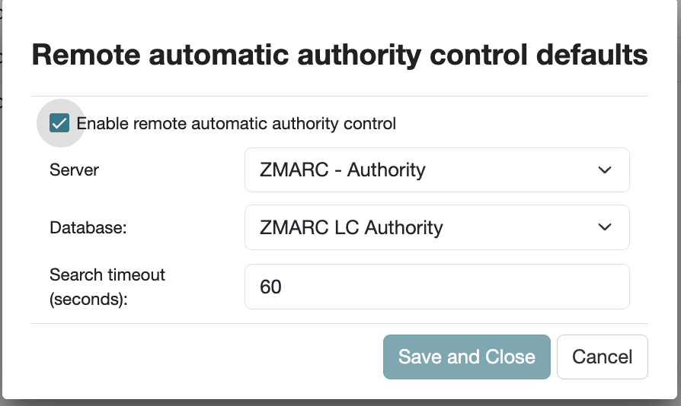
System Administration Profiles: Cataloging

Slide 13
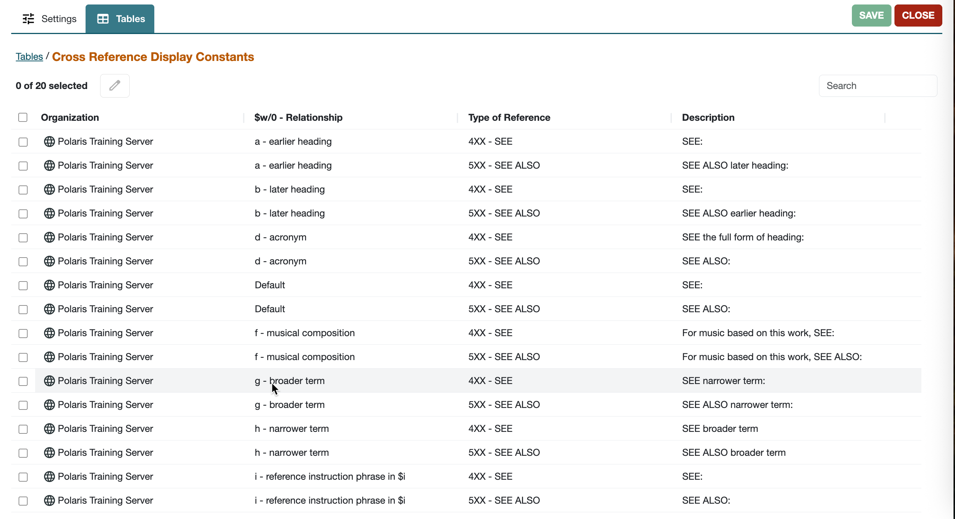
System Administration Policy Tables
Authority Overlay Retention
Authority Record Import: Preferred Cataloging Source
Cross-Reference Display Constants
The cross-reference structure is set up when Polaris is implemented. You cannot add or delete entries; you can only edit descriptions.
Search Databases

Slide 14
Overlay Based on Cataloging Source
The Authority Record Import: Preferred Cataloging Source policy table determines whether imported authority records overlay existing authority records when duplicates are found.
The code in the original cataloging source tag (040 $a) is checked against the entries in the table.
If the code matches an entry in the table, the preference order of the code is checked.
The existing record is overlaid with the new record if the code has a higher level of preference than the code in the existing record.
If using Authorities Weekly service, always overlay the database records; remove all entries at the System level.

Slide 15
Overlay Based on Cataloging Source
Preferred Cataloging Source Table Entries for Importing Library | Incoming Record Tag 040 $a | Import Processing Status
Has entries | Matches a table entry | Valid for import processing
Has entries | Does not match a table entry | Invalid record is logged in the import report, but is not added to the catalog
Has entries | No tag 040 | Invalid record is logged in the import report, but is not added to the catalog
No entries | No tag 040 | Incoming record is added to catalog as provisional. Logged in import report. Added to provisional record set if specified. Existing record is not changed.
No entries | Has original cataloging source information | Valid for import processing

Slide 16
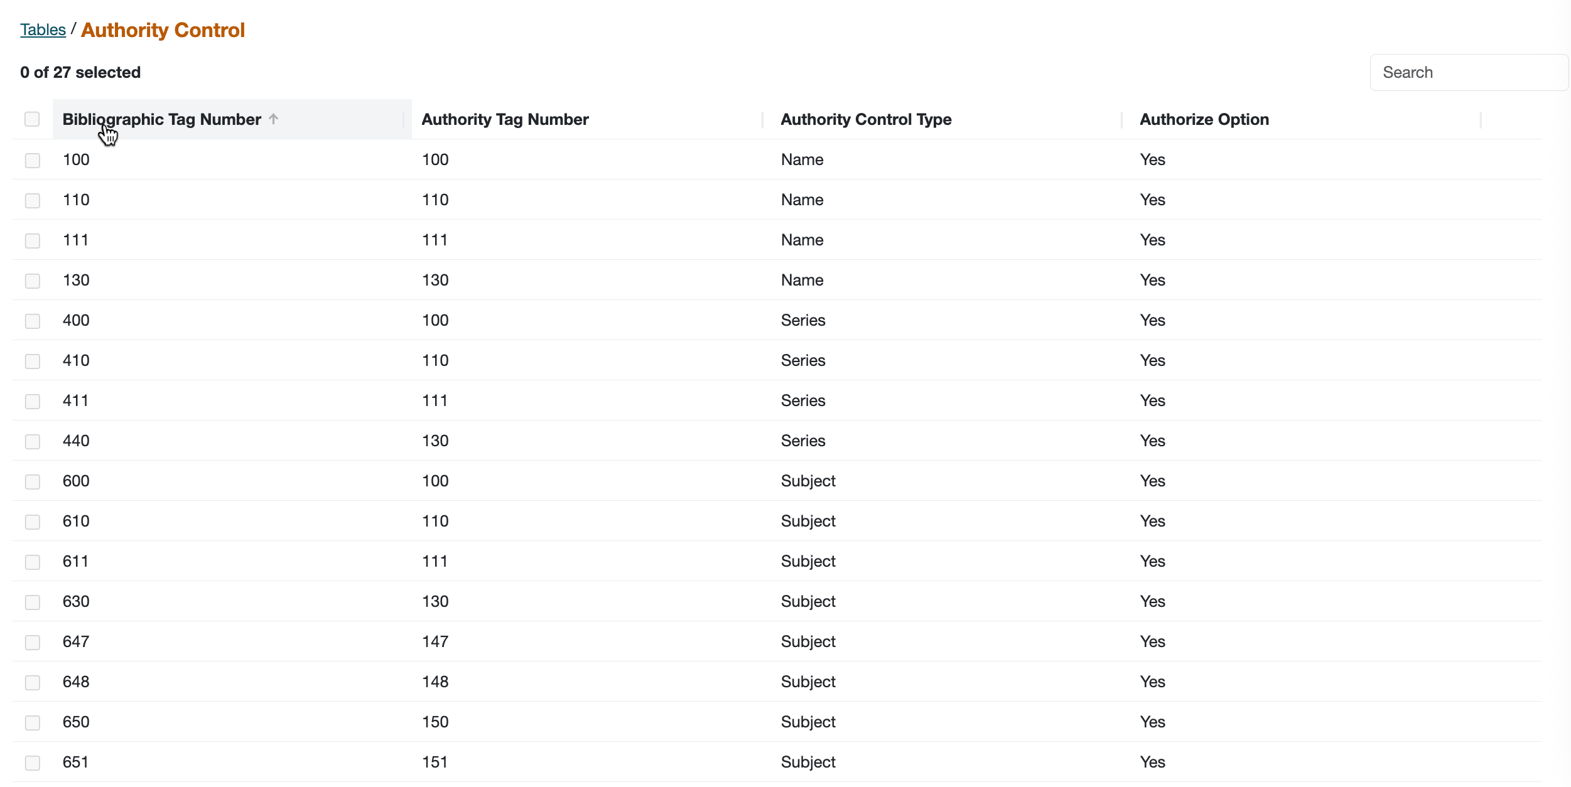
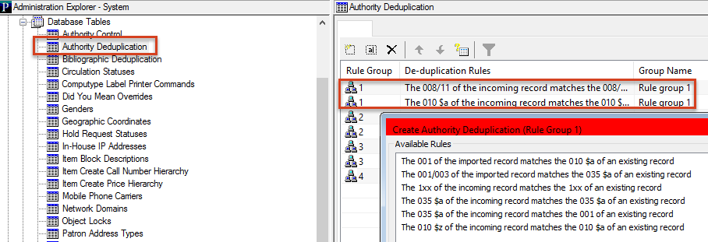
System Administration: Database Tables
Authority Control
Authority Deduplication

Slide 17
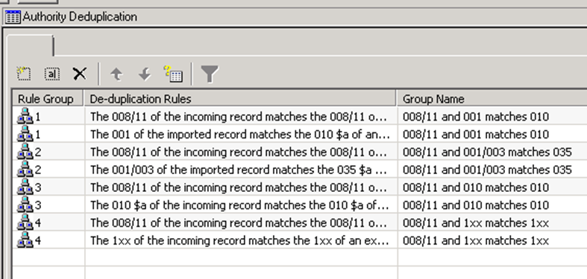
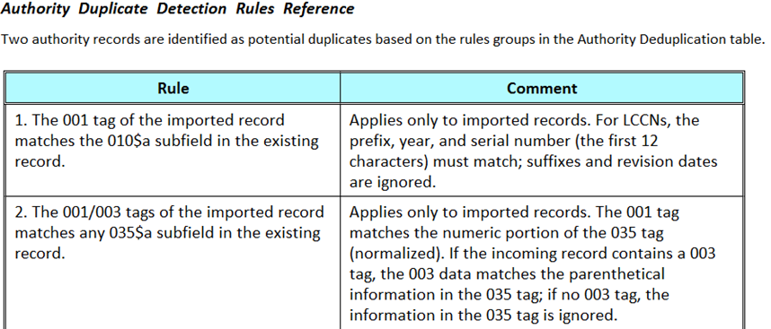
System Administration: Database Tables
Duplication Detection: Two records must meet all the rules in at least one group to be potential duplicates.
Database Tables—Authority Deduplication
Authority Duplicate Detection Rules Reference Help File

Slide 18
Authority Control Records Options in Polaris
Do-it-yourself (manually)
Retrieve and import needed authority records from an external source.
Create individual authority records.
Make system-generated authority records using the Create function.
Remote Automatic Authority Control (subscription service)
Periodic updates by third-party vendor
Combination of any of the above

Slide 19
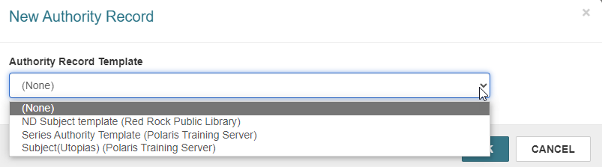
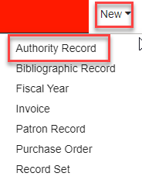
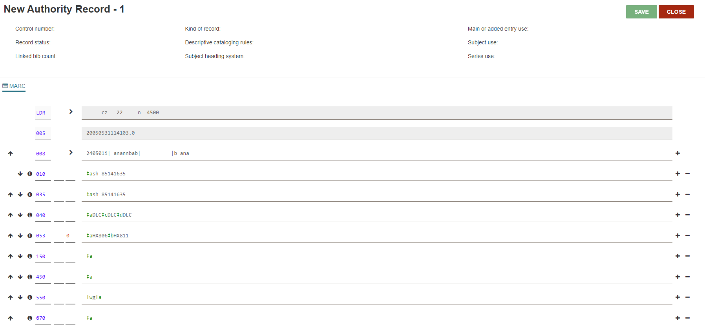
Authority Control Records Options in Polaris
Create an authority record with or without a template.

Slide 20
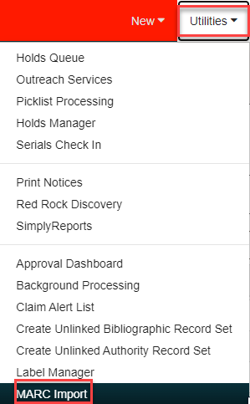
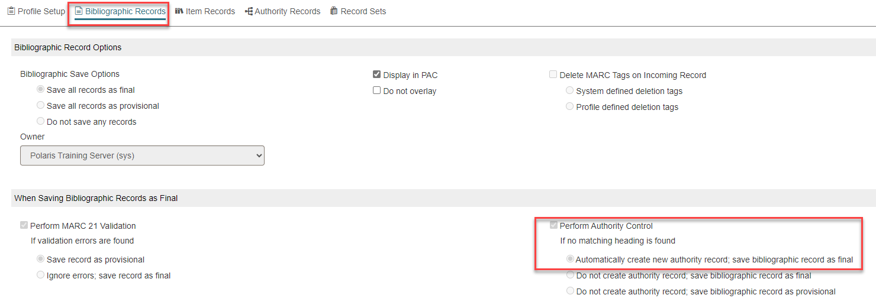
Creating Authority Records While Importing Bibliographic Records
System-generated authority records are very minimal and a base to use for creating a full record.

Slide 21
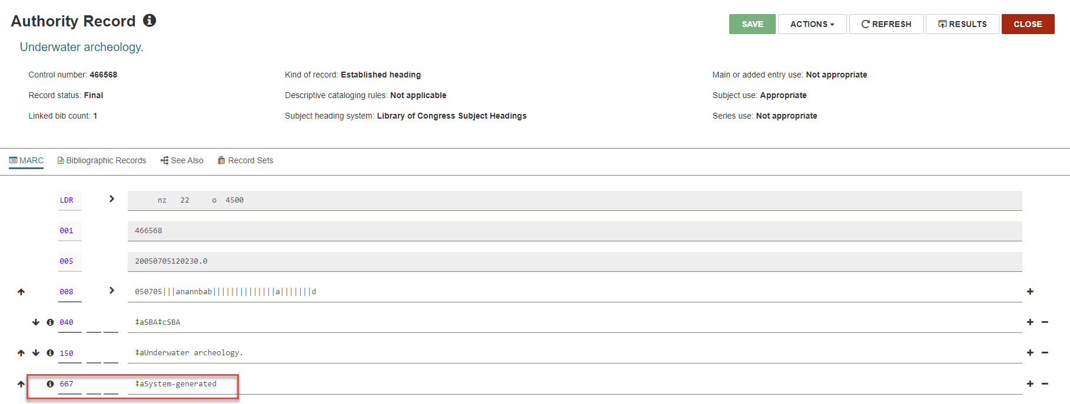
System-Generated Authority Record

Slide 22
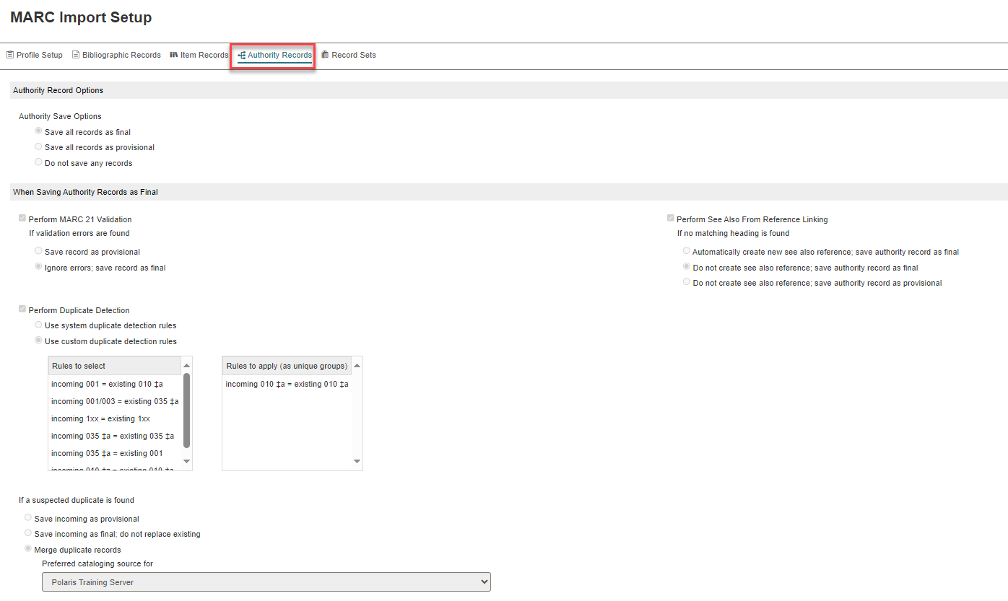
Importing Authority Record
When importing authority records, you can perform authority validation, duplicate checking, and see also reference linking.

Slide 23
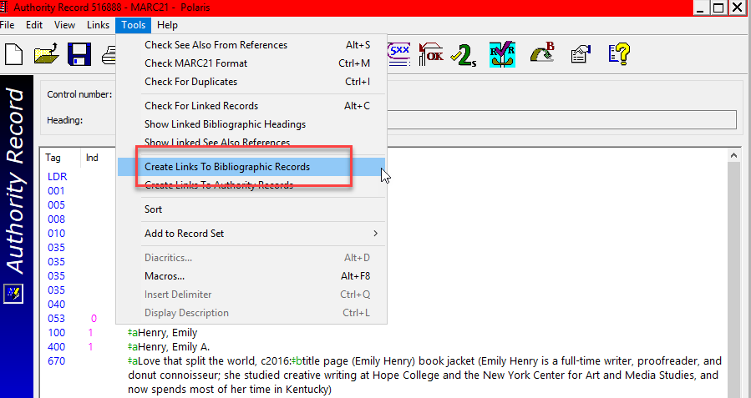
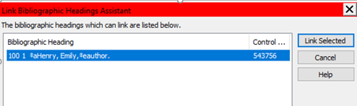
Linking to Bibliographic Records (Client Only)
Open authority record > (select field) > Tools > Link to Bibliographic records > Link Selected

Slide 24
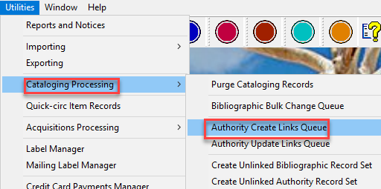
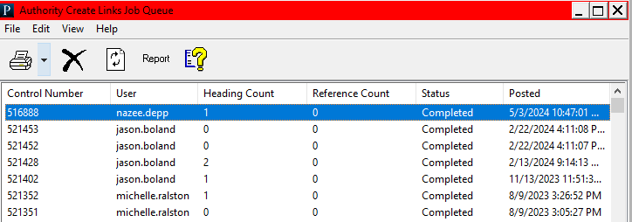
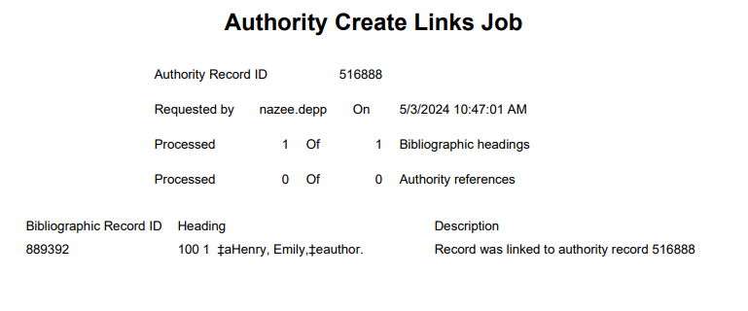
Linking to Bibliographic Records (Client Only)
To see the report in the Staff Client, select Utilities > Cataloging Processing > Authority Create Links Queue.

Slide 25
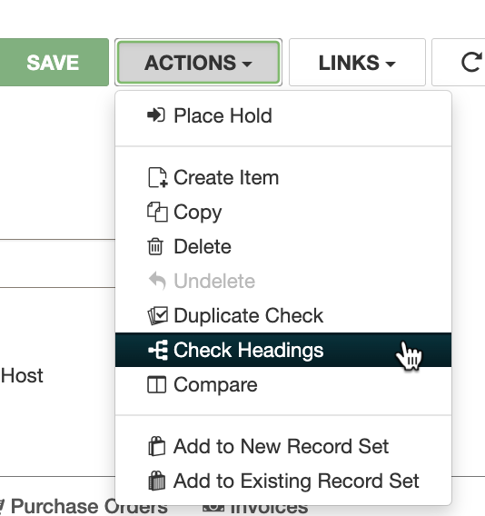
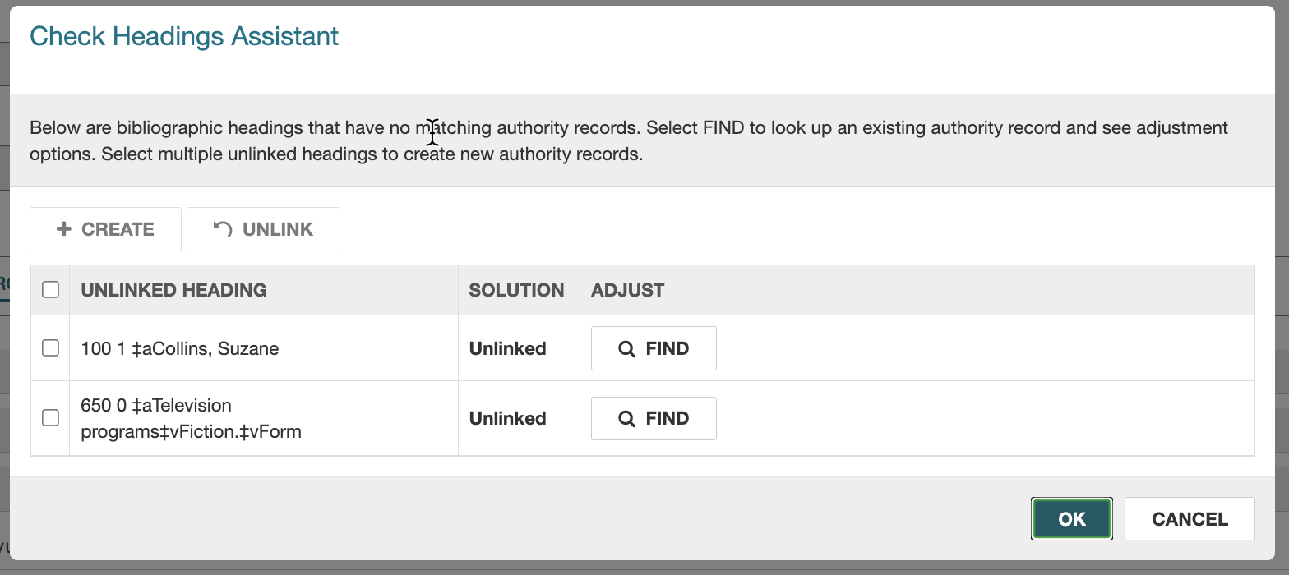
Linking from Bibliographic Records
When you save a new bib record, Polaris will do an authority check, but you need to continue saving and then go back to the bib record, choosing Check Headings.

Slide 26
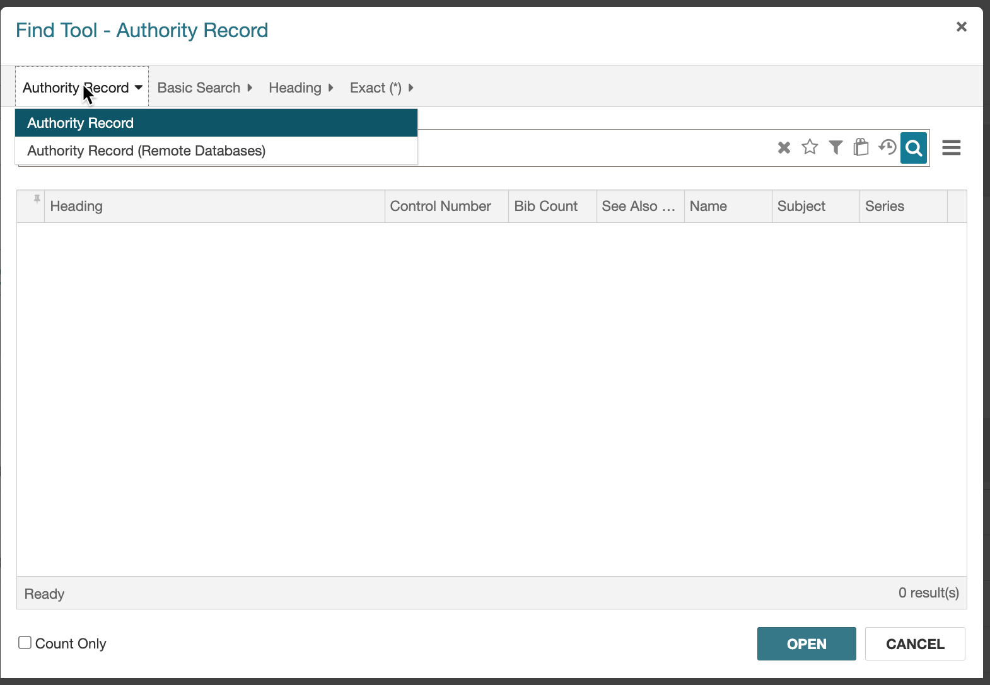
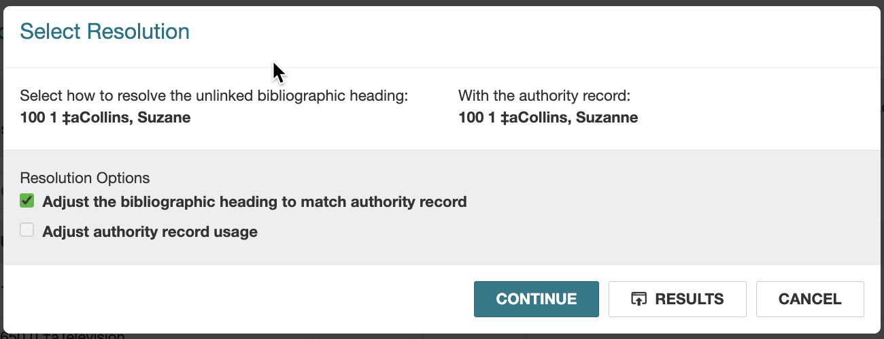
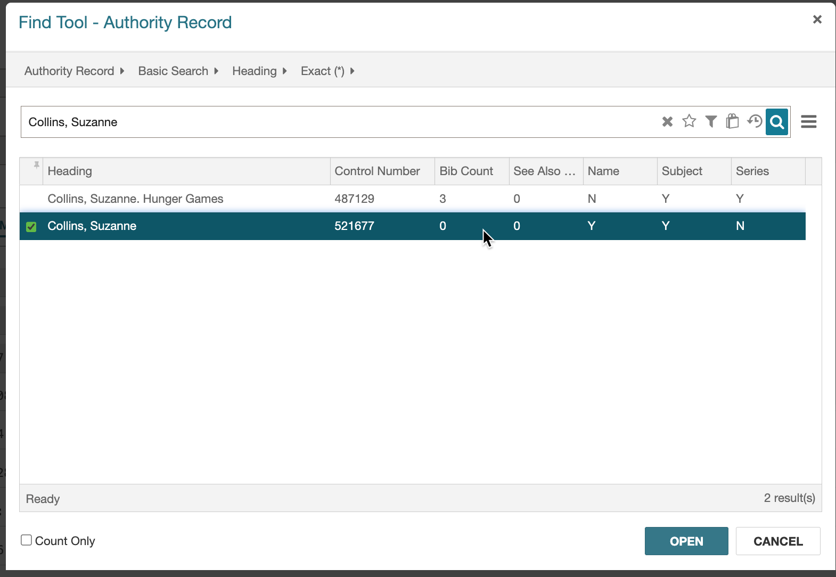
Linking from Bibliographic Records
You can search for the heading in Polaris and/or a remote database.
Choose the option you prefer and hit CONTINUE.

Slide 27
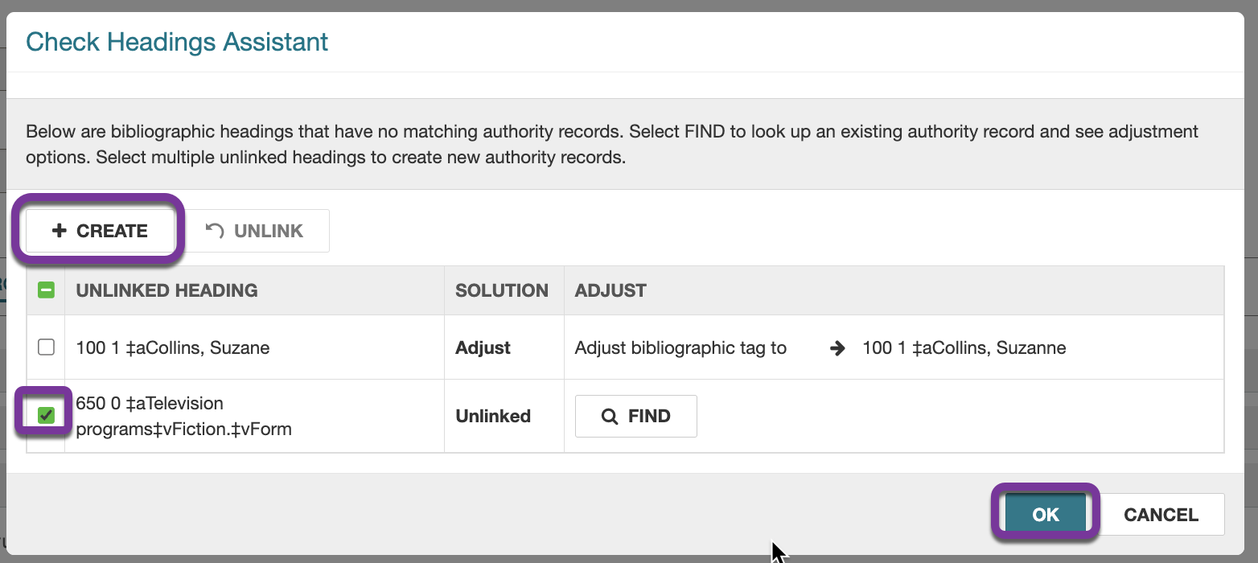
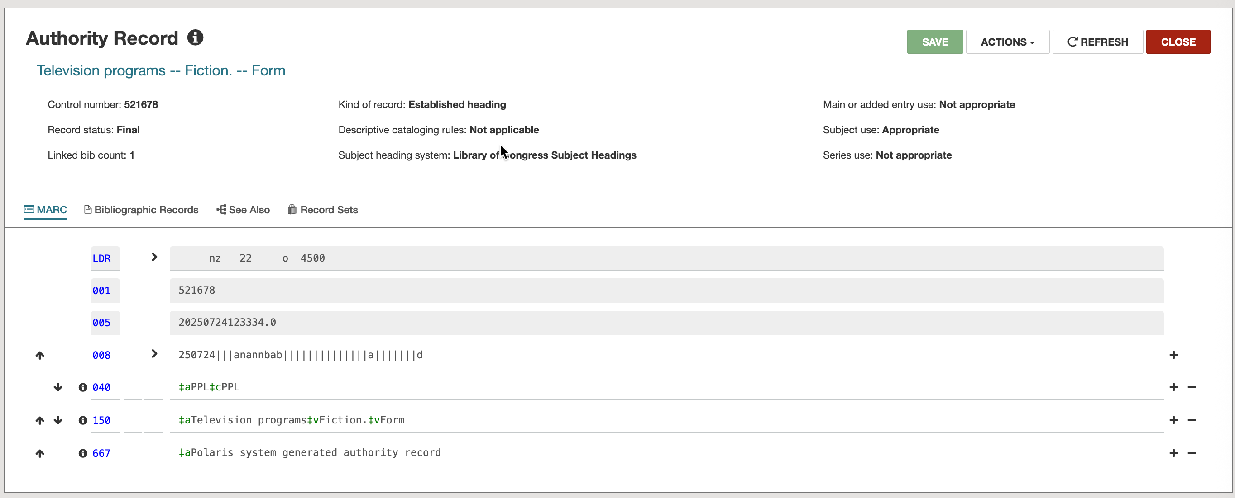
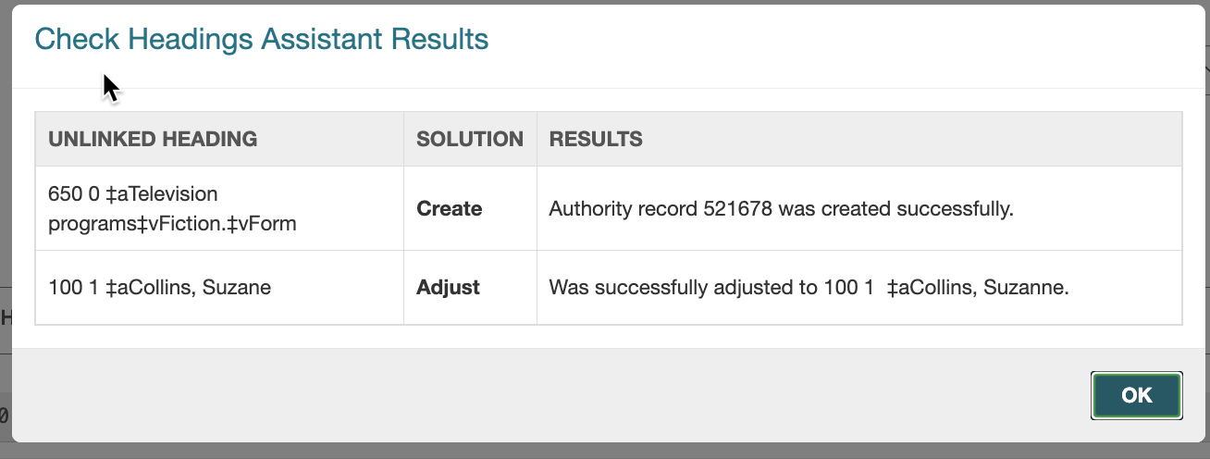
Linking from Bibliographic Records
There is also an option to create a very brief record which could be a base for a full record.

Slide 28
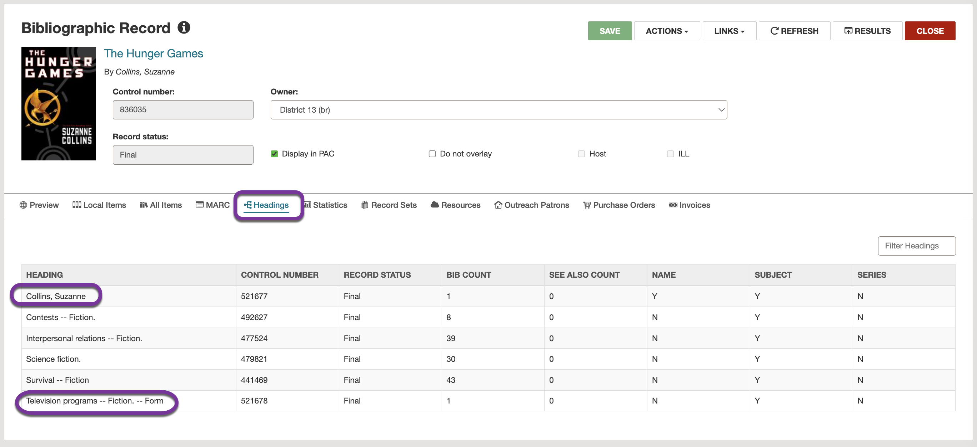
Linking from Bibliographic Records
After hitting refresh from the bib record, go to the Headings tab and you will see all headings linked to the bib.

Slide 29
Merging Authority Records
To merge two records:
Import authority records:
Add the 001 of the "bad" record in an 035 of the "good" record.
Import and overlay the incoming 035 matches existing 001 / retain incoming / delete existing (overlay).
Using the toolbar:
Look for duplicates--it is the same process, but you reverse it.
Add the 001 of the “good” record in an 035 of the "bad" record.
Search for dupes from the “good” record.
It may me necessary to perform minor editing on the good record in order to enable the Replace function.
NOTE: If you try a replace with an unedited authority record, the Enable is often greyed out.

Slide 30
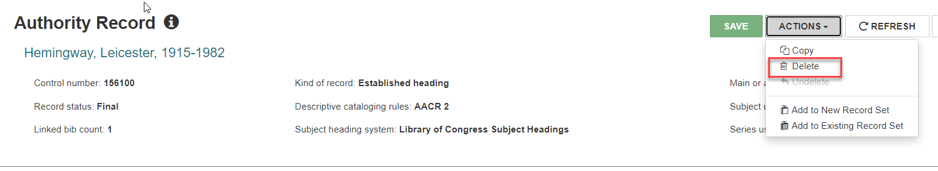
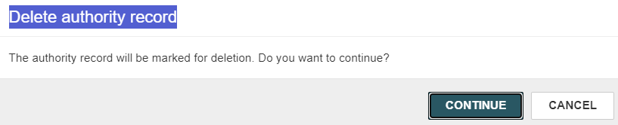
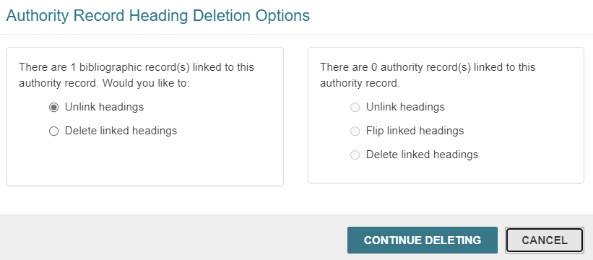
Deleting Authority Records
For linked bibliographic records, select one of the following options:
Unlink headings—Breaks links to any bibliographic headings linked to this authority record
Delete linked headings—Deletes the heading and tag in linked bibliographic records
For linked authority records, select one of the following options:
Unlink headings—Breaks links to any authority records
Flip linked headings—Converts the 5XX tag (see also from reference) in the linked records to a 4XX (see reference). This option is available only when an authority record is linked to the authority record you are deleting.
Delete linked headings—Deletes the linked authority headings

Slide 31
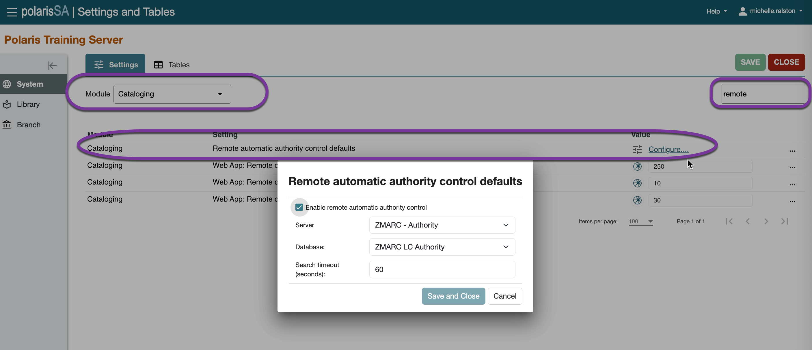
Remote Access via ZMARC
If your library subscribes to the Polaris ZMARC authority database, the database is checked for matching authority records when no match is found in the database.
The search for a match occurs automatically when you save a bibliographic or authority record, check headings, or import bibliographic records.
If an exact match is found in the remote authority database, it is saved to the local database and a link is made to the existing or imported record.
.

Slide 32
Polaris System Generated Reports
Authority records where 4XX matches 1XX
Authority records with no linked bib
Problem authority headings
Unlinked authority records

Slide 33
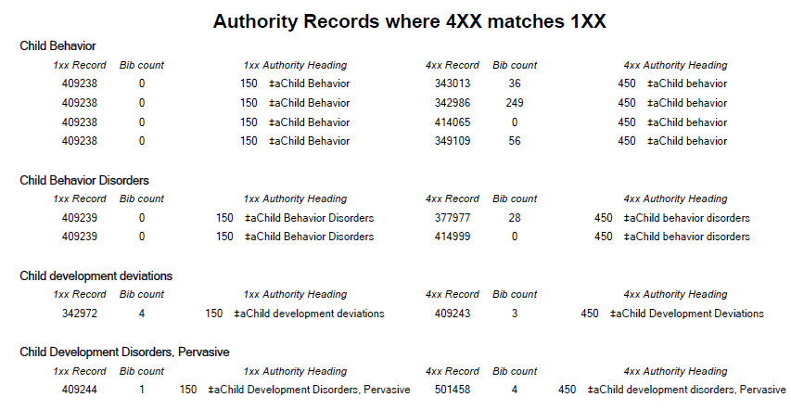
Authority Reports
Authority Records where 4XX matches 1XX:
Used to identify authority records where a see reference (4XX field) in one record matches a heading (1XX field) in another record.
It also lists situations where the same authority record contains a 1XX and 4XX that match because of normalization. For example, one heading using “and” while the other field with the same heading uses “&.”

Slide 34
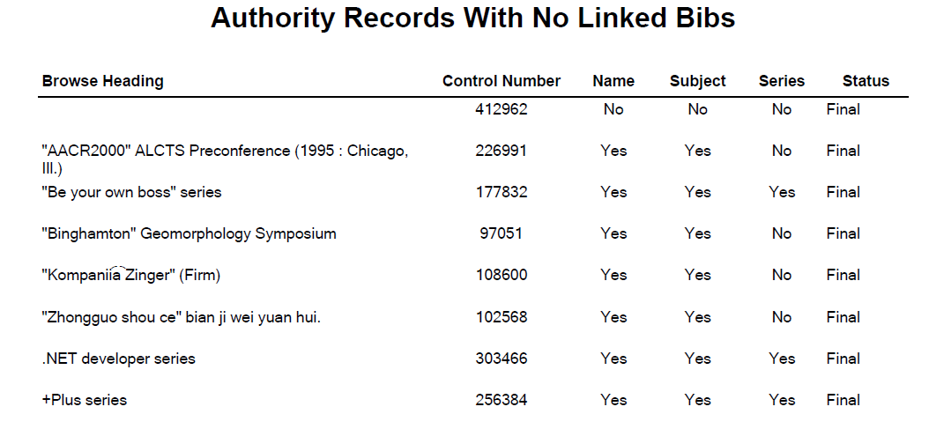
Authority Reports
Authority Records with No Linked Bibs:
Use this report to identify authority records that are not linked to any bibliographic record.
The authority record may have links to other authority records.

Slide 35
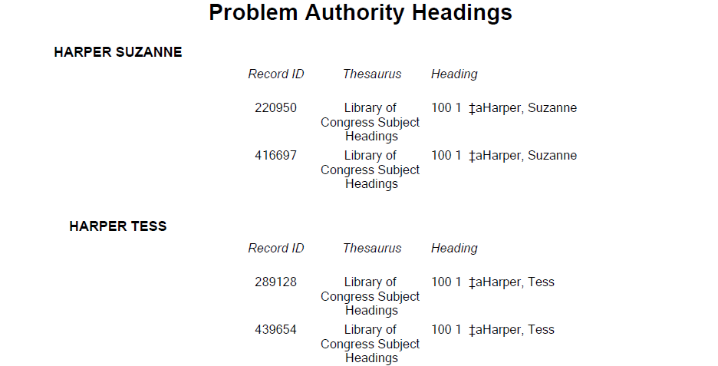
Authority Reports
Problem Authority Headings:
Use this report to identify possible duplicate authority headings where the normalized text is the heading of more than one authority record.
It lists the normalized heading that matched, the authority record IDs, the actual heading text, and the thesaurus of the authority record.

Slide 36
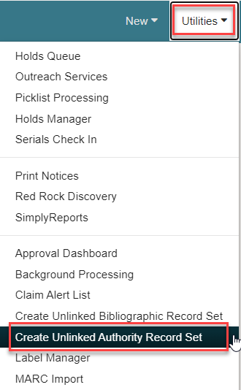
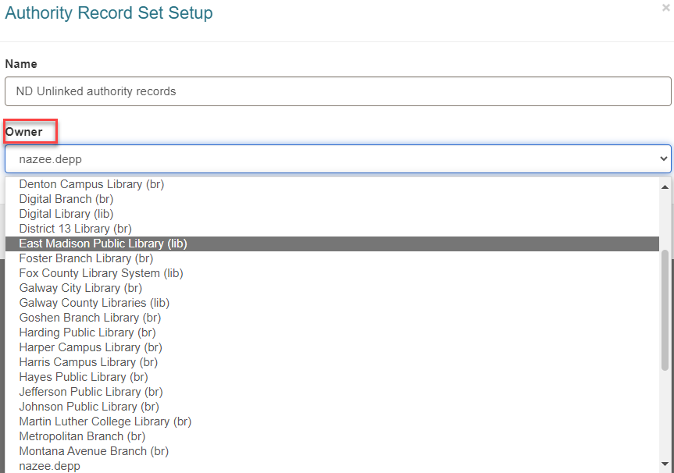
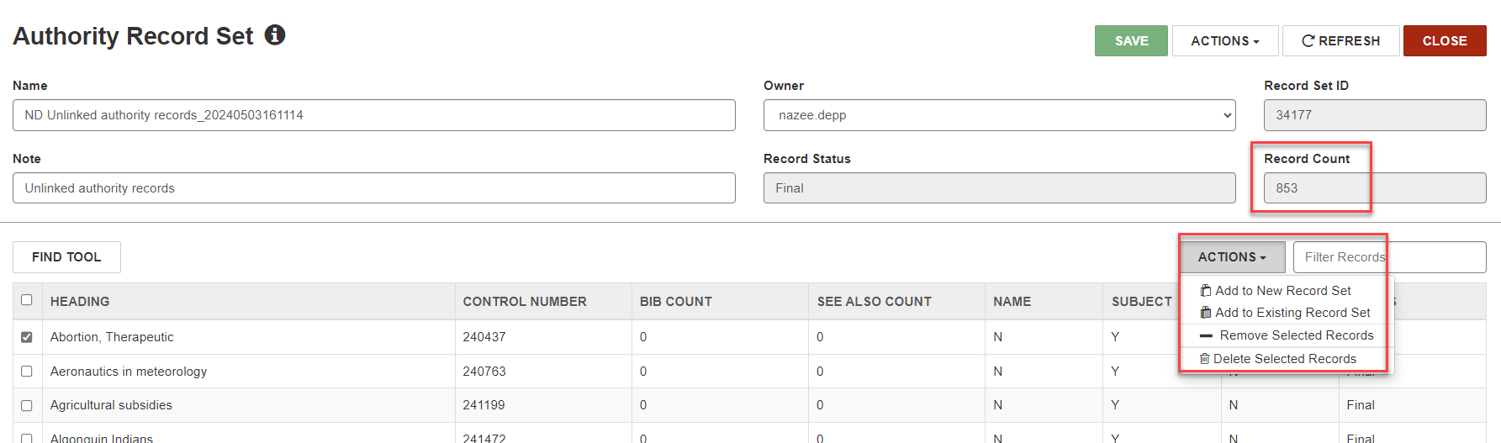
Creating an Unlinked Authority Record Set
You can automatically create a record set of bibliographic records that are not linked to any item records or a record set of authority records that are not linked to any bibliographic or authority records.

Slide 37


Forename Surname
forename.surname@clarivate.com
+000 000-0000
About Clarivate
Clarivate is a leading global provider of transformative intelligence. We offer enriched data, insights & analytics, workflow solutions and expert services in the areas of Academia & Government, Intellectual Property and Life Sciences & Healthcare. For more information, please visit clarivate.com.
© 2025 Clarivate. All rights reserved
Clarivate and its logo, as well as all other trademarks used herein are trademarks of their respective owners and used under license.

