Slide 1

Polaris Borrow by Mail

Slide 2
Borrow by Mail
Parameters – Requests – Borrow by Mail
Enabling Borrow By Mail, notes, charges and assigning processing centers
Setting Limits by patron codes & item material types
Print jobs & notices

Slide 3
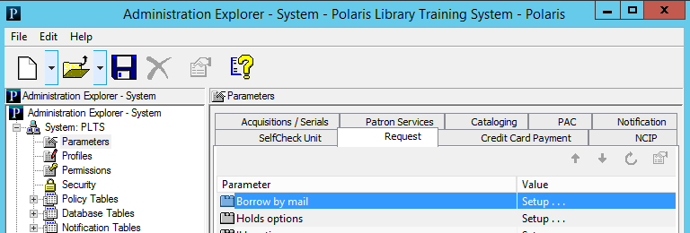
Setting Up Borrow by Mail in System Administration
Your library system may process Borrow by Mail items in a central location or during normal circulation. In central processing, one or more branches are designated as Borrow by Mail processing centers in System Administration.
Processing centers can only be designated at the system level. They may be actual branches or virtual organizations set up for this specific purpose.
You can designate multiple processing centers. A branch may handle both normal circulation and Borrow by Mail requests by establishing itself as a processing location
In SA Parameters, select Request > Borrow by Mail > Setup

Slide 4
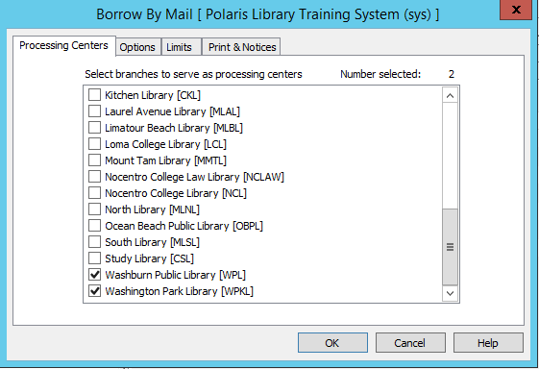
Setting Up Borrow by Mail in System Administration
Select the organizations that will serve as Processing Centers.
If all organizations will participate and use the same settings, the Options, Limits, and Print & Notices tabs may be set up here.
Otherwise, set them up at the branch that will use Borrow by Mail

Slide 5
Setting Up Borrow by Mail in System Administration
Note:
An item that fills a Borrow by Mail request created in the staff client is shipped to the processing center designated for the log-in branch of the workstation that created the hold request. An item that fills a Borrow by Mail request from the PAC is shipped to the processing center designated for the patron’s registered branch.
Requests placed from the PAC use the settings of the processing center for the patron’s registered branch, while requests placed from the staff client use the settings of the processing center for the workstation’s branch. It is therefore possible that the fee may differ depending on where the request is placed.

Slide 6
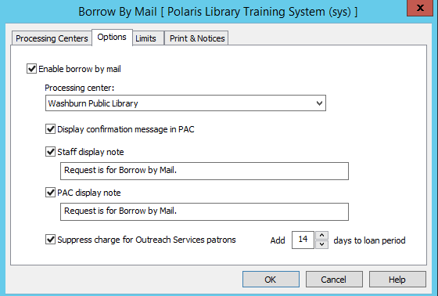
Setting Up Borrow by Mail in System Administration
Check Enable Borrow by Mail and select a processing center for this organization.
This will cause the Borrow by Mail and Tracking Number fields to appear in the Hold Request form.
Make sure the processing center is listed in the holds routing sequence table.
Select Display confirmation message in PAC to display a message when a Borrow by Mail request is placed in the PAC.
If Outreach is enabled, any charges may be suppressed for Outreach patrons by selecting Suppress charge for Outreach Services patrons.
The loan period may be extended to allow for shipping time.

Slide 7
Setting Up Borrow by Mail in System Administration
Staff and PAC display notes are placed in the Hold Request work form. They are optional and may be edited (max 250 characters).
Staff Display Note - If your library handles Borrow by Mail requests without sending items to a central processing center, the staff display note appears when the item is trapped at check-in, alerting you that the item needs to be mailed.
Or, a branch may handle both normal and Borrow by Mail requests by establishing itself as a processing location. In this case, an optional message alerts staff to a Borrow by Mail request when the item is trapped at circulation.

Slide 8
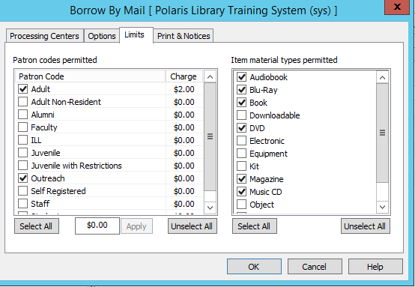
Setting Up Borrow by Mail in System Administration
The Limits tab is used to select the patron codes for the patrons permitted to place Borrow by Mail requests and to set any fees charged per patron code.
Check item material types that will be eligible to fill Borrow by Mail requests.
You can prevent a specific item from filling a Borrow by Mail request by checking the setting Do not mail on the Item Record work form - Cataloging view.

Slide 9
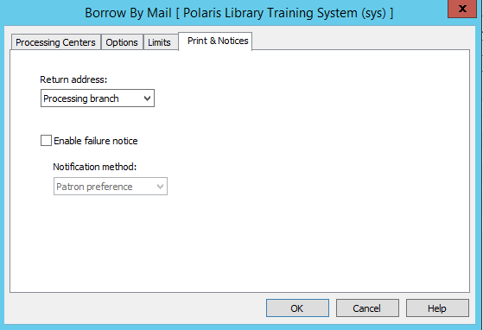
Setting Up Borrow by Mail in System Administration
On the Print & Notices tab specify a return address for the item mailer; it can be the processing branch or the item’s branch.
If the item cannot be checked out due to blocks on the patron’s account, a failure notice can be generated and sent via the Notification option.

Slide 10
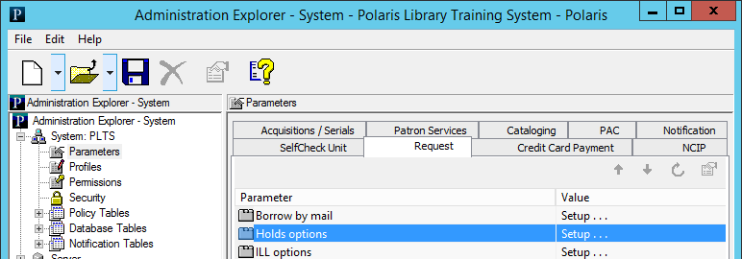
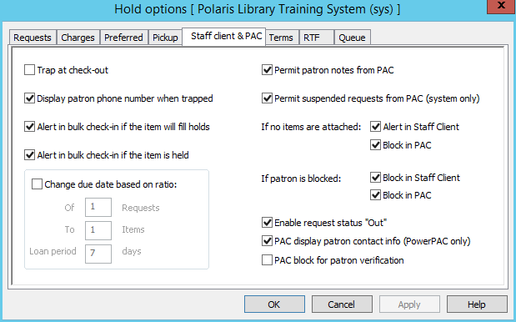

Setting Up Borrow by Mail in System Administration
SA options under Parameters > Request > Hold options > Staff client & PAC control the display of requests that have been checked out.
10

Slide 11
Setting Up Borrow by Mail in System Administration
Request status of Out:
When a held item is checked out, the request status changes to Out until the item is returned. The request is then deleted. The status is automatically enabled for organizations using Borrow by Mail and is displayed in the staff client and the PAC patron account (where it appears as Sent).
Organizations that do not use Borrow by Mail can choose to display or suppress the display of requests with the status of Out. On the Holds options dialog box - Staff & PAC tabbed page (Request parameters), select the option Display request status Out. The setting for the workstation’s logon branch controls the display in the staff client, while the setting for the patron’s registered branch controls the display in the PAC patron account.
11

Slide 12
Borrow by Mail: Requests
Placing Borrow by Mail requests in Leap
Placing Borrow by Mail requests in the Polaris PAC
Borrow by Mail Requests in the Holds Queue
Borrow by Mail Requests in the Patron Record
Borrow by Mail Requests in the Request Manager
Borrow by Mail Requests in the PAC
12

Slide 13
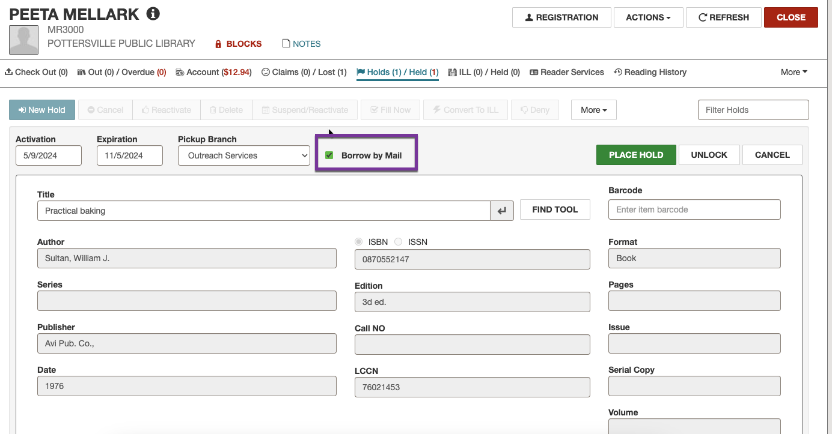
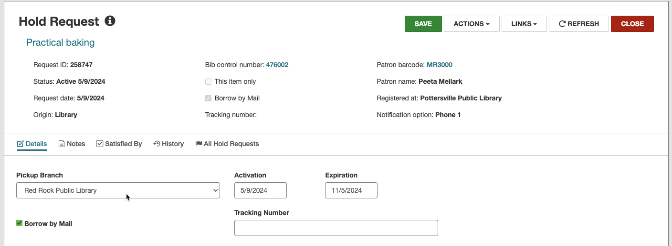
Placing Borrow by Mail Requests in Leap
Fill out the Hold Request workform just like any other request. Click in the Borrow by Mail box and save the request.
A tracking number (if available) can be entered to help manually track and troubleshoot delivery when the item is mailed. Tracking numbers are indexed and searchable. Tracking numbers are not assigned by Polaris.
The Hold Request workform will remain available until the item is returned, at which time it will be automatically deleted.
13

Slide 14
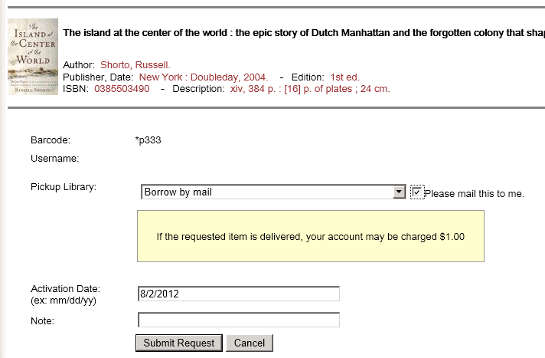
Placing Borrow by Mail Requests in the Polaris PAC
Borrow by Mail requests are initiated in the PAC like any other request.
When the Please mail this to me box is checked, the pickup library becomes Borrow by Mail, and the item will be sent to the designated processing center.
The Borrow by Mail pickup branch is the processing center selected by the patron’s branch in the SA setup; the branch name does not display.
If there will be a charge to the patron, a message is displayed, and the charge is automatically assessed by the processing center in coordination with the patron’s branch.
14

Slide 15
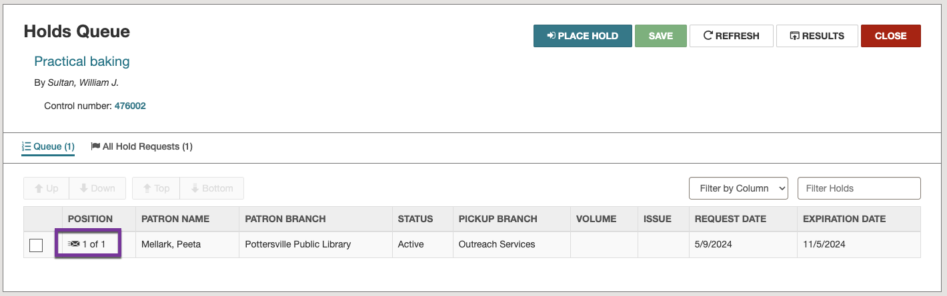
Borrow by Mail Requests in the Holds Queue
Once placed, Borrow by Mail requests show up in the holds queue just like any other request.
The requests have a special icon to show that they are designated as Borrow by Mail.
Other status terms may display based on where the piece is in the processing cycle.
15

Slide 16
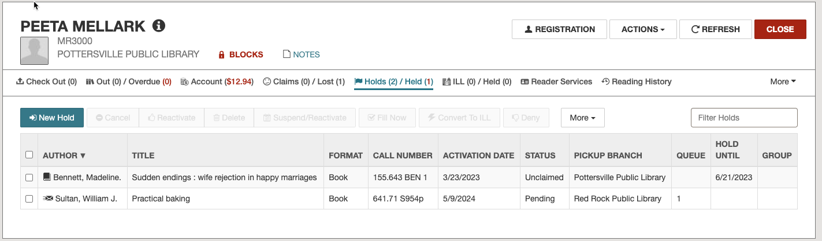
Borrow by Mail Requests in the Patron Status Record
Borrow by Mail requests show up in the Patron Record > Holds tab with a special icon to show that they are Borrow by Mail
It will also show if they are “Active” and pending OR have been captured , checked out with a status of “Out” on this view.
16

Slide 17
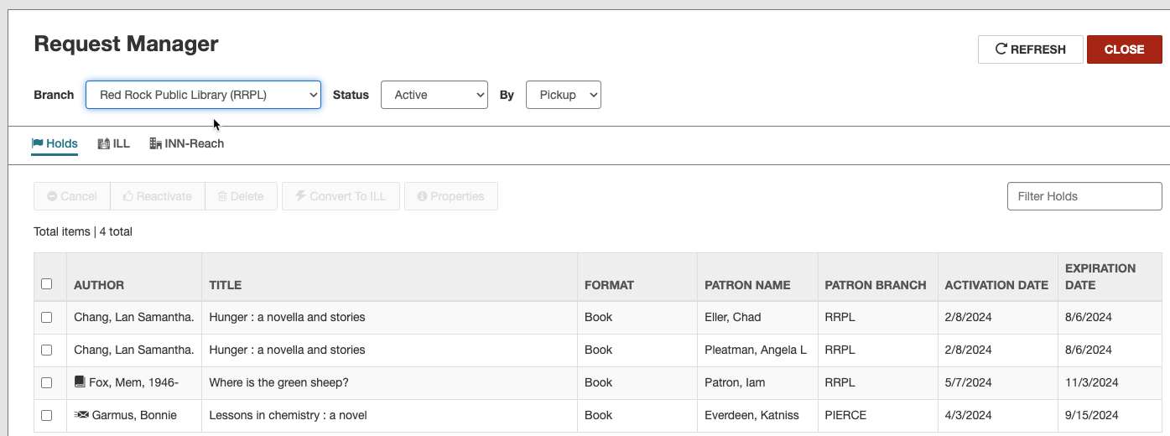
Borrow by Mail Requests in the Request Manager
Borrow by Mail requests show up in the Request Manager like any other request.
A special icon indicates they are Borrow by Mail requests.
17

Slide 18
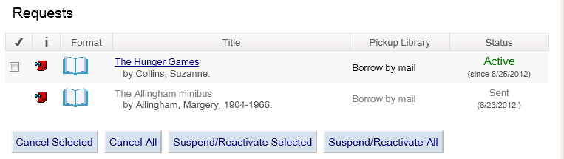
Borrow by Mail Requests in the PAC
The Patron Account in the PAC will show that the request is a Borrow by Mail using the icon seen above. The pickup library that is automatically assigned when the request is placed uses the phrase Borrow by mail.
The status will show as Active until captured at check in or Sent when it has been captured, checked out, and sent to the user. Polaris does not use the display of Out in the PAC for Borrower By Mail requests.
18

Slide 19
Borrow by Mail: Processing
Trapping Borrow by Mail items
Individual processing of Borrow by Mail requests
Bulk processing of Borrow by Mail requests
Tracking a Borrow by Mail request
Borrow by Mail requests in patron PAC account
Checking in Borrow by Mail items
Borrow by Mail reports

Slide 20
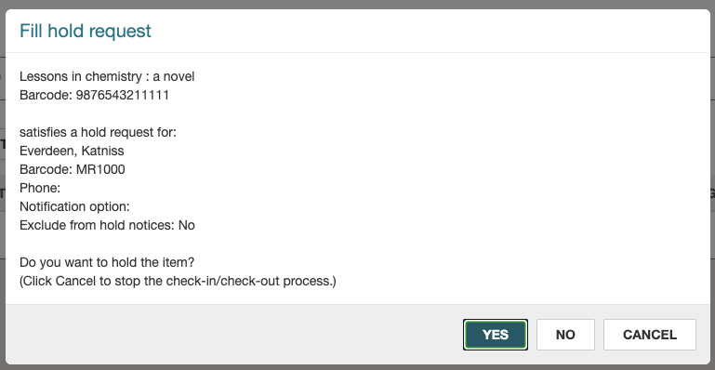
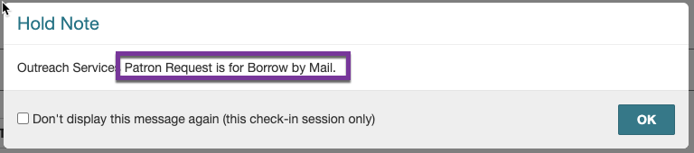
Trapping Borrow by Mail Items
Checking in an item that will satisfy a Borrow by Mail request will result in a warning that it satisfies a hold request…
Clicking on Yes will trigger the hold note (contents determined by SA settings).
If the item is not checked in at the processing center, it will go in transit to the processing center

Slide 21
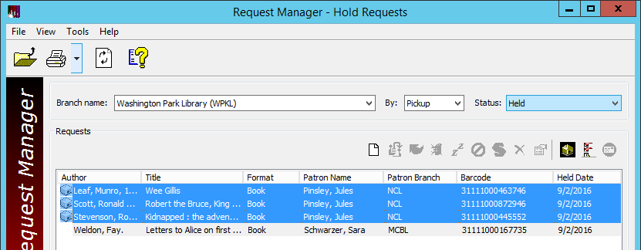
Bulk Processing of Borrow by Mail Requests (Client)
A faster way to process Borrow by Mail items is to manage them in bulk using Request Manager > Held or Shipped status.
Borrow by Mail items are marked by a “package” icon.
Highlight all the Borrow by Mail items and use the icons above the list to print a checklist of the items to be mailed and to print the mailers. The text can be customized in the Polaris Language Editor.

Slide 22
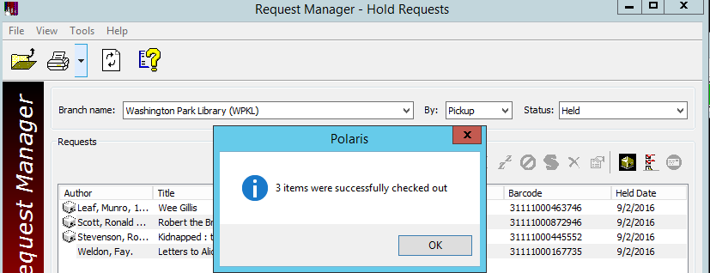
Bulk Processing of Borrow by Mail Requests (Client)
With the items still highlighted, click on the Bulk Check Out icon
Items will be checked out and moved to the Out status

Slide 23


Forename Surname
forename.surname@clarivate.com
+000 000-0000
About Clarivate
Clarivate is a leading global provider of transformative intelligence. We offer enriched data, insights & analytics, workflow solutions and expert services in the areas of Academia & Government, Intellectual Property and Life Sciences & Healthcare. For more information, please visit clarivate.com.
© 2025 Clarivate. All rights reserved
Clarivate and its logo, as well as all other trademarks used herein are trademarks of their respective owners and used under license.

