Slide 1

Polaris Offline Circulation Client

Slide 2
Setting Up Offline Circulation
Setting up offline files
PC vs. Terminal Server or RemoteApp
Designating offline workstations
Hosted sites
Automatic offline processing
Best practices

Slide 3
Setting Up Offline Files
Your system administrator has received instructions from your Polaris implementation manager regarding setting up offline circulation.
There are two .mdb files that need to be copied from the server to the workstation(s) where offline circ will be done.
  The PolPatron.mdb file is a copy of your patron database.
  The PolSystem.mdb file holds some of your SA settings.
Your system administrator has two options to copy these .mdb files to the correct place so offline circ will work correctly.
  Your system administrator/IT may copy the files manually; however, the files must be updated on a regular basis.
  It is also possible to set up a SQL job (Copy Offline Files) to automatically push the .mdb files to the correct workstation(s).

Slide 4
PC vs. Terminal Server or RemoteApp
Your chosen set up will determine the choices for offline circ configuration.
If you do not use a terminal server environment, the Polaris Staff Client must be loaded on each workstation(s) that will be used offline.
If you use a terminal server or RemoteApp, there are two choices:
  Copy the .mdb files to the terminal server itself and perform offline circ directly from the terminal server
  Load the client on the individual workstation(s) and copy the .mdb files there.
Be sure to take local drives with you into the terminal server environment when uploading transaction files manually.

Slide 5
Designating Offline Workstations
Designate which workstations at your library will be used for working offline.
  You don’t have to use all of your circulation workstations if they are not needed while you are offline.
  You will need to use at least one workstation in each branch.
  If you choose to register patrons, designate one workstation separate from the stations used for check out.
Offline transactions create a .trn file.
These are the files that will be uploaded into the database after server connection is restored.

Slide 6
Hosted Sites
Shared hosted sites can retrieve their .mdb files at http://libraryname.polarislibrary.com/offline.
  You will be asked for a username and password.
  Shared hosted must load clients on their local machines for offline circ.
Virtual or Dedicated Hosted sites may work within their terminal server environment.
  Ask your Polaris Support Engineer to help with copying the .mdb file to the terminal server.
  Clients can be loaded on local machines as well but be sure to take local drives with you into the terminal server environment when uploading.

Slide 7
Automatic Offline Processing
When connection to your server has been restored, there are two choices for uploading .trn files:
  Manually upload the files.
  Use Automatic Offline Processing.
Your system administrator may set up Automatic Offline Processing so that .trn files do not have to be manually uploaded.
After the files have been uploaded automatically, the resulting log files may be emailed to specified staff at branches.
Automatic Offline Processing is not available to shared hosted sites.

Slide 8
Best Practices
Log off and back on every hour or so to prevent large corrupt .trn files.
If doing check in, strongly consider leaving the SA default for the Patron Services Parameter, Offline: Trap holds at check-in set to No.
  Set this to Yes if you want to trap holds; reports will tell staff which titles were trapped and must be gathered.
  Set this to No if you do not want to trap holds; holds will be trapped at a later time.
Designate a separate workstation for registering patrons.
If uploading files manually:
  Upload patron files first.
  Upload all files in date and time stamp order.

Slide 9
Working Offline
Log on offline
Offline circulation
  Check out
  Check in
Registering patrons

Slide 10
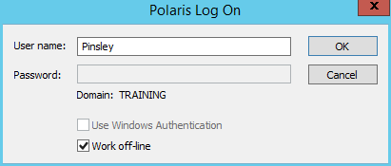

Log On Offline
Enter your username in the Polaris Log On window.
Click the Work off-line box.
The Password field will be grayed out.
Click OK.
Many of the shortcut bar icons will be grayed out and offline status is confirmed at the top of the shortcut bar.

Slide 11
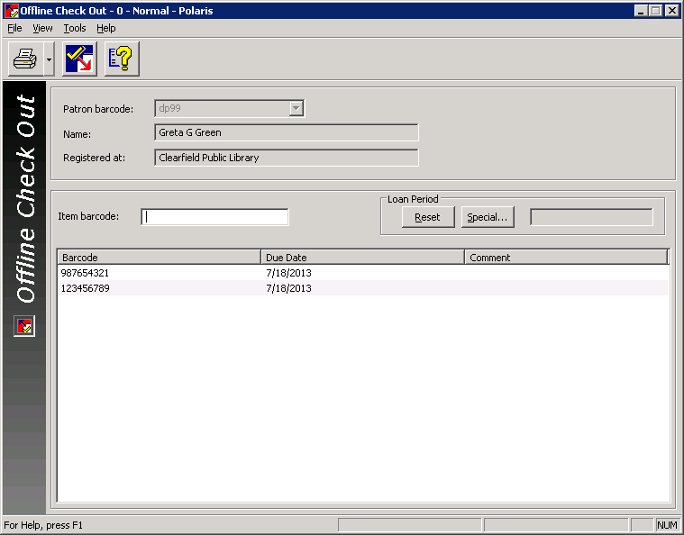
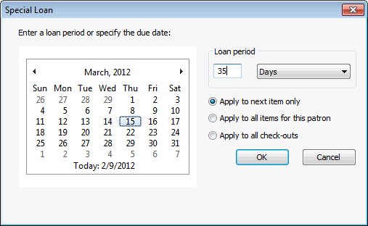

Offline Circulation – Check Out
F3 can still be used to access check out.
Scanning in the patron’s barcode may retrieve their name from the PolPatron.mdb file.
As item barcodes are scanned in, only the barcode can be seen, and a date due is calculated per a default set in SA.
If a different date due is needed, you can use the Special button to set the correct date prior to check out.
The Enter key will clear the screen and print a brief receipt.

Slide 12
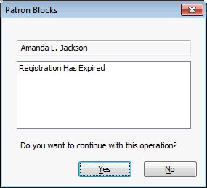
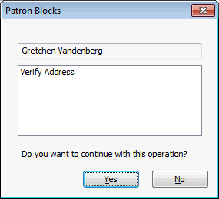
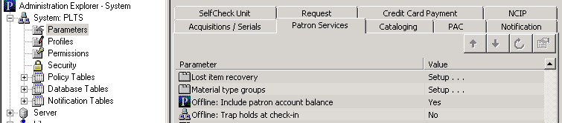
Offline Circulation – Check Out
Staff might see a few patron blocks during offline circulation.
They will not see item blocks.
Patron Services Parameters settings determine whether the patron account balance is displayed.

Slide 13
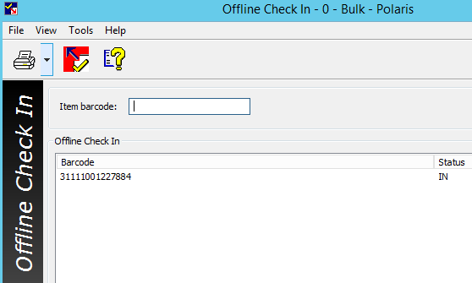
Offline Circulation – Check In
Hint:
Go to Parameters > Patron Services > Offline > Trap holds at check-in to turn off the capture of holds during offline period.
Check in can also be done offline, though this is not recommended.
A System Administration setting will determine the ability to trap holds when the transaction files are uploaded/
  Set this to Yes if you want to trap holds; reports will tell staff which titles were trapped and then they must be gathered.
  Set this to No if you do not want to trap holds; holds will be captured at a later point.

Slide 14
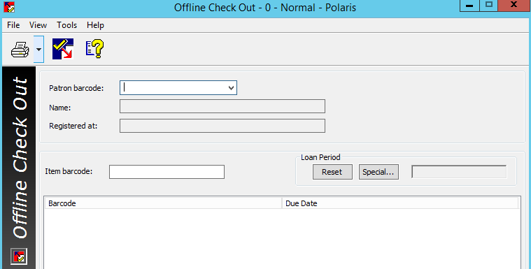
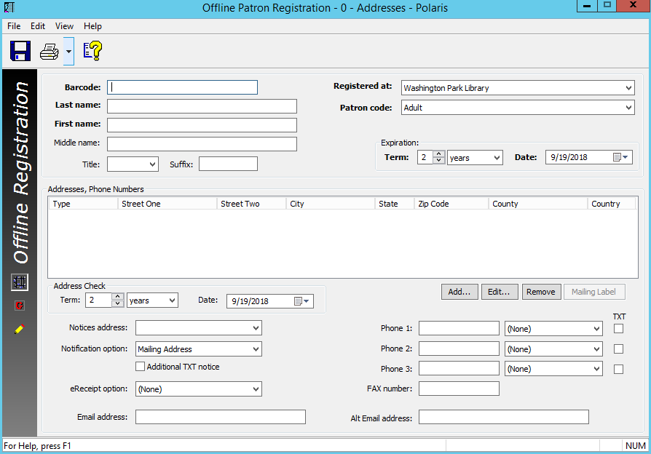
Registering Patrons
It is possible to register patrons in offline mode.
If a patron’s information is not in the PolPatron.mdb file, the patron information will not display when the barcode is scanned; a decision needs to be made whether to re-register these patrons.
F7 will bring up a blank registration workform.

Slide 15
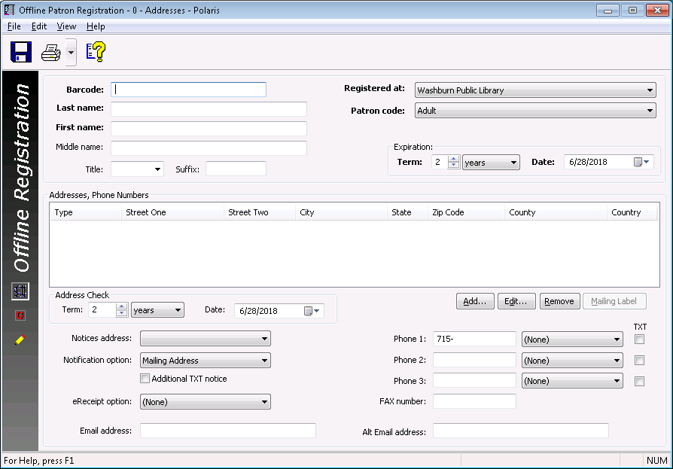
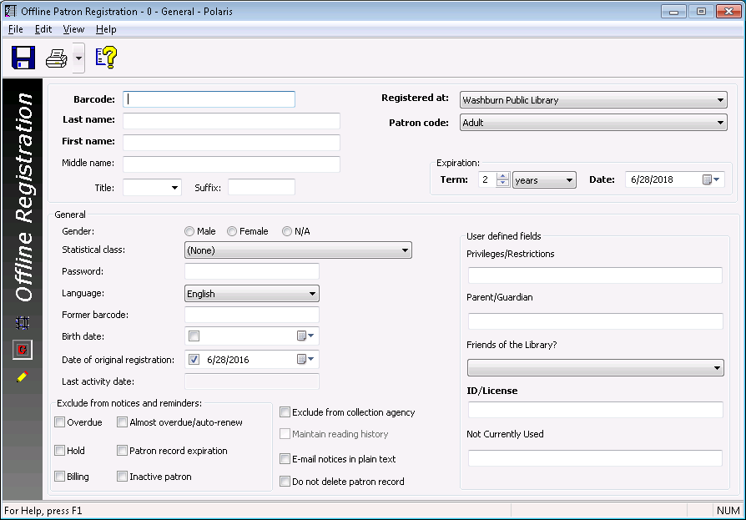
Registering Patrons
The Registration workform should be filled out in the same way as when working online.
A Verify Patron block is added to any new patron record created in offline mode.
If possible, dedicate a specific workstation for patron registration, as all new patron records should be uploaded before check out transactions.

Slide 16
Transaction Files
Uploading offline transaction files
Reviewing reports

Slide 17

Uploading Offline Transaction Files
Your system administrator will determine who will be uploading offline files.
Log into the Polaris client in the usual way.
Click on the second red marble to open the Circulation tool bar followed by the BookMobile icon.
You can also go to Circulation > BookMobile on the shortcut bar.

Slide 18
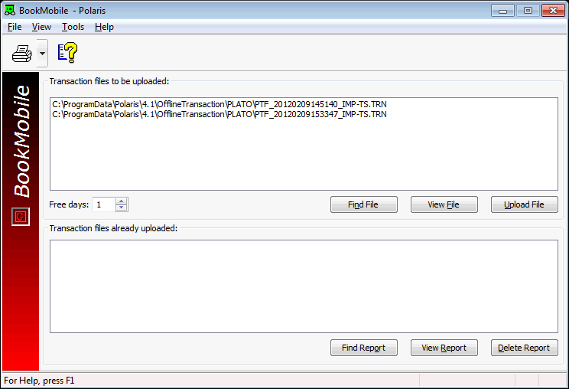

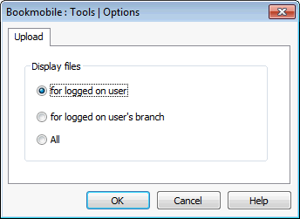
Uploading Offline Transaction Files
The BookMobile workform opens…
If there are no files in the Transaction files to be uploaded box, go to Tools | Options on the BookMobile workform to find files by:
  Logged on user
  Logged on user’s branch
  All

Slide 19
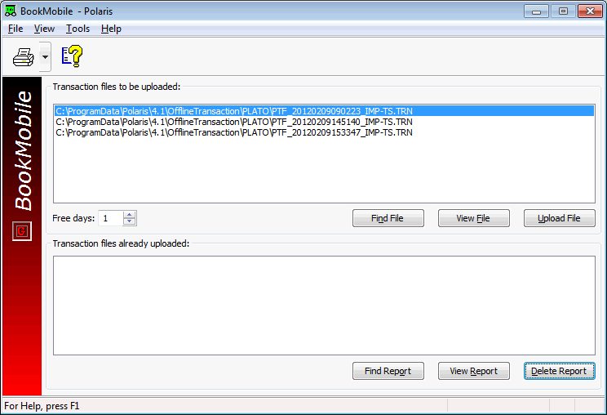
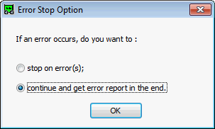
Uploading Offline Transaction Files
If performing manual upload, each workstation’s files must be uploaded in date and time stamp order (the file name includes the date and time stamp).
If check in was done, set the number of Free Days desired.
Highlight a .trn file and click Upload File.
Determine the Error Stop Option.
After a few .trn files have been uploaded and reviewed, it is possible to multi-select files for upload.

Slide 20
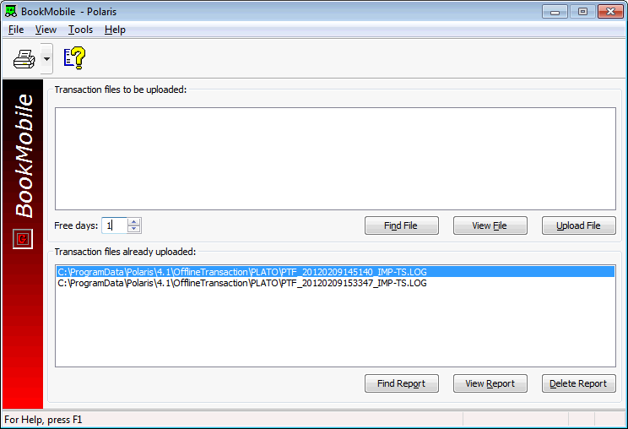
Uploading Offline Transaction Files
After the file is uploaded, it will appear in the Transaction files already uploaded box and will have a .log extension.
Highlight the file that has been uploaded and select View Report.
If using Automatic Offline Processing to upload .trn files, one report per branch will be automatically emailed to a specified staff member.

Slide 21
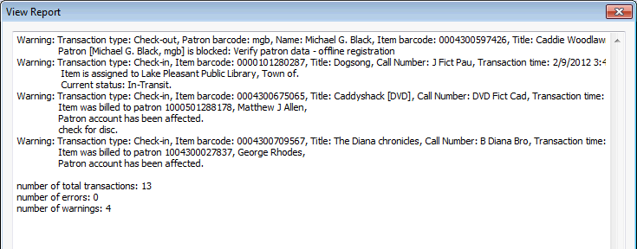
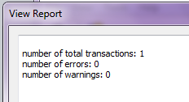
Reviewing Reports
When viewing reports, you may see a very small file where the number of transactions, errors, and warnings is provided.
Other files may have error and warning details:
  A warning still allows the transaction to go through.
  Carefully review errors as a resolution should take place.
  The total error rate should be 5% or less.

Slide 22


Forename Surname
forename.surname@clarivate.com
+000 000-0000
About Clarivate
Clarivate is a leading global provider of transformative intelligence. We offer enriched data,
insights & analytics, workflow solutions and expert services in the areas of Academia & Government, Intellectual Property and Life Sciences & Healthcare. For more information, please visit clarivate.com.
© 2025 Clarivate. All rights reserved
Clarivate and its logo, as well as all other trademarks used herein are trademarks of their respective owners and used under license.

