Slide 1

Polaris Offline Circulation Leap

Slide 2
Important System Admin Settings
In Parameters > Patron Services, Enable automatic offline uploading should be set to Yes.
Polaris user for automatic upload should be PolarisExec.

Slide 3
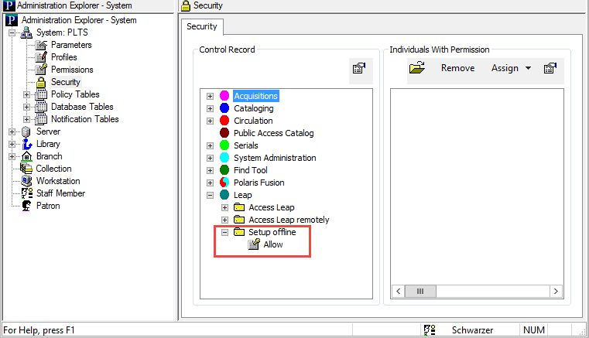
Leap Offline Setup Permission
In the Polaris Staff Client, go to Administration Explorer and select Security > Leap > Setup offline > Allow.

Slide 4
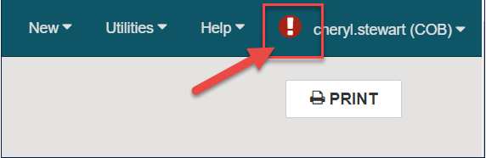
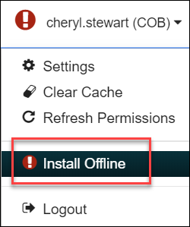

Installing Leap Offline
You must have the Leap Offline permission enabled and use a compatible web browser to install the application (Not compatible with IE).
If Leap Offline has not been previously installed, you will see an installation warning icon (exclamation mark). To install, select the warning icon.
Click on Install Offline. A temporary Installing offline files… will display.

Slide 5

Installing Leap Offline
Once files are installed a confirmation message on a green background will display.
Click on the Leap Offline link.
It is very important to bookmark this page for easy accessibility in the future when offline circulation is needed.

Slide 6
Accessing Leap Offline
To open Leap Offline, go to the bookmarked URL.
You can directly type the URL, but it is case sensitive.
Example: https://--servername--/leapoffline/#/checkout

Slide 7
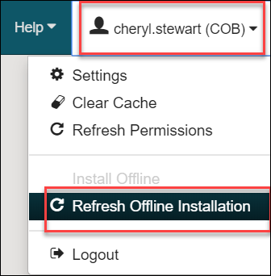
Refreshing Leap Offline Installation
Leap Offline will open in the browser.
Select Refresh Offline Installation.
Refreshing the installation updates:
User ID
Username
Workstation ID
Workstation Branch ID
Workstation Name
Branch ID
Standard Loan Period
Branch Name
Branch Phone
Branch Home Page
Branch Receipt Note
Locale Name

Slide 8
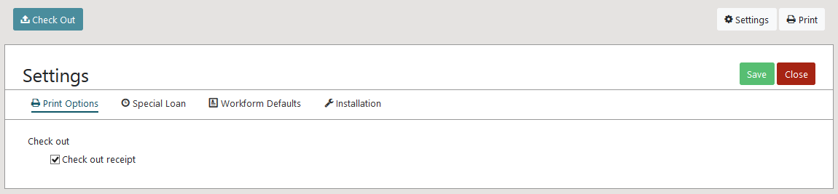
Leap Offline Settings: Print Options
This setting is used to choose whether to print a receipt.

Slide 9
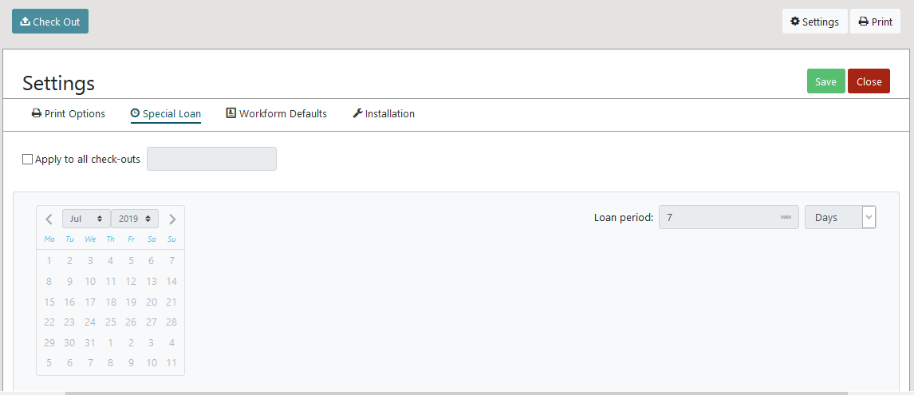
Leap Offline Settings: Special Loan
This setting allows a specific loan period to be set.
It may be applied to all checkouts, overriding the default set in System Administration.

Slide 10
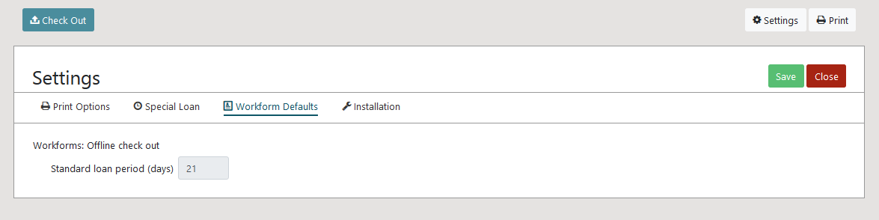
Leap Offline Settings: Workform Defaults
This setting shows the standard loan period that will be applied to all the checkouts (if Special Loan is not used).

Slide 11
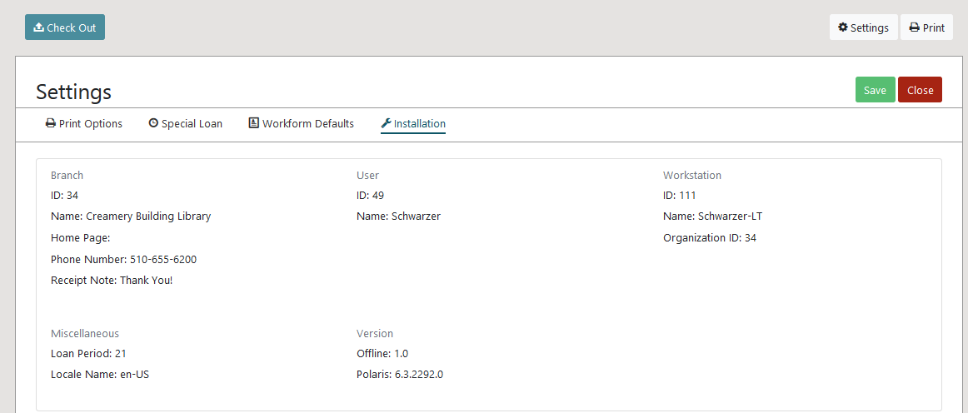
Leap Offline Settings: Installation
This setting displays Leap Offline installation values.

Slide 12
Leap Offline Circulation: Check Out
Scan the patron’s barcode.
Note: No additional patron data will be stored locally.
As item barcodes are scanned in, only the barcode can be seen and the due date is calculated per a default set in SA.
After scanning all items, select Complete button to finish the checkout and print a receipt.
This will clear everything so you can check items out to the next patron.

Slide 13
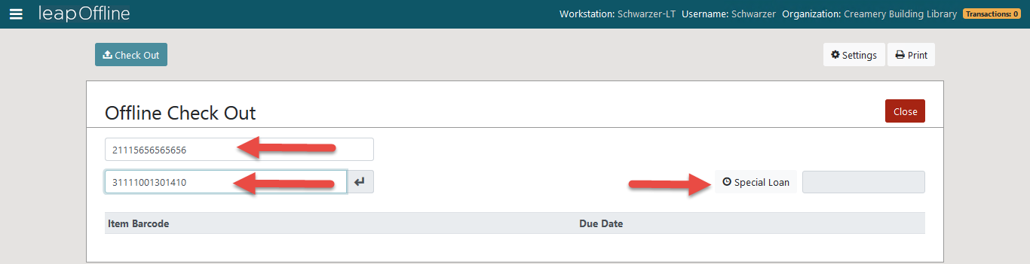
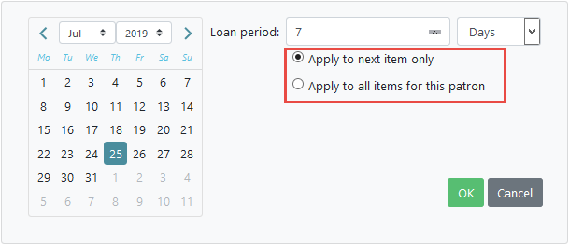
Leap Offline Circulation: Check Out
If a different due date is needed, you can use Special Loan to set a different date before scanning the item.

Slide 14
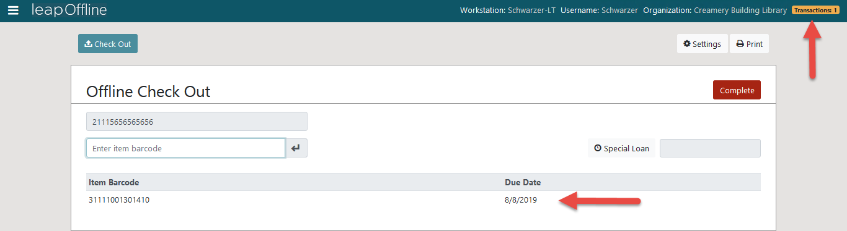
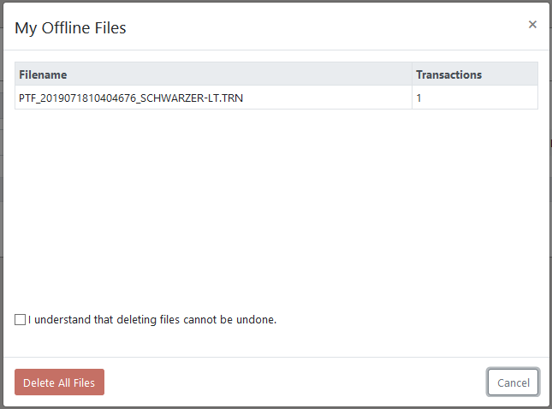
Leap Offline Circulation: Check Out
Offline transactions are stored in the local storage of the user's browser until the user chooses to send them to the server for processing or delete them.
As you work in Leap Offline, you will see your transaction count increase with each check out. The Transactions badge will keep you informed of your progress.
Selecting Transactions opens a dialog showing all of the offline transaction files you have generated along with an option to delete them. Deleting files cannot be undone.
Staff will not see patron or item blocks or any patron data.

Slide 15

Once Back Online/Connected to Server
When connection to your server has been restored, log in to Leap.
If you have unprocessed offline transactions, you will see the following message:

Slide 16
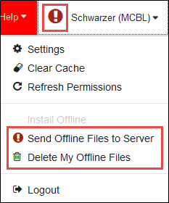

Transaction Files
The user profile is set to the warning icon. Select the icon to access options to process offline transactions.
Send Offline Files to Server sends all unprocessed offline transactions to the server for processing. All transactions sent to the server will be processed and uploaded using the Automatic Offline Upload process.
Delete My Offline Files deletes all unprocessed offline transactions from the browser. The deleted transactions cannot be recovered.
After selecting Send Offline Files to Server, Leap displays a status pop-up.

Slide 17
Automatic Offline Processing
An SQL needs to be enabled to run automatically (or be run manually) after an offline period.
This should be set up or taken care of by system administrators.
Once the SQL job runs, you will see the transactions on the patron’s account.

Slide 18


Forename Surname
forename.surname@clarivate.com
+000 000-0000
About Clarivate
Clarivate is a leading global provider of transformative intelligence. We offer enriched data, insights & analytics, workflow solutions and expert services in the areas of Academia & Government, Intellectual Property and Life Sciences & Healthcare. For more information, please visit clarivate.com.
© 2025 Clarivate. All rights reserved
Clarivate and its logo, as well as all other trademarks used herein are trademarks of their respective owners and used under license.

