Slide 1

Polaris Outreach Services

Slide 2
Outreach Services Setup
Outreach services overview
System Administration Settings
Setting up ORS Policy Tables
Setting up ORS Parameters

Slide 3
System Admin Settings: Outreach Policy
Automates title selection and delivery for homebound and/or other designated patrons or institutions
Allows for individual patron profiles based on reading preferences, delivery mode and other characteristics
Allows for generation of selections lists for individual or multiple patrons or institutions
Allows outreach patrons to submit reader ratings
Can be set up at the system, library or branch level

Slide 4
Outreach Services Overview
Automates title selection and delivery for homebound and/or other designated patrons or institutions
Allows for individual patron profiles based on reading preferences, delivery mode and other characteristics
Allows for generation of selections lists for individual or multiple patrons or institutions
Allows outreach patrons to submit reader ratings
Can be set up at the system, library or branch level

Slide 5
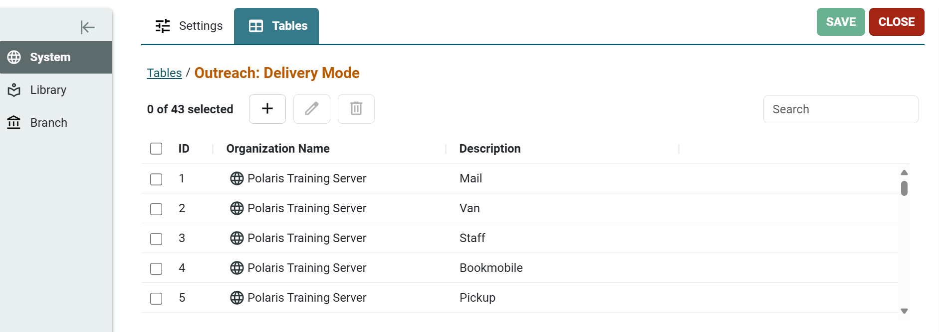
System Administration Settings: Outreach Table Options
To set the Delivery Mode in System Administration, go to Settings & Tables > Tables
Choose System, Library, or Branch.
Search for Outreach.
Choose the Outreach: Delivery Mode table.
Enter the options the library has chosen.
Note: Delivery Mode is not required, but it provides a dropdown menu during patron setup.

Slide 6
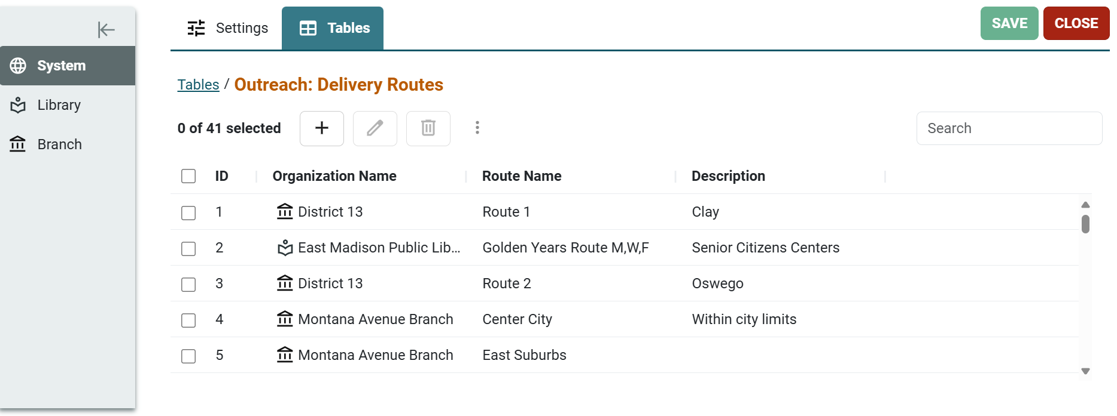
System Administration Settings: Outreach Table Options
To set Delivery Routes in System Administration, go to Settings & Tables > Tables.
Choose System, Library, or Branch.
Search for Outreach.
Choose the Outreach: Delivery Routes table.
Clicking on the route name gives you the stops table for adding individual stops (this appears at the bottom of the screen).
Note: Delivery Routes is not required, but it provides a dropdown menu during patron set up.

Slide 7
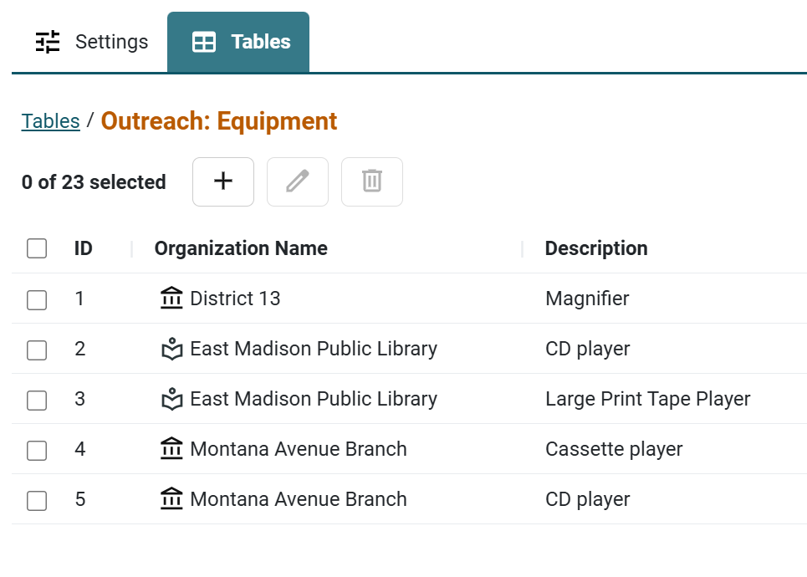
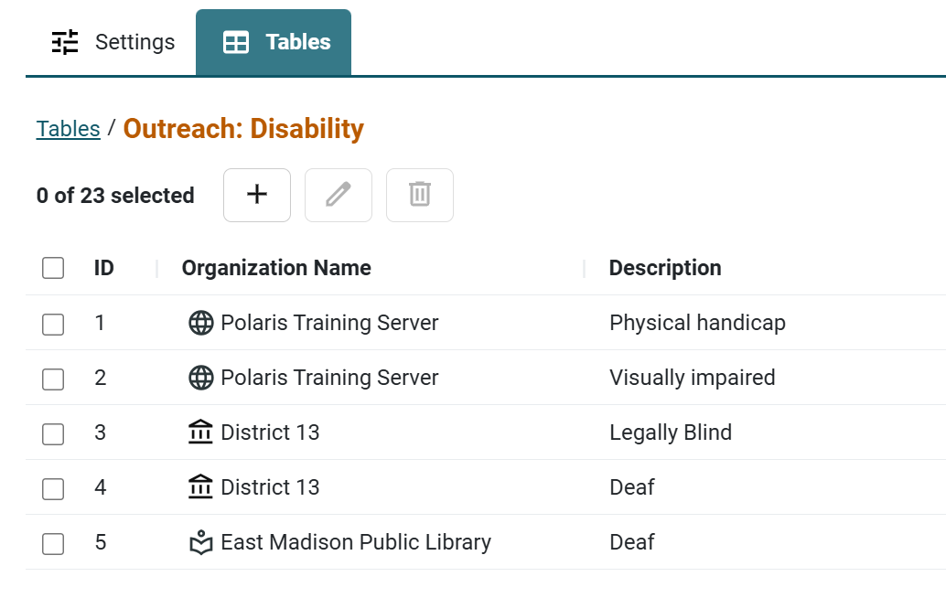
System Administration Settings: Outreach Table Options
There are also two tables (also optional) that allow you to add
Disability
Equipment

Slide 8
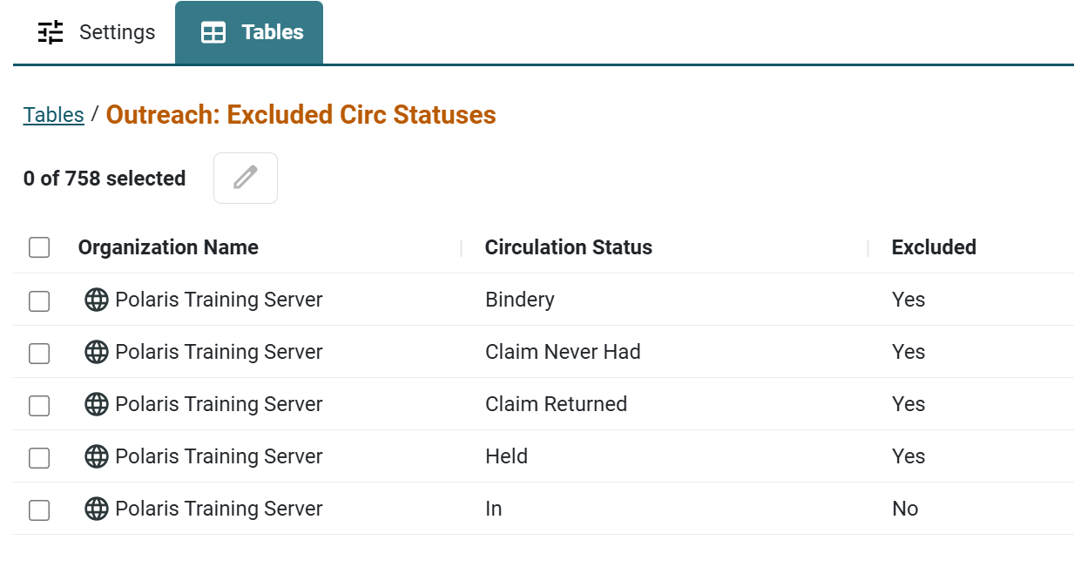
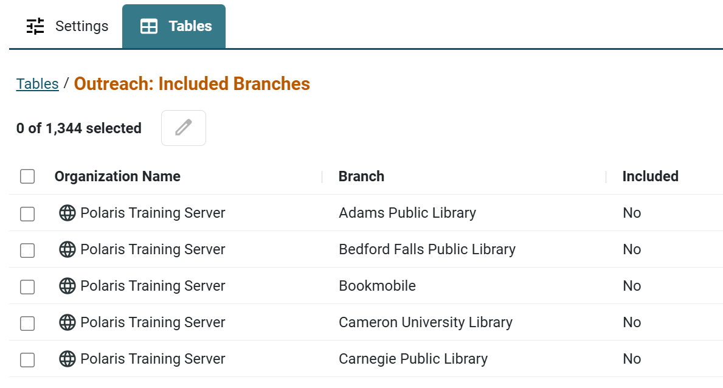
System Administration Settings: Outreach Table Options
Outreach: Excluded Circ Statuses controls which circulation statuses to exclude (yes) or include (no) from the selection lists.
Outreach: Included Branches allows you to select which (other) branches’ materials are included in the selection list.

Slide 9
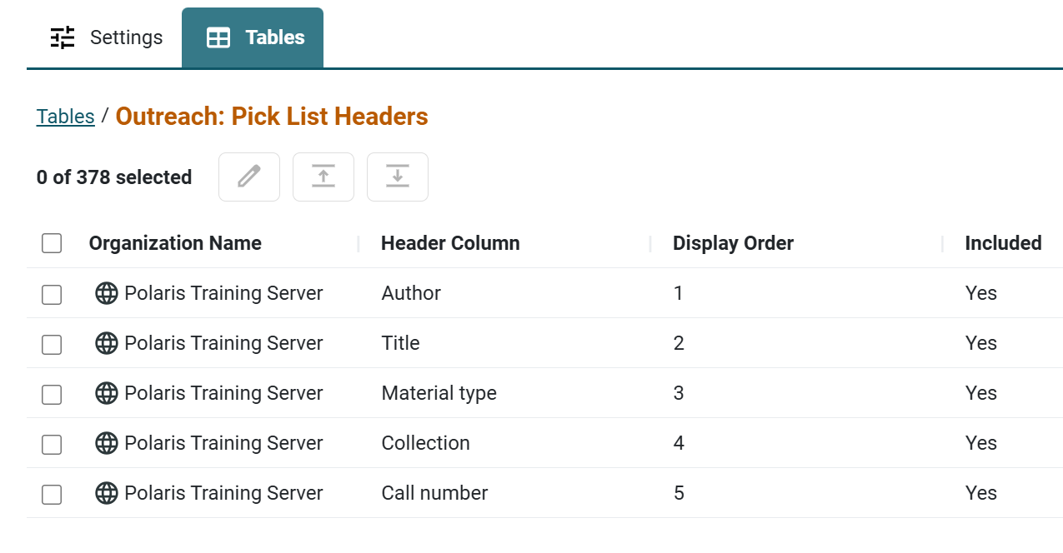
System Administration Settings: Outreach Table Options
Outreach: Pick List Headers indicates which columns should be included in the pick list.
The display order can be changed.
Table entries cannot be added or deleted.

Slide 10
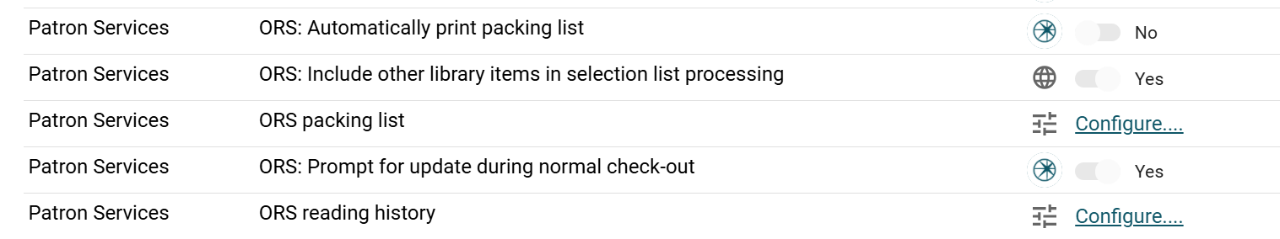
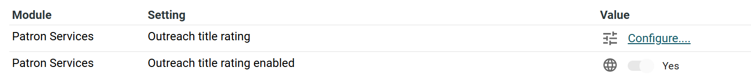
System Administration Settings: Outreach Settings Options
Use the Settings tab and search for Outreach and ORS to find all applicable outreach settings.
These settings control reading history limits, automatic printing of packing lists, and whether to prompt for outreach update under normal check out.

Slide 11
System Administration Settings: Outreach Settings Options
ORS: Include other library items in selection list processing may be set to Yes ,and if yes is chosen, this setting will use the Outreach: Included Branches table.

Slide 12
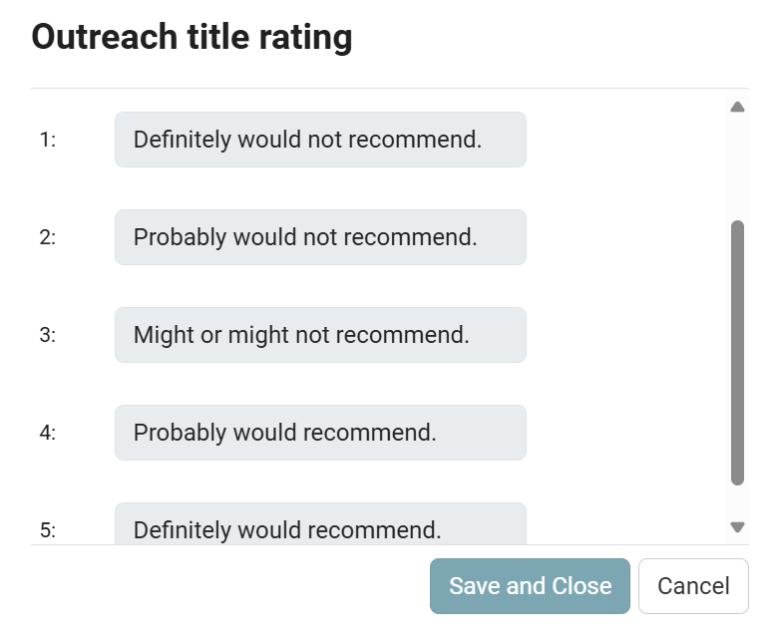
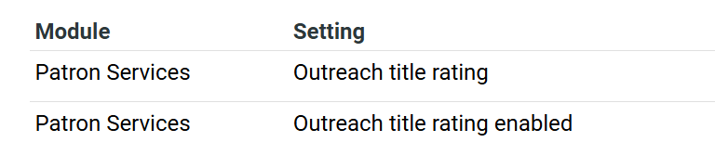
System Administration Settings: Outreach Settings Options
Outreach title rating enabled must be set to Yes to allow staff to enter ratings returned by outreach patrons.
Outreach title rating will allow you to describe your ratings if this option will be used (System level only)

Slide 13
System Administration Settings: Outreach Settings Options
Outreach title rating enabled must be set to Yes to allow staff to enter ratings returned by outreach patrons.
Outreach title rating will allow you to describe your ratings if this option will be used (System level only).

Slide 14
Managing Outreach Services
Creating outreach patron profiles
Processing outreach items for individual patrons
Processing outreach items for multiple patrons
Processing reader ratings
Outreach Reports

Slide 15
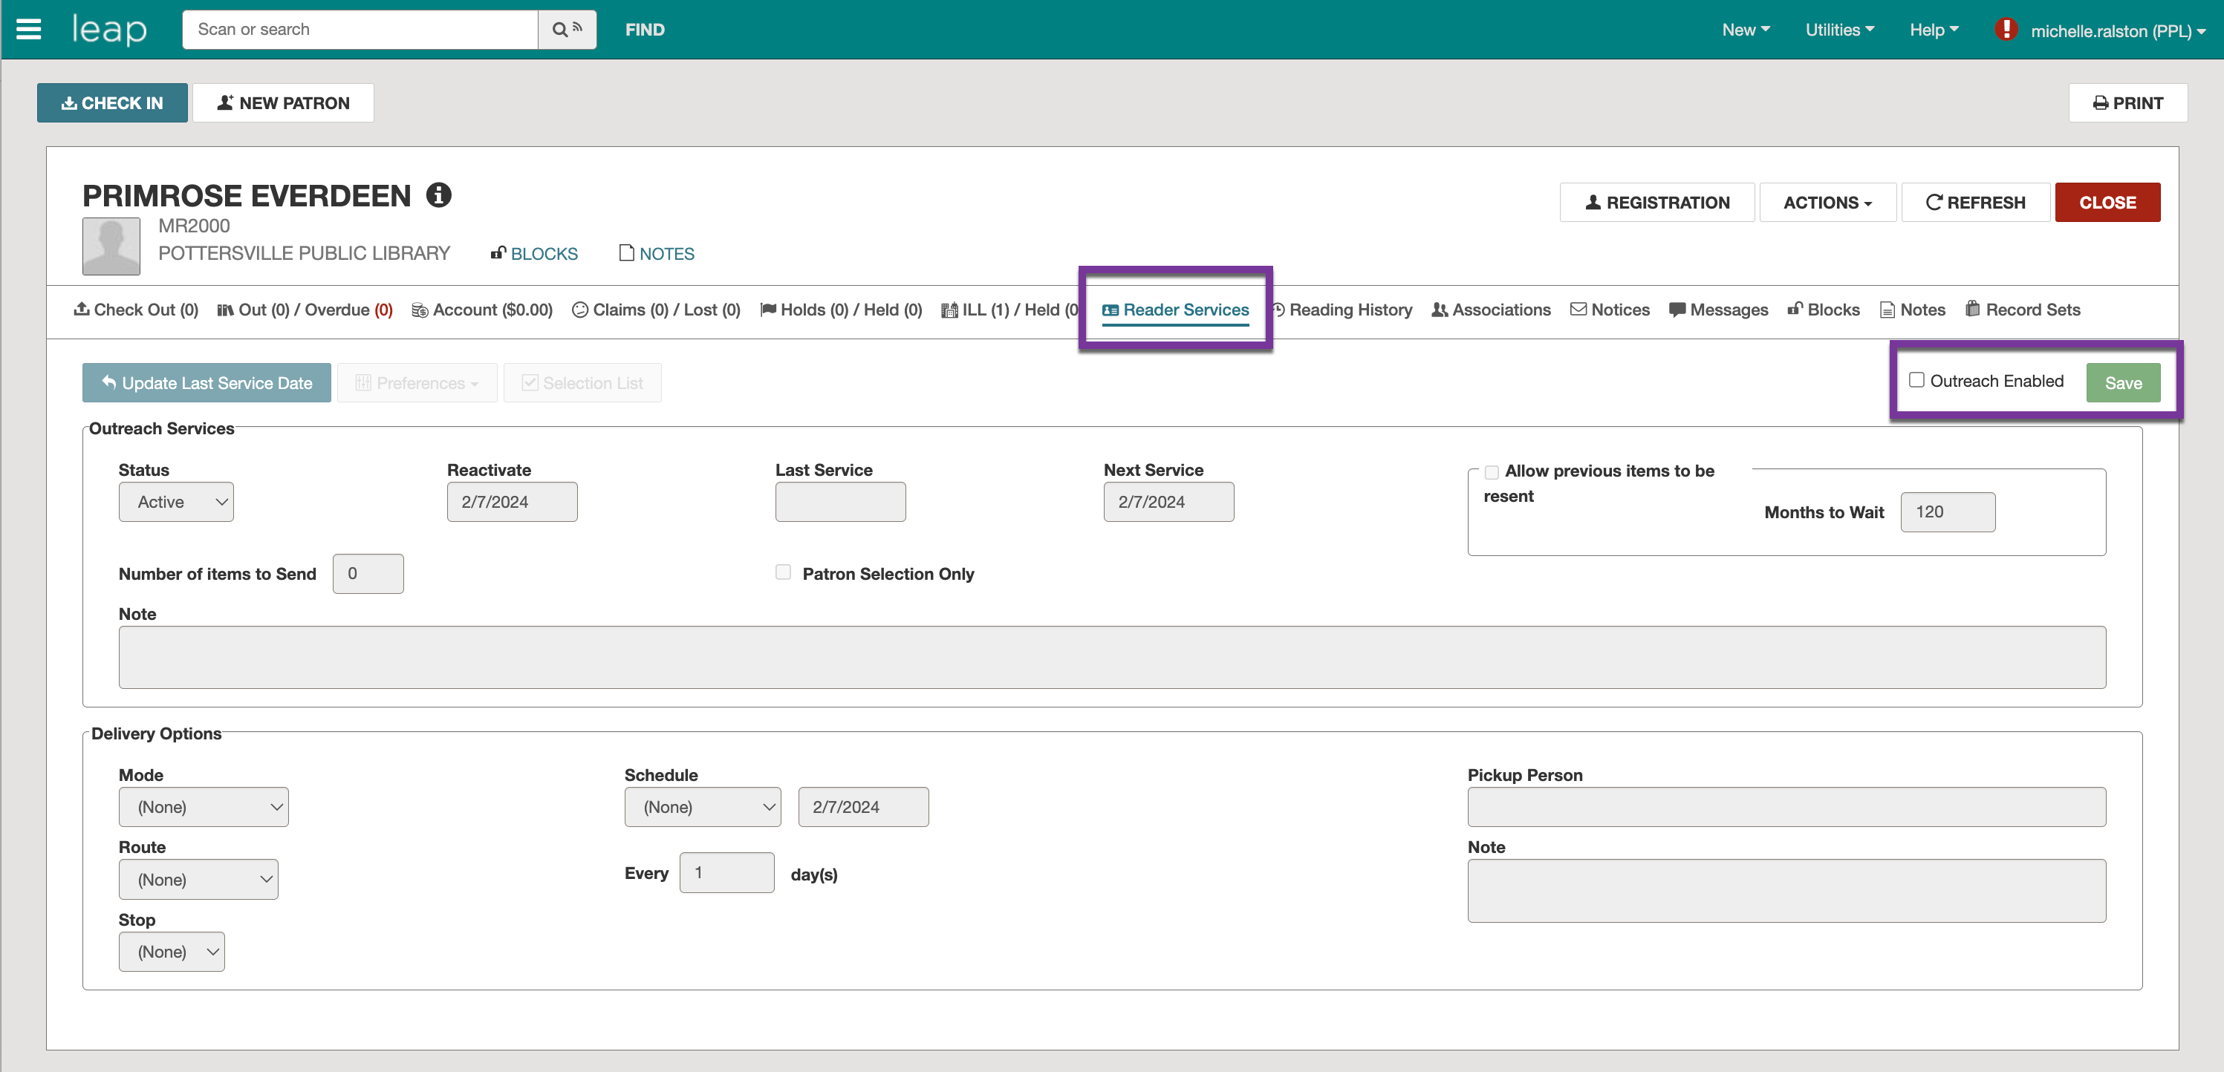
Creating Outreach Patron Profiles
Find the patron and click on the Reader Services tab.
Click on the checkbox next to Outreach Enabled and select SAVE.

Slide 16
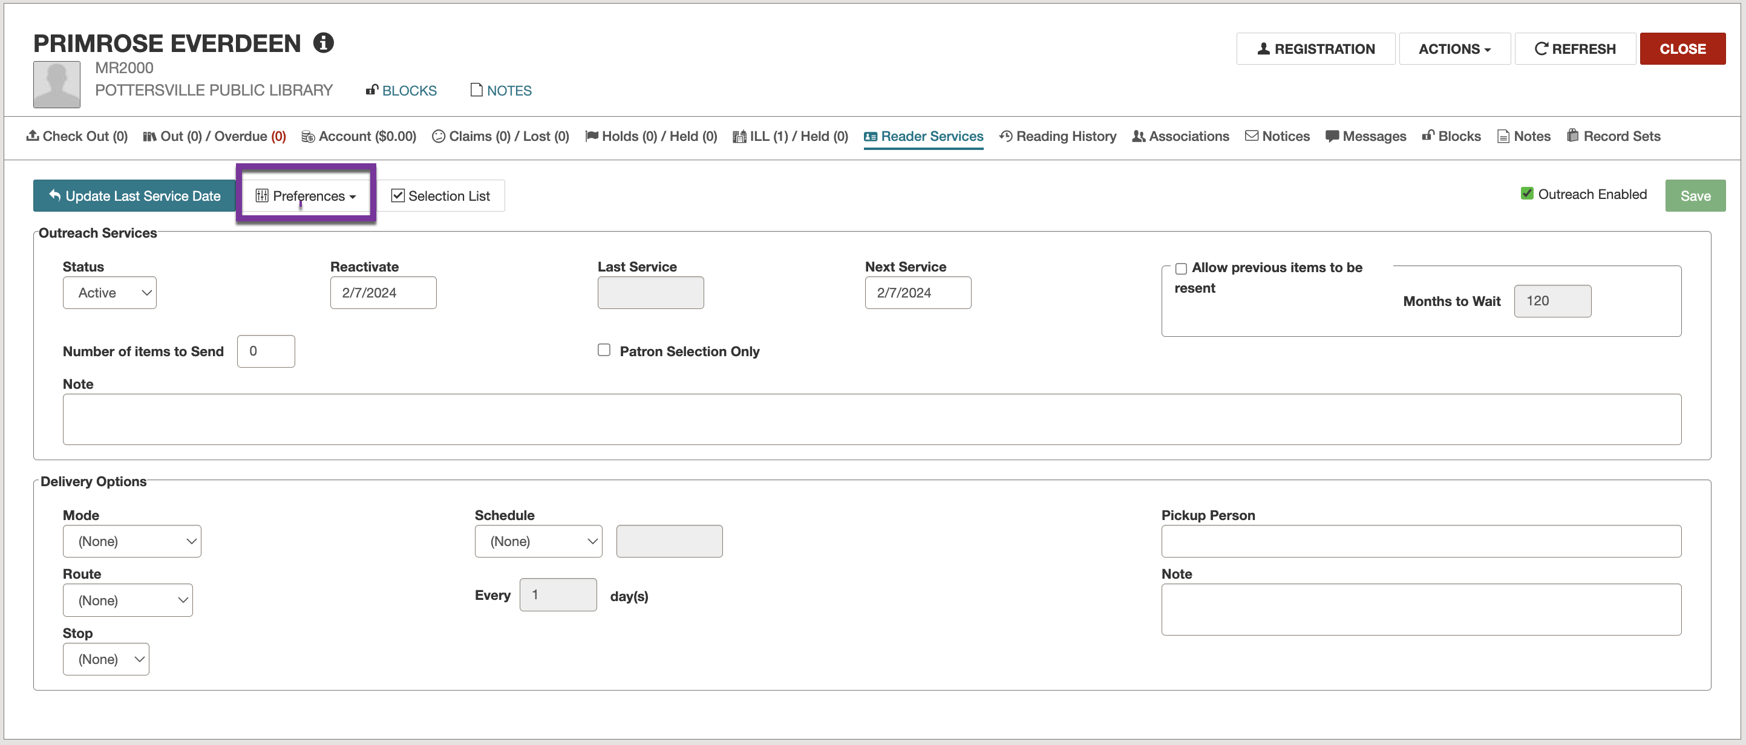
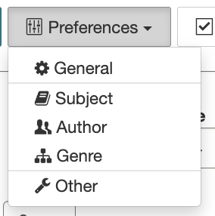
Creating Outreach Patron Profiles
Inside the Reader Services tab, the Preferences button will allow you to set up your patron’s preferences.

Slide 17
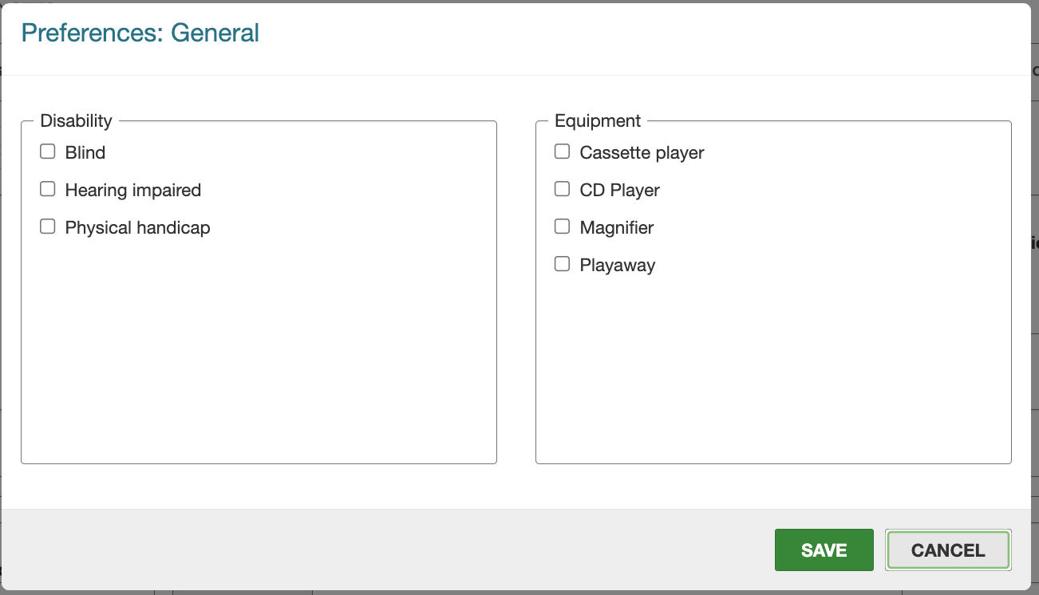
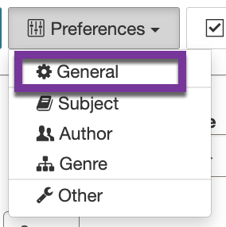
Creating Outreach Patron Profiles
General options are here if you choose to set up these tables.
These are informational only and do not affect the selection list.

Slide 18
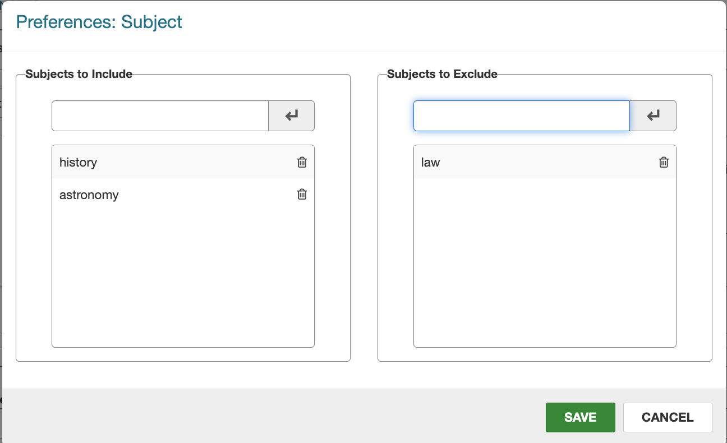
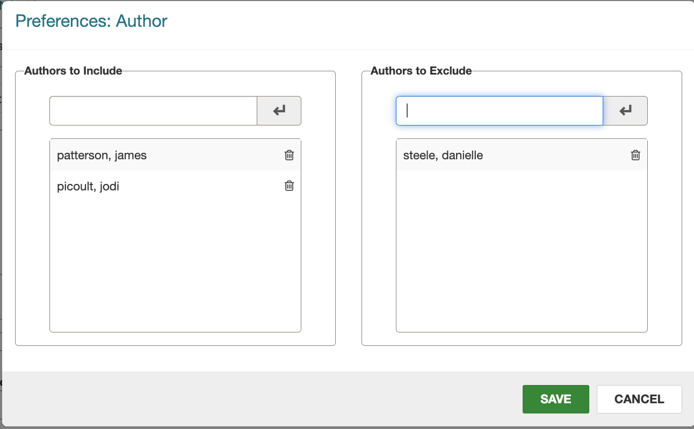
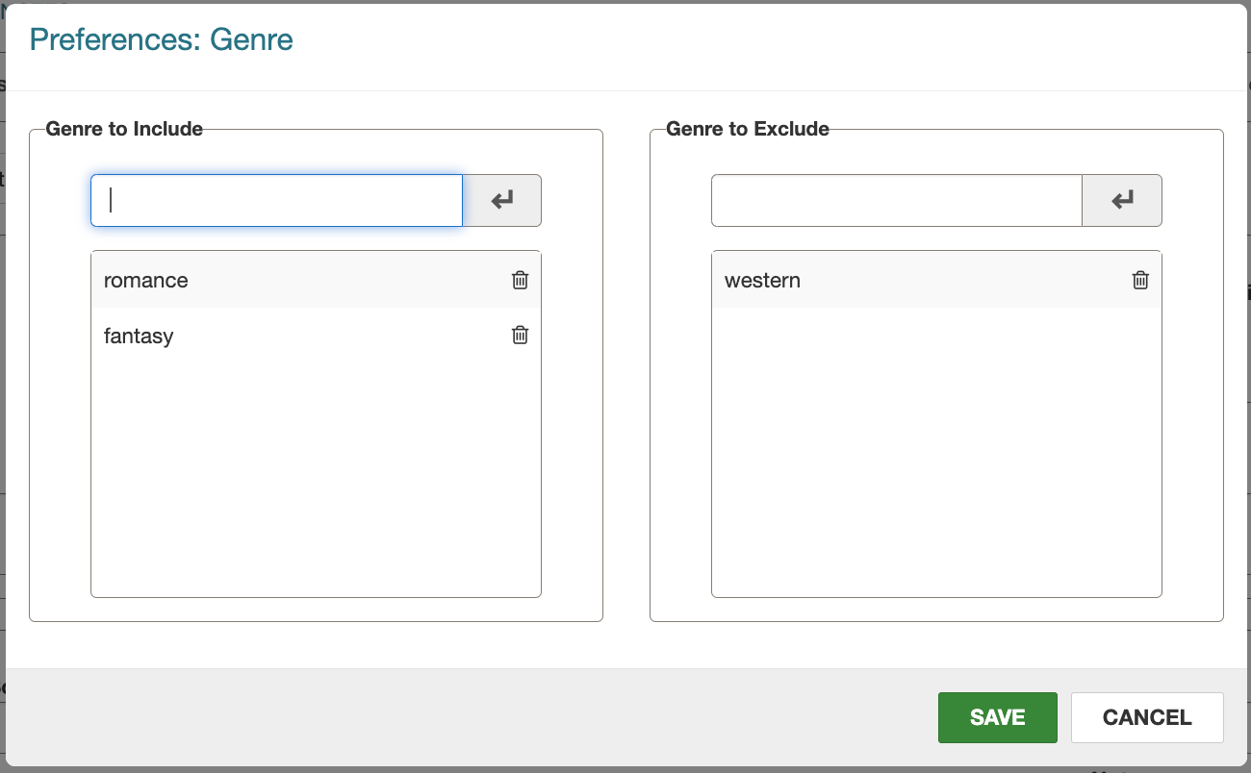
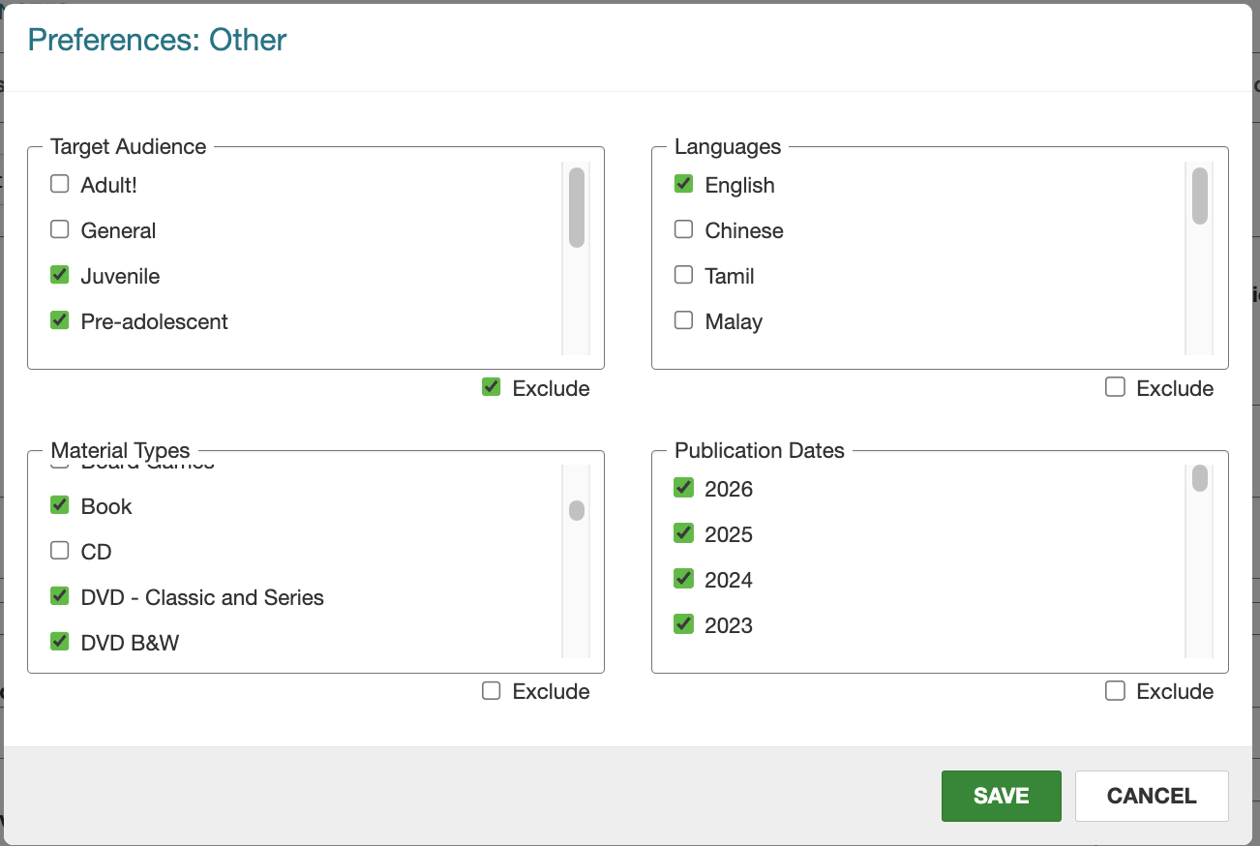
Creating Outreach Patron Profiles
Preferences can be set to include or exclude subjects, authors, genre, target audience, languages, material types, and publication dates.
Multiple word subjects and authors are treated as explicitly truncated phrase searches.
Multiple subjects are treated as “or” searches.
Genre is a keyword search.

Slide 19
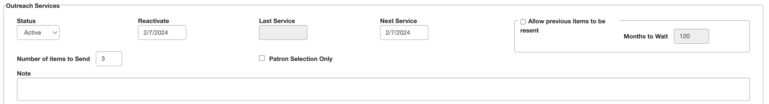
Creating Outreach Patron Profiles
This section shows if the patron is active (with option to change to inactive), the last service date, number of items to send, and if there are any notes.

Slide 20
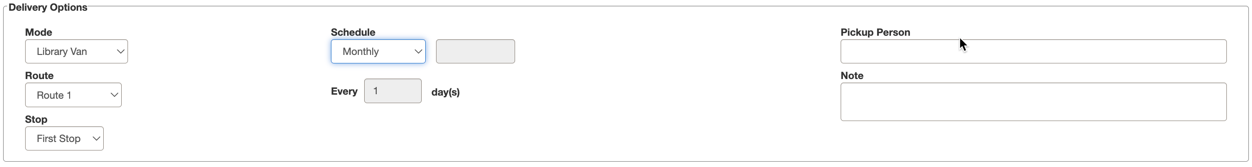
Creating Outreach Patron Profiles
Delivery Options come from the System Administration Delivery Mode and Delivery Routes tables. A schedule period is also assigned here.
These settings are useful when processing items for multiple patrons.
A pickup person can be named and informational notes added.

Slide 21
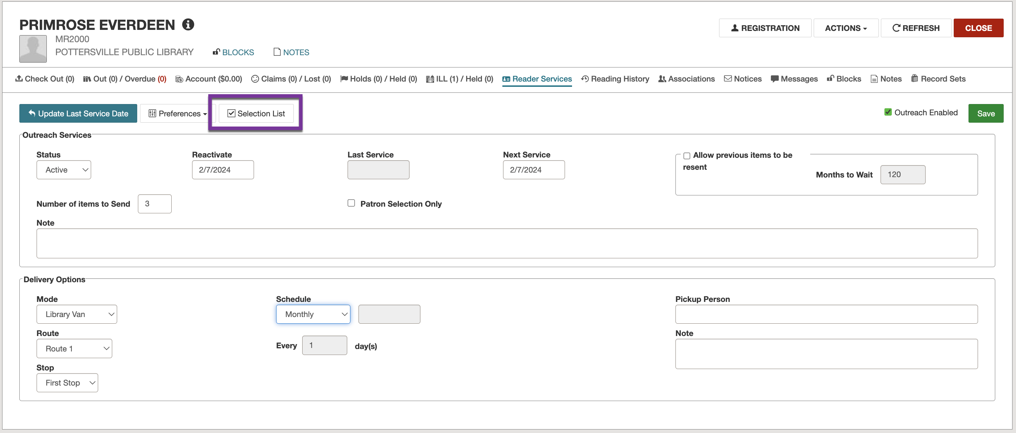
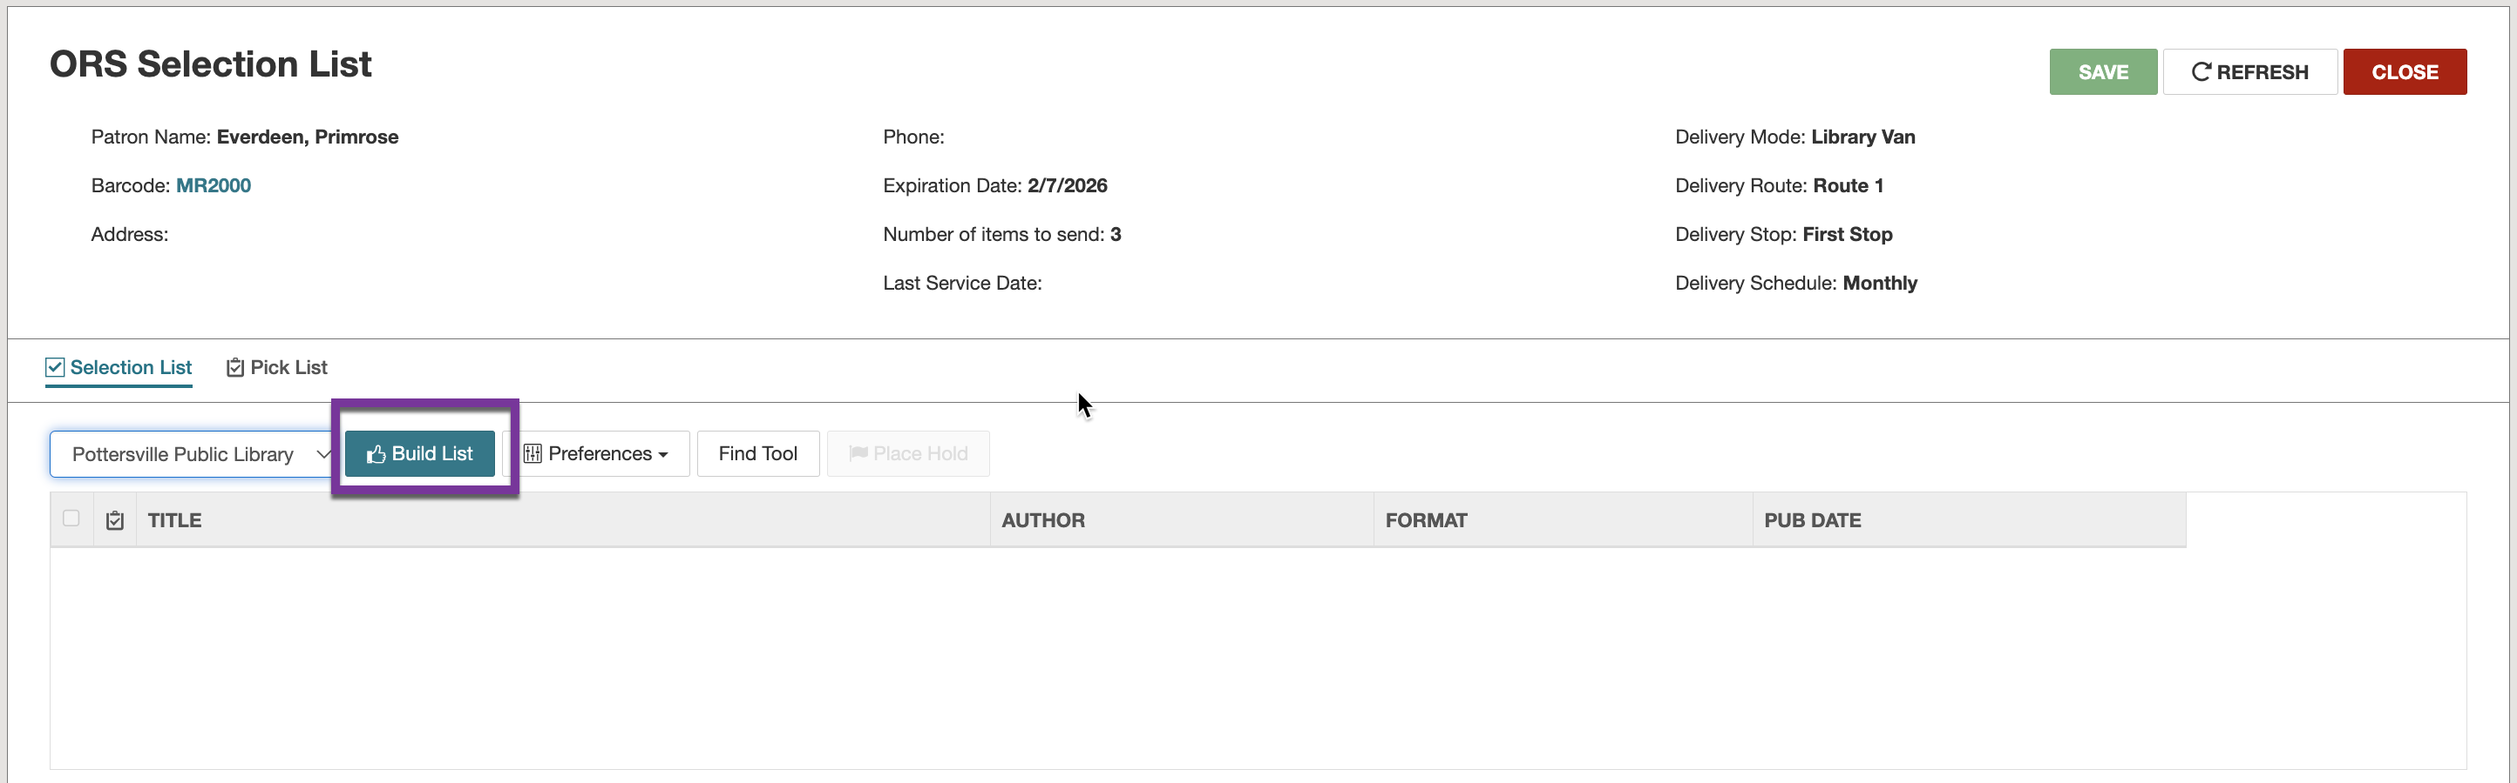
Processing Items for Individual Patrons
Click the Selection List button.
If no items show on the list, click the Build List button.

Slide 22
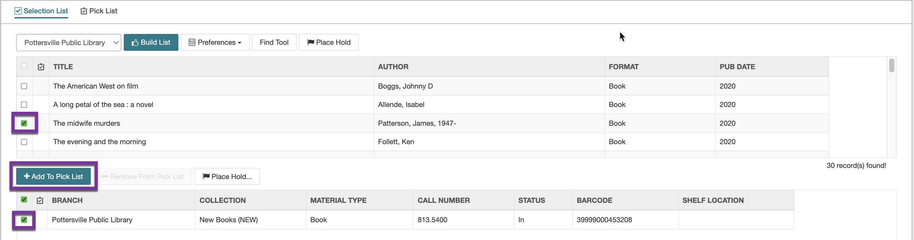
Processing Items for Individual Patrons
Click on the title box and the item(s) will appear below (showing their status).
Click the check box next to the item and then select Add to Pick List.
If the item is not available, you can instead click the Place Hold button.

Slide 23
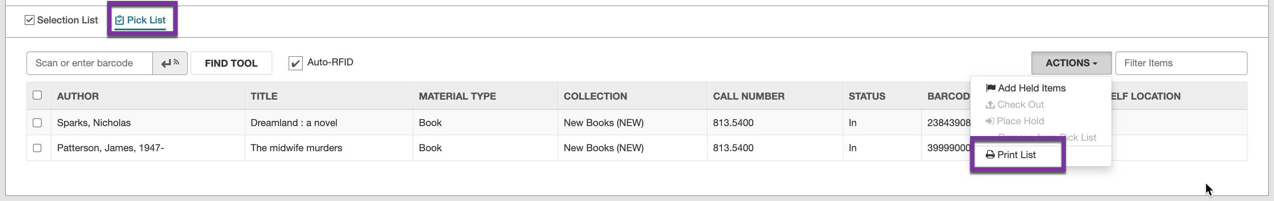
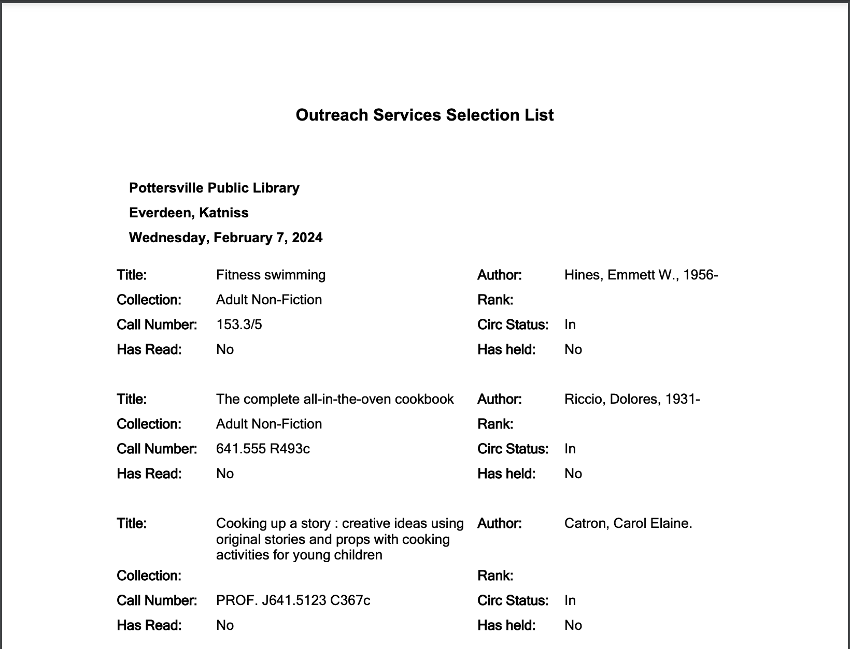
Processing Items for Individual Patrons
Click the Pick List tab.
Select ACTIONS > Print List.

Slide 24
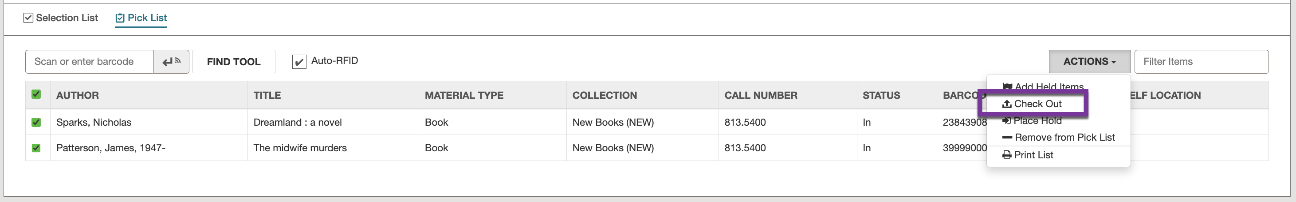
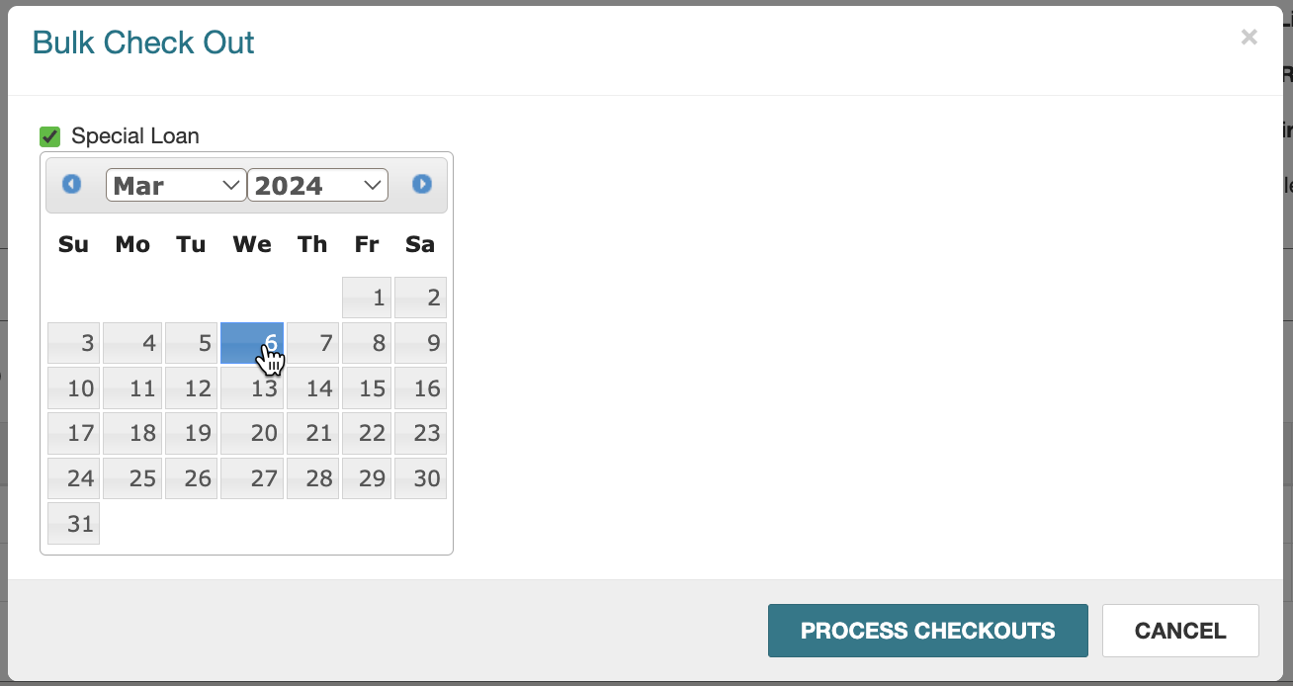
Processing Items for Individual Patrons
Click on all items to be checked out to the patron.
Select ACTIONS > Check Out.
Select the due date and click PROCESS CHECKOUTS.

Slide 25
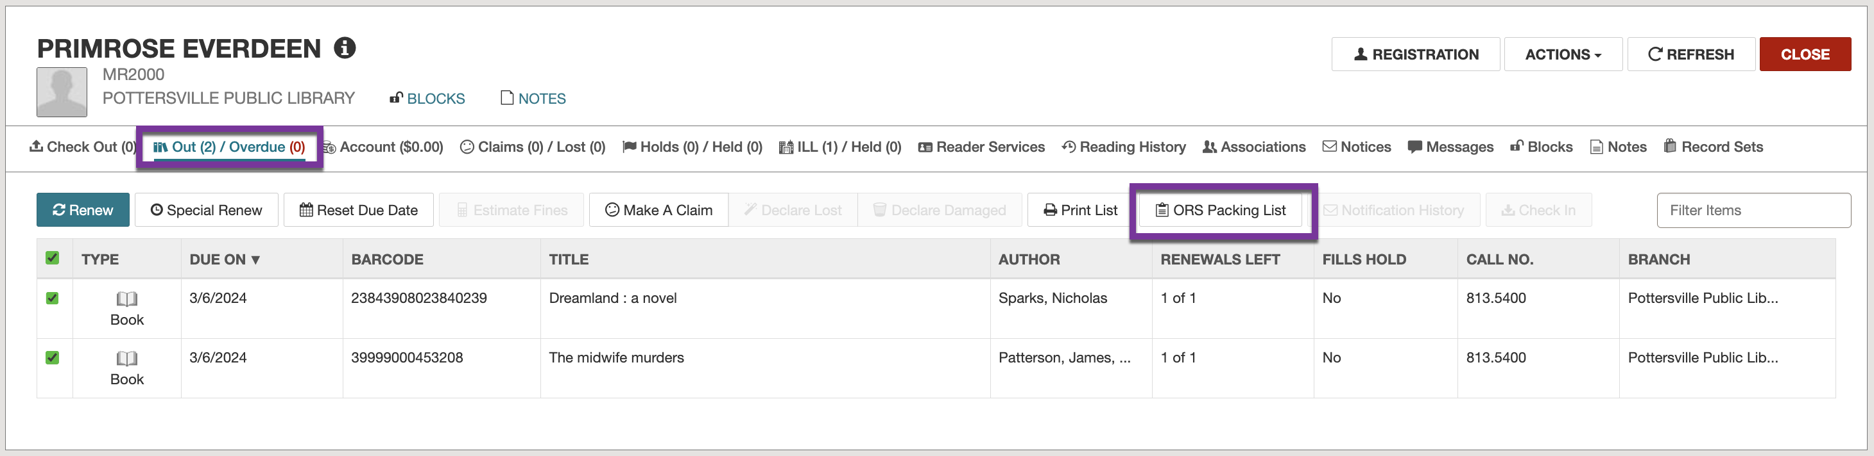
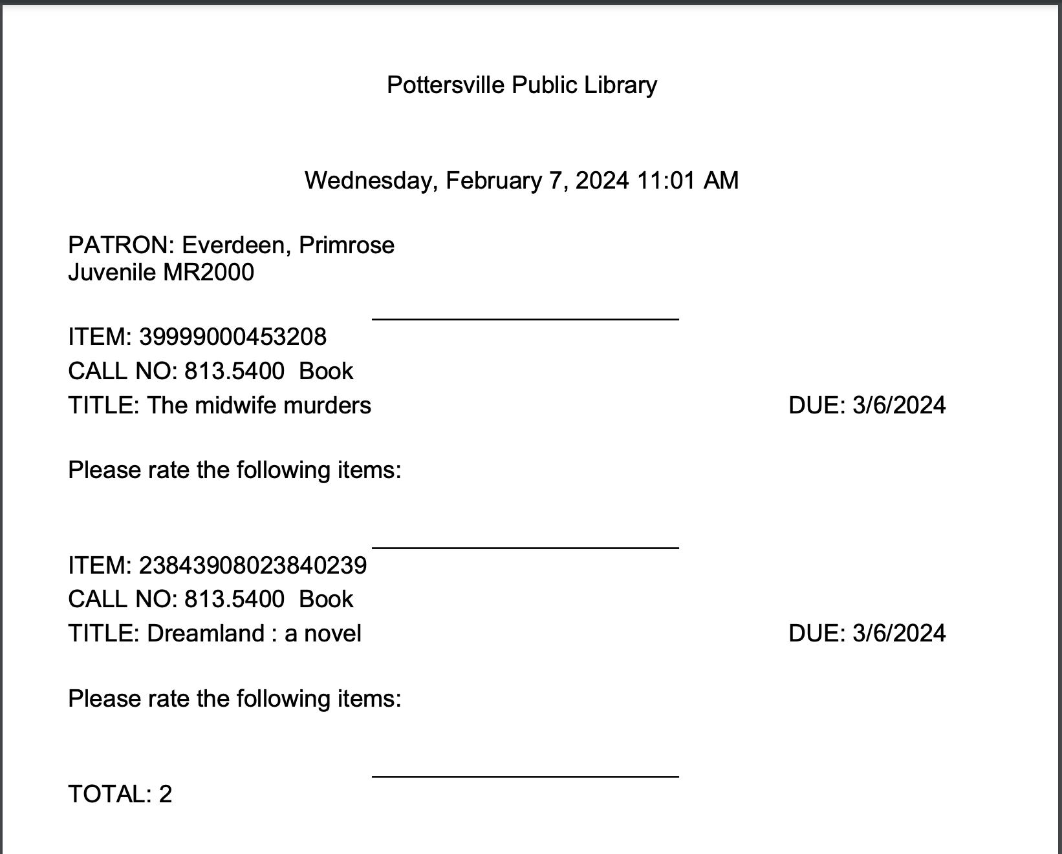
Processing Items for Individual Patrons
Navigate to the patron’s Out/Overdue tab.
Select the items that were just checked out.
Click on ORS Packing List to print.

Slide 26
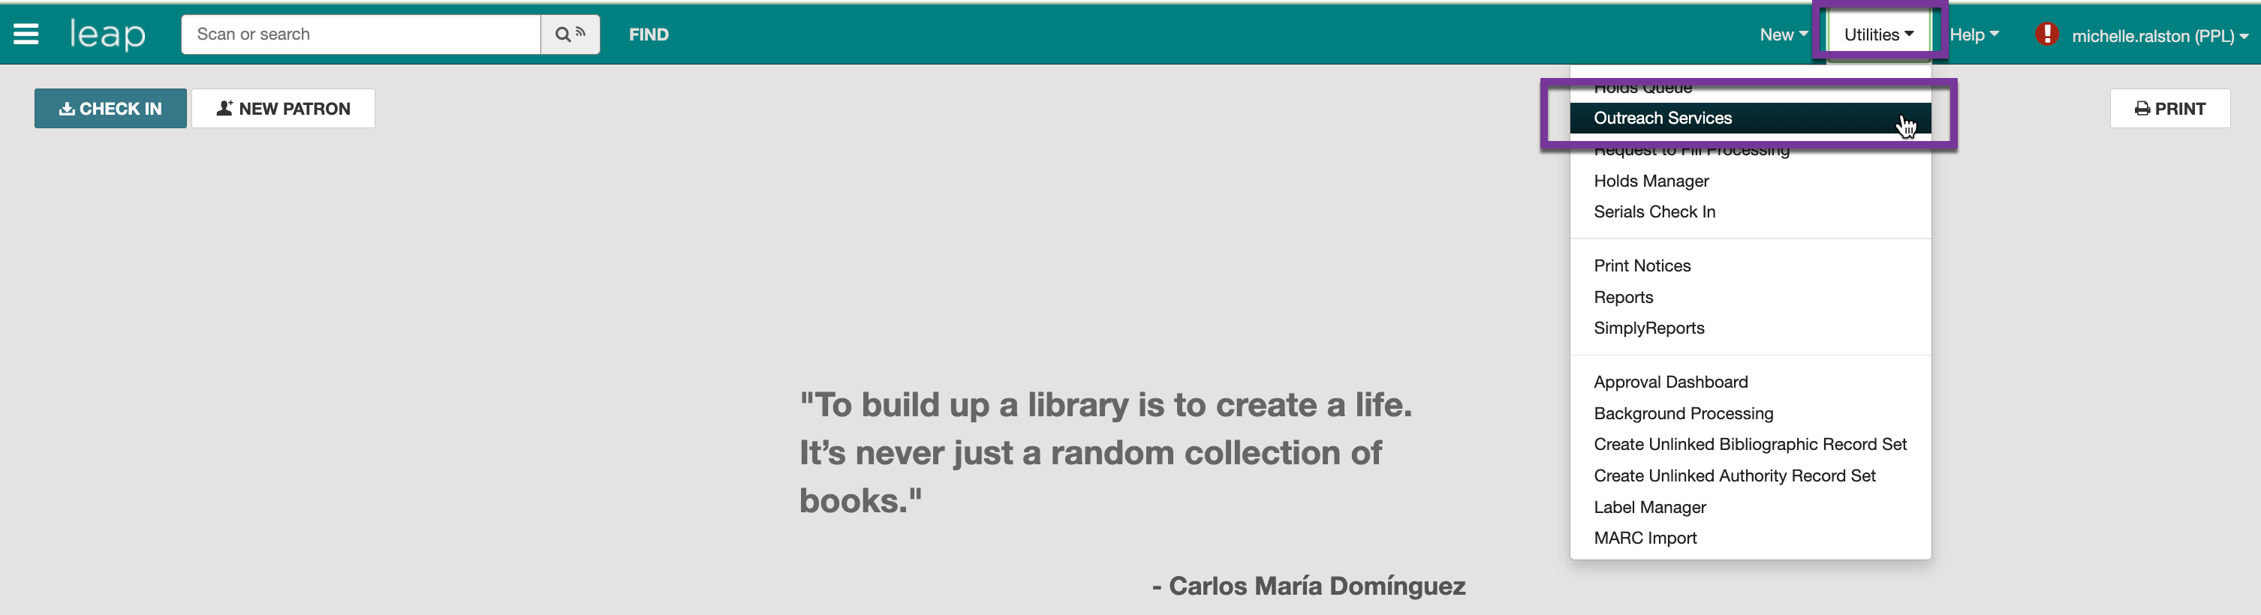
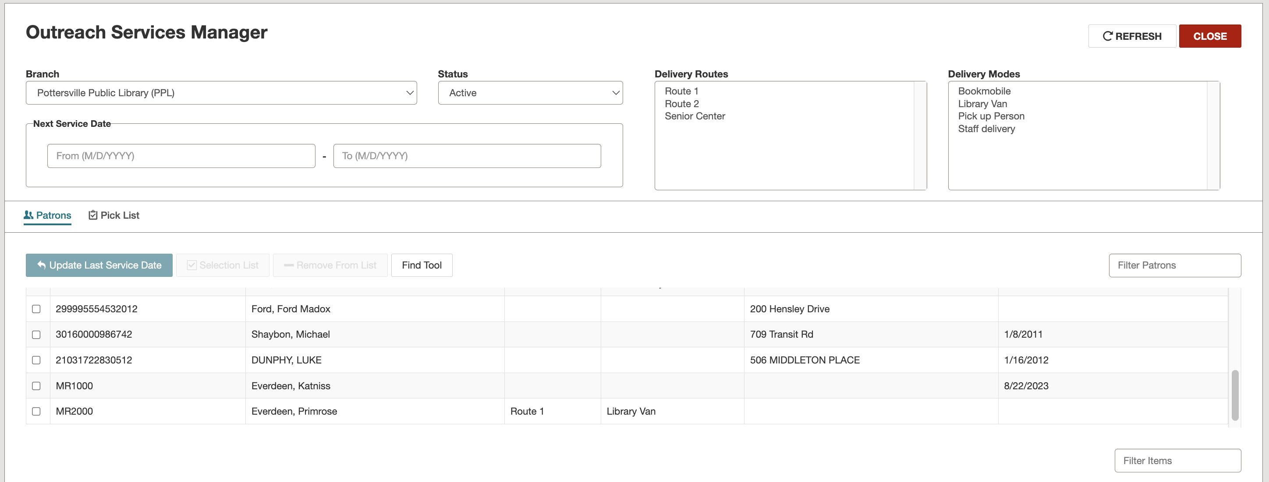
Processing Items for Multiple Patrons
Use Utilities > Outreach Services.
You can use Delivery Routes, Delivery Modes, or Next Service Date to limit patrons of a certain type.

Slide 27
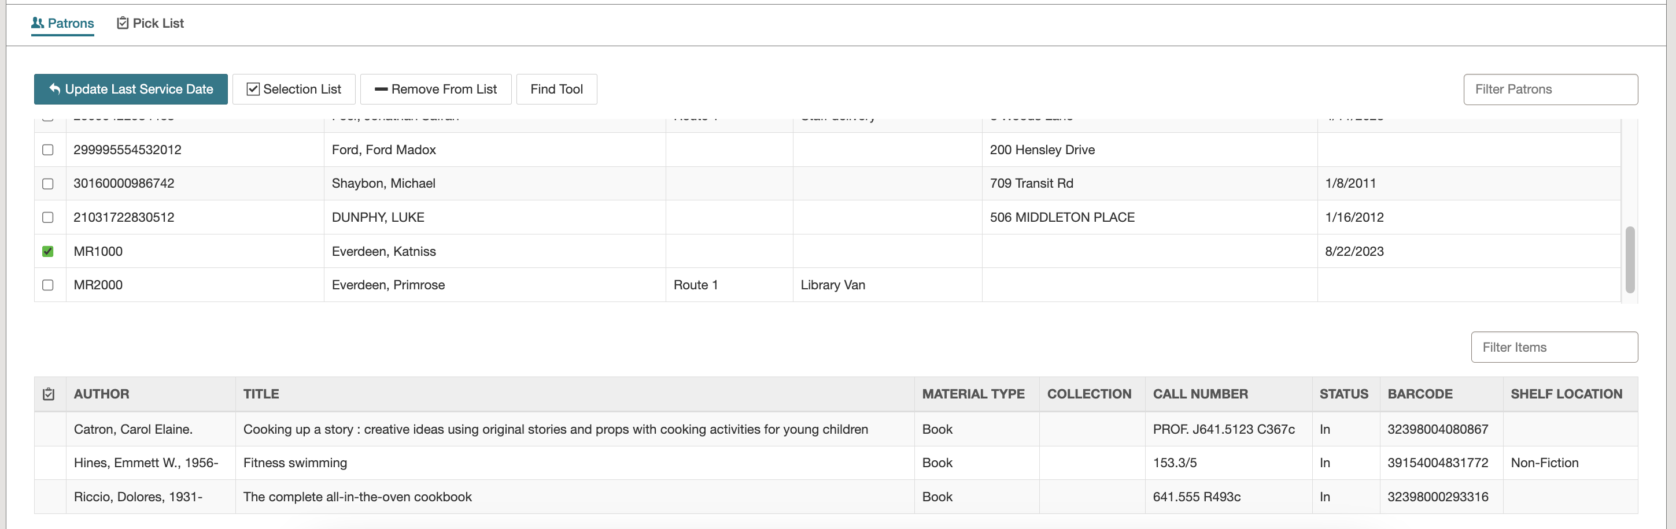
Processing Items for Multiple Patrons
Clicking on a patron will show their Selection List.
If no items show, click on Selection List to build a list for the patron (remember to click SAVE).

Slide 28
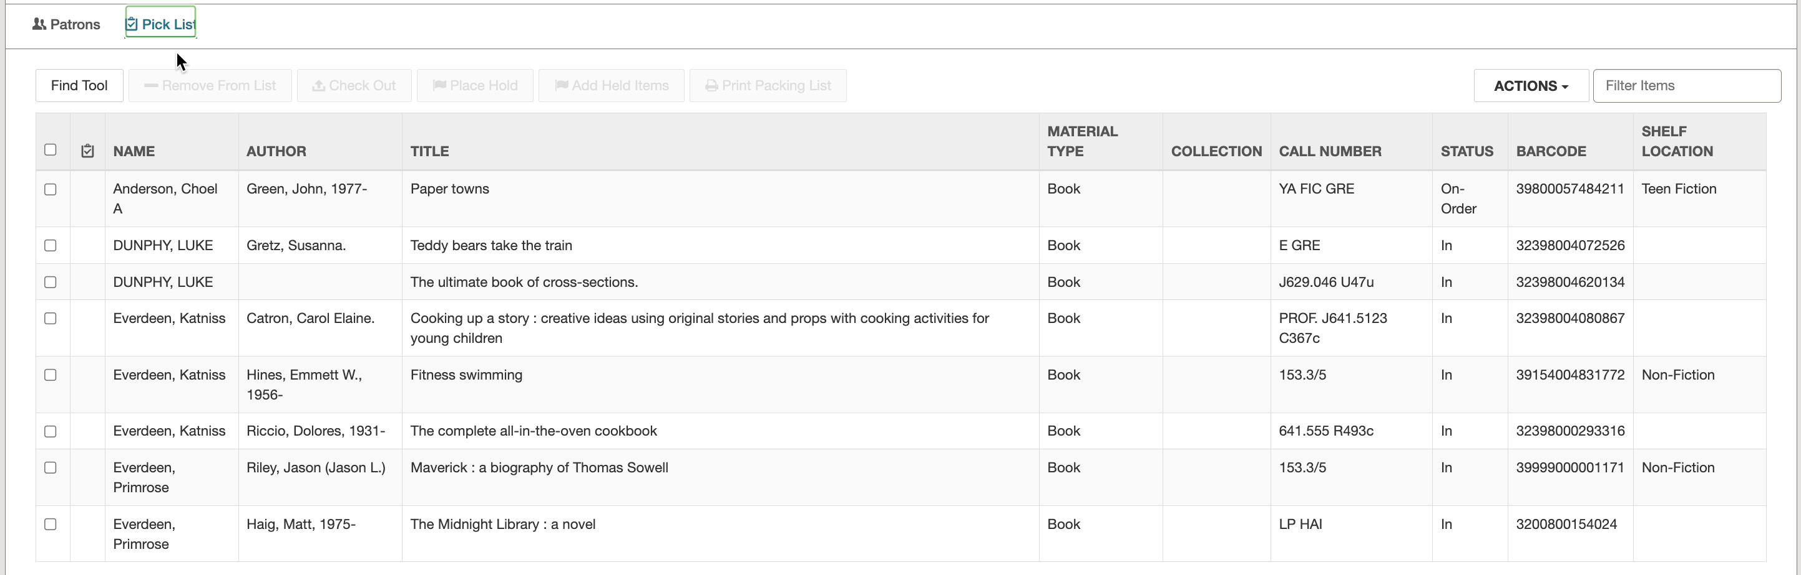
Processing Items for Multiple Patrons
Click the Pick List tab to view all items.

Slide 29
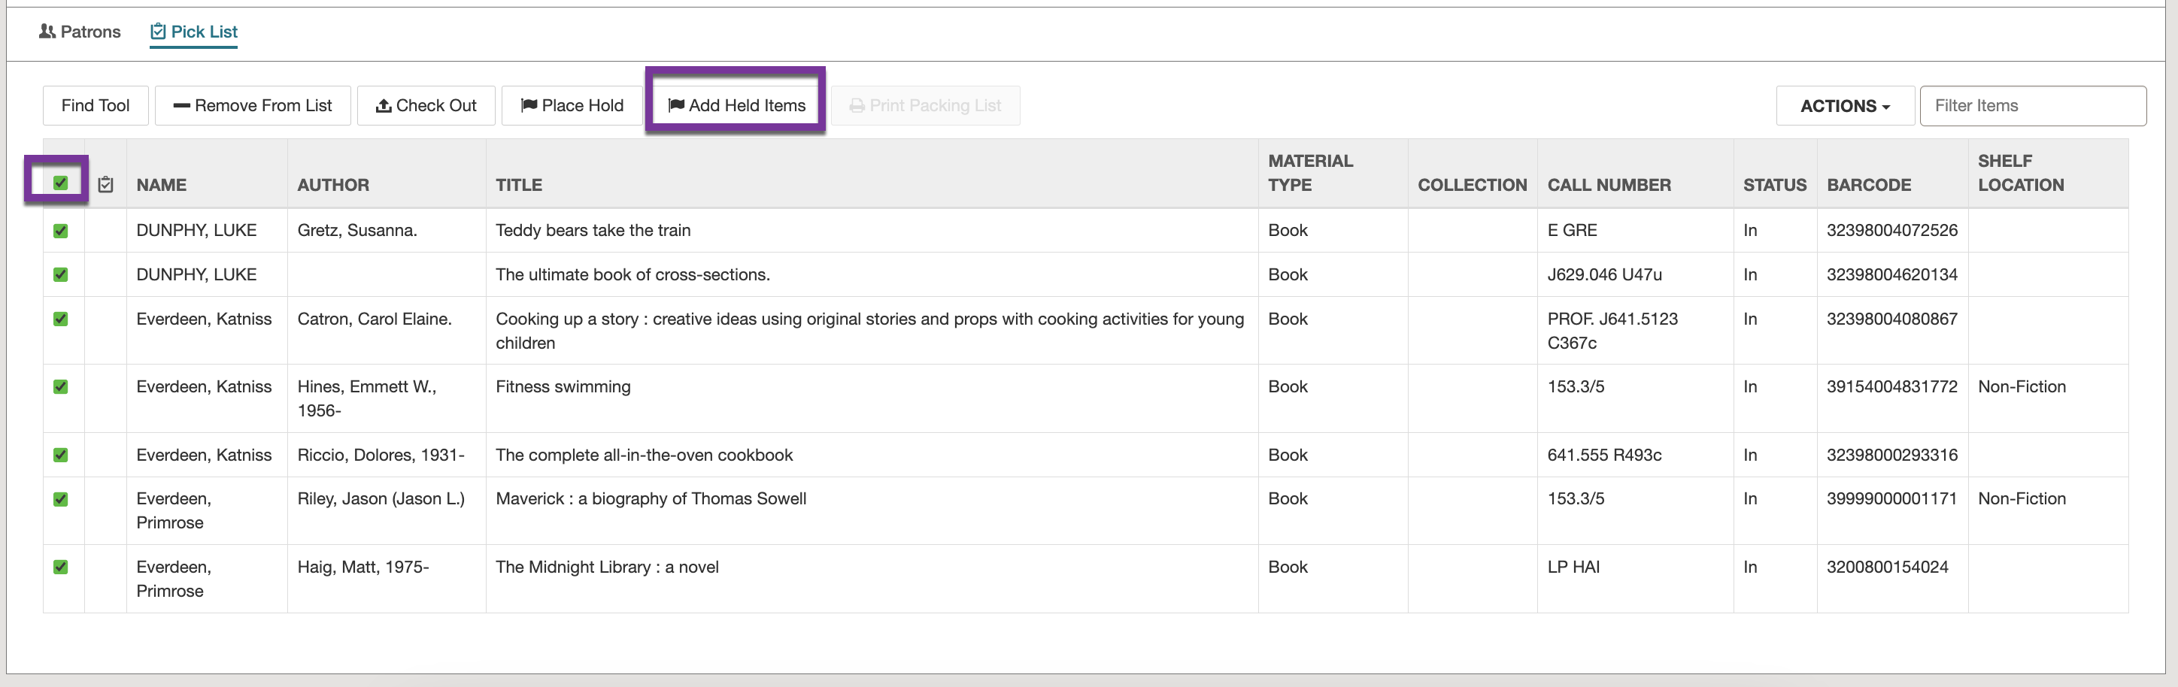
Processing Items for Multiple Patrons
Click the checkbox to select all.
Optionally, click Add Held Items if any of the ORS patrons have a hold ready.
Print list.

Slide 30
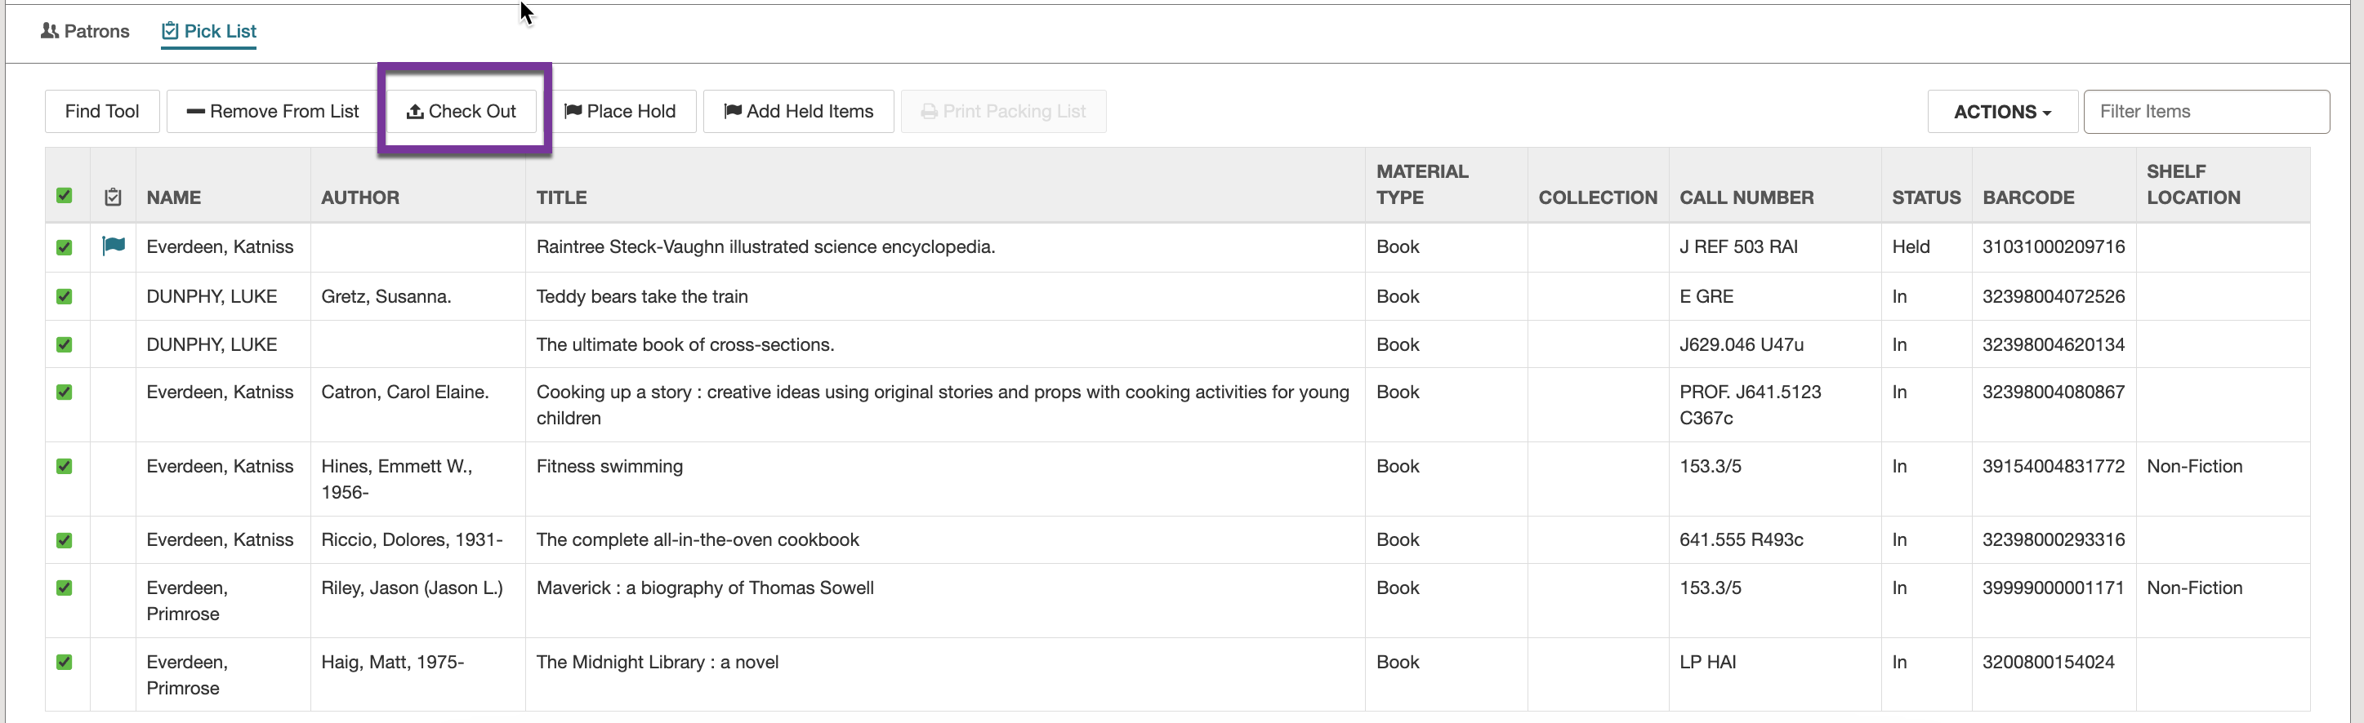

Processing Items for Multiple Patrons
With all selected, click Check Out.
Choose due date.
Click Process Checkouts.

Slide 31
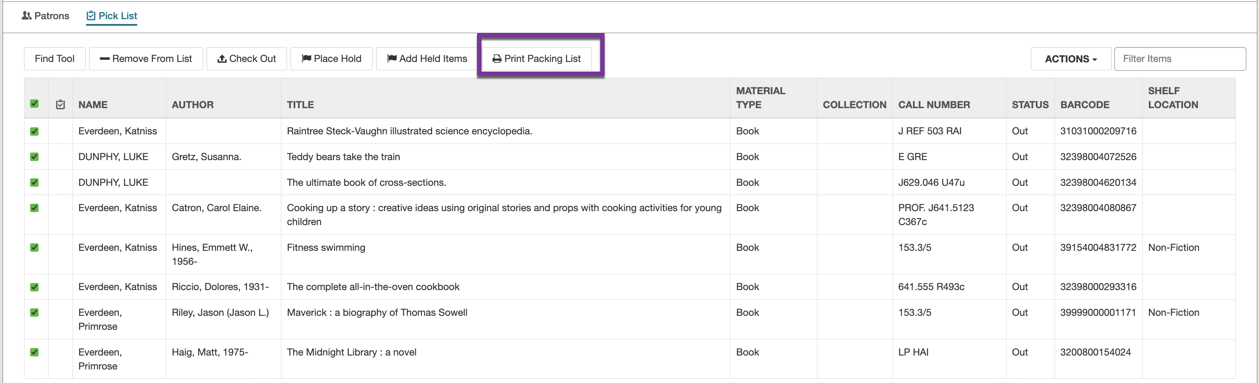
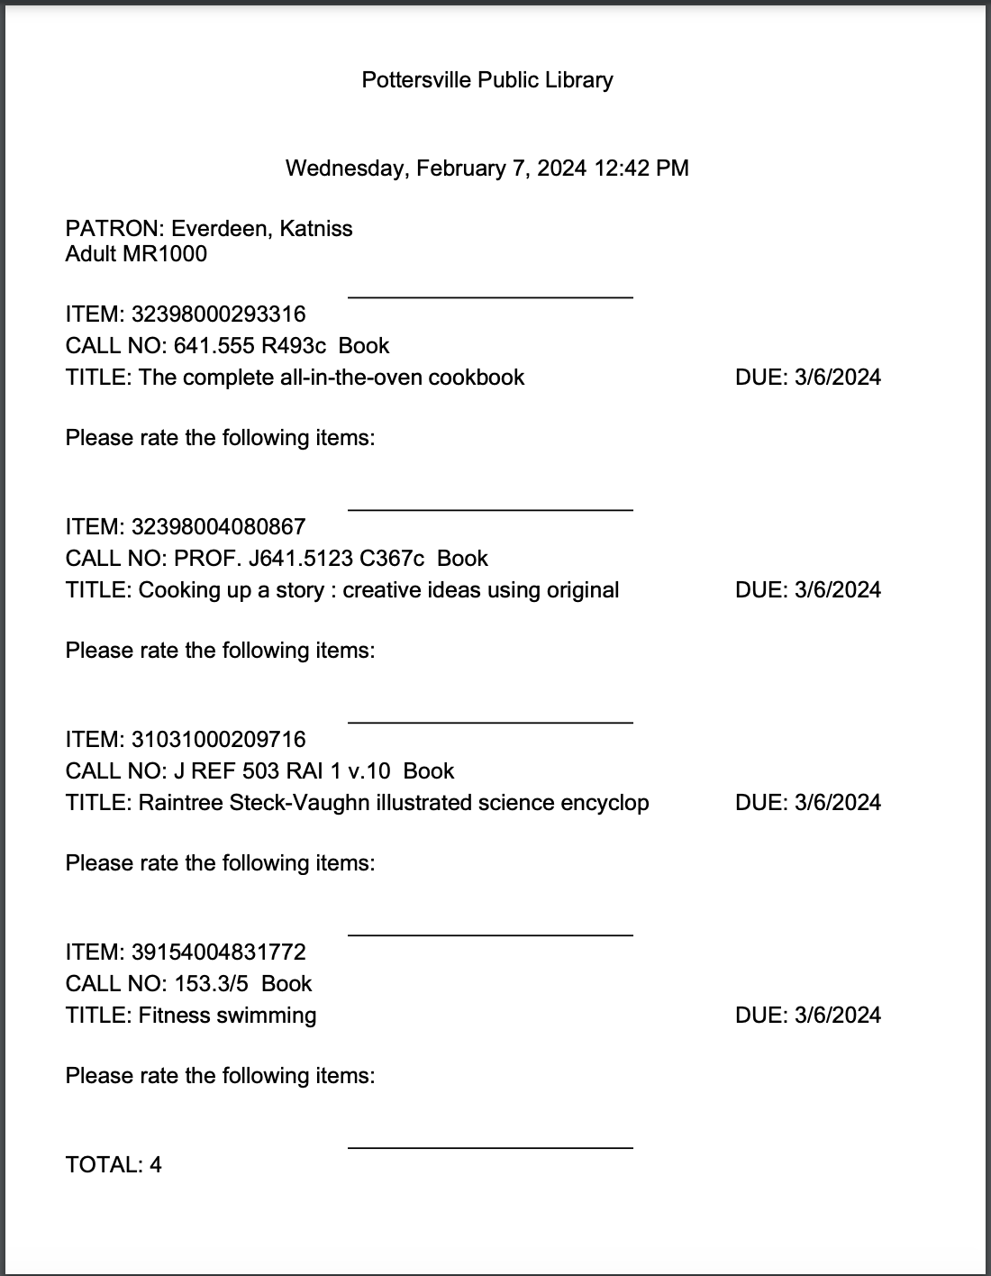
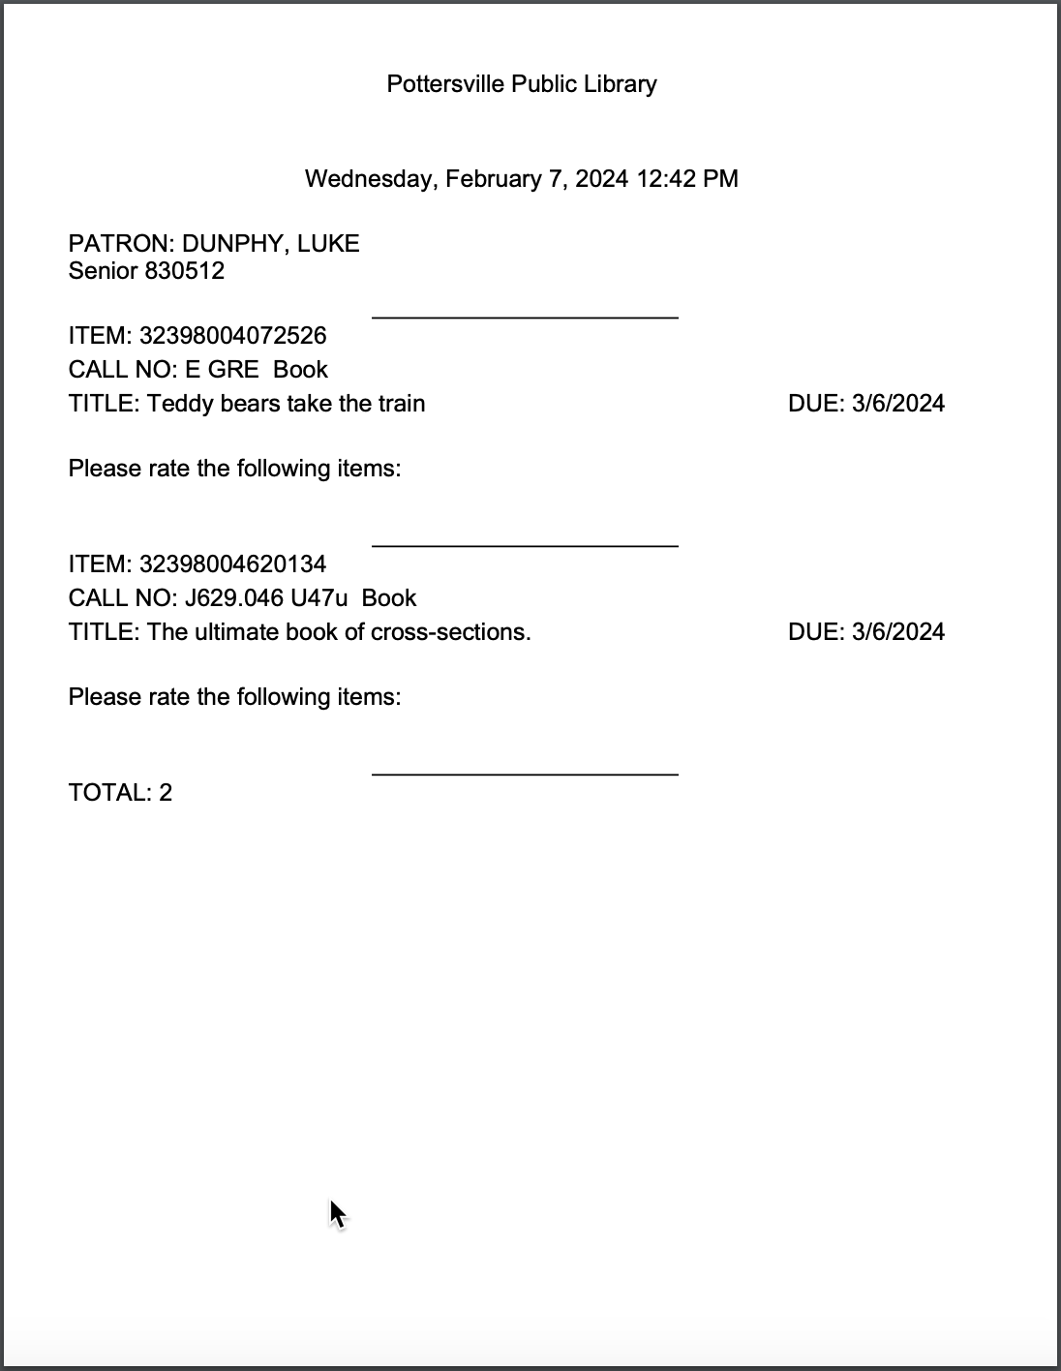
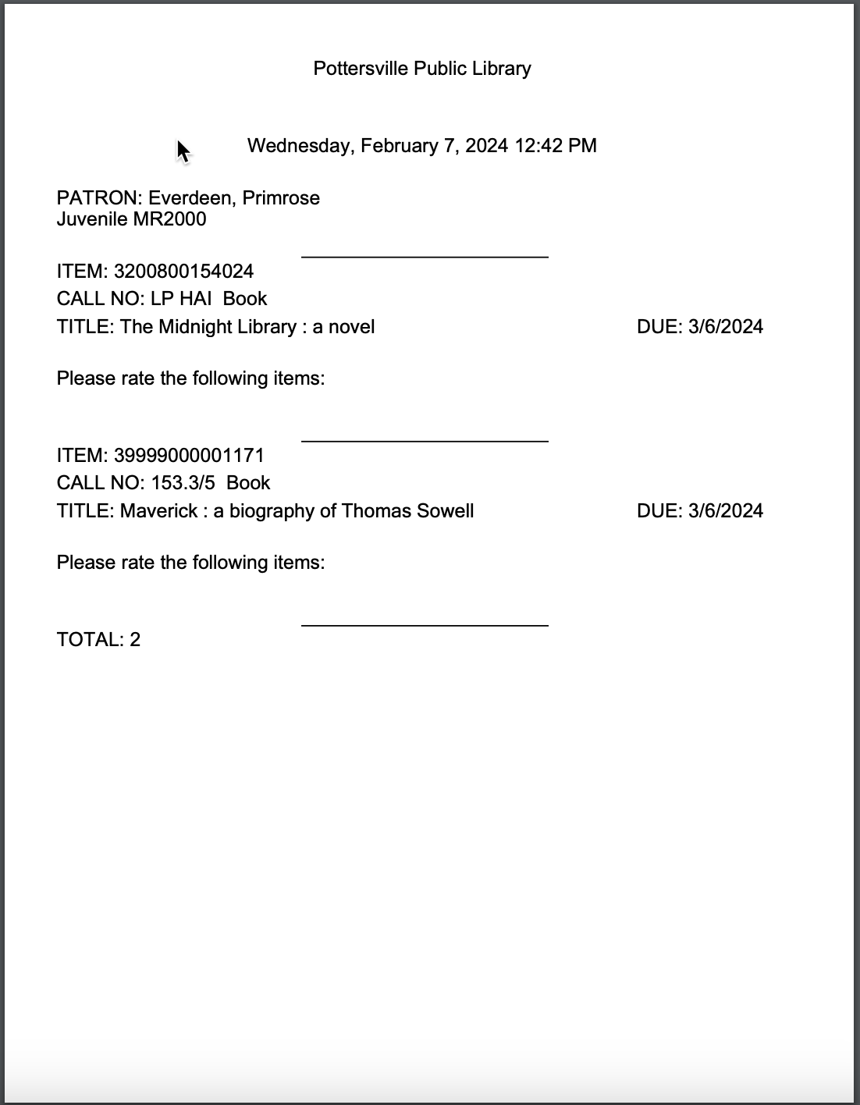
Processing Items for Multiple Patrons
After checkouts process, make sure all are selected and then click Print Packing List.
A packing list will print for each patron.

Slide 32
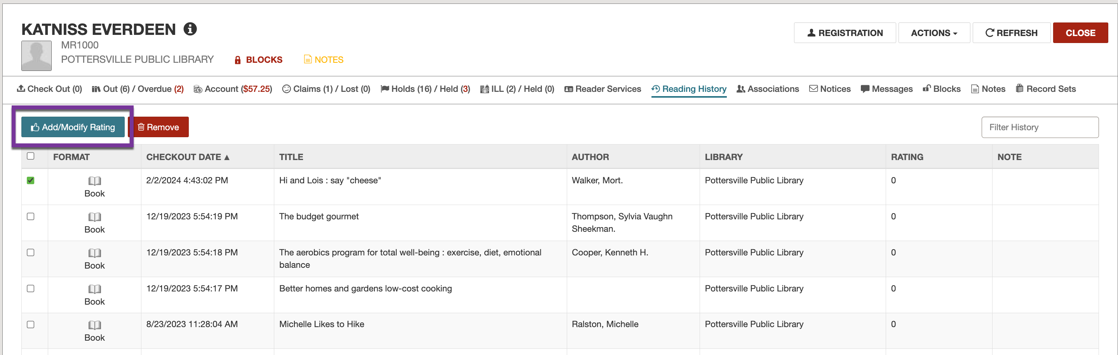
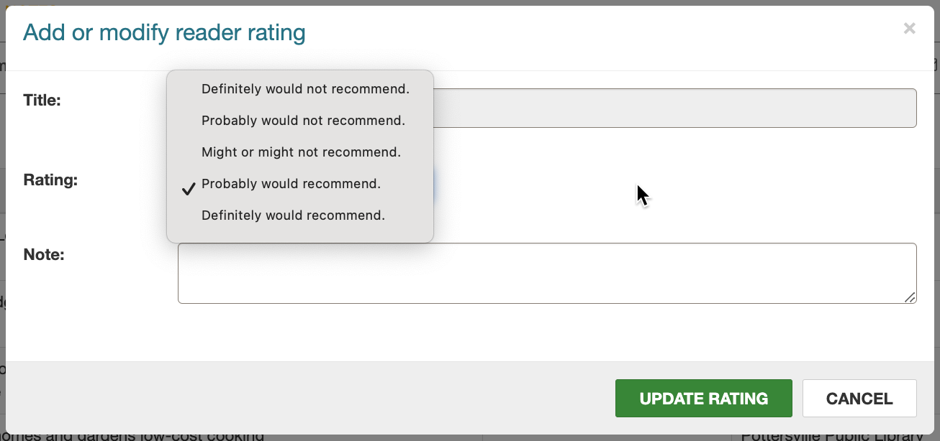
Processing Reader Ratings
On the patron record, click the Reading History tab.
Select the title and click Add/Modify Rating.
Choose the rating from the dropdown and click Update Rating.

Slide 33
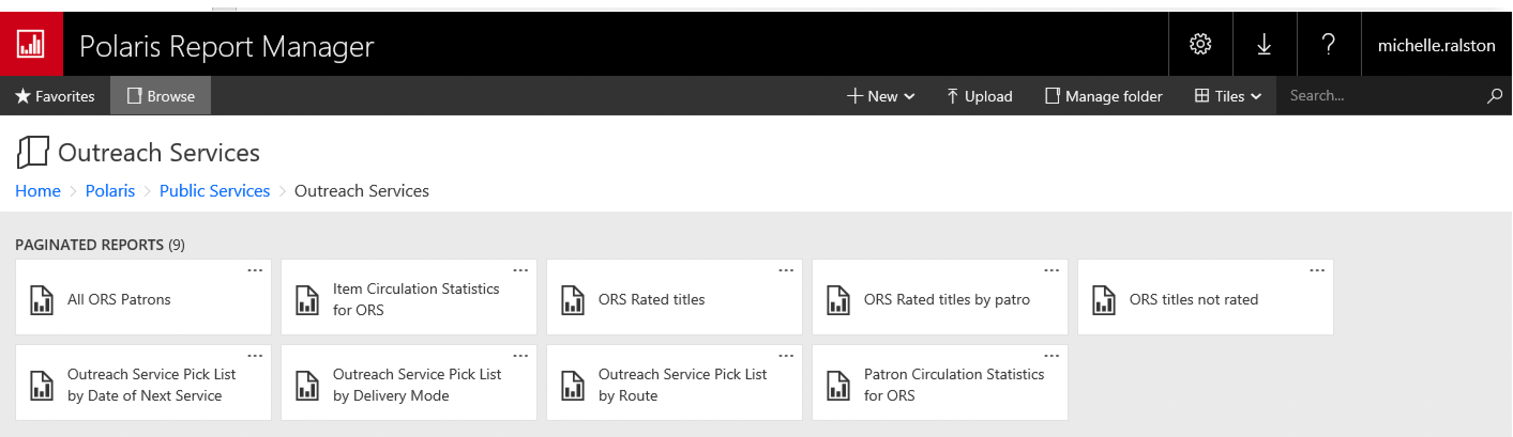
Outreach Reports
Access the Polaris Report Manager (reports server).
Polaris > Public Services > Outreach Services

Slide 34


Forename Surname
forename.surname@clarivate.com
+000 000-0000
About Clarivate
Clarivate is a leading global provider of transformative intelligence. We offer enriched data, insights & analytics, workflow solutions and expert services in the areas of Academia & Government, Intellectual Property and Life Sciences & Healthcare. For more information, please visit clarivate.com.
© 2025 Clarivate. All rights reserved
Clarivate and its logo, as well as all other trademarks used herein are trademarks of their respective owners and used under license.

