Slide 1

Polaris Inventory Manager

Slide 2
How Does Inventory Manager Work?
Using a wireless tablet/PC and Polaris Inventory Manager software:
  Go into to the shelves to take an inventory of items.
  Identify the items that are:
    Mis-shelved
    Have a status other than In
    Satisfy hold requests
  Mark items for weeding.
  Update the item records in the Polaris database with the latest inventory date.
A report is automatically generated along with a text file that identifies any scanned barcodes not in the call number range of the items you inventoried.

Slide 3
Considerations Before Beginning PIM
Are the shelves in good order?
  If not, the inventory process may be very slow while trying to account for all the problem items.
  Weed before doing inventory.
Are items consistently cataloged?
  In PIM, item data is sorted in a normalized call number order.
  To be more efficient, make sure the call numbers are consistent.
Stylus vs Barcode Scanner?
  PIM allows items to be marked as inventoried by selecting boxes with a stylus or by scanning barcodes.
  The stylus is quicker because the item stays on the shelf, but in this case the spine labels must be visible.
  Scanning is more efficient when spine labels are not consistent with call numbers, or if items have the same call number.

Slide 4
What is Needed for PIM?
A license (and the software) from Innovative for each workstation
  Please contact your site manager to receive this information.
A Windows-based laptop or Windows tablet (with Bluetooth) running Microsoft Windows 7, 8, or 10
Barcode scanner or stylus
Wireless network to connect to your Polaris database

Slide 5
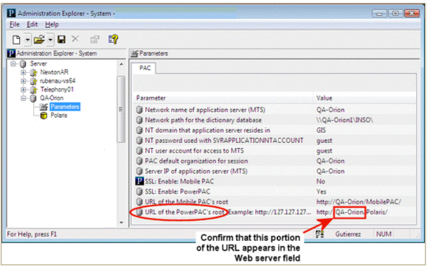
Configuring PIM
To find the Server:
  Explorer > Server > Parameters

Slide 6
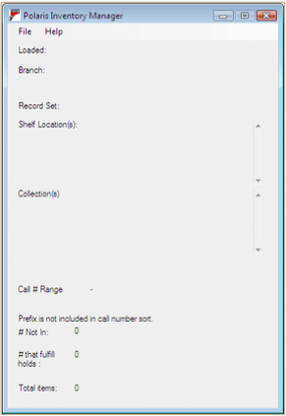
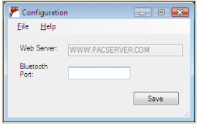
Configuring PIM
On the PC or tablet, open Polaris Inventory Manager
Select File > Configure
Confirm the server:

Slide 7
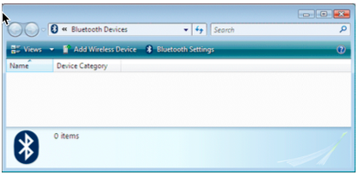
Configuring PIM: Optional Bluetooth Scanner
Enter the Bluetooth port: Open Bluetooth Devices on the tablet or PC:
Scan barcodes 1-15 (on page 28 of PIM guide)
Select Add Wireless Device and follow directions on page 23 of PIM guide

Slide 8
Load Item Data for Inventory
When loading data into PIM, specify a group of items:
  Call number range
  Shelf location
  Collections
  Record set
All the data is loaded, but PIM is able to keep track of where you left off in the loaded data in order to allow several sessions.
NOTE Circulation status and hold alert information for the items is valid when the information is loaded but may become out of date if the inventory for this group of items takes several days.

Slide 9
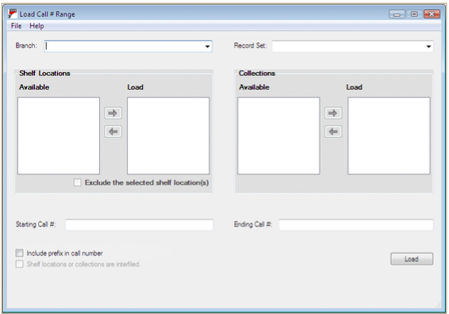
Load Item Data for Inventory
Connect the PC/tablet to your network.
Open PIM.
Select File > Load.

Slide 10
Load Item Data for Inventory
Record set includes only the record sets owned by the branch selected for inventory and only items belonging to that branch
Collections OR Shelf locations, but not both
  Can choose more than one collection or shelf location
    If choosing more than one collection or shelf location, choice of which is displayed in the list for easy inventory management
Call number values: range specified, blank to a specified, specified to blank, blank to blank
  If items are shelved together regardless of whether the call number begins with a prefix, be sure Include prefix in call number is not checked (uncheck the option if it is checked).
  NOTE The maximum number of records you can load at once depends on your network and server, but it is possible to load more than 10,000 records. The more records you load at once, the longer the loading process. If you receive an error message, load a smaller call number range, fewer shelf locations, fewer collections, or a record set with fewer records.

Slide 11
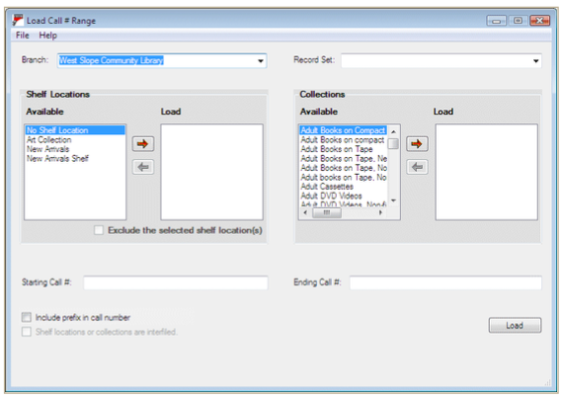
Load Item Data for Inventory
Select Branch
(if applicable)
Shelf Location
option
Select Collection
Enter Call Number range to load

Slide 12
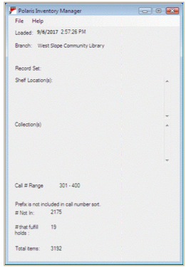
Load Item Data for Inventory
After clicking Load (on the previous slide) select File > Close.
The PIM main window appears, displaying the summary
information about the item records specified and the
date and time the data was loaded.
Select File > Scan.

Slide 13
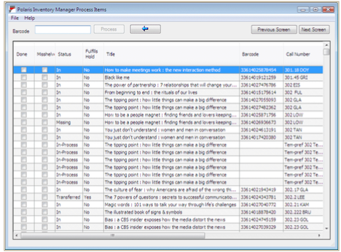
Setting Inventory Preferences
From the PIM Process items window:
  Select File > Preferences

Slide 14
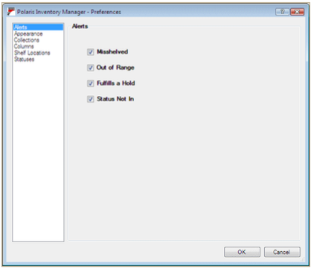
Setting Inventory Preferences
Preferences—Alerts
  Misshelved
  Out of Range
  Fulfills a Hold
  Status Not In

Slide 15
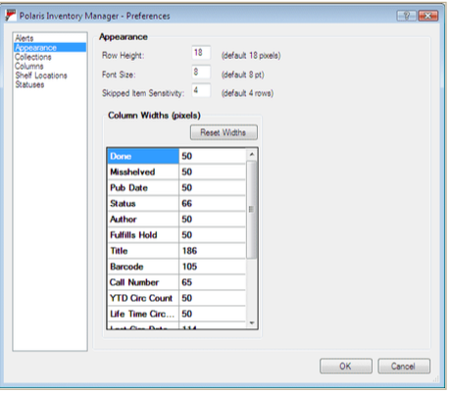
Setting Inventory Preferences
Preferences—Appearance
  Row Height
    TIP If using a stylus, increase the row height to make selecting the boxes easier.
  Font Size
  Skipped Item Sensitivity
    TIP If the items are not in call number order, increase the Skipped Item Sensitivity to avoid repeated messages.

Slide 16
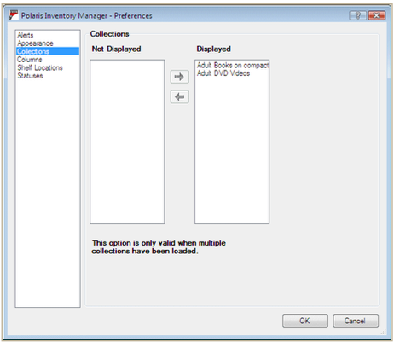
Setting Inventory Preferences
Preferences—Collections
  If multiple collections were specified in the load, choose which collections display in the inventory list.
    Change preferences again to display a different collection.

Slide 17
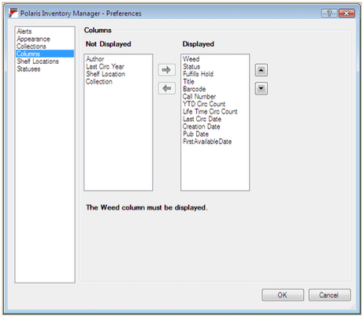
Setting Inventory Preferences
Preferences—Columns
  Weed column must be displayed
  Top column will be far left in the list

Slide 18
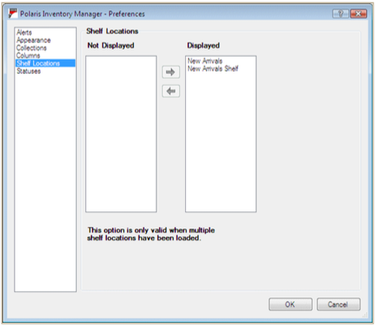
Setting Inventory Preferences
Preferences—Shelf Locations
  If multiple shelf locations were specified in the load, choose which shelf locations display in the inventory list.
  Change preferences again to display a different shelf location.
  NOTE This option is only available when multiple shelf locations have been loaded.

Slide 19
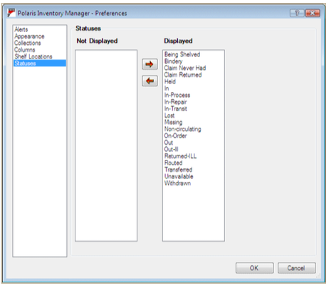
Setting Inventory Preferences
Preferences—Statuses
  Use this preference to suppress items with specified statuses from the list (Example: “On-Order”).

Slide 20
Preference Set
Once the Preferences window is closed, the Process Items window will display the inventory list.
Scroll right to see all columns.
Change the width of a column.
The default sort order is normalized call number (shelf order).
NOTE You can sort by any column, but you must click the Call Number heading to resort before starting inventory

Slide 21
Steps for Taking Inventory
Inventory the items using one or both of these methods:
  Stylus: As you visually inspect the shelf, select the DONE check box for each item you see.
  Scanner: Scan each items barcode and the DONE box is checked for the item.
NOTE You can mark any item for weeding during this process

Slide 22
Possible Messages During Inventory
Item not found in the current call number range.
  Select OK and set the item aside.
  When the Polaris database is updated, a text file is automatically created listing out-of-range barcodes.
Item’s status is Not In.
  Select OK and set the item aside (these items should be checked in using Leap).
The status of this item is [Status].
  Select OK and set the item aside for appropriate processing (example: On-Order or other filtered status).
Item fills a hold request.
  Select OK and set the item aside (these items should be checked in using Leap; checking in will trap the hold).
Item is misshelved (barcode scans only).
  Select OK and set the item aside for proper shelving.

Slide 23
Steps for Taking Inventory
Once you have finished the list, select File > Close or use the X in the upper right corner.
Any items you marked to weed can be listed on a report when you upload your inventory data to the Polaris database.

Slide 24
Update the Polaris Database
When you update the Polaris database with your inventory data, the inventory date for the relevant items is updated and an Inventory Statistics Report is automatically generated as a .pdf file. The report includes information such as:
  Update date and time
  Date and time the item record information was loaded
  Branch and call number range
  Record set
  Totals
  Any subreports

Slide 25
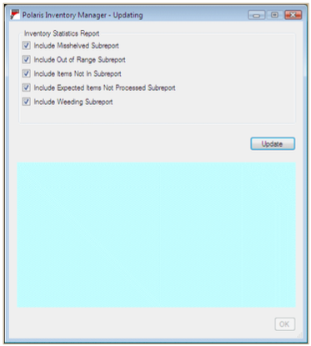
Update the Polaris Database
Establish a network connection on the PC/tablet.
From the main window of the PIM, select File > Update.
Select which subreports to include in the Inventory Statistics Report:
    Misshelved, Out of Range, Items Not In, Expected Items Not Processed, Weeding
Click Update.

Slide 26
Record Set Options
If items were expected but not processed between the first and last item you checked, you will see a message that offers the option to create a Polaris record set of the items. Click Yes to create the record set.
These items are also summarized and listed in the Inventory Statistics Report (max 5000).
If items were marked for weeding, there will be a message that offers the option to create a Polaris record set of the items. Click Yes to create the record set.

Slide 27
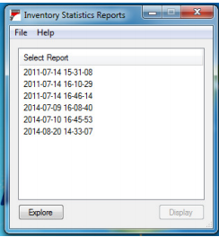
Success!
A message indicates that the update was successful and the Inventory Statistics Report opens as a .pdf file. It includes any subreports selected.
  You can review the report and print or copy to another workstation for later review.
  Click OK; the Updating window will close and the main PIM window will open again .
NOTE If you have previously updated the database, you can view the earlier reports. Select File > Report on the main window of the Polaris Inventory Manager and select the report from the report window. Select the report you want to view and click Display.

Slide 28
Inventory Reports
After you update the database, you can run standard Polaris inventory reports from the Client. Select Utilities > Reports and Notices > Cataloging.
  Inventory Exception Incorrect Status—Lists items that had a status other than In during inventory. You specify a call number range and a cut-off date. Set the cut-off date to the day before the inventory date. You can filter the report by organization.
  Inventory Exception Misshelved—Lists items with a status of In that should have been in the inventory sequence but were not. You specify a call number range and a cut-off date. Set the cut-off date to the date you started the inventory. You can filter the report by organization.
  Inventory Shelf List—Lists inventoried items in a specified call number and date range. You can filter the report by organization.

Slide 29


Forename Surname
forename.surname@clarivate.com
+000 000-0000
About Clarivate
Clarivate is a leading global provider of transformative intelligence. We offer enriched data,
insights & analytics, workflow solutions and expert services in the areas of Academia & Government, Intellectual Property and Life Sciences & Healthcare. For more information, please visit clarivate.com.
© 2025 Clarivate. All rights reserved
Clarivate and its logo, as well as all other trademarks used herein are trademarks of their respective owners and used under license.

