Slide 1

Polaris Client Basics

Slide 2
Polaris Client Basics
Logging On and Off of the Client
Shortcut Bar
Staff Client Visual Alert Configuration
Modifying Text Size and Resolution

Slide 3
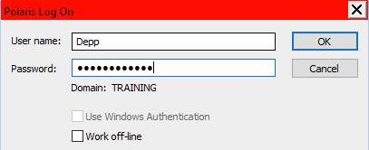

Logging On and Off the Client
Click on the Polaris icon to bring up the Polaris Log on screen.
Enter your username and password, verify the domain, and click OK.
Even though your username is not case sensitive, your password is.

Slide 4
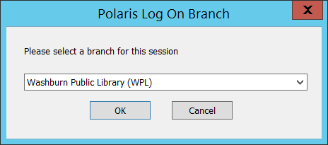
Log On - Branch
You may be logged directly into the branch you always work at and never see this window.
However, if your library has multiple branches you may be asked to select which branch you would like to log into.

Slide 5
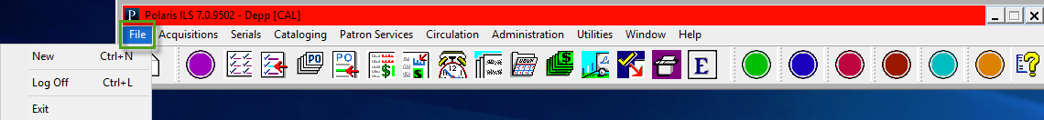
Logging On and Off the Client
You can log off of Polaris by either going to File/Log off, by using the keystroke Ctrl+L or by clicking the ‘X’ in the upper right corner of the Polaris shortcut bar.
If you are using a Terminal Server environment, make sure you log out correctly.

Slide 6
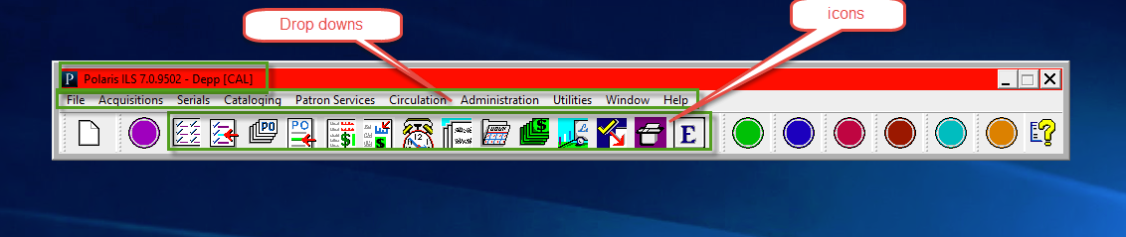
Shortcut Bar
The shortcut bar is your Polaris navigational tool.
Once you have logged in, your username and branch abbreviation will display on the top of the shortcut bar.
The toolbar offers access to subsystems through drop-down menus or by clicking on icons.

Slide 7
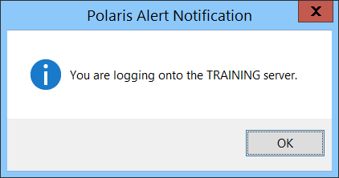
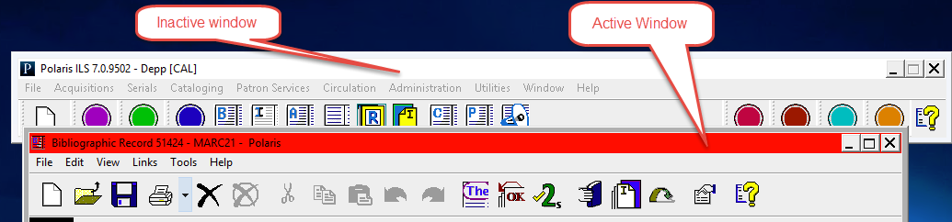
Staff Client Visual Alert Configuration
There are two ways to signal staff when they are logging into the training server:
  Logon alert message
  Custom title bar color
These alerts may be used individually or in conjunction with one another.
They may be set on each server, so you know immediately which server you are logging onto—training or production.

Slide 8
Modify Text Size and Resolution
Text:
  Using Control Panel/Display on your PC, you may set your computer’s display from Small to Medium or Large and the Polaris interface will reflect these changes without reducing what is visible on the screen.
  Workstations must be running Windows.
  IMPORTANT—This option is not supported in Terminal Services.
Resolution:
  Polaris will be optimized for monitors set at 1024 x 768 resolution.
  Customers using large monitors will be able to set them at this resolution.

Slide 9
Navigation in Polaris
Drop-down Menus
Icons
Shortcut Keys
Linking in Polaris
Permission Blocks
Where to find help

Slide 10
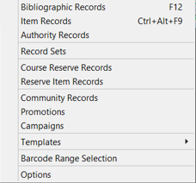
Dropdown Menus
Clicking on each title in the menu bar presents a drop-down menu to access functions in each subsystem.

Slide 11
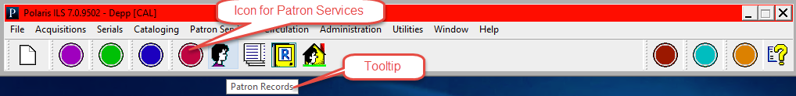
Dropdown Menus
Another way to access the Polaris subsystems is to click on the corresponding icon on the tool bar.
Hovering over each icon brings up a tooltip hint to show you what you may access when clicking on the icon.
Clicking on a round icon “slides open” the subsystem’s menu to present the related icons.
Each subsystem is color coded—Cataloging is blue, circulation is red, etc.

Slide 12
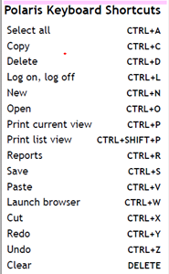
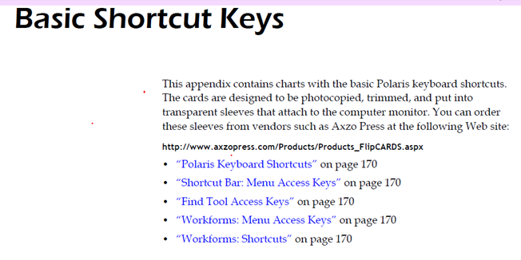
Shortcut Keys
For users familiar with Windows Shortcuts, many are built into Polaris.
Numerous CTRL and ALT combinations will bring up menus and workforms in Polaris.
Keyboard shortcut cheat sheets can be found at the end of each user guide for a particular subsystem.

Slide 13
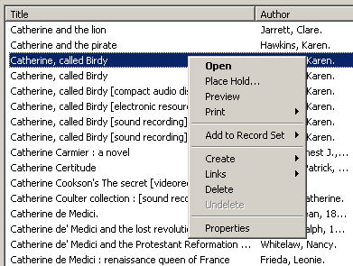
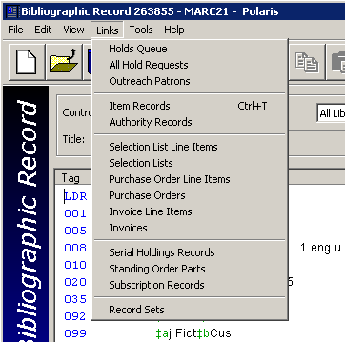
Linking in Polaris
One of the fastest ways to navigate in Polaris is by linking from one record to another.
  From a result set in the Find Tool, right click and choose Links.
  From a workform, go to Links in the menu bar.
You can link to other workforms or perform specific functions without additional keystrokes.

Slide 14
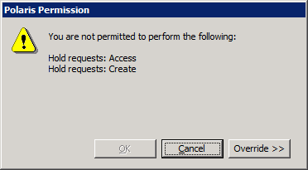
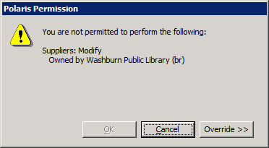
Permission Blocks
You may encounter a message that says that you do not have permission to complete a certain task
Click Override and ask someone with the permission to override blocks in that subsystem to enter their username and password for a onetime override
If this is a permission that you frequently need, write down the exact wording of the permission from the pop-up message to give to your System Administrator

Slide 15
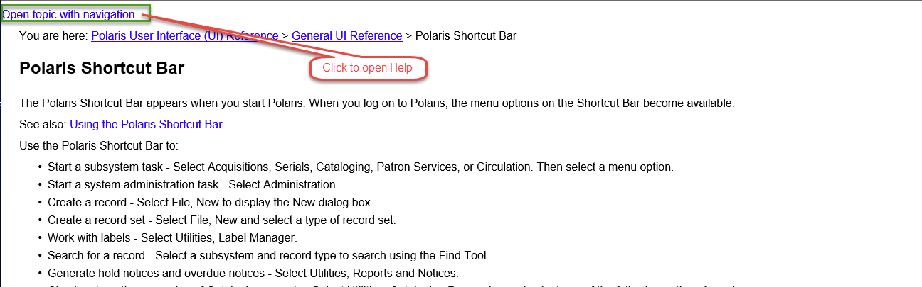



Where to Find Help
Documentation may be seen by going to Help/Polaris Topics on the Shortcut bar.
Content-specific help can be accessed by pressing the F1 key or clicking on the help icon in the toolbar on any workform.

Slide 16
Find Tool
Types of Searches
Setting User Defaults
Wildcard Characters
Find Tool Tabs
Additional Find Tool Searches
Search Results

Slide 17
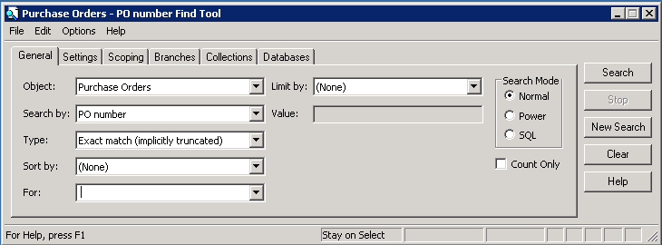
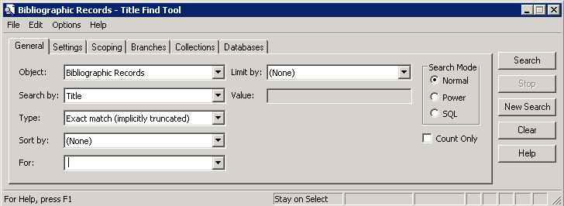
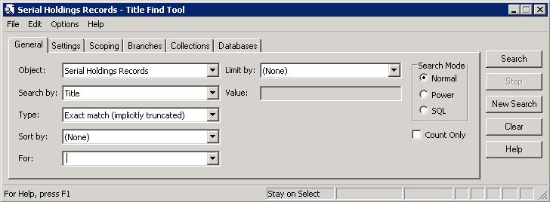
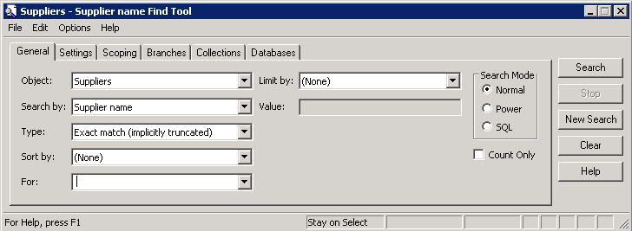
Find Tool
The Find Tool has the same format in all subsystems, but with different options/indexes in the drop-down menus:
  Object—what you are looking for
  Search by—what index you would like to use
  Type—What type of search you would like to perform
  For—type in your search terms
The Find Tool allows users to do everything from basic to advanced searching.

Slide 18
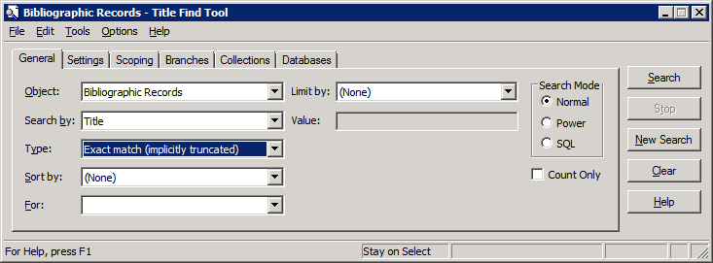
Types of Searches
Exact match (implicitly truncated).
Displays all records beginning with the characters entered in the For box.
No asterisk is needed after the term(s) as truncation is implied.

Slide 19
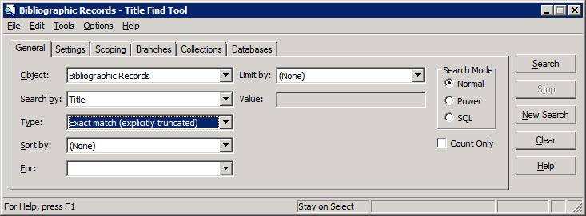
Types of Searches: Exact Match
Exact match (explicitly truncated)
  Displays only the records that exactly match the characters in the For box.
  If you enter an asterisk after the search term(s) the results are the same as they would be on an implicitly truncated search.
  Helpful for one word title searches.

Slide 20
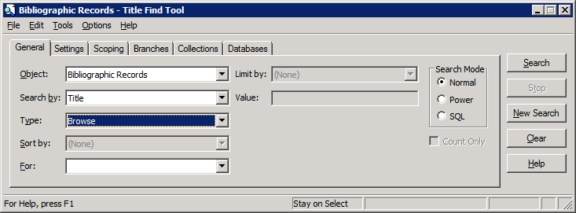
Types of Searches: Browse
Browse
  Displays the specified index headings beginning with entries that start with text in the For box
  Unicode compliant—diacritics or special characters are accepted if they match the heading
  Name indexes are searched in the last name, first name format—no comma is necessary

Slide 21
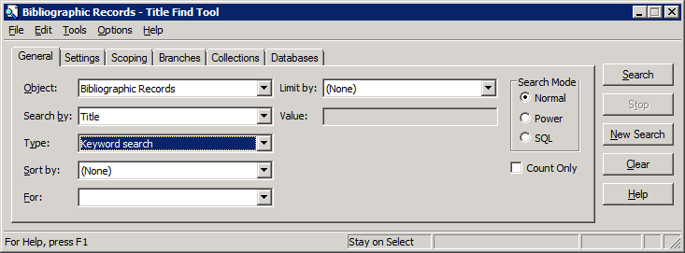
Types of Searches: Keyword Search
Keyword search
  Finds records that include the exact search term or terms in any order
  There is an implied AND between each word entered as a search term
  Offers auto-suggest feature if enabled

Slide 22

Types of Searches: Phrase Search
Phrase search
  A specialized keyword search that searches multiple words in the exact order in which they were entered.
  Offers auto-suggest feature if enabled.

Slide 23
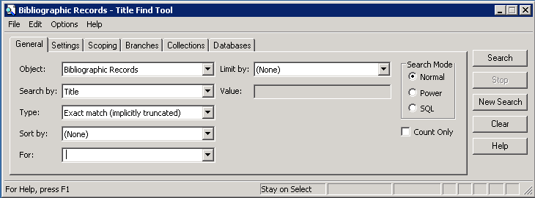
Setting User Defaults
Users may define custom search defaults on the General tab of each Find Tool.
Defaults include Search by, Type, Sort by and Limit by.
Once selections are made for default searches, go to Options/Save as User Default to have those settings take effect.
Settings are linked to a username.

Slide 24
Wildcard Characters
An asterisk * and a question mark ? Are valid wildcard characters.
They may be used with multiple search types, for example:
  Keyword
    note = note
    note* = note, notes, notebook
    *note = footnote
    *note* = footnotes
  Exact match—implicitly truncated
    metal = metal, metals, metalsmith
    *metal - fullmetal

Slide 25
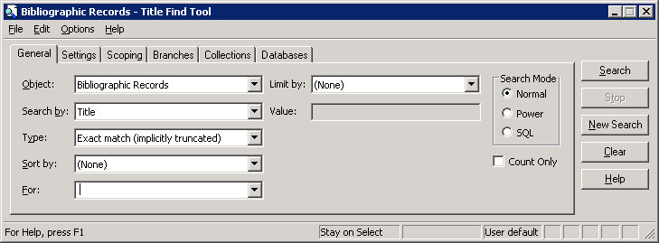
Find Tool Tabs: General
Object—default object is selected but this may be changed to any object in the dropdown list.
Search By—access point or index.
Type—type of search to perform.
Sort by—order of the results.
For—where the user enters the search string.
Limit by—add a narrowing criterion if available-some limits allow multiple values to be selected.

Slide 26
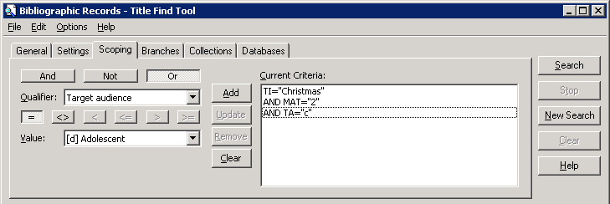
Find Tool Tabs: Scoping
Begin your search on the general tab and then narrow the search further by using the scoping tab
Select the operators, qualifiers and value
Add the criteria to the search string by clicking the Add button

Slide 27
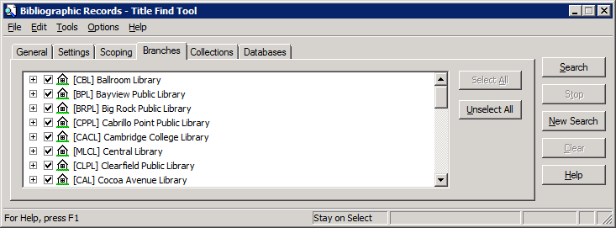
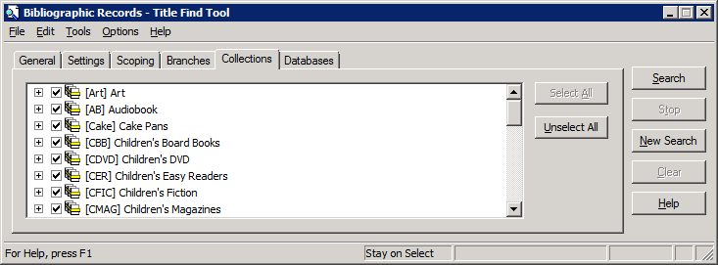
Find Tool Tabs: Branches and Collections
Some searches can be narrowed by opening the branches and/or collections tabs and making additional selections.
Tip—use the Unselect All button to clear all Branches or Collections, then click the desired boxes.

Slide 28

Additional Find Tool Searches
Power—gives staff the ability to use CCL (Common Command Language) to create a search.
SQL—if permissions are given, allows staff to create, save and run SQL queries within the Find Tool.
Count Only—allows staff to get a quick count of records without displaying the results list—helpful for reporting purposes.

Slide 29
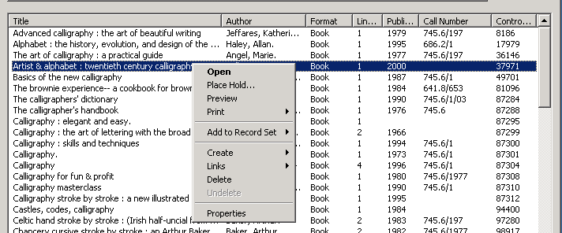
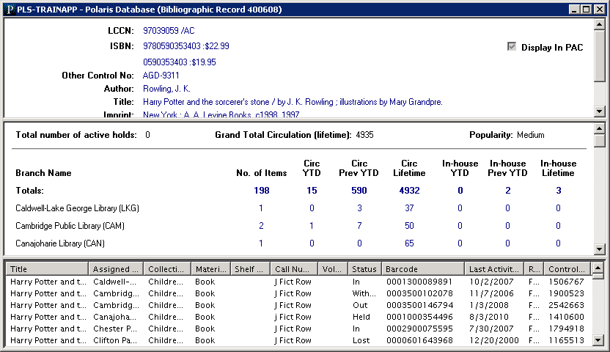
Search Results
Sort—by clicking the column headers, lists can be sorted in ascending or descending order.
Right-click—allows staff to easily move into other functionality or link to related workforms.
Preview—allows staff to see quick information about a title and all connected items—staff can easily move through a list of titles by using the arrow up and down keys.

Slide 30
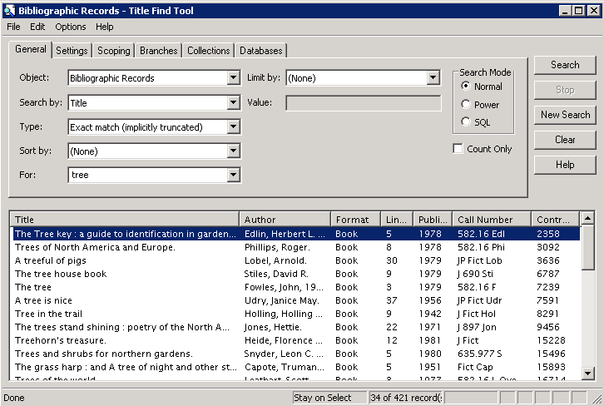


Search Results
If the result set is large, only a subset of the results is initially brought back.
CTRL+Shift+A will retrieve all the records and then sorted by clicking on the column header.
CTRL+Shift+A

Slide 31
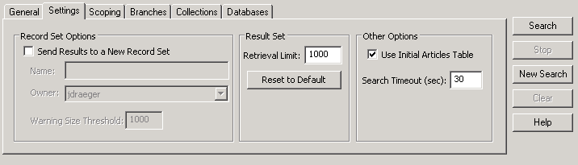
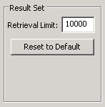


Search Results
There is a default limit set in System Administration (typically 1000) for the maximum number of records retrieved in a search
Go to the Settings tab, edit the value in Retrieval Limit and click Search
Ctrl + Shift + A to see all the results

Slide 32
Workforms
Workform Layout
Property Sheets

Slide 33
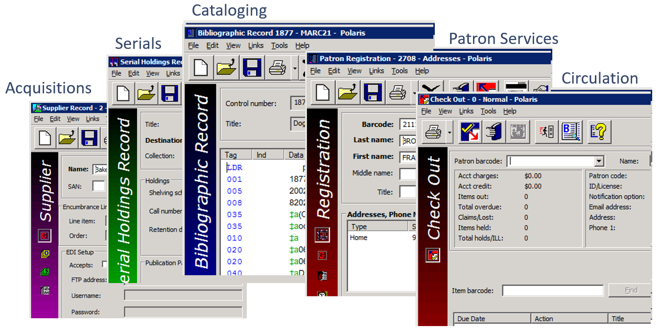
Workform Layout
There are many different types of workforms in Polaris.
Each workform is color coded by subsystem.

Slide 34
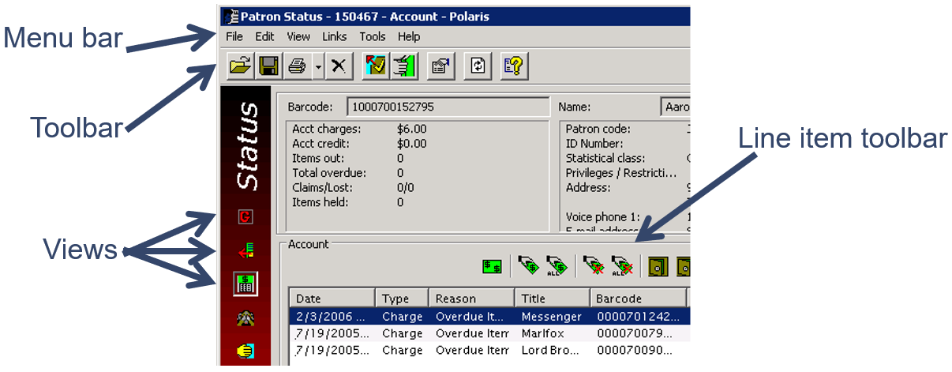
Workform Layout
Menu bar—access functions of the entire workform via drop-down menus.
Toolbar—access functions of the entire workform via icons.
Views—different pages of the workform.
Line item toolbar—controls functions of the workform below itself.

Slide 35
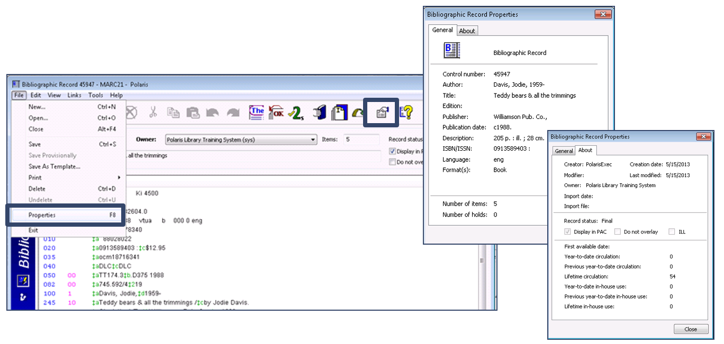
Property Sheets
From most workforms you can go to File/Properties, use F8 or click the Properties icon to retrieve the corresponding property sheet.
Property sheets contain useful information about records in the database.

Slide 36
Record Sets
Purpose and types of record sets
Creating record sets

Slide 37
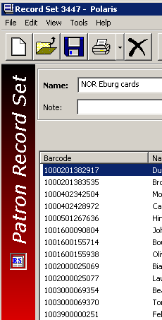
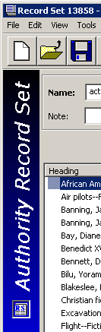
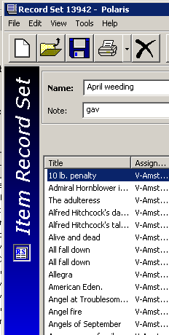
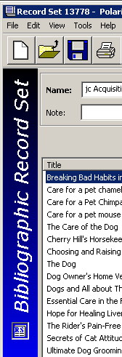
Purpose and Types of Record Sets
Subsets/virtual groupings of Bibliographic, Item, Authority or Patron records.
Records are grouped together for specific functions within Polaris—a listing of records or for bulk change purposes.
Additional information regarding record sets will be communicated during Cataloging and Patron Services/Circulation training.

Slide 38
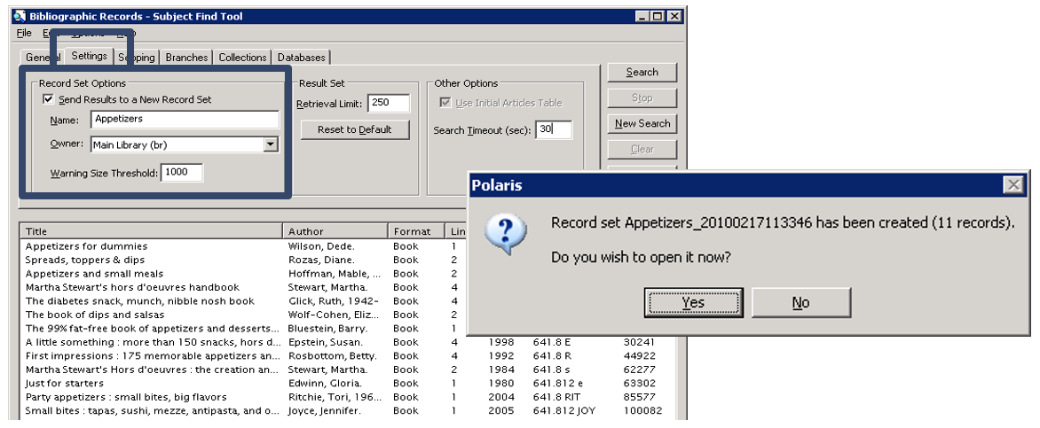
Creating Record Sets
There are many ways to create record sets.
For example, using the settings tab in the Find Tool to create a record set directly from a results list.

Slide 39
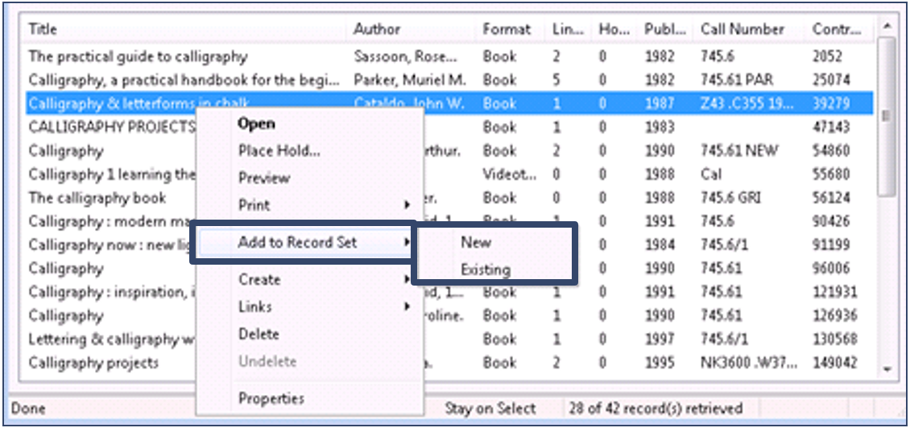
Creating Record Sets
Another option is available from the right-click functionality of the results list.
Selected records may be put in a new or an existing record set.
Multiple records may be selected for inclusion.

Slide 40


Forename Surname
forename.surname@clarivate.com
+000 000-0000
About Clarivate
Clarivate is a leading global provider of transformative intelligence. We offer enriched data,
insights & analytics, workflow solutions and expert services in the areas of Academia & Government, Intellectual Property and Life Sciences & Healthcare. For more information, please visit clarivate.com.
© 2025 Clarivate. All rights reserved
Clarivate and its logo, as well as all other trademarks used herein are trademarks of their respective owners and used under license.

