Slide 1

Polaris Floating Collections

Slide 2
Floating Collections
Floating collections overview
System Administration:
Designating floating collections
Setting parameters
Setting home and receiving branch policies
Floating: To Branch
Floating: Collection Limits
Floating: Material Types
Floating: Material Type Limits
Setting profiles
Excluding an individual item from floating

Slide 3
Floating Collections Overview
Floating collection processing is the ability to allow certain items to remain at the branch where they were last checked in.
Floating collections allow high-demand items to remain at high-traffic organizations and collection contents to change as the demand changes.
This reduces the cost involved in returning materials to a single starting point after each use at another branch.
Using floating collections is optional.
If the system consists of organizations that do their own purchasing and processing, and item ownership is important to each organization, staff may not wish to implement floating collections across the entire system.
If the system uses centralized purchasing and processing, floating collections may prove useful.

Slide 4
Floating Collections Overview
Floating collections can be configured at the branch level.
Each home branch can determine if any of its items are allowed to float (and to which branches).
Libraries can choose to float all items.
In addition to the above limits:
Libraries can choose to float some collections or only some material types within collections.
Libraries can choose between the following two options:
Libraries can set limits on the number of items within a collection a branch may receive for load balancing purposes.
A library can define how many items attached to the same bib record can be accepted at the receiving branch.
Individual items can be designated as exempt from floating.

Slide 5
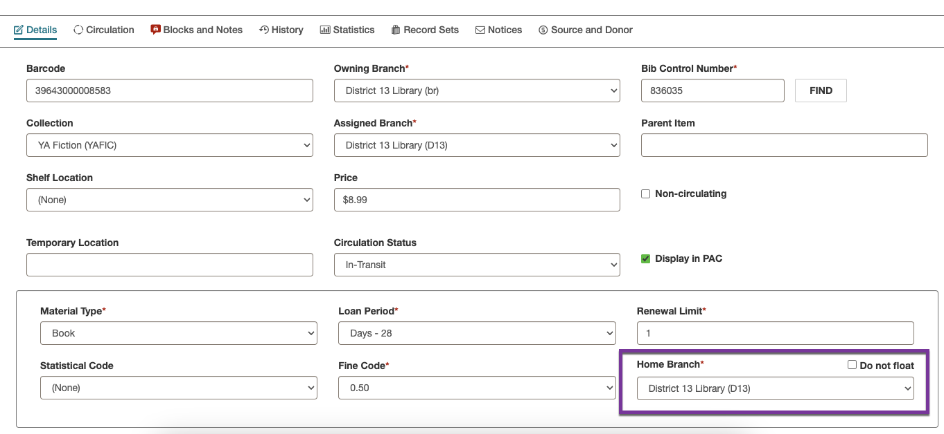
Floating Collections Overview
The Home Branch is seen on the Details view of the item record.
Each time an item floats, an entry is added to the item’s History view: Modified via Floating Collection processing.

Slide 6
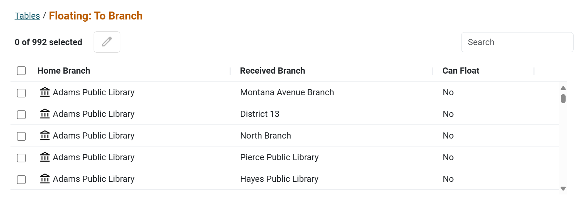
System Admin: Designating Floating Collections
Determine which collections are eligible to float from which home branches in System Administration.
Settings and Tables > Tables > Floating: To Branch

Slide 7
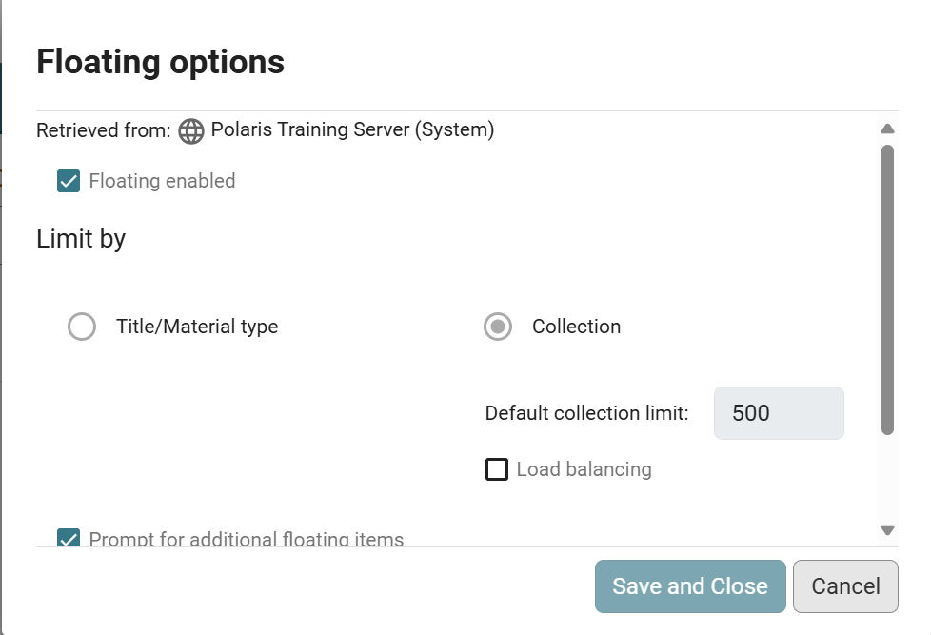
System Admin: Settings Options
HINT
Leave the Floating enabled check box unchecked until all floating set up has been completed.
Settings options are configured at the System level; go to Settings and Tables > Settings > Patron Services Floating Options > Configure.
When choosing Title/Material type, additional check boxes are available to:
Prompt for additional floating items
Float items with no matching collection
Float items with no collection
Further limits can be set at the Library or Branch level using Settings and Tables > Tables > Floating: Material Type Limits.

Slide 8
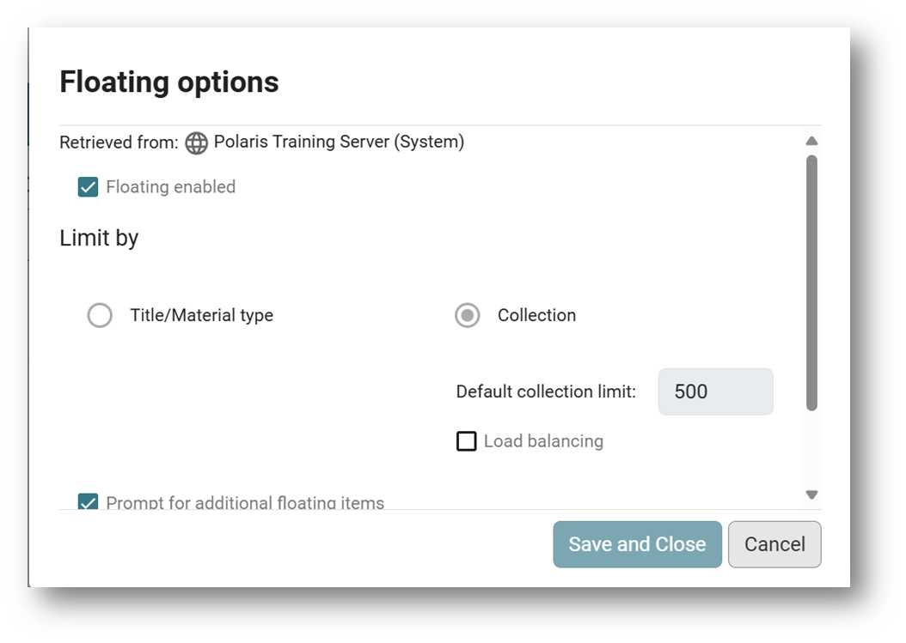
System Admin: Settings Options
When selecting Collection, Load balancing is an option.
Refined limits can be set at the library or branch level using Settings and Tables > Tables > Floating: Collection Limits.
When load balancing is enabled and an item cannot float into the receiving branch due to collection limits, Polaris checks all eligible receiving branches and will float the item to the branch that has the lowest ratio of the number of items to the collection limit.
Turning on the Prompt for additional floating items gives staff the ability to accept an item even though it would exceed the collection limit.

Slide 9
System Admin: Setting Branch Policies
Four tables set floating item polices:
Floating: Collection Limits
Are there limits to the number of items that should be added to a specific collection?
The maximum collection total is a combination of a Final record status and a circulation status of In and In-Transit.
Floating: Material Types
Are there certain material types that should not float even if they belong to eligible collections?
This table sets material types that should not float. The home branch defined in the item record determines the material types that should not float.
Floating: Material Type Limits
How many items of the same title (attached to the same bib record) is the receiving branch willing to accept?
The receiving branch determines separate limits for the ‘In’ items attached to the same bib record and items of any circulation status attached to the same title.
Floating: To Branch
If items can float, to which branches can they go?
This table sets the possible receiving branches. The home branch defined in an item record determines the branches to which its items can float.

Slide 10
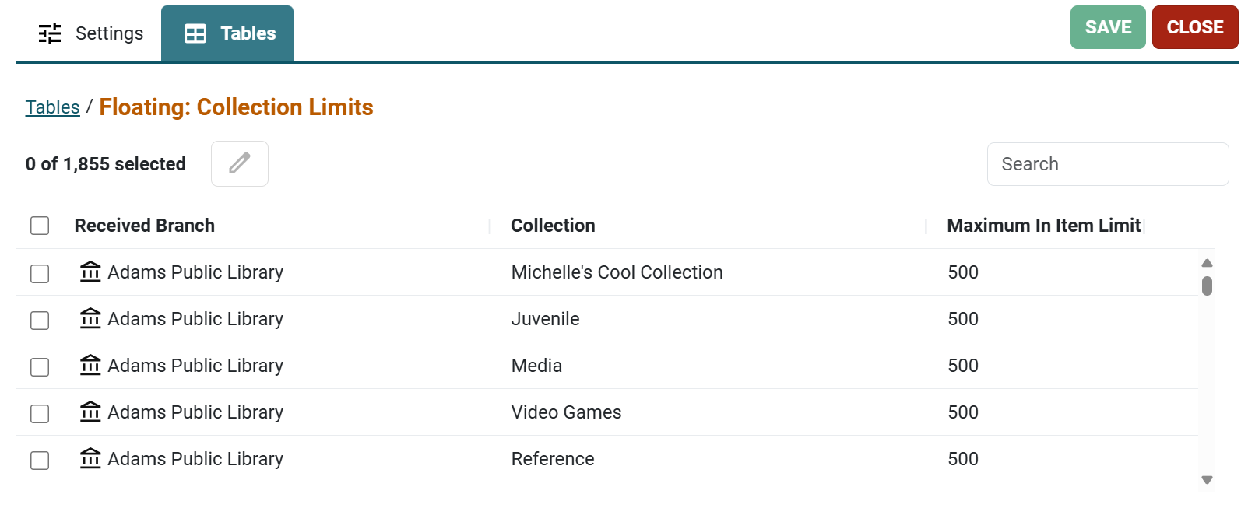
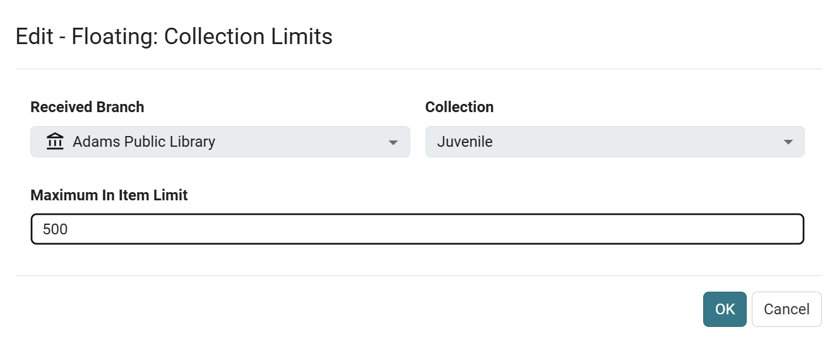
System Admin: Floating: Collection Limits
A default collection limit of 500 is coming from the system level.
Each branch may set their own limits per shelving space.
The maximum collection total is a combination of a Final record status and a circulation status of In.

Slide 11
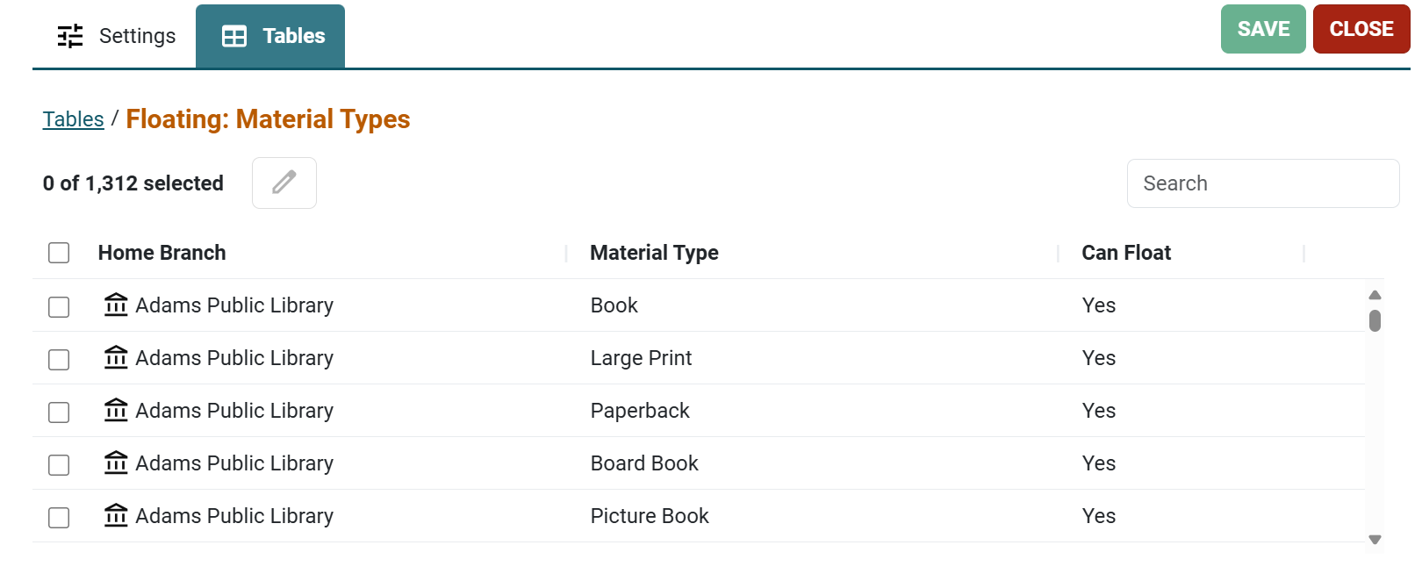
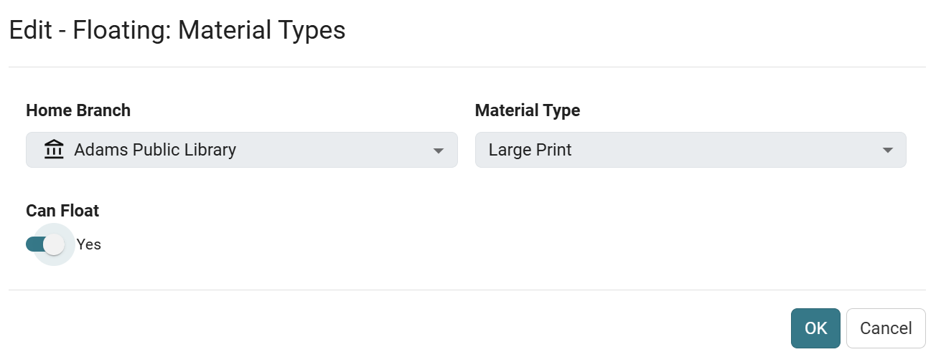
System Admin: Floating: Material Types
This table prevents certain material types from floating.
Even if an item belongs to a collection that a home branch allows to float, the home branch can prevent certain material types from floating.
This must be set for each home branch that floats.

Slide 12
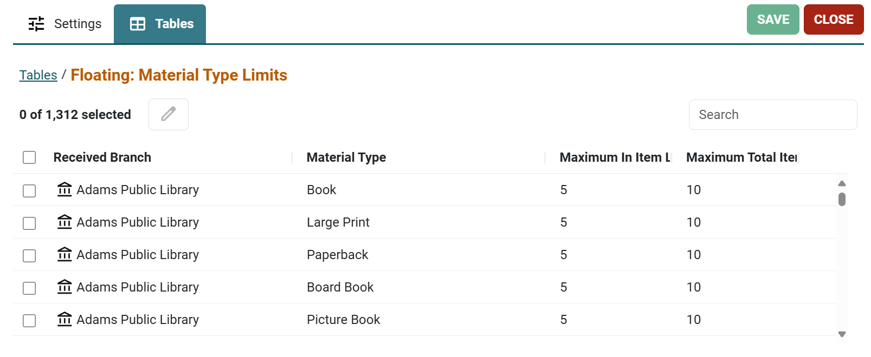
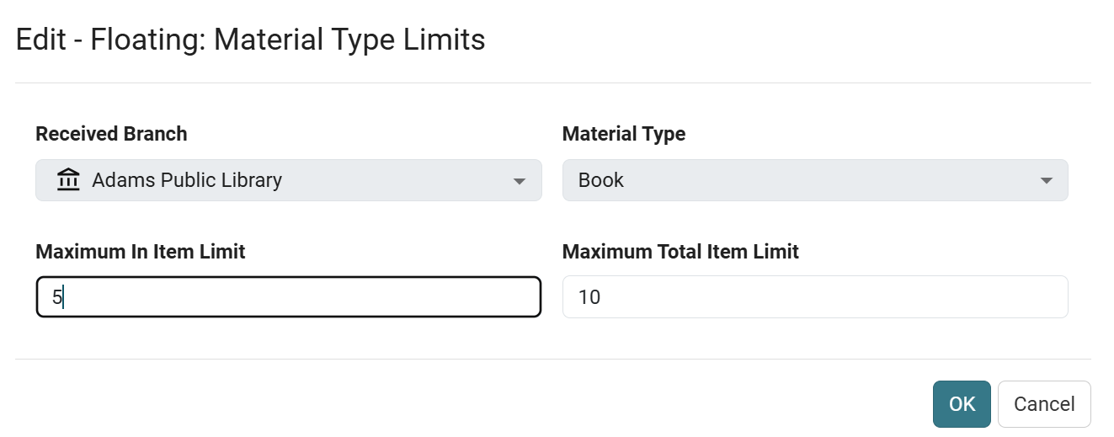
System Admin: Floating: Material Type Limits
This table limits the number of floating items a branch can receive per bib record.
Staff can limit the number of items attached to the same bib record that the receiving branch can accept
For example, a limit of 5 Video/DVD indicates that the receiving branch will not accept more than 5 copies of any given Video/DVD attached to one bib record with a status of In.
In determining how many items to bring in, the system counts how many of the items are immediately available (In), as well as how many of the items have floated to the receiving branch, regardless of their current circulation status,

Slide 13
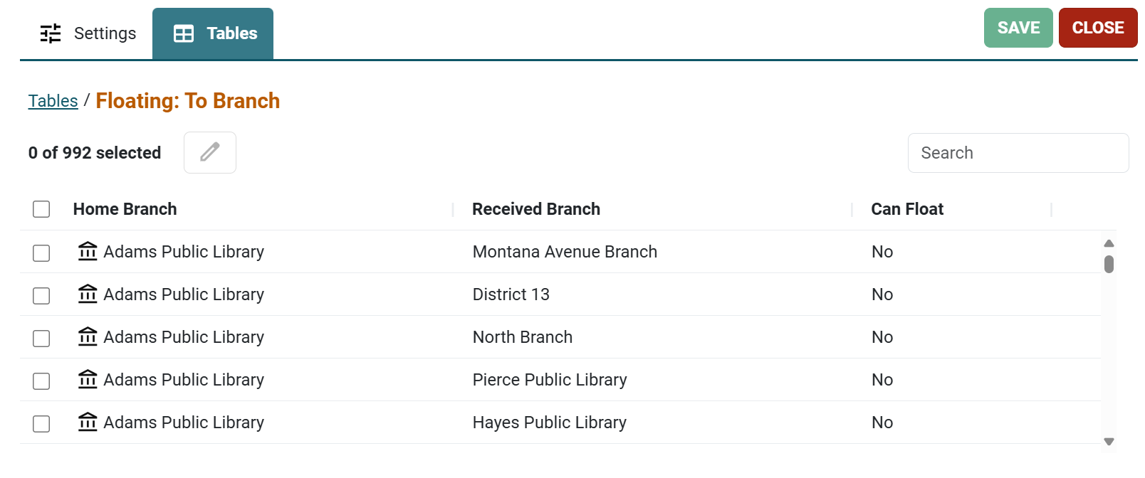
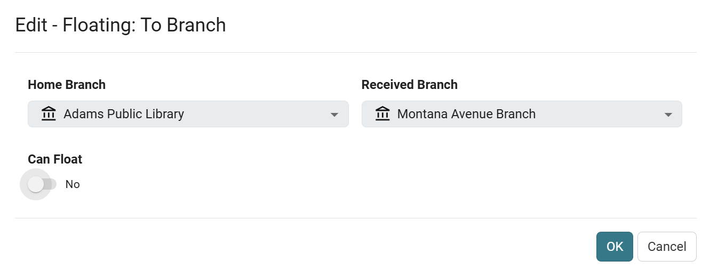
System Admin: Floating: To Branch
The home branch decides which branches can receive its floating items.
This must be set for each home branch that floats.

Slide 14
System Admin: Setting Profiles
To display a warning message during item bulk change when an item’s assigned or home branch is changed, in Settings > Cataloging > Item bulk change: Warning if changing assigned or home branch, set to Yes.
To display a warning message when an individual item’s assigned or home branch is changed, set Item records: Warning if changing assigned or home branch to Yes.
These settings may be implemented at the System, Library or Branch levels.

Slide 15
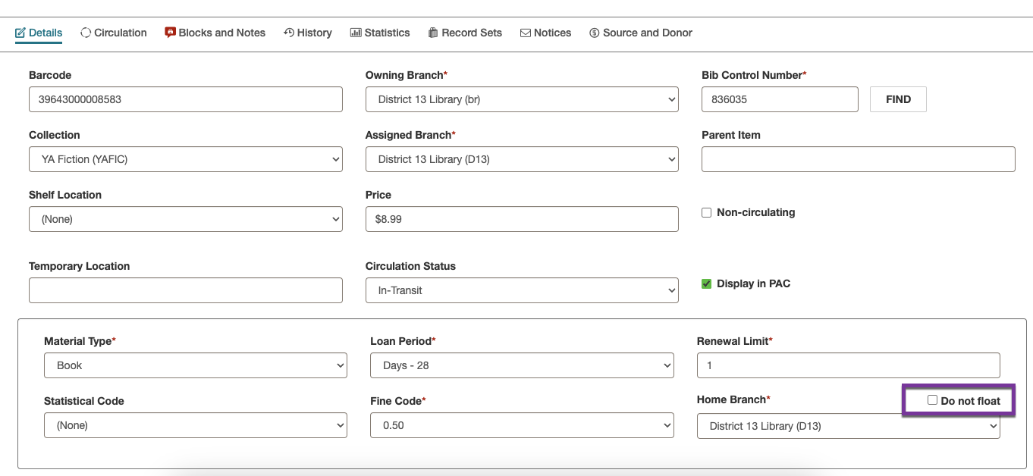
Excluding an Individual Item from Floating
Even when floating has been enabled for collections, it is possible to mark individual items as Do not float.
To exclude an individual item or items from floating:
Check the Do not float box in the item record.
Check the Do not float box in an item template if all items created with that template will not float.
Perform a bulk change on an item record set.

Slide 16
Floating Collections
The floating process in circulation
Cooperative considerations

Slide 17
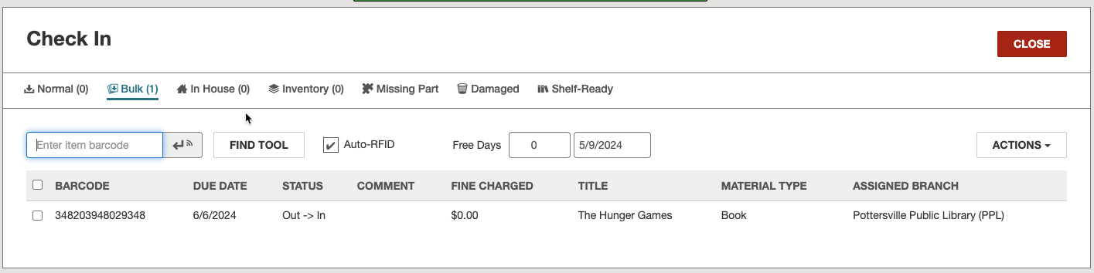
Floating Process in Circulation
Floating collection processing takes place at check in.
This process happens automatically; no message is displayed to the staff member when the item floats to its new assigned branch.

Slide 18
Floating Process in Circulation
When a floating item is checked in at the receiving branch, the item record fields are updated as follows:
Assigned branch: Changes to the branch of the check-in workstation
Collection: If both home branch and receiving branch are assigned the collection, that collection is displayed. If the receiving branch is not assigned to the collection or if there is no collection indicated in the item record, the behavior depends on System Administration settings.
Loan Period: The loan period defined for the receiving branch
Fine Code: The fine code defined for the receiving branch
Shelf Location: The program attempts a character-for-character match on the field; if the fields match, the value remains. However, if the fields do not match, the value is set to None.
Stat code: Same processing as Shelf Location
Library-assigned blocks: Same processing as Shelf Location
Free text block: The text is not altered or deleted; it appears in the item record after check-in.

Slide 19
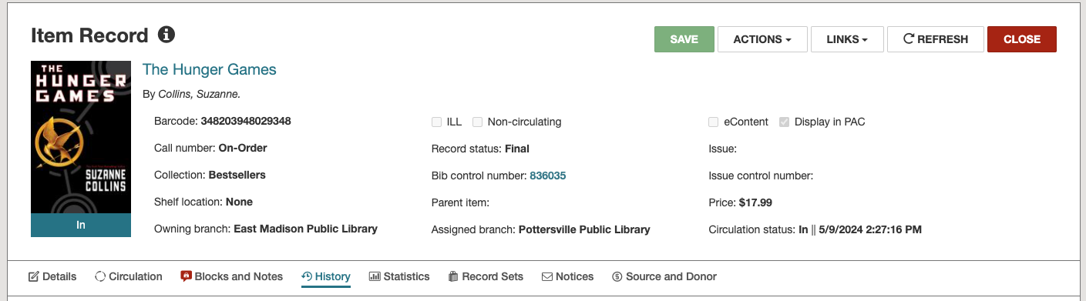
Floating Display in Item Circulation History
The History view of an item record shows the circulation history of the item as it moves from branch to branch.
Two transactions appear each time an item floats:
One for the check-in
One for the change in assigned branch due to settings related to floating collections

Slide 20
Cooperative Considerations
Libraries and branches that participate in floating collections may want to have matching, reciprocal policies to help maintain a balance of items. For example:
If A allows items to float to B, B may want to put A on its floating list.
Consider shelving schemes/filing integration.
If two libraries do not use the same classification system, integrating floating items would be nearly impossible.
It may also be problematic if using the same classification system with radically different call numbers; identical items could be shelved in different places.
Consider using the same collections.
If the Patron Services parameter Floating: Float items with no matching collection is set to Yes, it is possible to receive a floating item where the receiving branch has no matching collection.
If items with no assigned collection are allowed to float, set the Patron Services parameter Floating: Float items with blank Assigned Collection to Yes.

Slide 21
Cooperative Considerations
The two parameters in combination have the following effect:
A Floating: Float items with no matching collection = Yes &
A Floating: Float items with blank Assigned Collection can float = No
Result: An item may float to a new branch even if the receiving branch has no matching collection. The Assigned Branch will change to the receiving branch, and the Assigned Collection will change to null (blank)—the item will not float again.
B Floating: Float items with no matching collection = No &
B Floating: Float items with blank Assigned Collection can float = Yes
Result: Any item with no Assigned Collection will float normally.
C Floating: Float items with no matching collection = Yes &
C Floating: Float items with blank Assigned Collection can float = Yes
Result: Any item with no Assigned Collection will float. As mismatched items float to a new branch, the number of items with no Assigned Collection will increase.
D Floating: Float items with no matching collection = No &
D Floating: Float items with blank Assigned Collection can float = No
Result: These are the default settings. Items with no Assigned Collection do not float. Only items with matching collections will float. No mismatched items will be reassigned a null Assigned Collection.

Slide 22


Forename Surname
forename.surname@clarivate.com
+000 000-0000
About Clarivate
Clarivate is a leading global provider of transformative intelligence. We offer enriched data, insights & analytics, workflow solutions and expert services in the areas of Academia & Government, Intellectual Property and Life Sciences & Healthcare. For more information, please visit clarivate.com.
© 2025 Clarivate. All rights reserved
Clarivate and its logo, as well as all other trademarks used herein are trademarks of their respective owners and used under license.

