Slide 1

Polaris SimplyReports

Slide 2
Reports Result Options
I have my report, what can I do with it?
Downloading a report
Saving report parameters
Saving to a record set

Slide 3

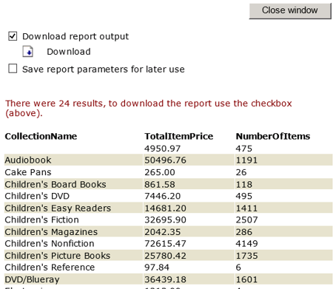
Downloading a Report
Report output is selected on the page where the query is created.
To download your report in the selected format after running the query, check the Download report output box and select Download.
If working in a Terminal Server environment and Excel is not present, do a Save As and save the file to a local machine drive.

Slide 4
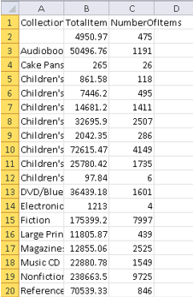
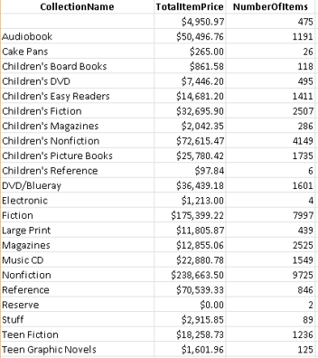
Downloading a Report
If Excel is present on the machine, the XLS file can be opened.
Once opened, the data may be formatted as desired.

Slide 5
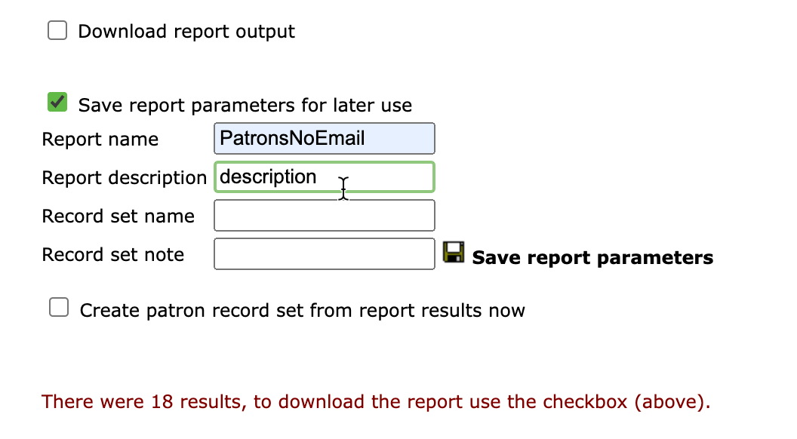
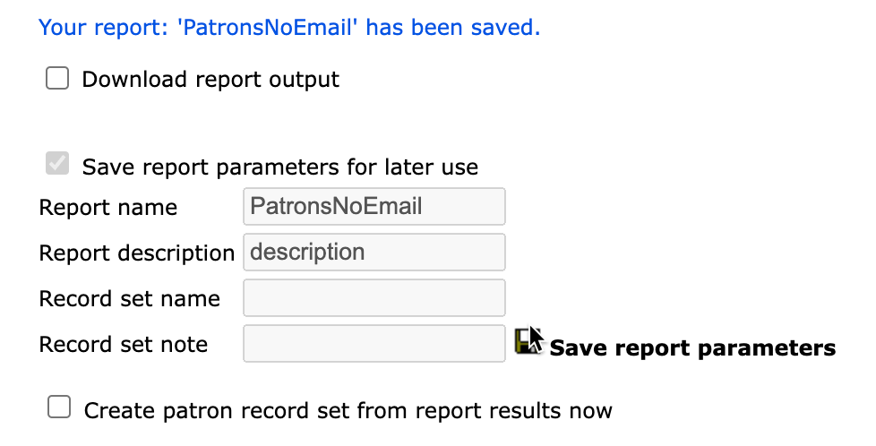
Saving Reports Parameters
To save report parameters, click the Save report parameters for later use box, enter a Report name, and click the Save report parameters icon.
The report description is optional.
You will receive a confirmation that the report is saved.

Slide 6
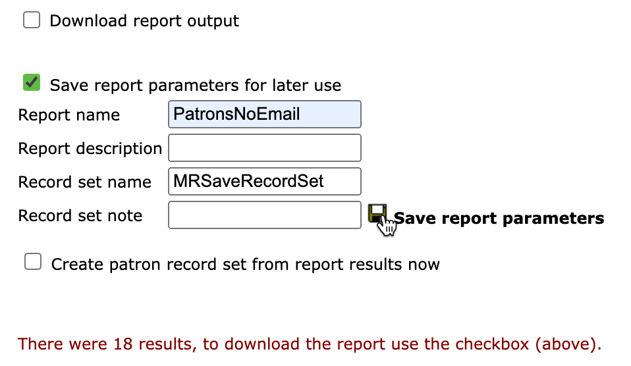
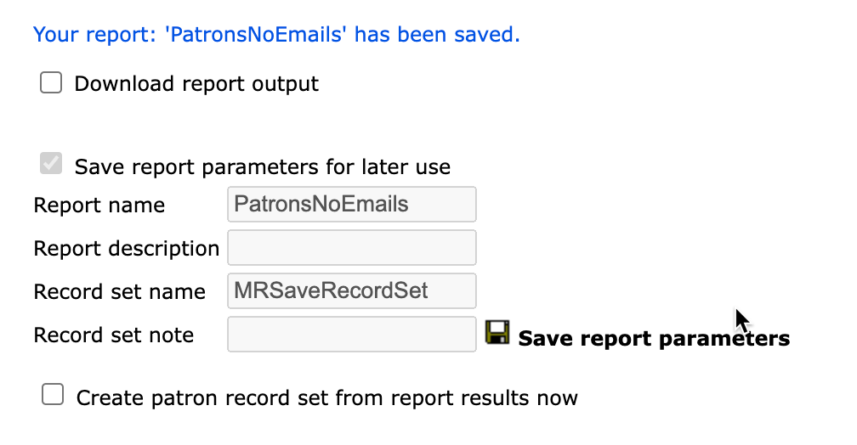
Saving Reports Parameters with a Record Set
To save report parameters with a record set, click the Save report parameters for later use box, enter a report name, also enter a Record set name, and click the Save report parameters icon.
The descriptions are optional.
You will receive a confirmation that the report is saved.

Slide 7
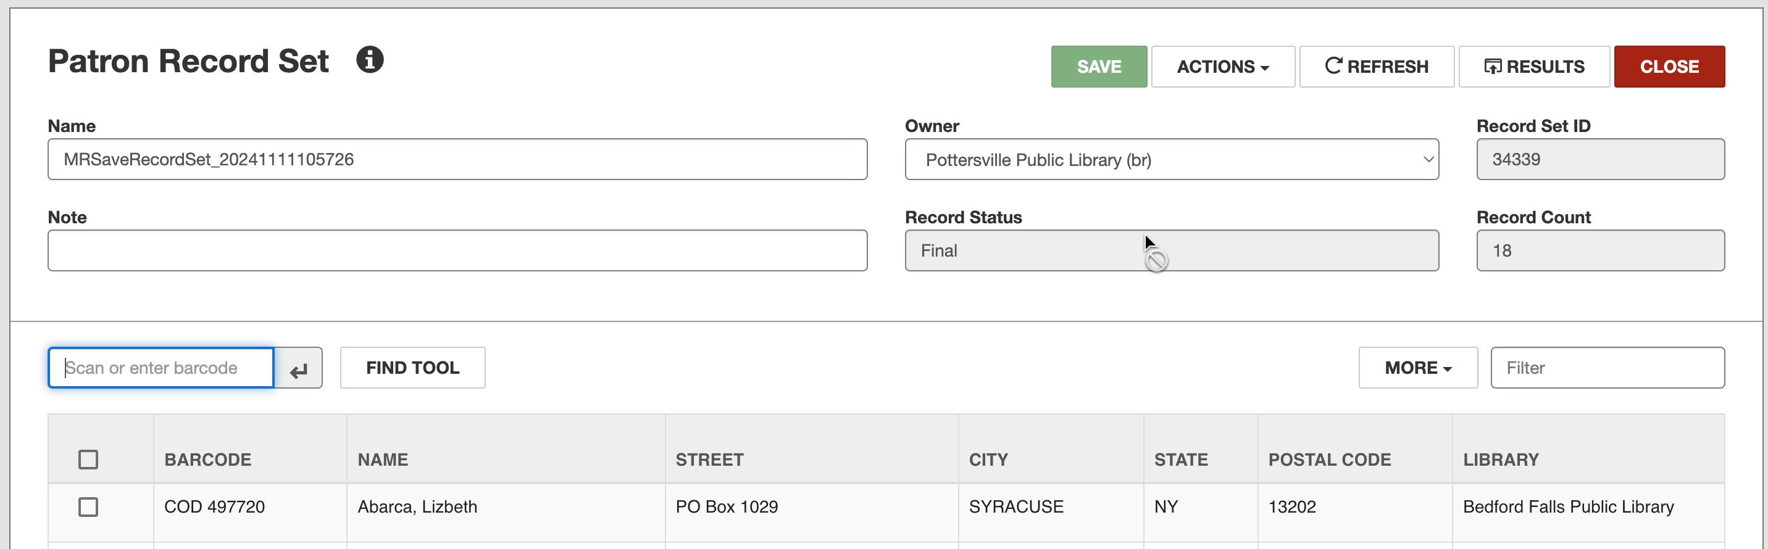
Saving Reports Parameters with a Record Set
When the saved report is run, the record set will be created (with a date/time stamp).
You can find the record set in Polaris.

Slide 8
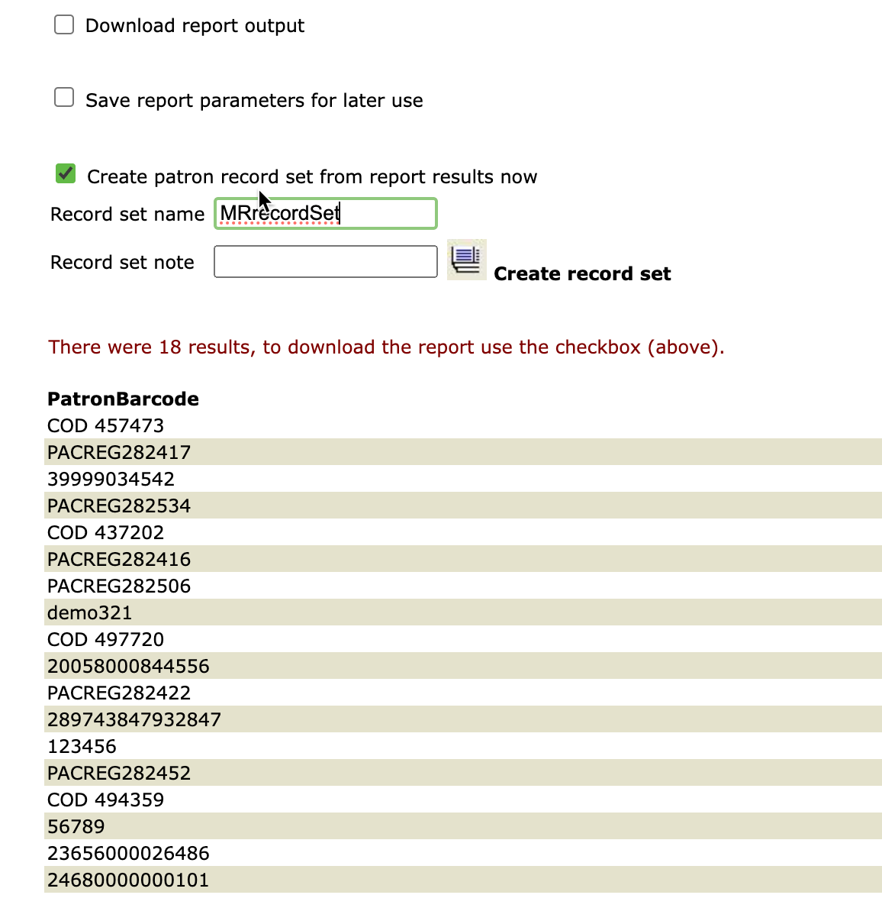
Saving to a Record Set Now
Four different types of record sets can be created: Patron; Item; Authority; Bibliographic.
Check the Create [type of] record set from report results box, name your record set, and click the Create record set icon.

Slide 9
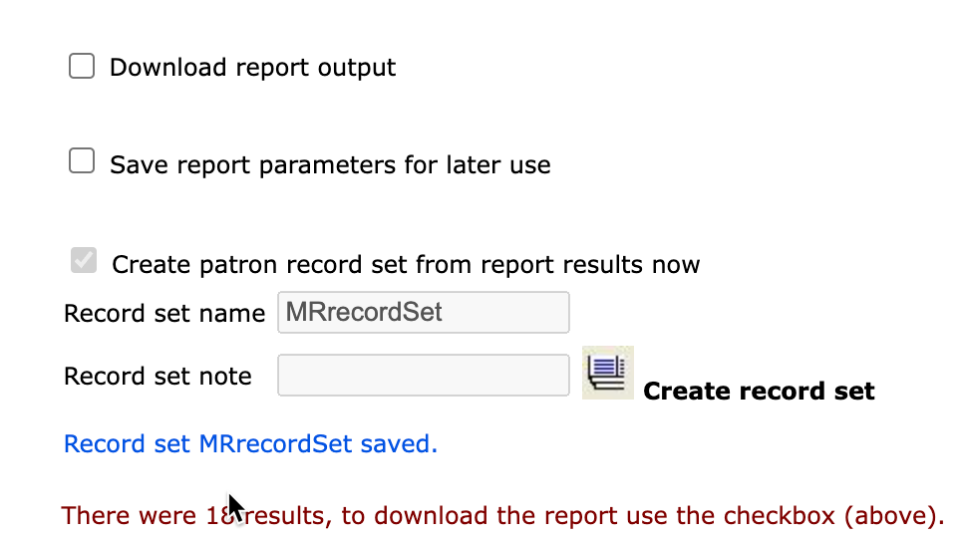
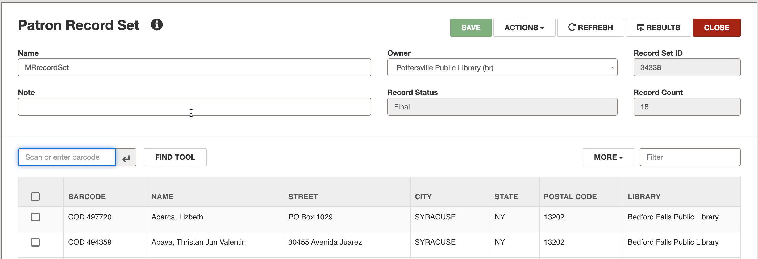
Saving to a Record Set Now
You will receive a confirmation message that the record set has been created.
The record set may now be retrieved in Polaris.

Slide 10
Working with Saved Reports
Where do my reports go?
  Ad hoc reports
  Saved reports
How do I edit a saved report?
How do I schedule a report?
How do I retrieve scheduled report results?
How do I publish a report to the Polaris Toolbar?
What is Advanced Publishing?

Slide 11
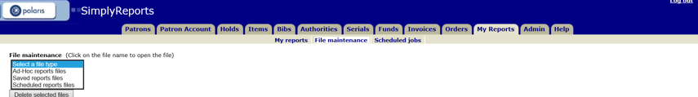
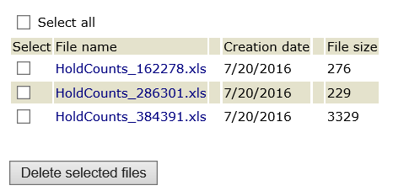
Where Do My Reports Go? (Ad Hoc)
If you are running a report in the moment and do not save it for later use, the file can be retrieved under My Reports > File maintenance > Ad hoc reports files.

Slide 12
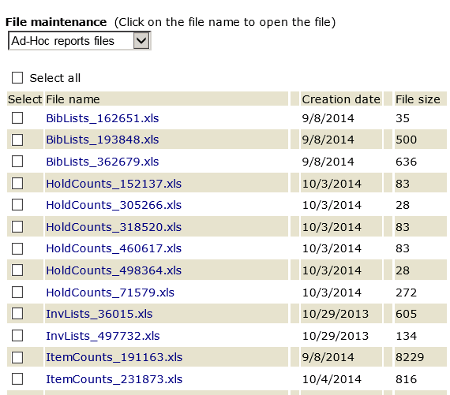
Where Do My Reports Go? (Ad Hoc)
To find the correct report, look for the type of report/date combination.
Clicking the blue link allows you to open the report again.

Slide 13
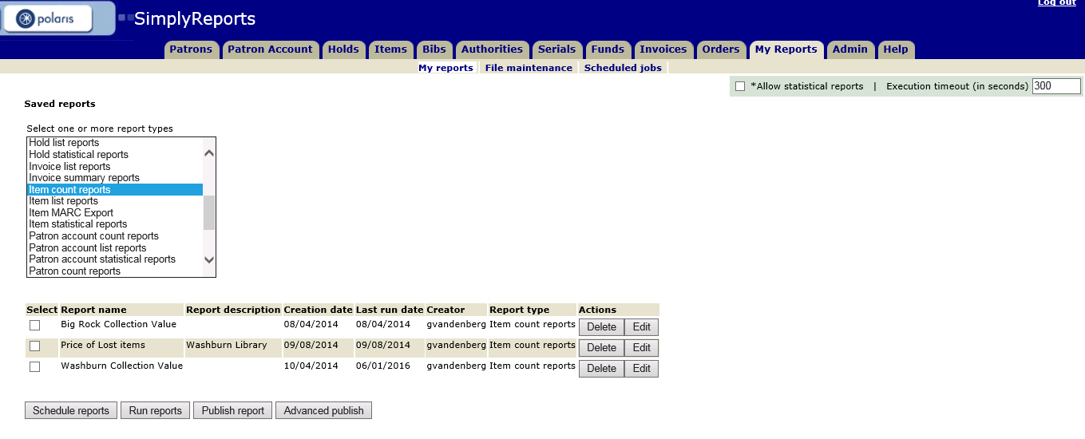
Where Do My Reports Go? (Saved)
All reports that have been saved will appear under My Reports > My reports > Saved reports.
Select the type of report you created to find your specific report listed below.

Slide 14
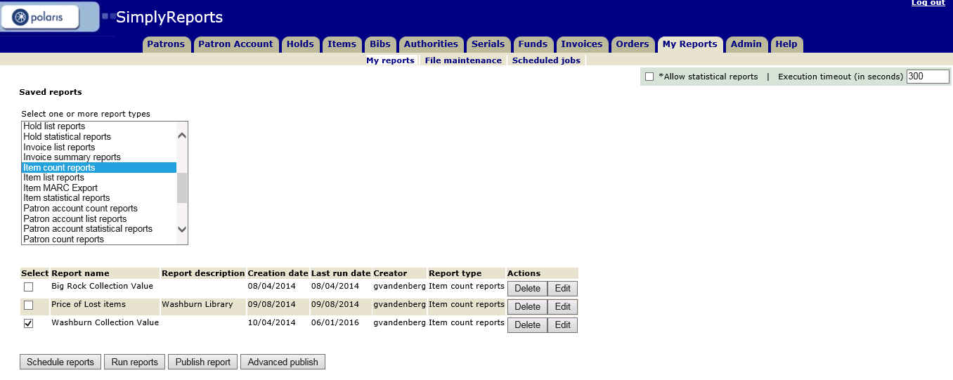
Where Do My Reports Go? (Saved)
One of the options with saved reports is to rerun them whenever you need new results.
Select the report and click the Run reports button.

Slide 15
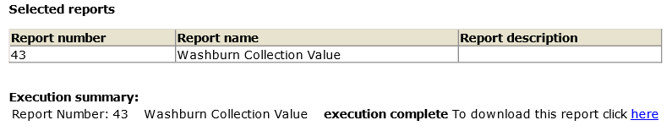
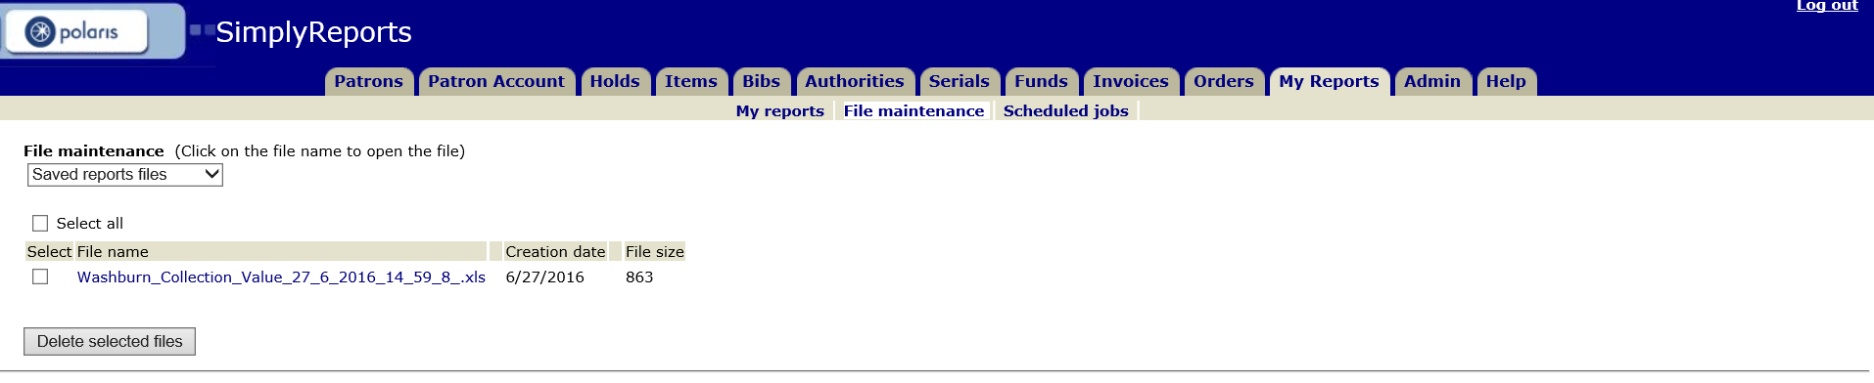
Where Do My Reports Go? (Saved)
The newly run report can be downloaded by clicking the blue here link.
It is also saved under My Reports > File maintenance > Saved reports files and may be downloaded at any time.
Look for the report name/date combination and click the blue link to download.

Slide 16
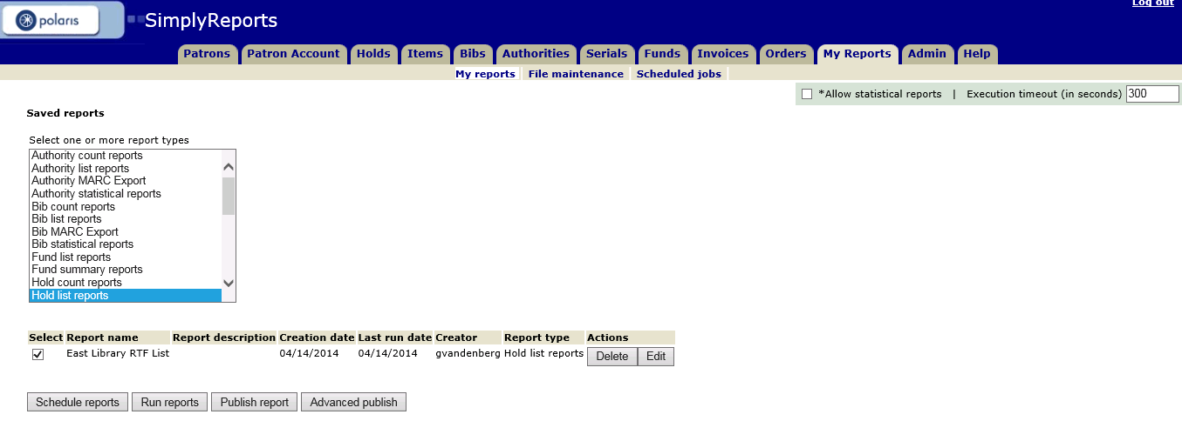
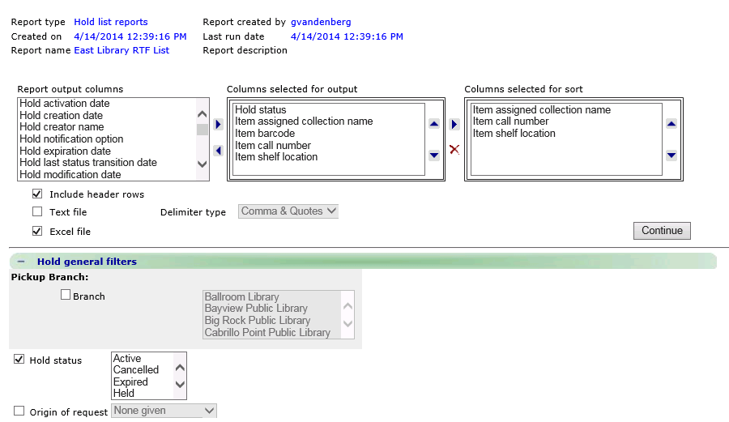
How do I Edit a Saved Report?
Columns and filters for saved Item, Patron, Patron Account and Hold list and count reports may be edited.
Select the report under My Reports > My Reports > Saved reports.
Click the Edit button.
After edits have been made, click Continue and you will be able to save the report under the same or a different name.

Slide 17
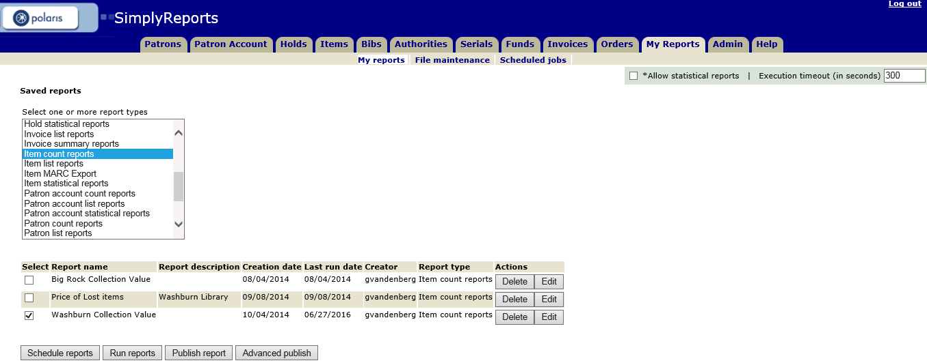
How do I Schedule a Report?
A report must be saved to be scheduled.
Look for your report under My Reports > My Reports > Saved reports.
Select your saved report and click the Schedule reports button.

Slide 18
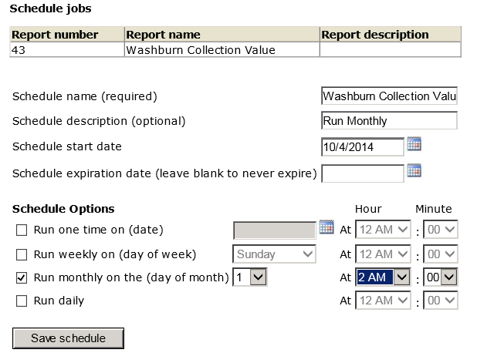
How do I Schedule a Report?
Fill in the Schedule name, select a Schedule start date. and select a Schedule Option.
You will receive a confirmation message after clicking Save schedule.

Slide 19
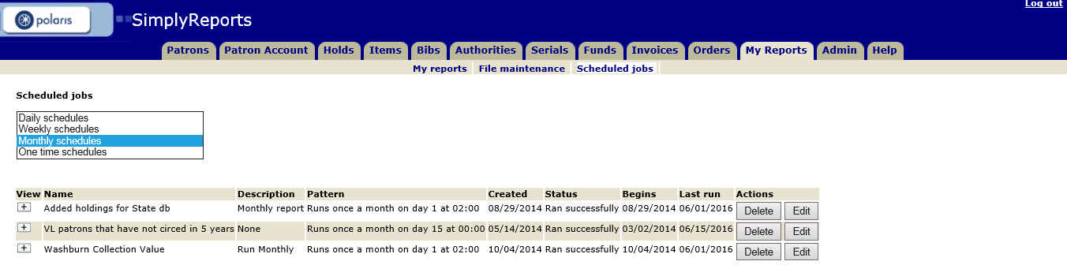
How do I Schedule a Report?
You can edit schedules for reports under My Reports > Scheduled jobs.
Select the type of schedule to see the report.
The last date the report was run and if it ran successfully can also be seen here.

Slide 20
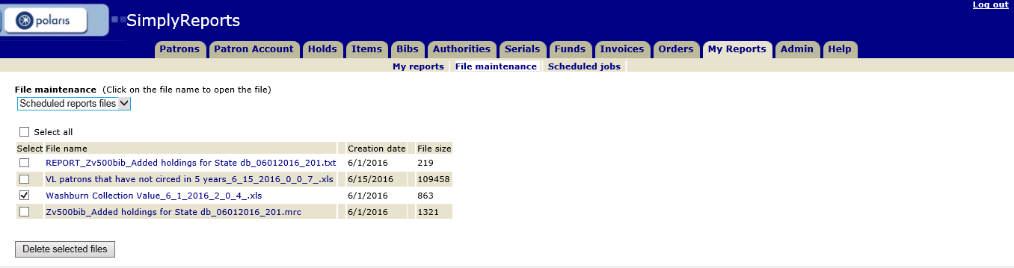
How do I Retrieve Scheduled Report Results?
To retrieve the results of a scheduled report, go to My Reports > File maintenance.
Select Scheduled reports files.
Look for the name of the report/date combination.
The report can be downloaded by clicking the blue link.

Slide 21
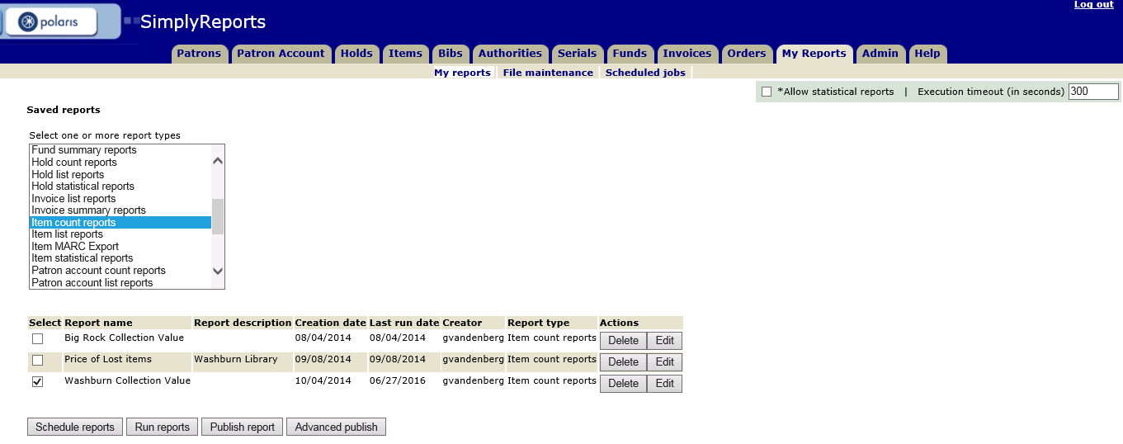
How do I Publish a Report to the Report Server?
A report must be saved to be published.
Look for your report under My Reports > My Reports > Saved reports.
Select your saved report and click the Publish report button.

Slide 22
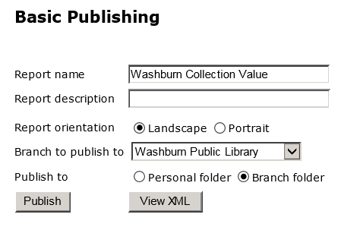
How do I Publish a Report to the Report Server?
HINT
Statistical reports cannot
be published to the Polaris
toolbar.
A report name is automatically entered in the Basic Publishing box, but this name may be edited.
Selecting a branch creates a Branch folder under the Custom folder in Reports & Notices.
Selecting Personal folder will create a subfolder with your user ID within the Branch folder.
Click the Publish button and a confirmation message appears.

Slide 23
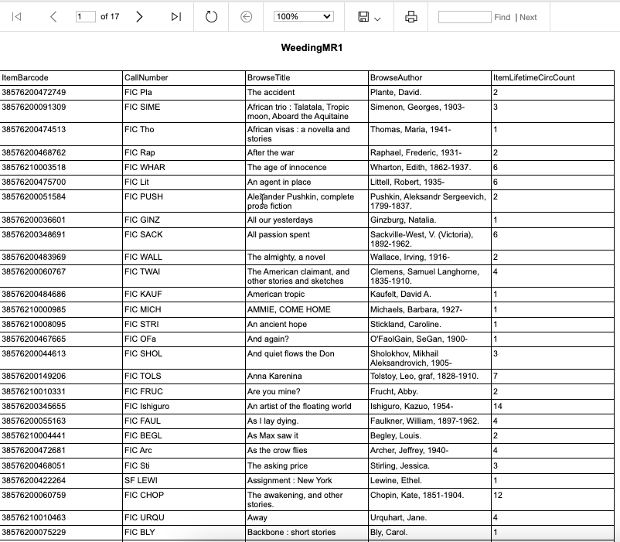
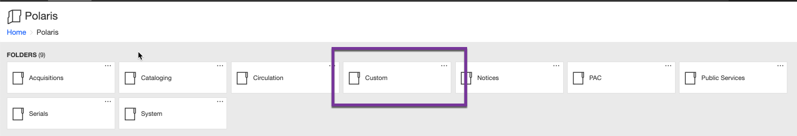
How do I Publish a Report to the Report Server?
On the Report Server, navigate to the report in the Custom folder.
The published report can now be run from here.

Slide 24
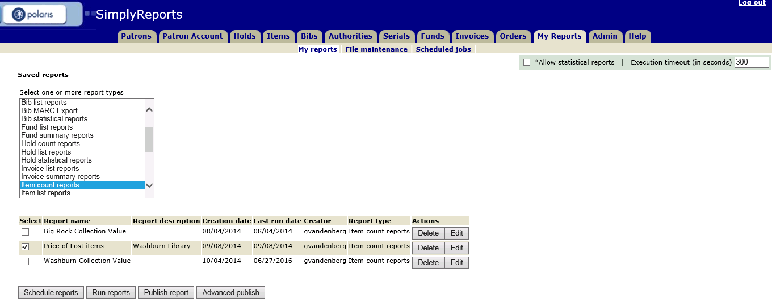
What is Advanced Publishing?
Using the Advanced publish button allows you to open a report in Report Builder for further customization.
The report must be saved first.
Look for your report under My Reports > My Reports > Saved reports.
Select your saved report and click the Advanced publish button.

Slide 25
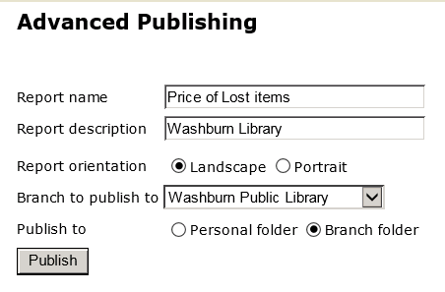
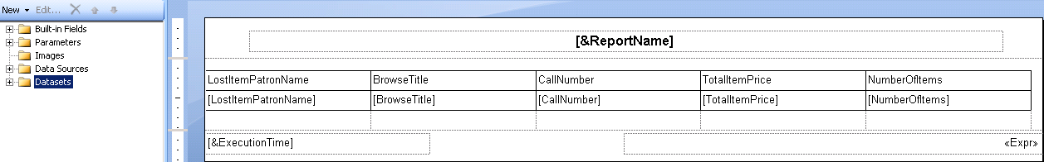
What is Advanced Publishing?
Fill out the Advanced Publishing box as you would for basic publishing.
Click the Publish button.
The report is published to the Toolbar and opened in Report Builder.

Slide 26
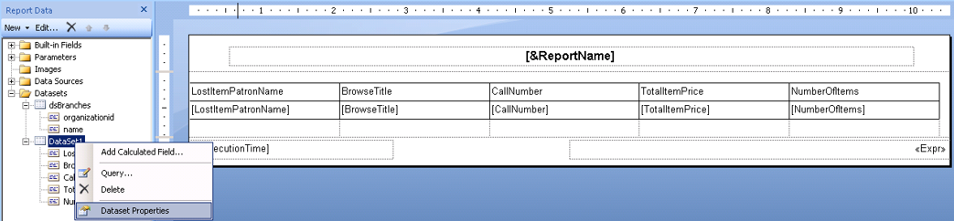
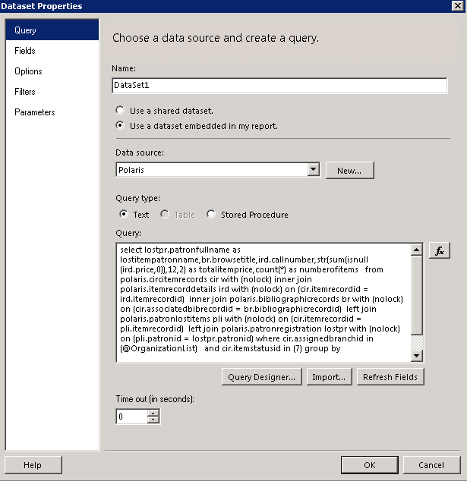
What is Advanced Publishing?
To see the SQL behind the SimplyReport query, extend the Datasets folder.
Right-mouse click on the dataset and select Dataset Properties.
You can begin a query in SimplyReports and expand on it using Report Builder.

Slide 27
Reporting Services
What is Reporting Services?
How do I delete a report I longer need from the Custom folder?
How do I subscribe to a report, and have it emailed to me?
Report Builder and Reporting Services

Slide 28
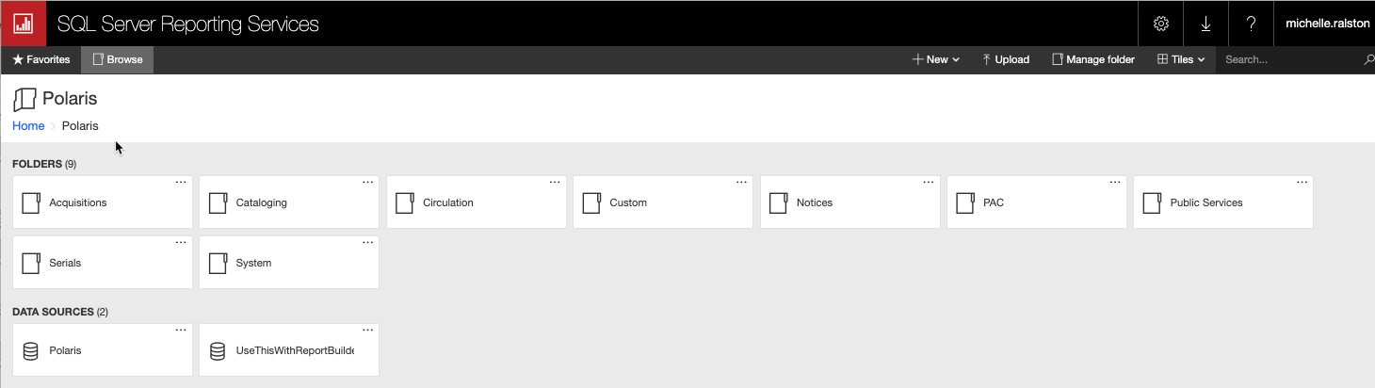
What is Reporting Services?
Reporting Services is a tool that works within the Microsoft Visual Studio environment and is fully integrated with SQL Server tools and components.
One of its purposes is to create reports from relational data sources such as Polaris.

Slide 29
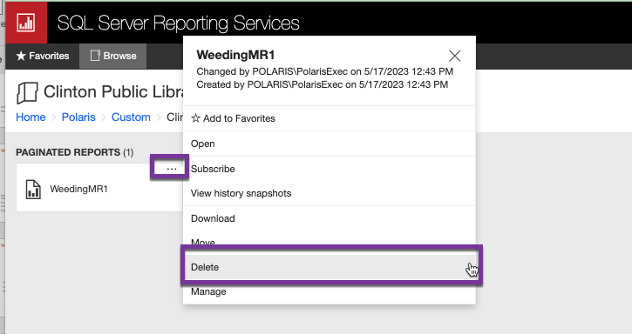
Deleting a Report from the Custom Folder
Navigate to the Custom folder and the report you would like to delete (just as you would in Reports & Notices).
Click the three dots in the right-hand corner and select Delete.
The report is deleted here as well as from Reports & Notices.

Slide 30
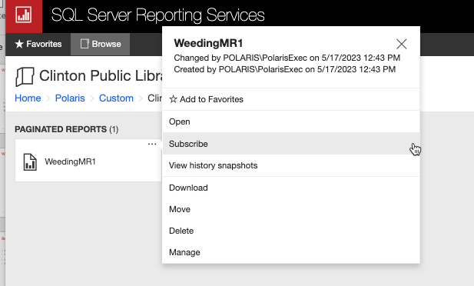
How do I Subscribe to a Report and Have it Emailed to Me?
Navigate to the Custom folder and the select the report to which you would like to subscribe.
Click the three dots in the right-hand corner and select Subscribe.

Slide 31
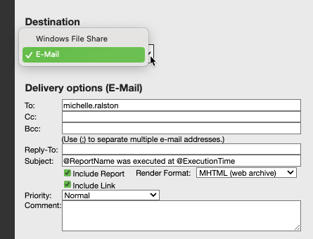
How do I Subscribe to a Report and Have it Emailed to Me?
Two options are available when subscribing to a report:
  The report may be emailed to the subscriber.
  The report may be pushed out to a shared network folder.

Slide 32
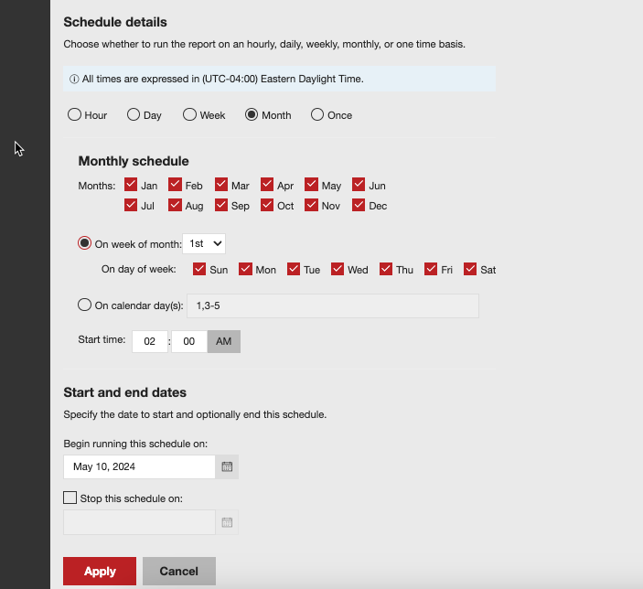
How do I Subscribe to a Report and Have it Emailed to Me?
Whether subscribing using email or a shared drive, click the Edit Schedule button and complete the schedule details.
Click Apply when complete.

Slide 33


Forename Surname
forename.surname@clarivate.com
+000 000-0000
About Clarivate
Clarivate is a leading global provider of transformative intelligence. We offer enriched data,
insights & analytics, workflow solutions and expert services in the areas of Academia & Government, Intellectual Property and Life Sciences & Healthcare. For more information, please visit clarivate.com.
© 2025 Clarivate. All rights reserved
Clarivate and its logo, as well as all other trademarks used herein are trademarks of their respective owners and used under license.

