Slide 1

Polaris System Administration

Slide 2
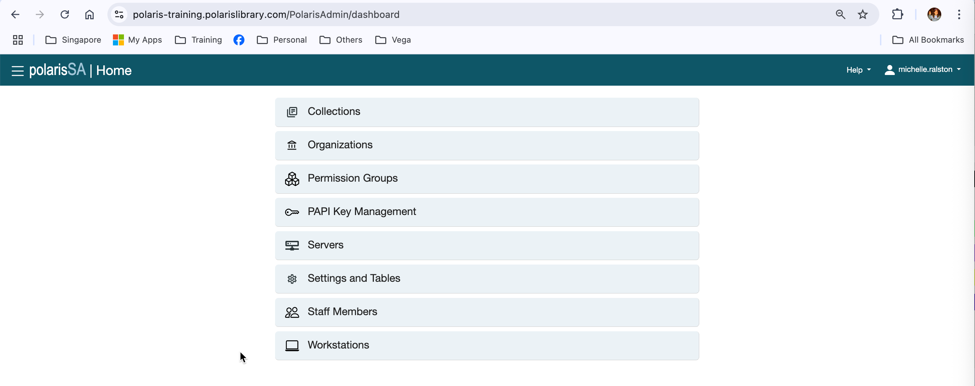
Getting Started
Polaris Administration settings determine how data is categorized, used, and stored, along with what functions are available in Leap (and the Staff Client).
When a library goes live on Polaris, the System Administration settings will be tailored to the decisions made with the Polaris Implementation Manager during the profiling process.
It should be expected that changes will be needed once staff use the software and discover the implications of their decisions and what new features Polaris can offer.
Web Access: https://[libraryserver].polarislibrary.com/polarisadmin

Slide 3
Organization Levels
Three organization levels create the basic hierarchy of the system:
System—The System level is at the top of the Polaris hierarchy. It represents a single library or group of libraries that use one Polaris system. One system level administration record is defined for each Polaris installation.
Library—Organizations at the Library level can represent any of the following entities:
A single, functional repository (branch) in the system
Multiple branches, with the library itself being a functional branch in the system
Multiple branches, but the library organization itself is not a functional repository (branch) in the system
Branch—A Branch is part of a library, usually in a separate physical location or repository, consisting of one or more collections. Each branch you identify must be associated with a parent at the library level. Each branch is represented by its own record.

Slide 4
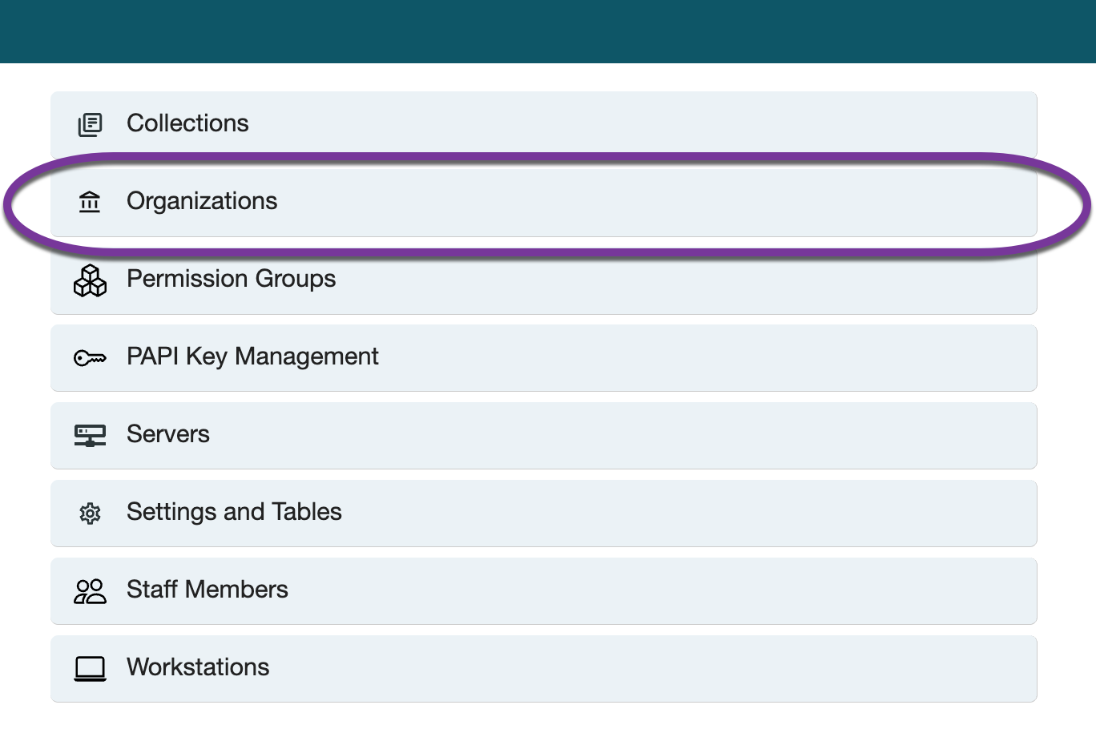
Administration

Slide 5
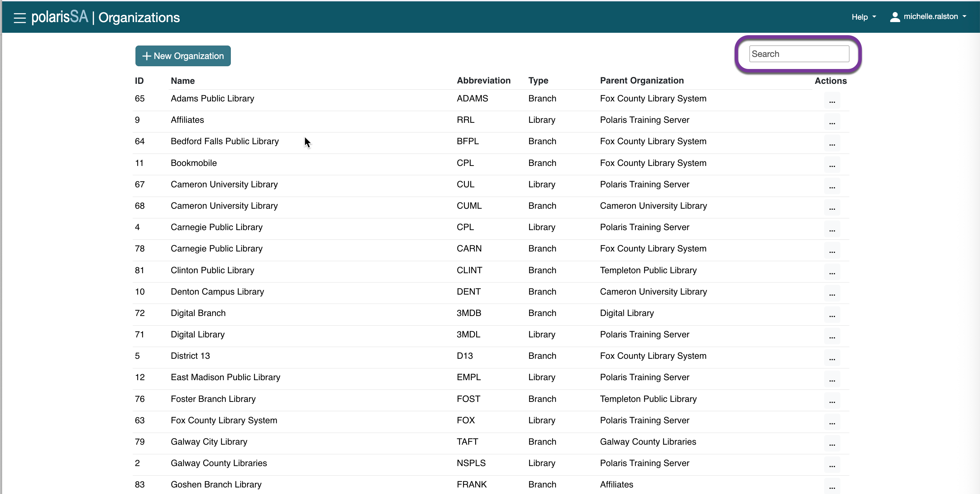
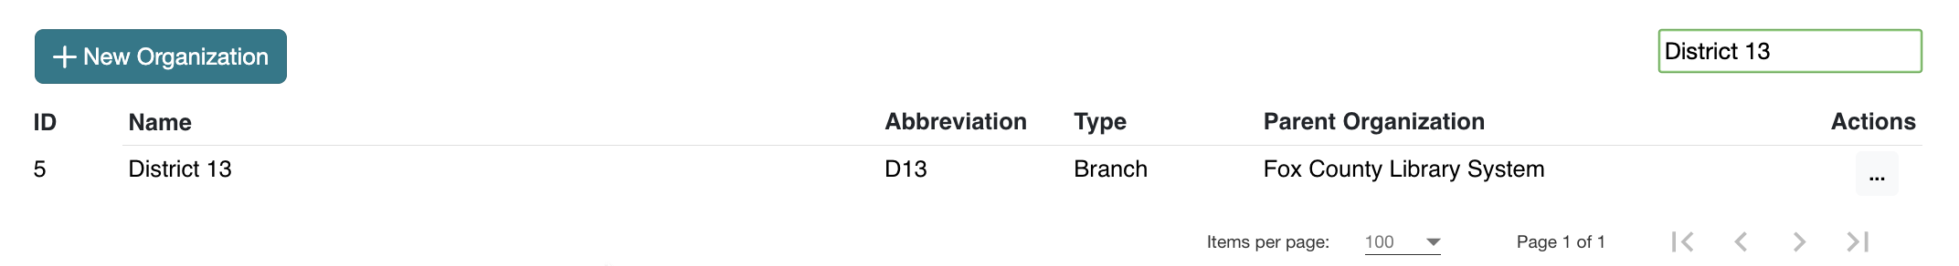
Administration Records
You can use search to find the system, library, or branch record that you’d like to access.

Slide 6
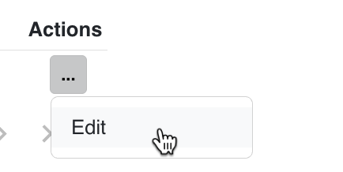
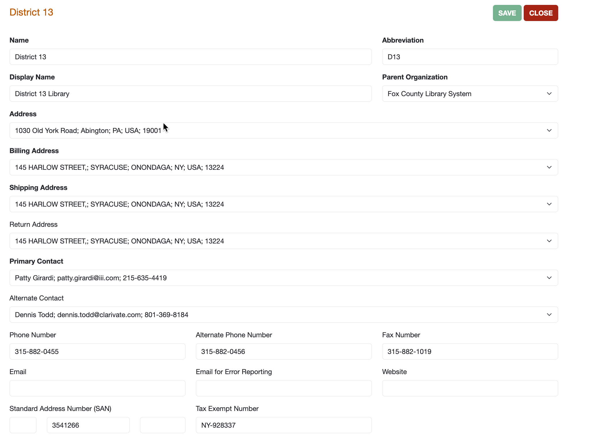
Administration Records
Some entries may be changed directly, while the Addresses and Contact Representatives fields provide a dropdown list for selection; the text in these two fields comes from the Tables - Addresses and Contact Persons, where the information must be entered before it is available in the organization workform.

Slide 7
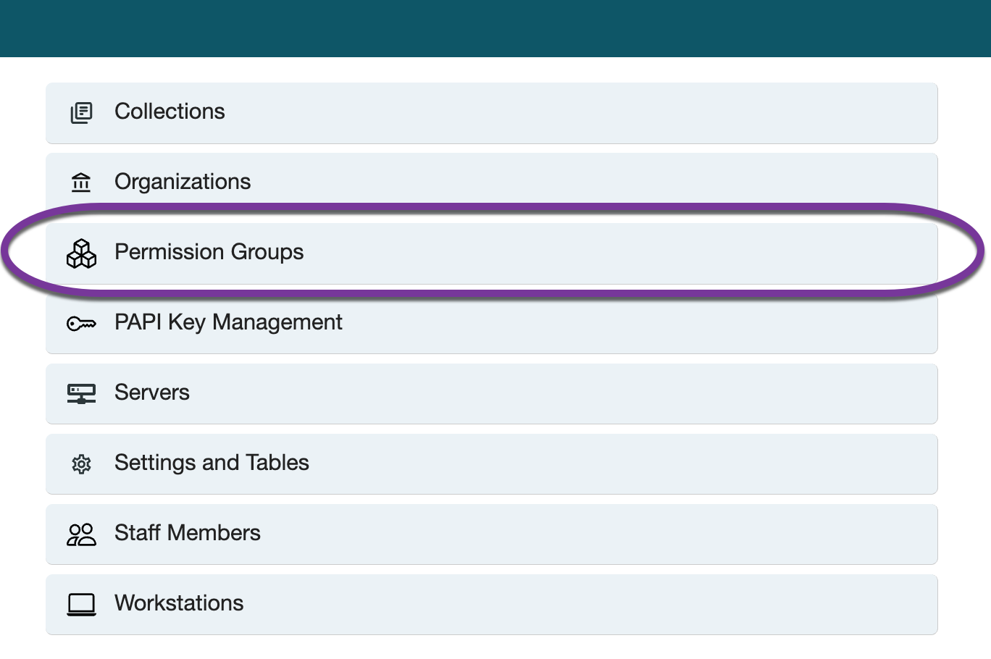
Permissions
Managing permissions with groups
Permission references
Permission Group workform
General View
Permissions View
Permissions Find Tool
Staff Members
Permissions
Group membership
New Staff Member or Workstation
Security

Slide 8
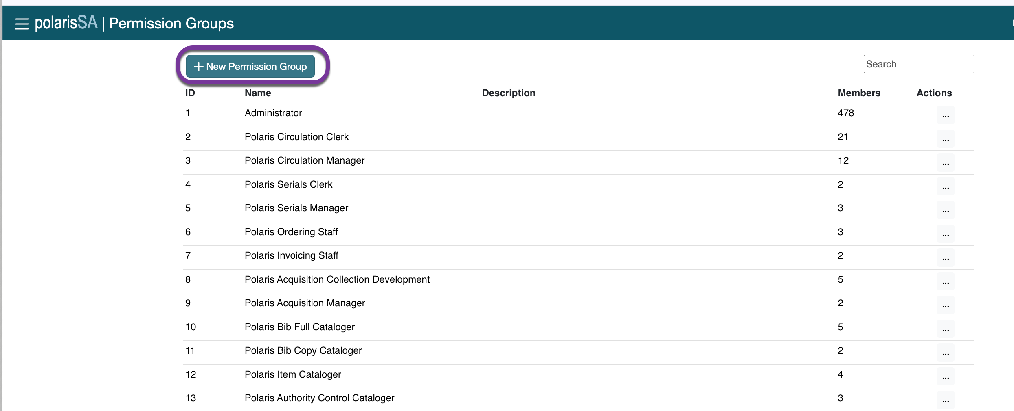
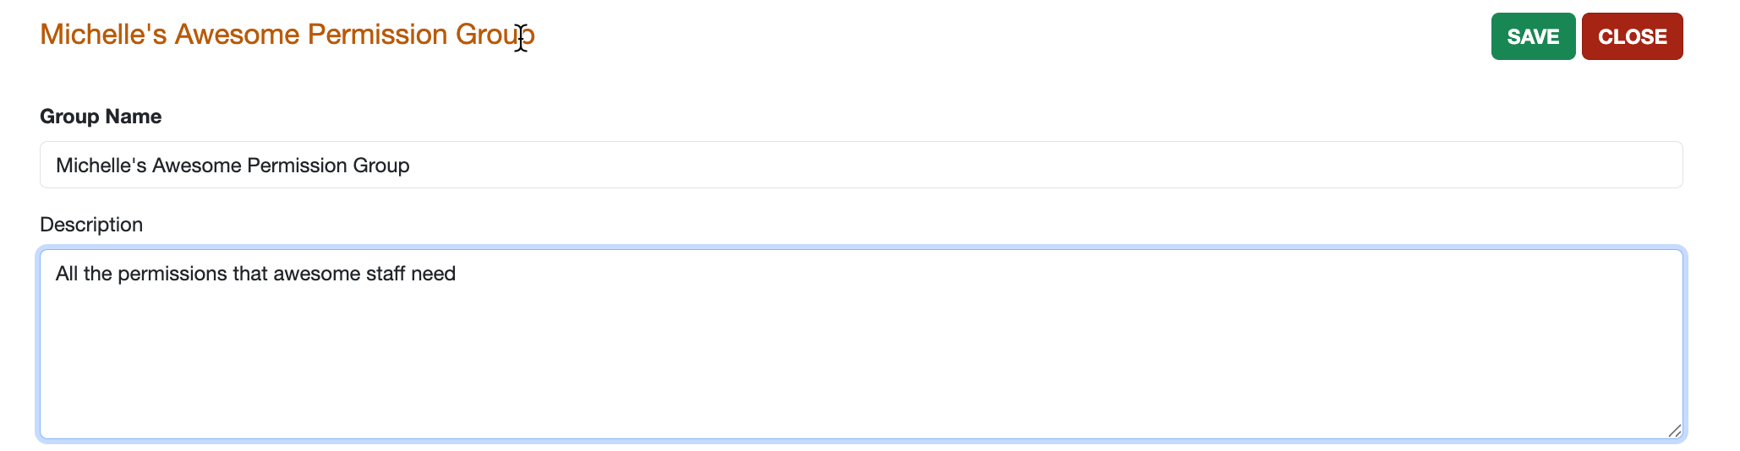
Managing Permissions with Groups
If you are creating permissions for a main functionality, the Group method is the best strategy.
You can set up groups of staff members involved in the same types of tasks in the library, then assign the permissions to the group itself.
When staff members are hired, you simply add them to the appropriate group.
Polaris supplies default groups which can be copied, renamed, and modified; alternatively, permissions may be acquired from these defaults and applied to other groups.
To create a new permission group, use the +New Permission Group button.

Slide 9
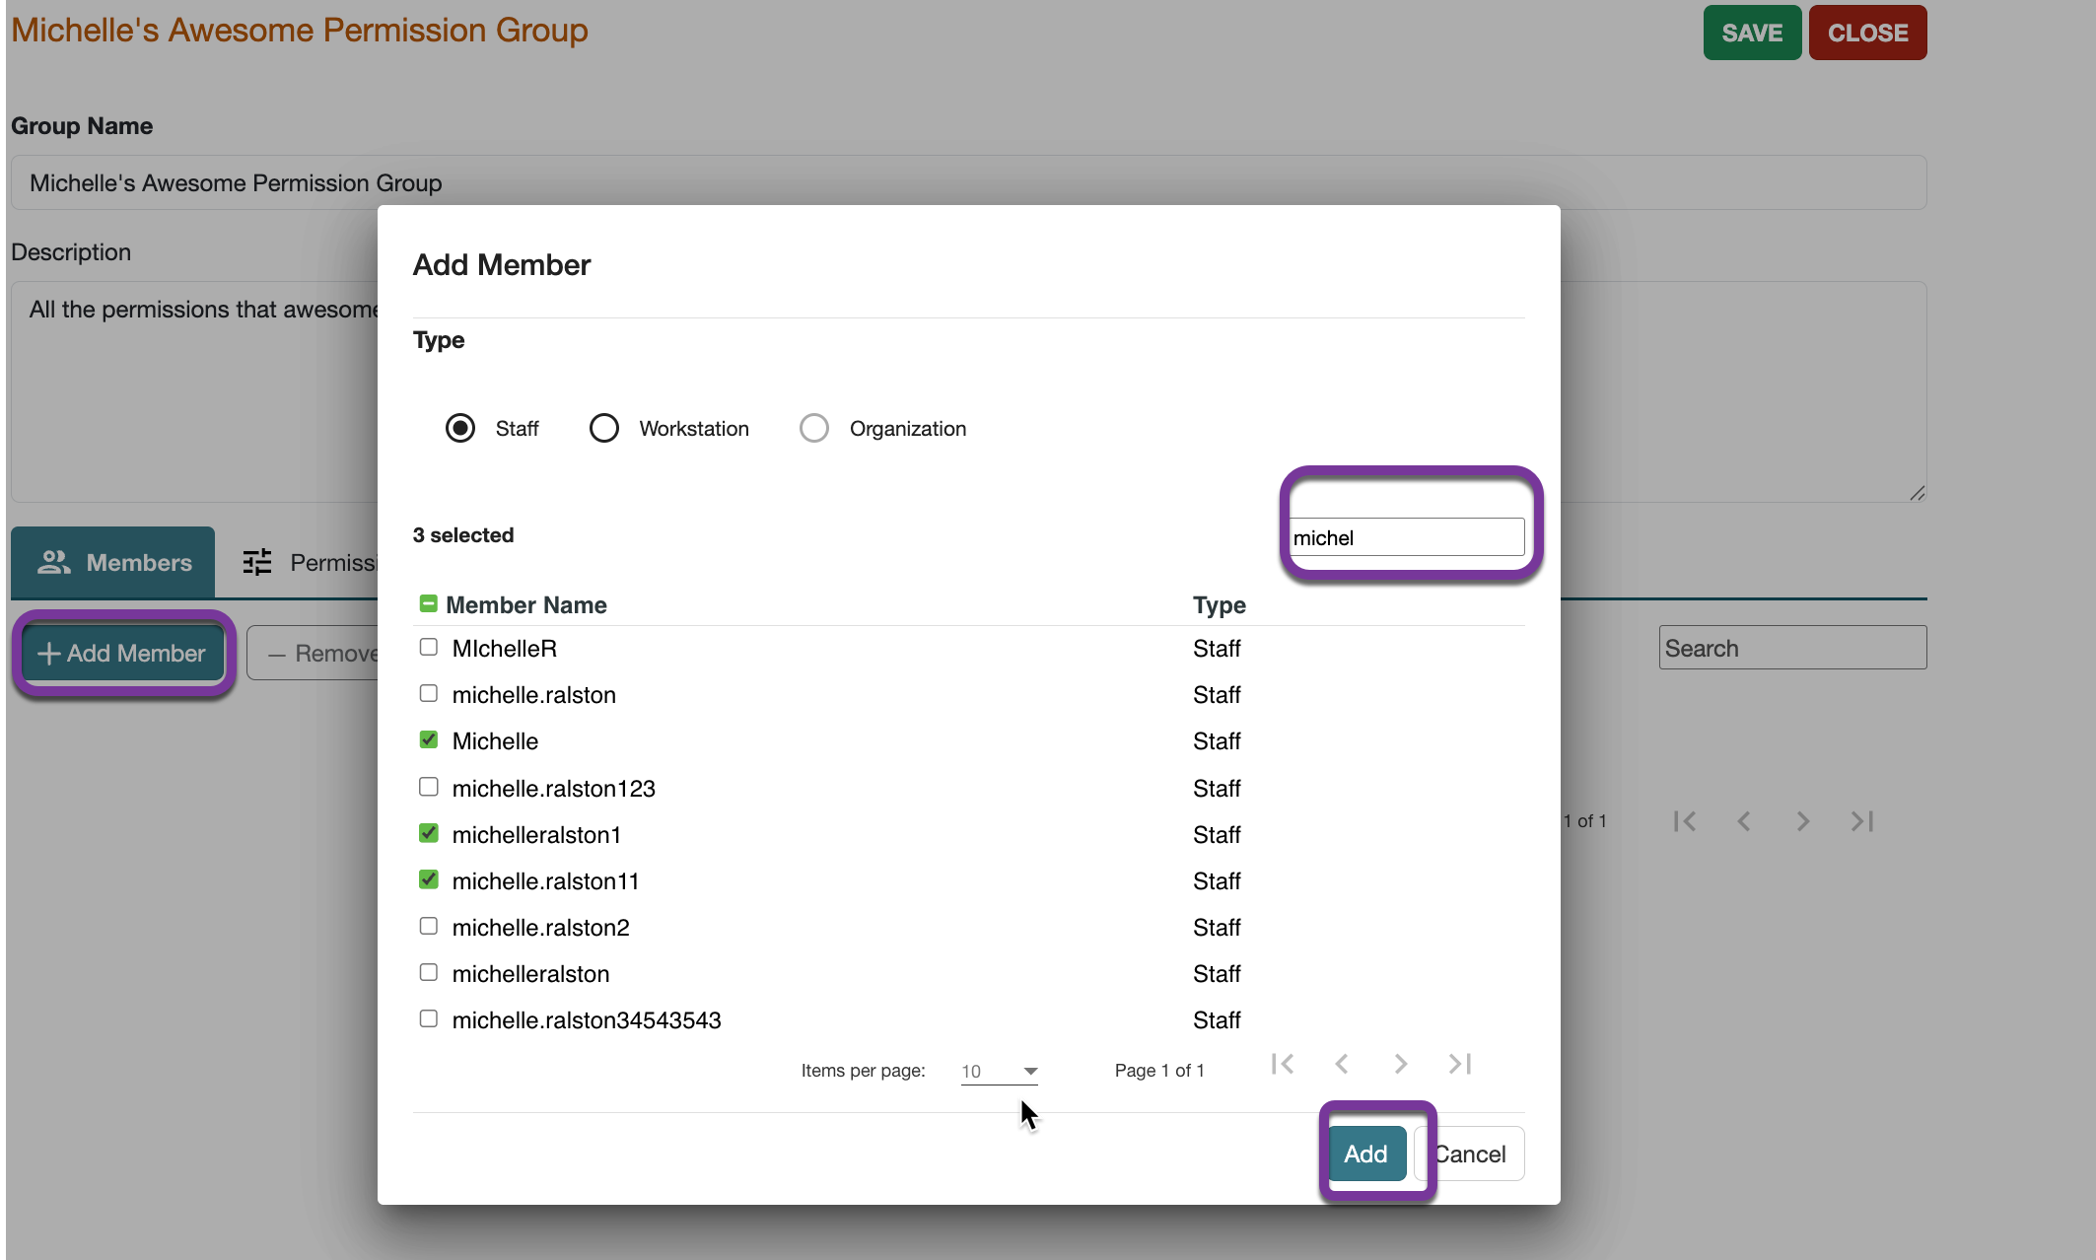
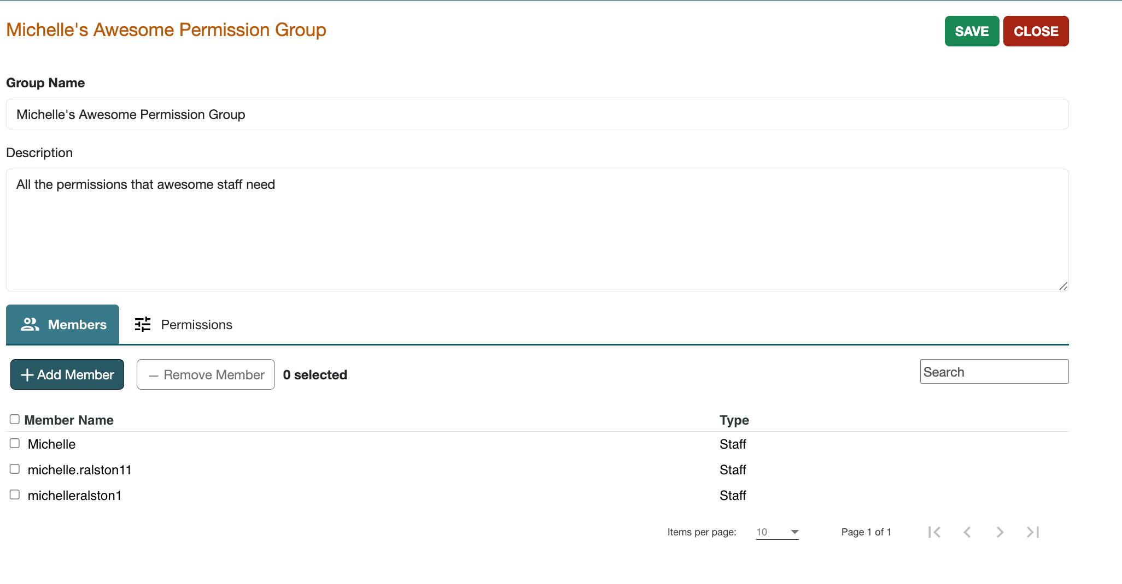
Permission Groups: Members View
The Members view of the group workform will show which members are currently in the group. You can add and remove members from here.

Slide 10
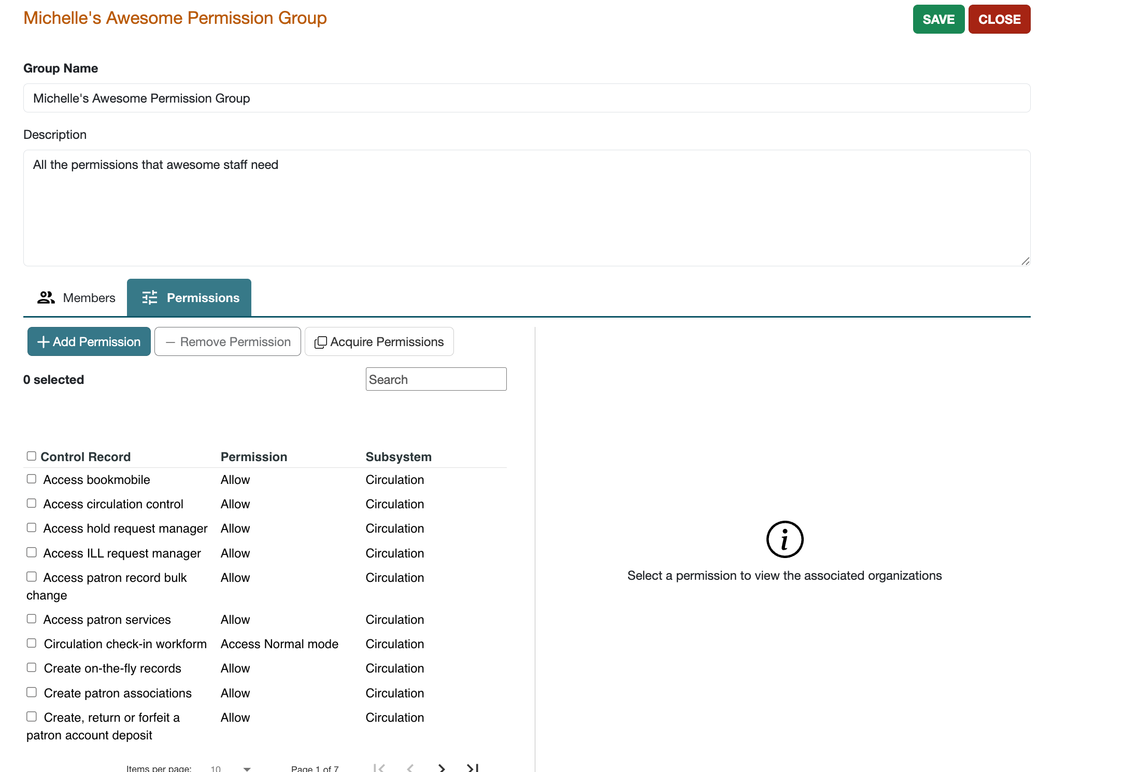
Permission Groups: Permissions View
TIP
To see a list of all permissions, open the Permissions view of the Administrator group.
The Permissions view allows you to add a new permission, acquire another group’s permissions, or remove selected permissions.

Slide 11
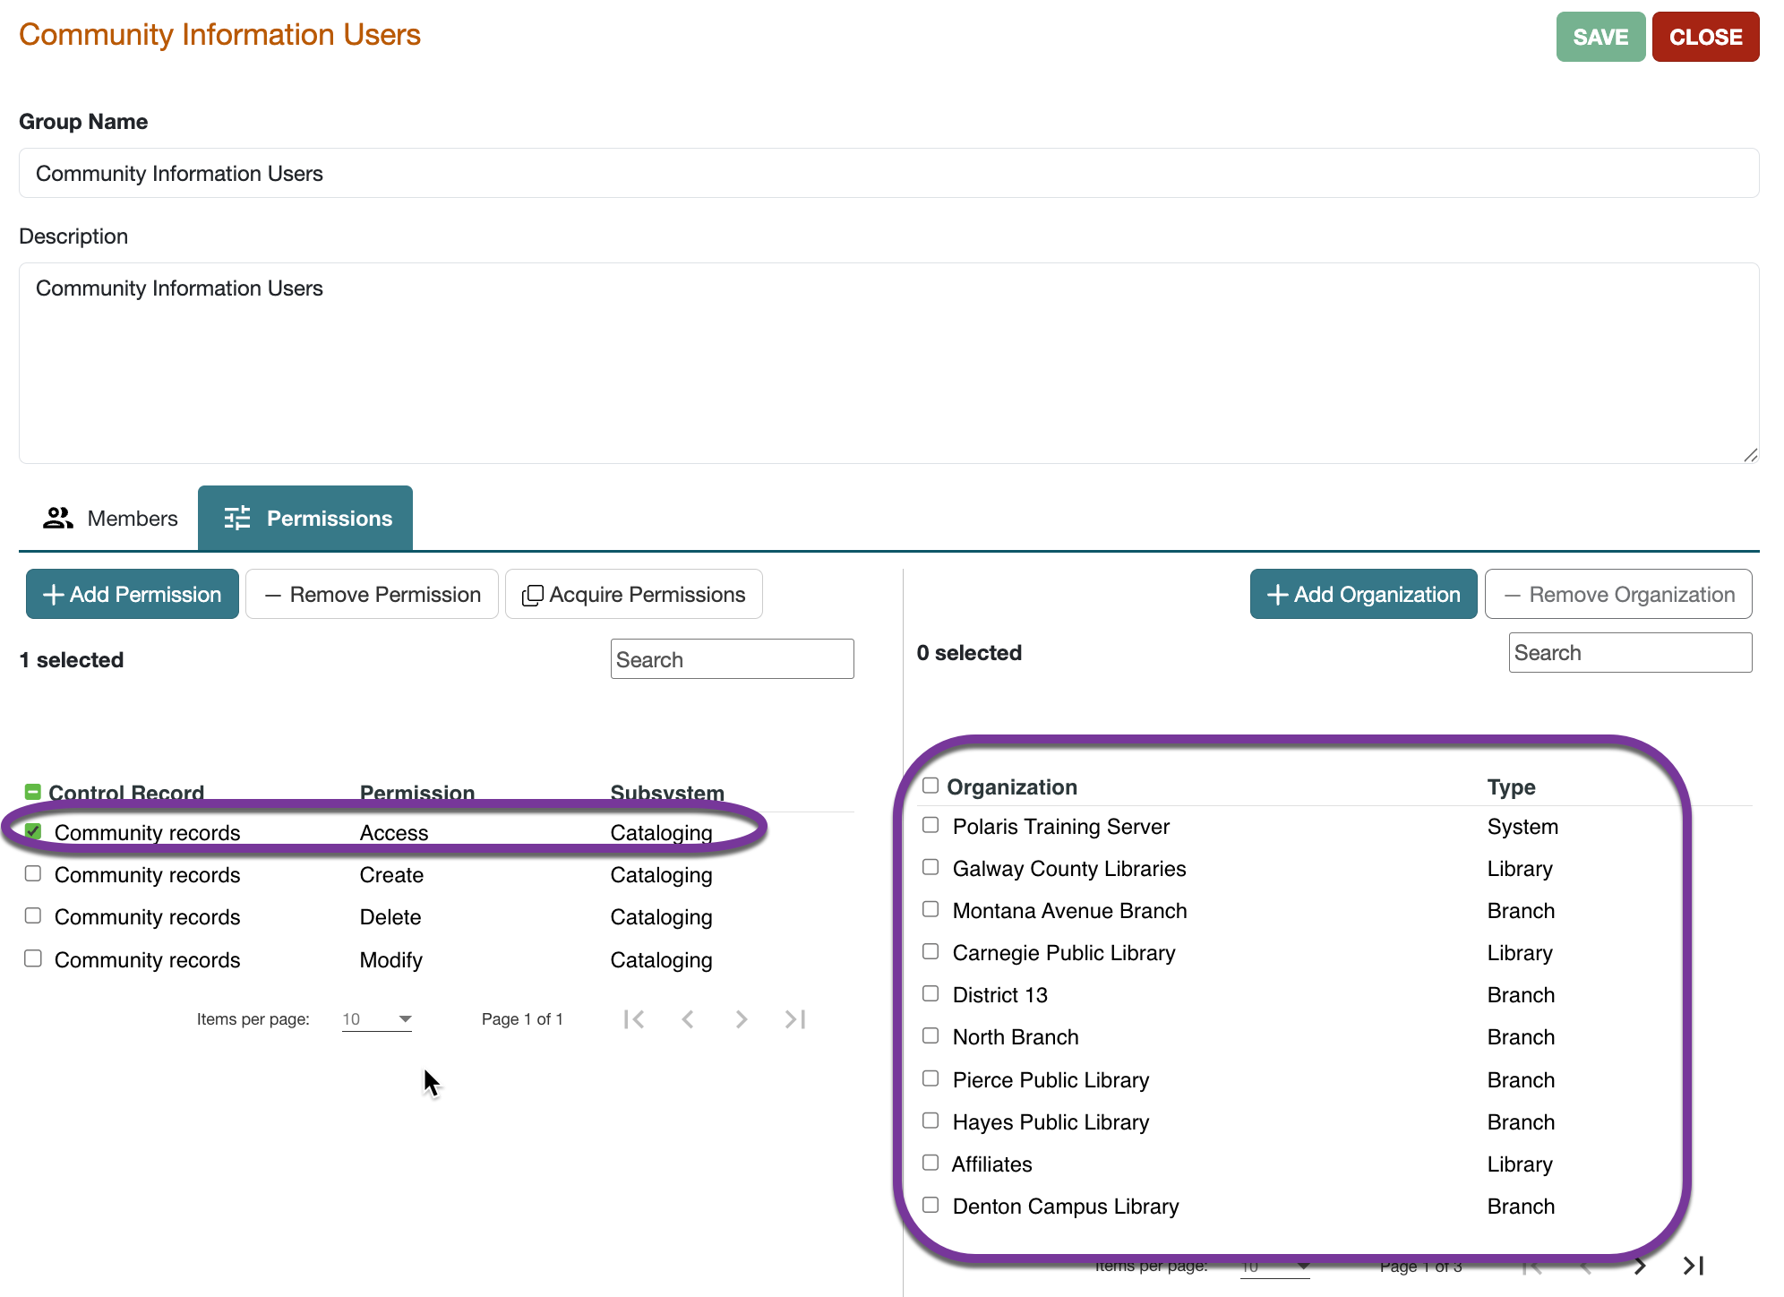
Permission Group Workform: Permissions View
The left pane of the Permissions view lists the permissions by control record name.
The right pane shows the permissions' associated organizations when a specific permission is selected in the left pane.

Slide 12
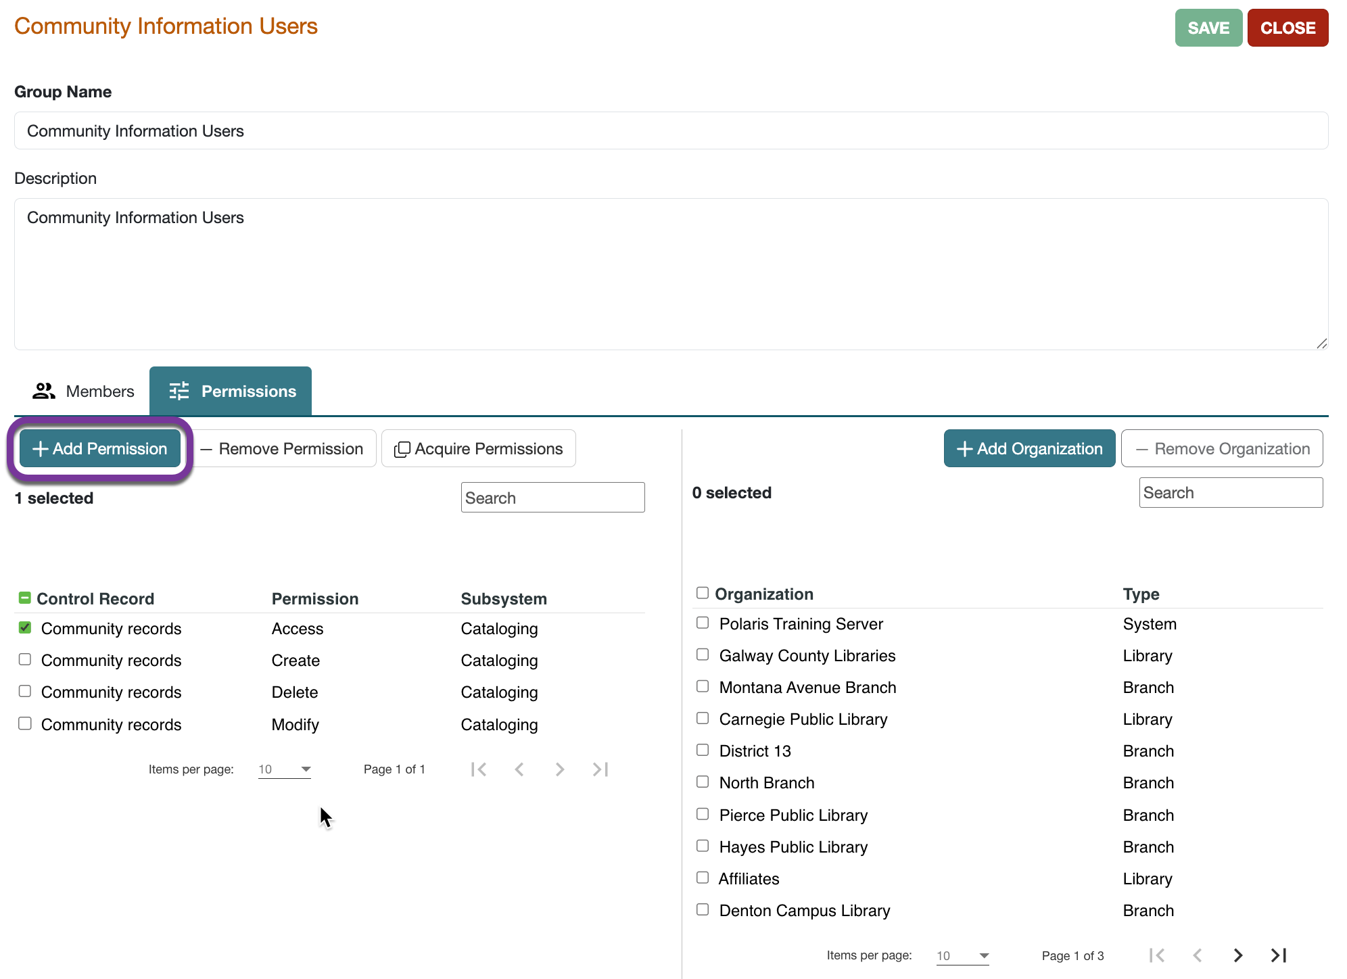
Permissions Find Tool
Since the list of permissions is very long, helpful information for effectively using this Find Tool may be found in Polaris Help > Polaris Administration Topics > Granting Permissions.

Slide 13
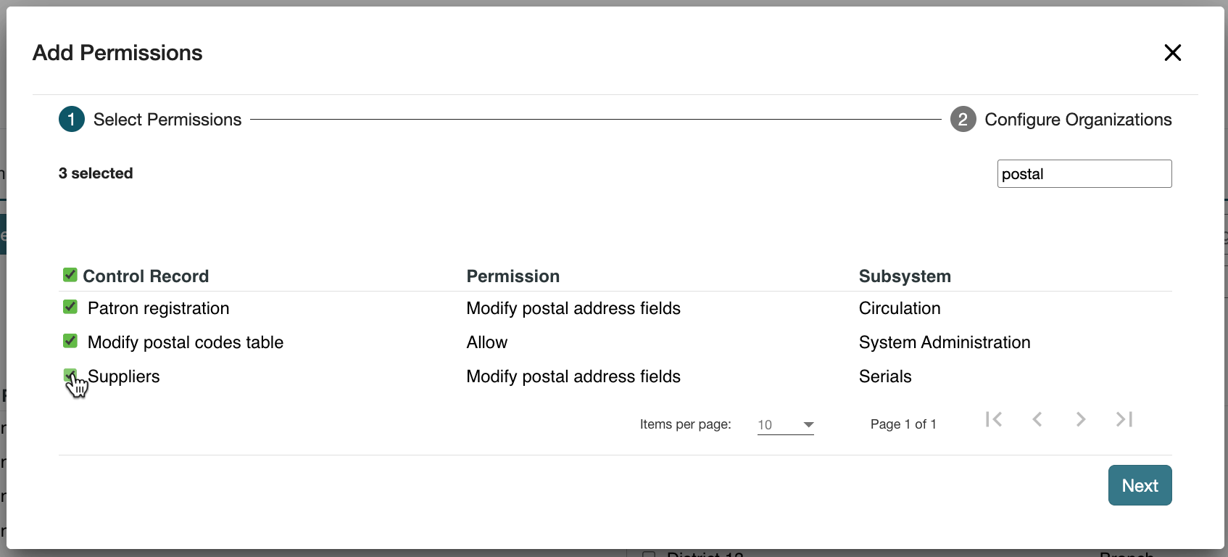
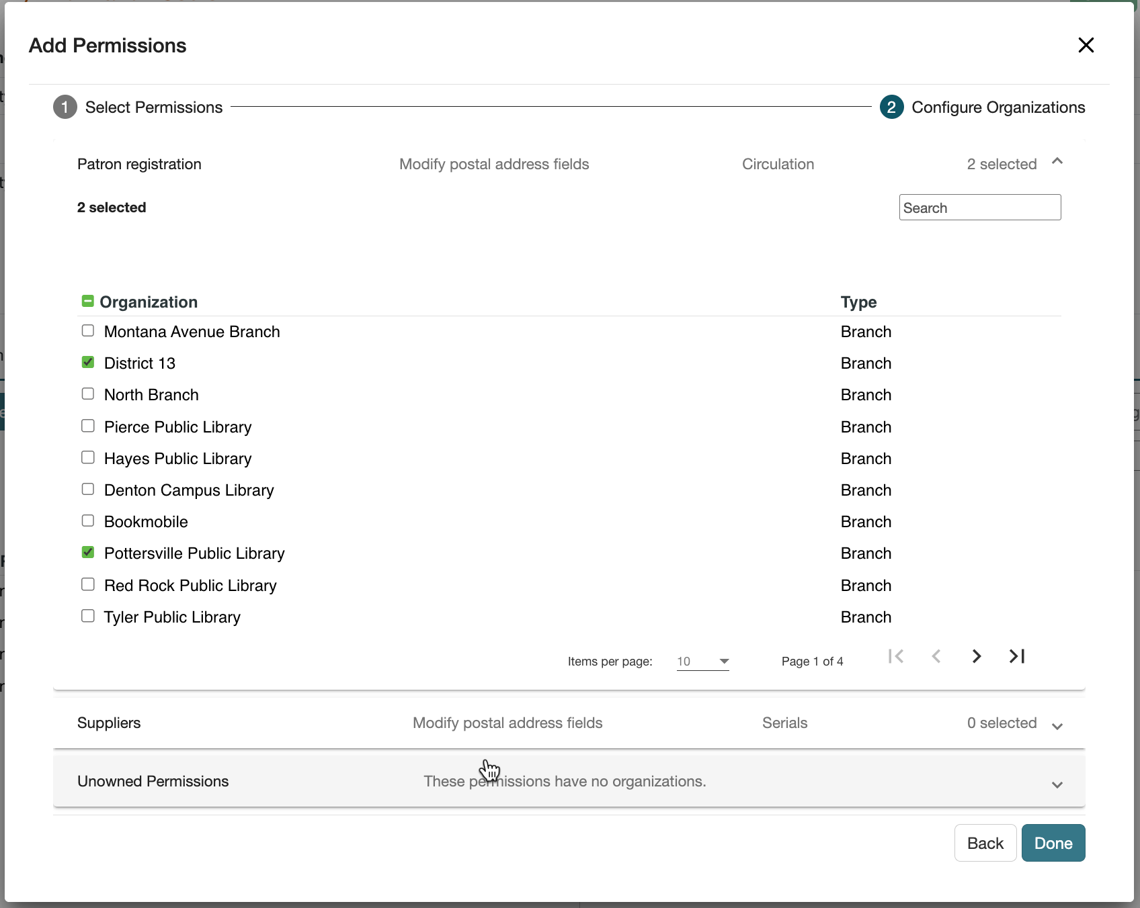
Permissions Find Tool
TIP
Most permission names fall within Access, Allow, Create, Modify and Delete
Use the search box to find specific permissions.

Slide 14
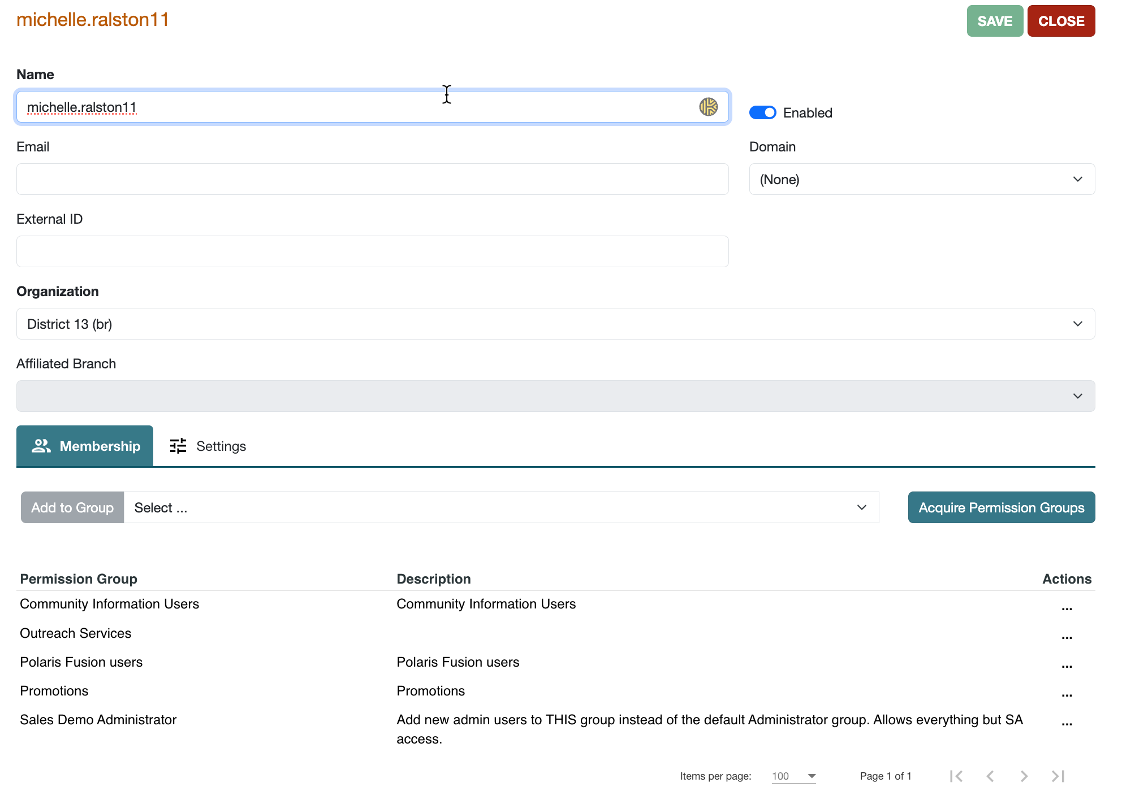
Staff Member: Permissions
The Membership view of the Staff Member workform displays the Permission Groups that staff member is assigned to.
There may be more groups than shown; use the page arrows to view more.

Slide 15
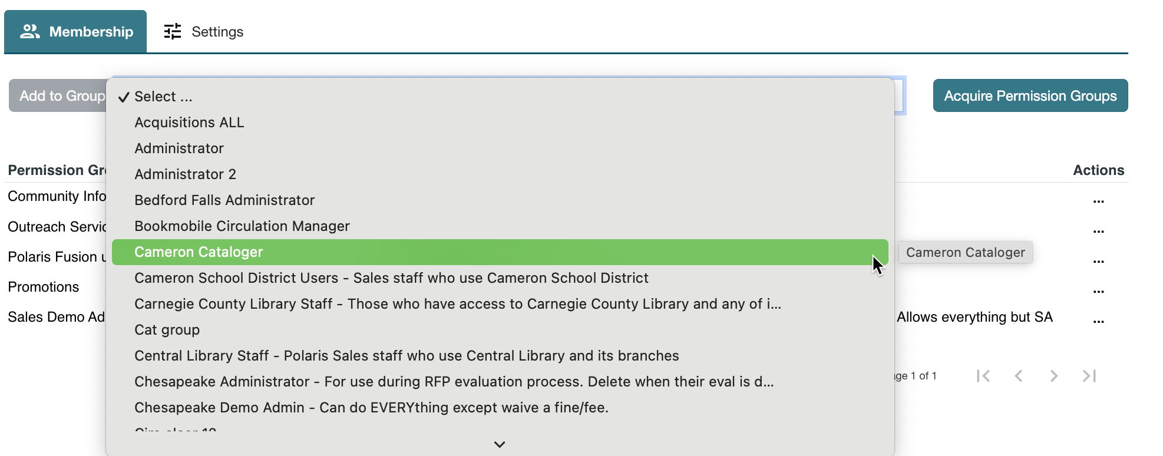
Staff Member: Group Memberships
You can add the staff member to any permission group.

Slide 16
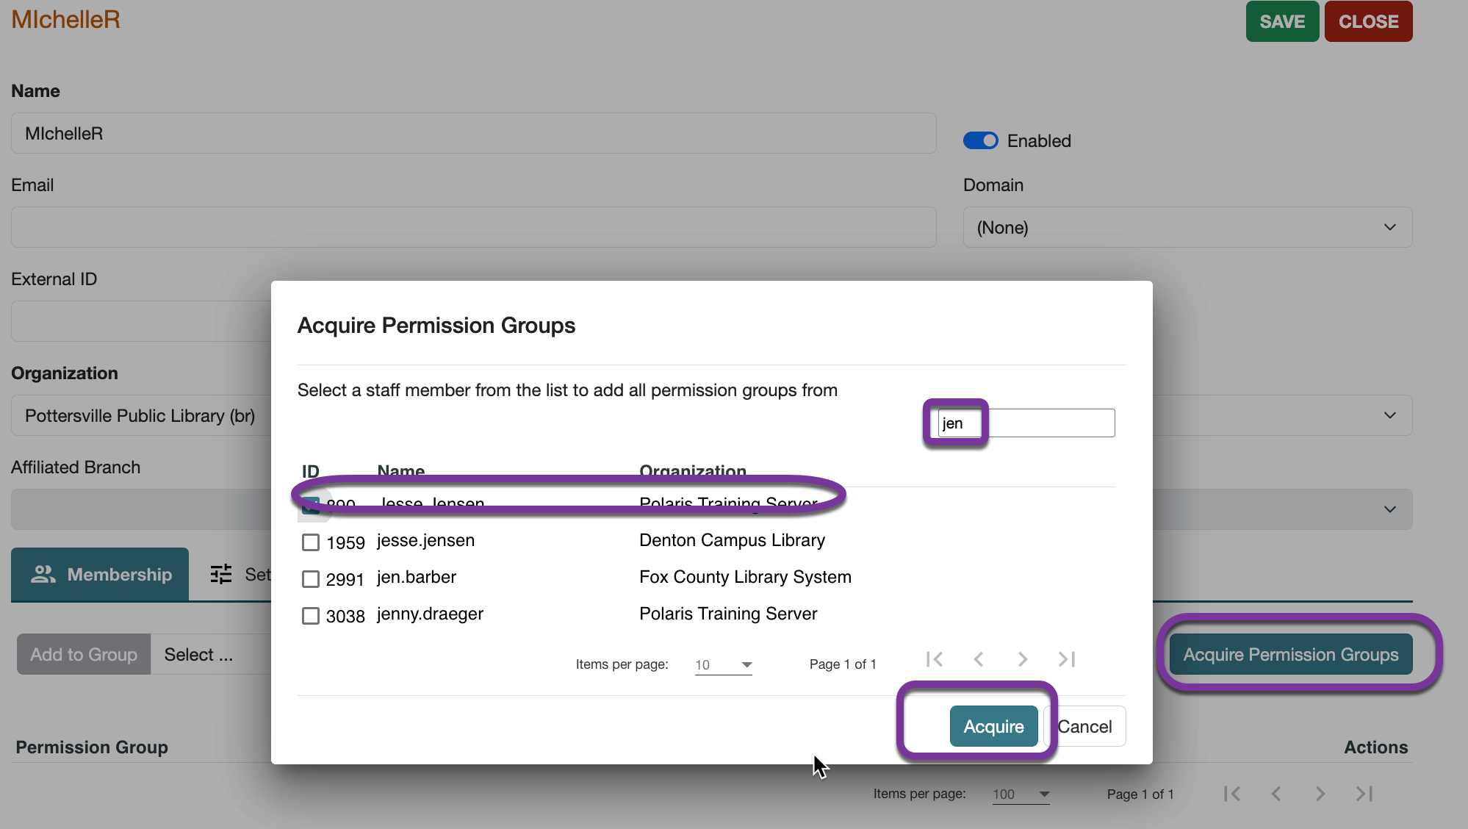
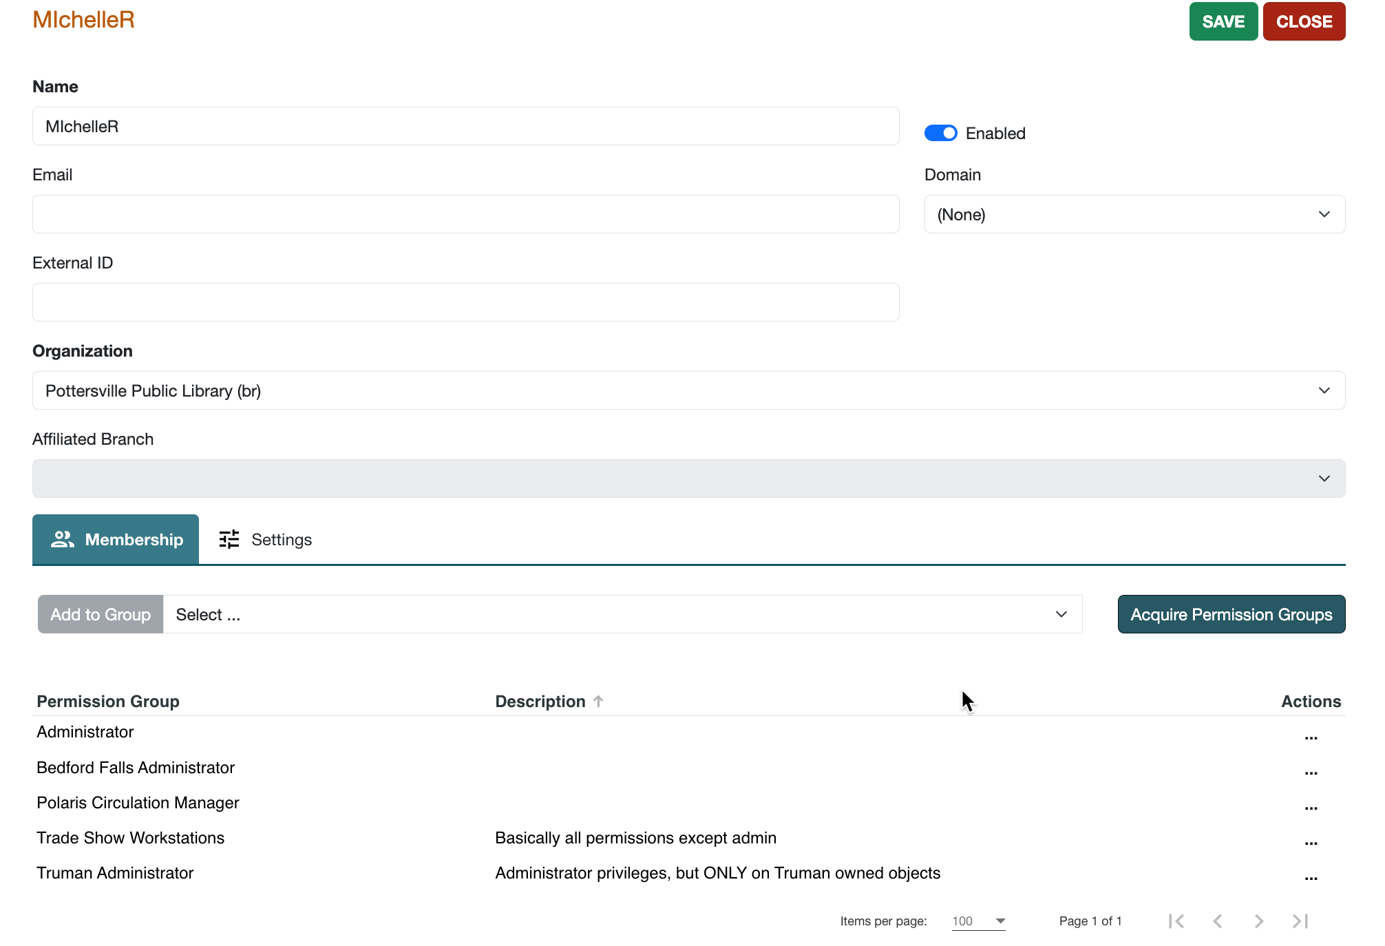
Staff Member: Aquire Group Memberships
You can acquire the groups of another staff member.

Slide 17
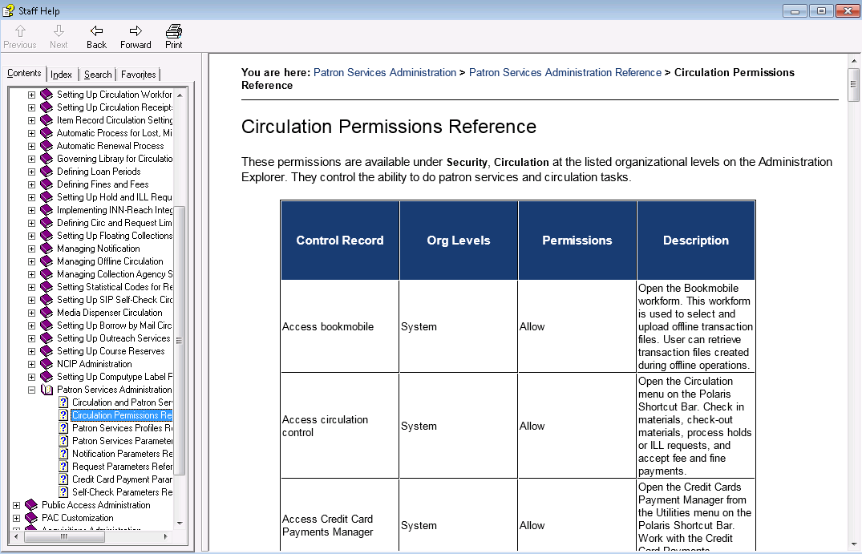
Permission References
TIP
Permission references are included in the following guides:
Administration
Patron Services Administration
Acquisitions Administration
Cataloging Administration
Serials Administration
At the end of several Polaris Guides is a Permissions Reference.
Each permission is listed along with applicable organizational levels, different permissions types (Allow, Create, etc.), and explanations.

Slide 18
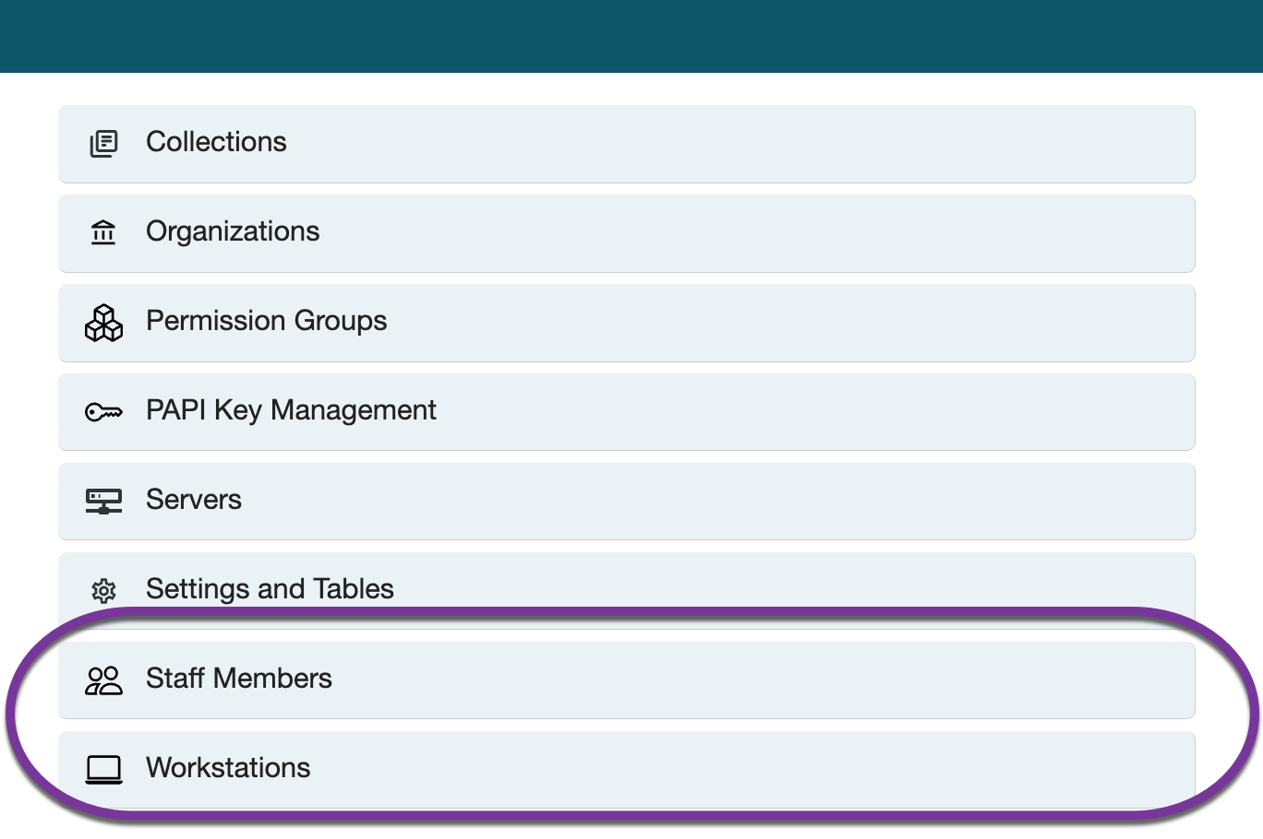
New Staff Member or Workstation
TIP
Polaris does not store passwords for staff members; they must be added to the DNS server/Active Directory.
To add a new Staff Member or Workstation, navigate to the appropriate place, and use the +New button.

Slide 19
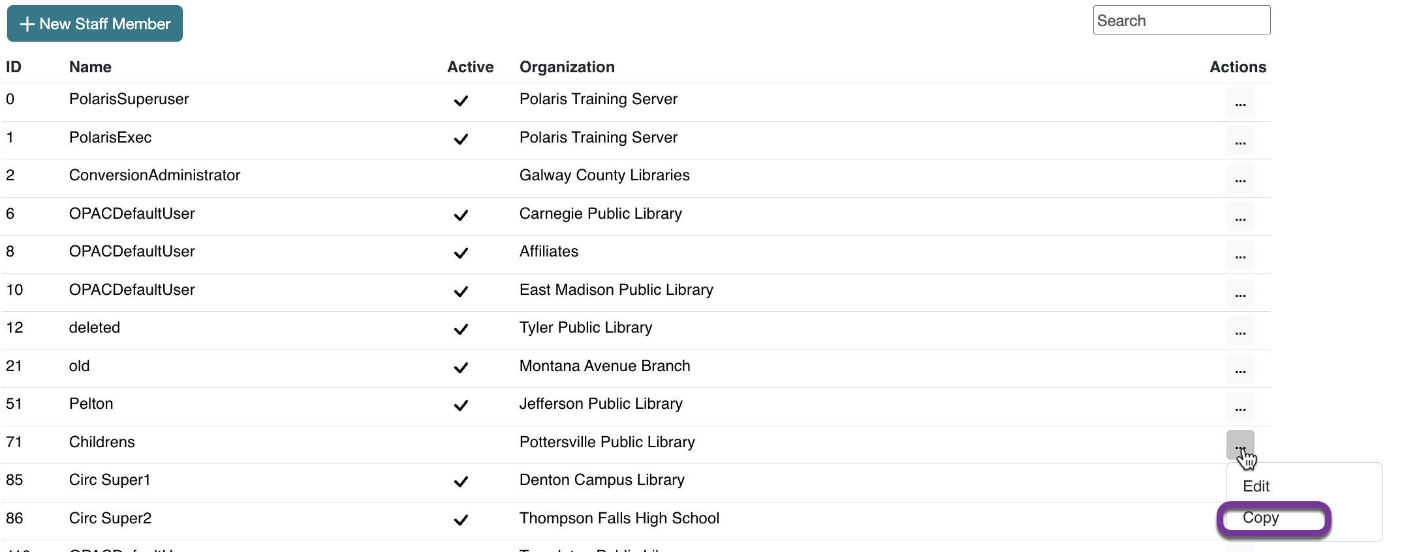
New Staff Member or Workstation: Copy
While using +New produces a staff member or workstation without permissions, Copying (“…” > Copy) produces a staff member/workstation with the same permissions as the original.

Slide 20
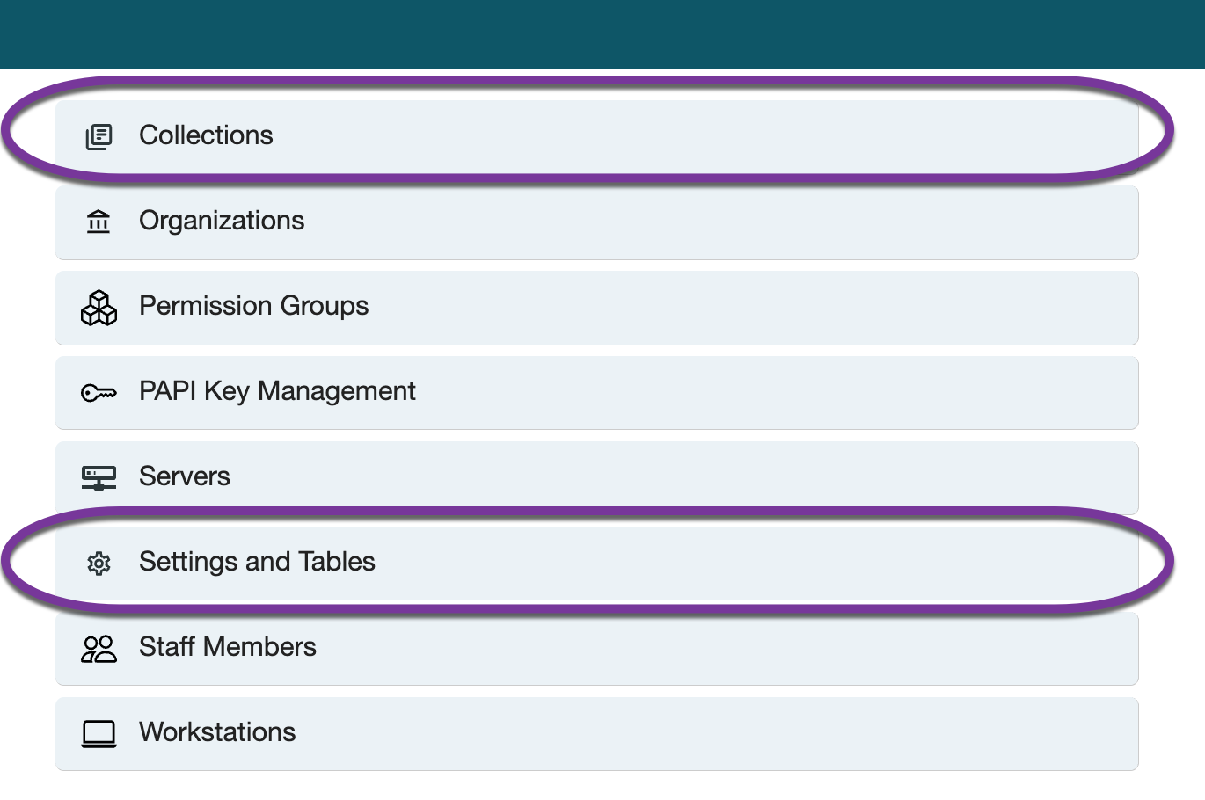
Settings, Tables, and Collections
Settings
Settings references
Recognizing changed settings
Tables
Table references
Collections

Slide 21
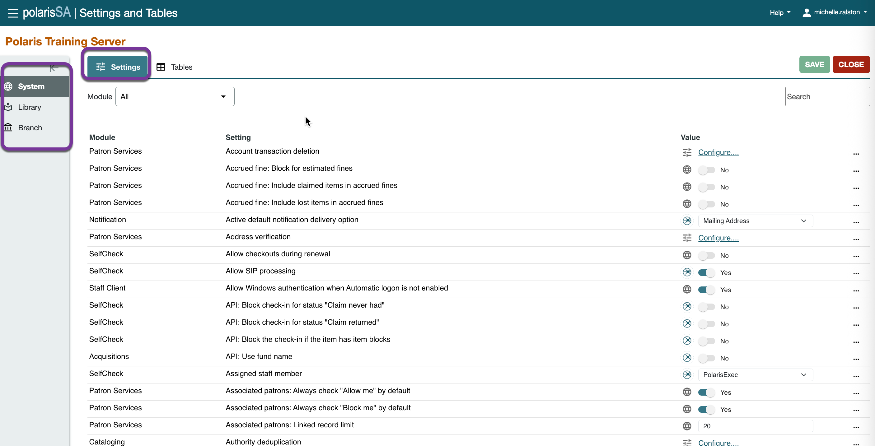
Settings
Settings are guidelines for the way Polaris operates. They represent library policies in Polaris and define what is displayed.
They are set at the system, library, and branch levels.

Slide 22
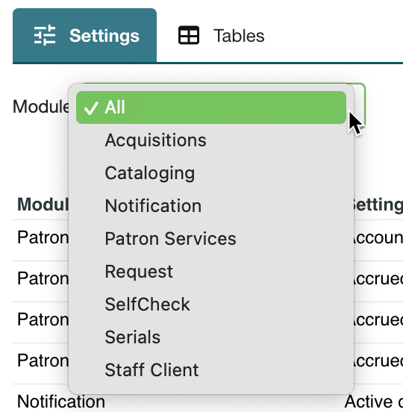
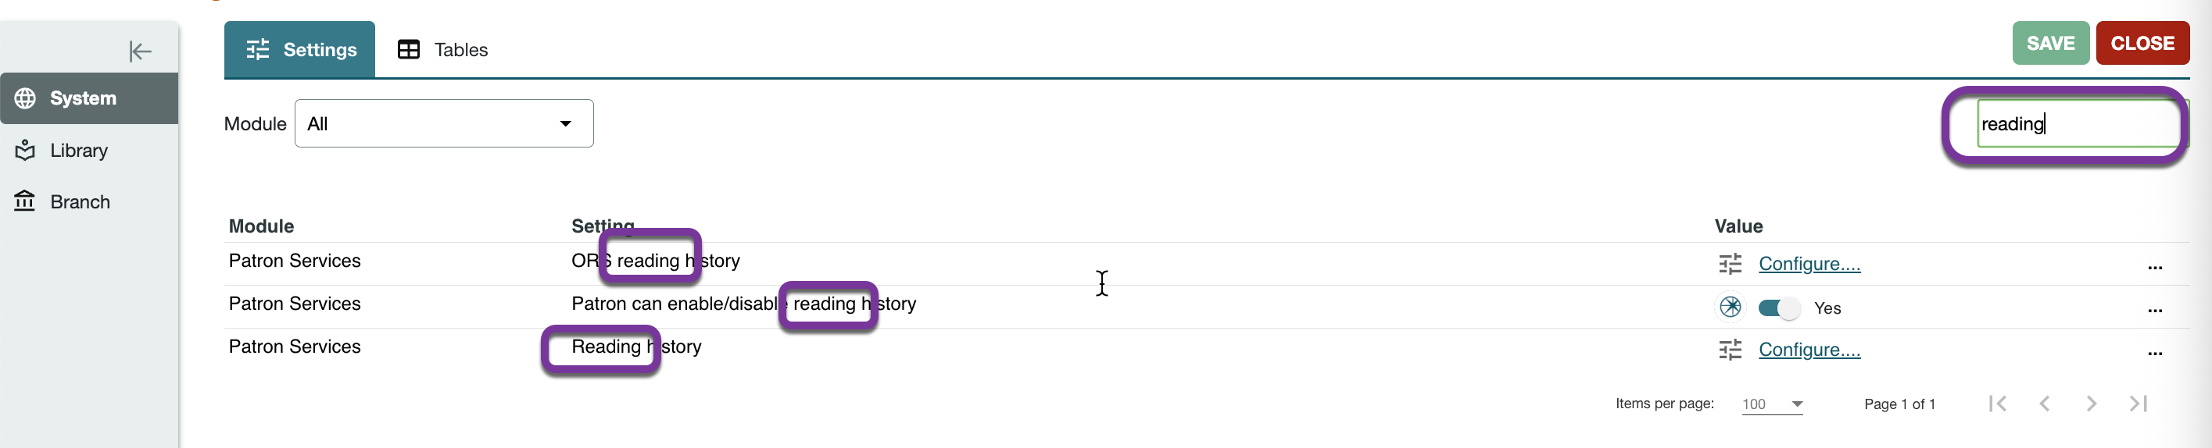
Settings
You can search for settings by specific module (Acquisitions, Cataloging, etc.) and/or search keywords.

Slide 23
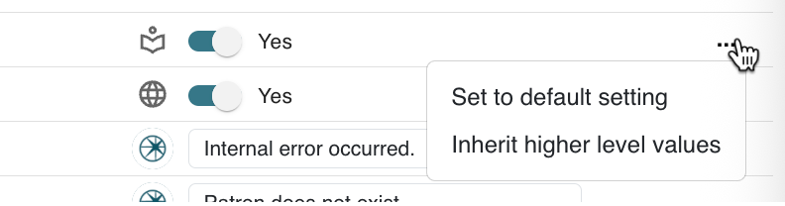
Settings
TIP
Not all settings can be transmitted or inherited. If the options are greyed out, they are unavailable.
You can adjust settings by any of the following methods:
Going to the level and entering a setting
Set to default setting
Inheriting the setting from higher levels

Slide 24






Recognizing Changed Settings
The icon beside a setting indicates the level at which it has been set:
Not changed since Polaris was installed
Belongs to the system organization level. All organizations use the setting unless it is changed at a lower level. If the icon is displayed for settings opened at the library and branch level, then the setting is shared by all other organizations in the Polaris installation. If the setting is changed at the library or branch level, the change applies to the whole system.
Belongs to the library organization level. If the icon is displayed for settings opened at the branch level, then the setting is shared by all branches in the library.
Belongs to the branch organization level. Each branch in the Polaris installation can have its own setting, different from other branches.
Belongs to the workstation. Each workstation can have its own setting, different from other workstations at the same branch.
Belongs to the staff member. Each staff member record can have its own setting, different from other staff members at the same branch.

Slide 25
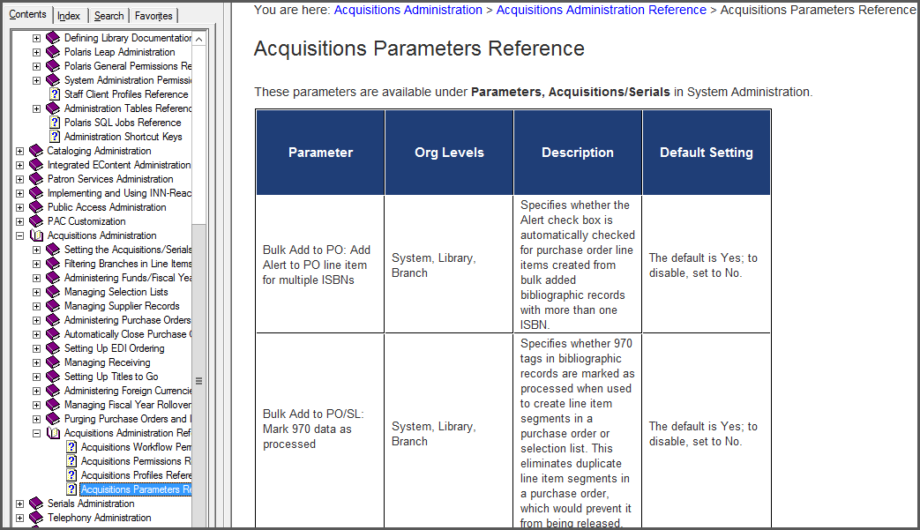
Settings References
TIP
Settings References are included in the following guides:
Administration
Patron Services Administration
Acquisitions Administration
Cataloging Administration
Serials Administration
At the end of several Polaris guides are settings references for each subsystem.
Each is described along with what organizational levels it may be set at and, if applicable, the default setting.
Each setting is listed along with applicable organizational levels, defaults, and explanations.

Slide 26
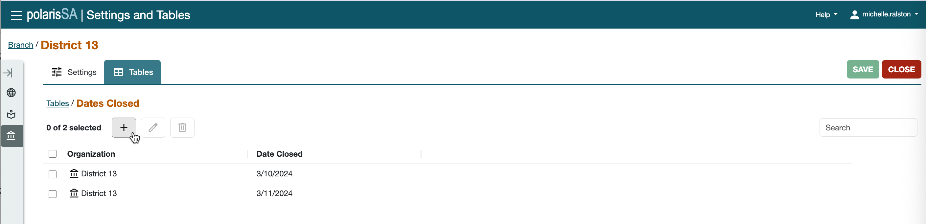




Tables
All tables can be opened at the system level, and some may also be opened at the library and branch levels.
Table settings cannot be transmitted or inherited.
For some tables, the settings apply systemwide, while others must be defined specifically for each organization.
To make changes to a table, select it in the left pane and use the following icons on the right pane tool bar:
Add Edit Delete (some table entries are protected from deletion) Reorder entries

Slide 27
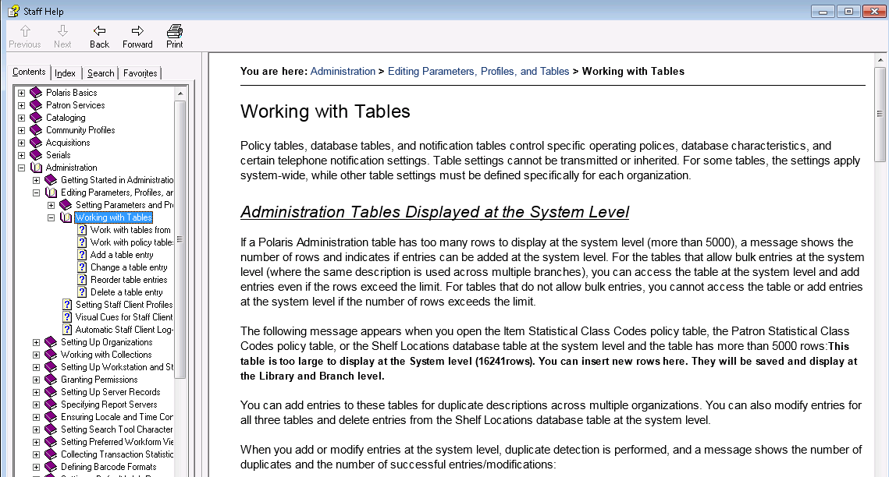
Policy, Database, and Notification Tables
For more information, see the documentation at Administration > Editing Parameters, Profiles and Tables > Working with Tables.

Slide 28
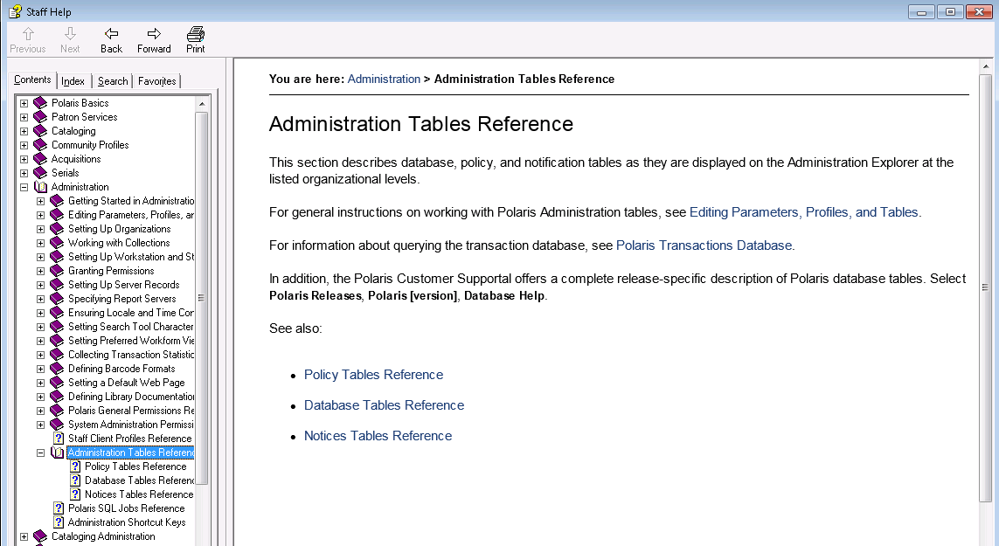
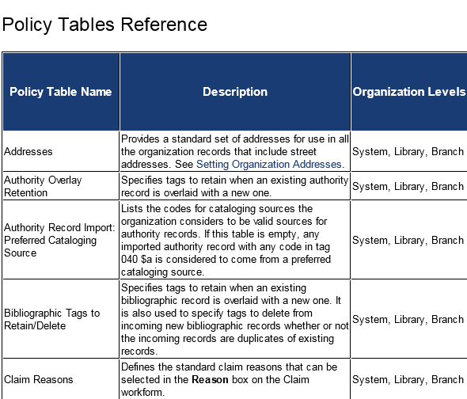
Table References
At the end of the Administration guide are references for the tables—Policy, Database, and Notice.
Each table is described, and organization level is included.

Slide 29
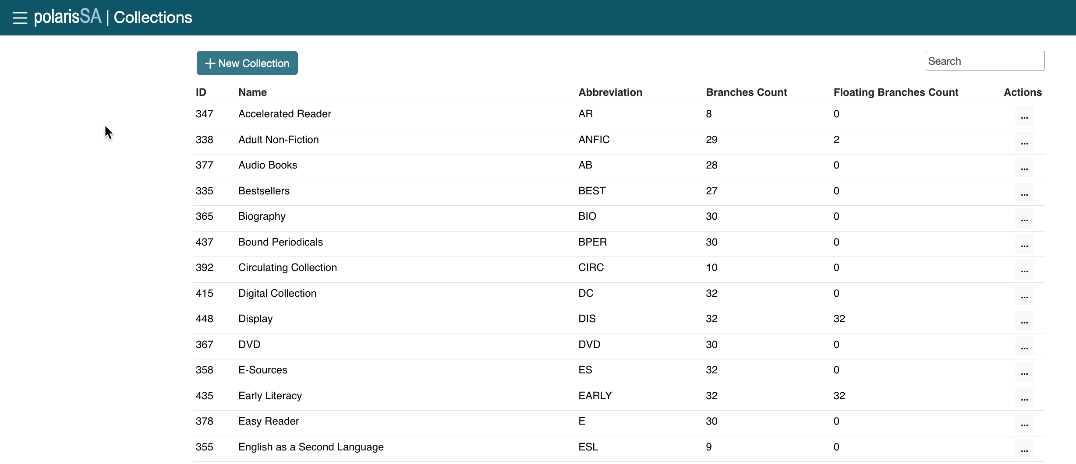
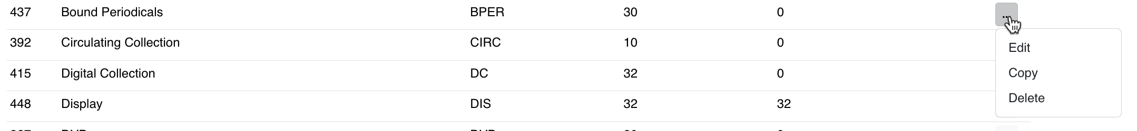
Collections
Use the +New Collection button to add a new collection.
Use the “…” button to edit/copy/delete a collection.

Slide 30
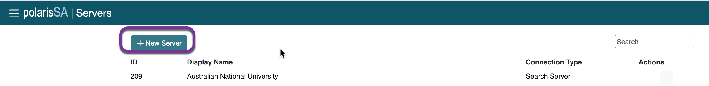
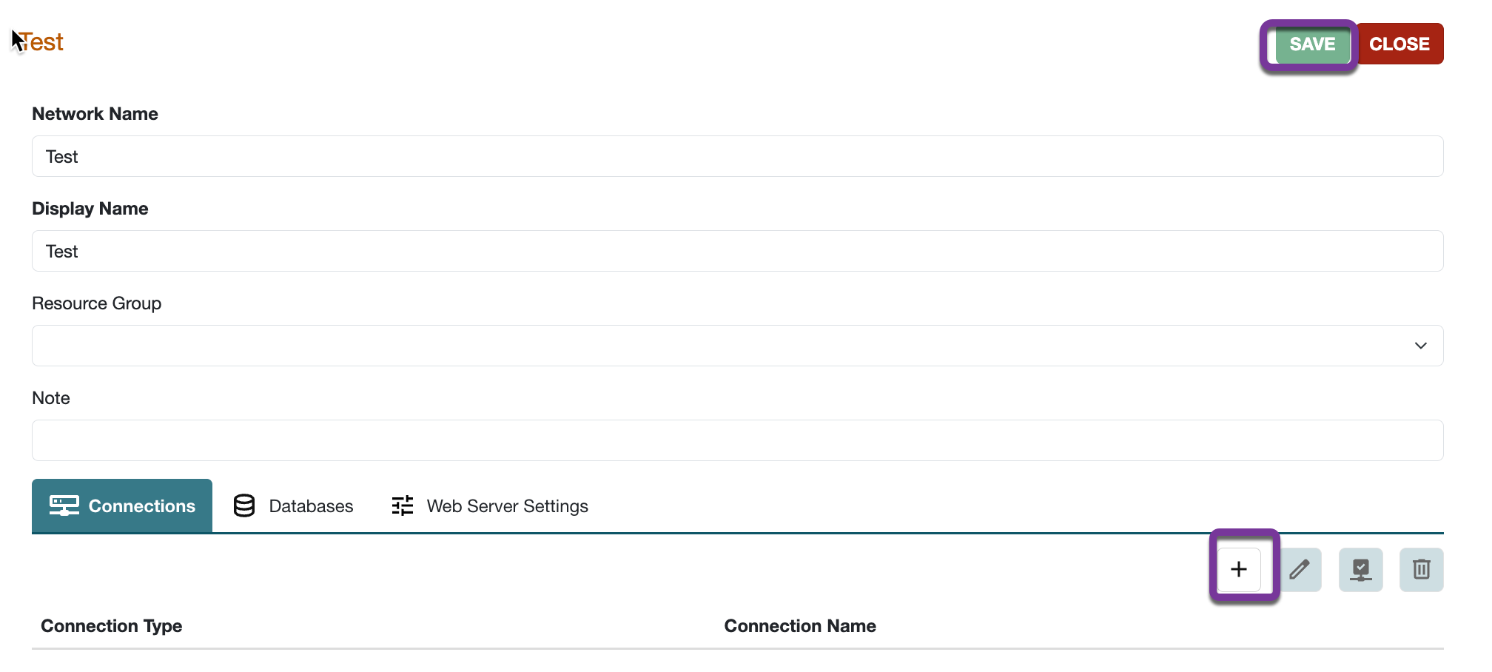
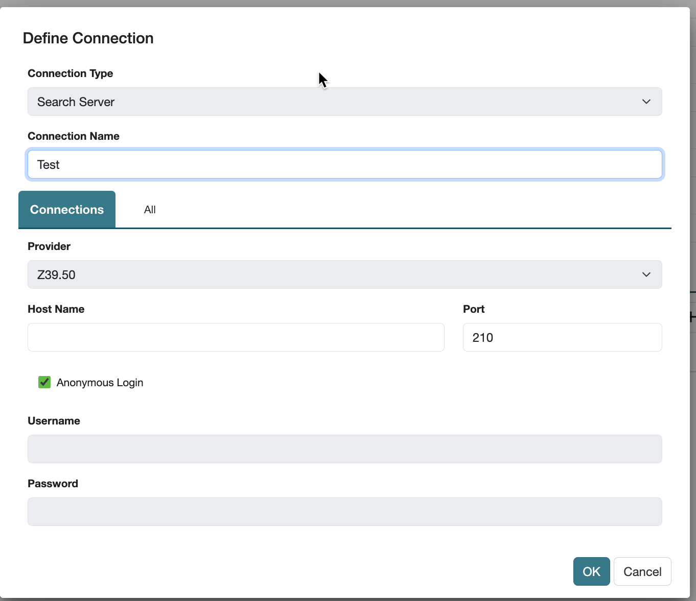
Defining a Remote Z39.50 Server Connection
Obtain the IP address, database name, and any logon information for the remote Z39.50 target server.
After clicking the +New Server button, name your database and SAVE, then click the + under the Connections tab to add a new connection.
Follow the step-by-step instructions in Polaris Help: Polaris Administration Topics > Setting Up Server Records > Registering Remote Resource Servers

Slide 31
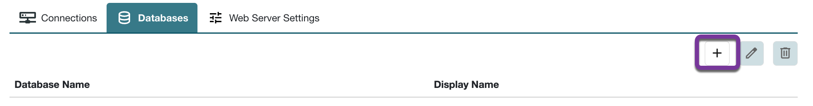
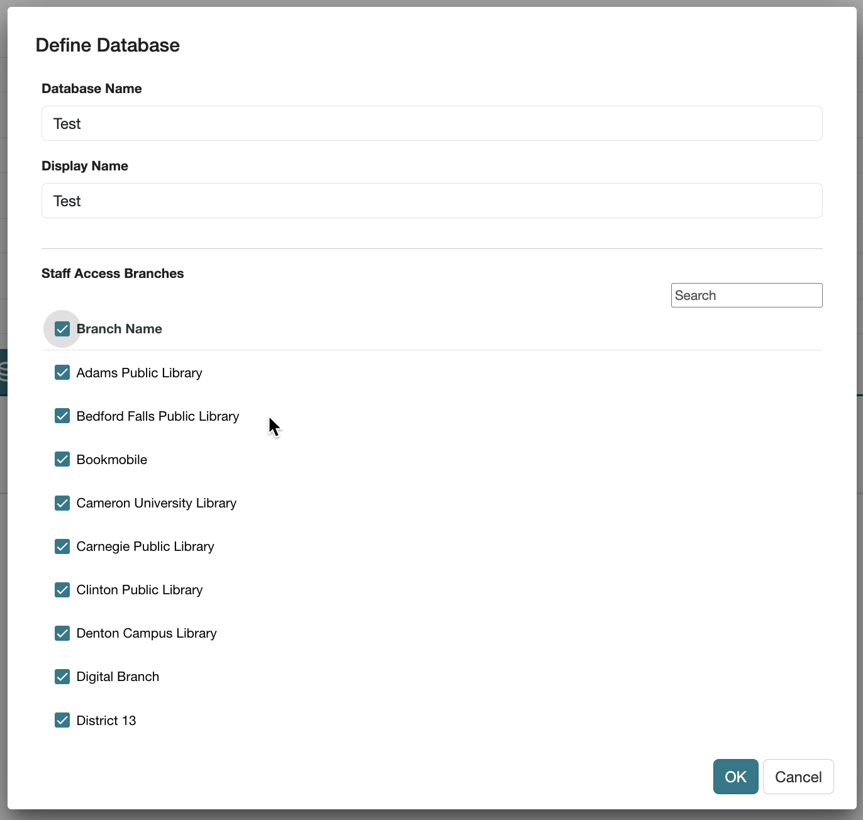
Defining a Remote Z39.50 Server Connection
Click on the Database view and click the + to add a new database.
Enter Database Name and Display Name
Select each branch to make that database available in Find Tool searches in Leap.

Slide 32
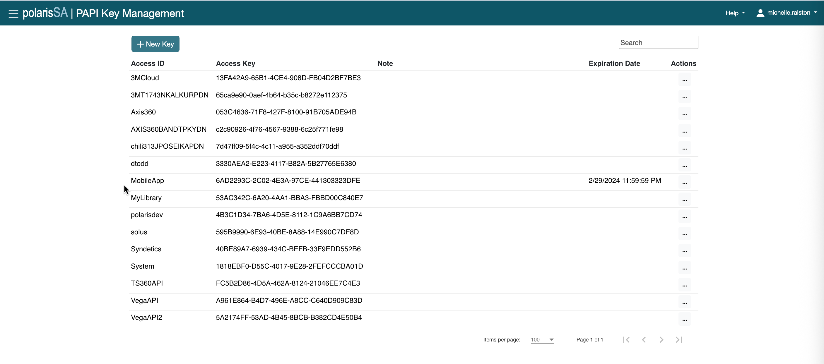
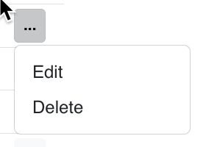
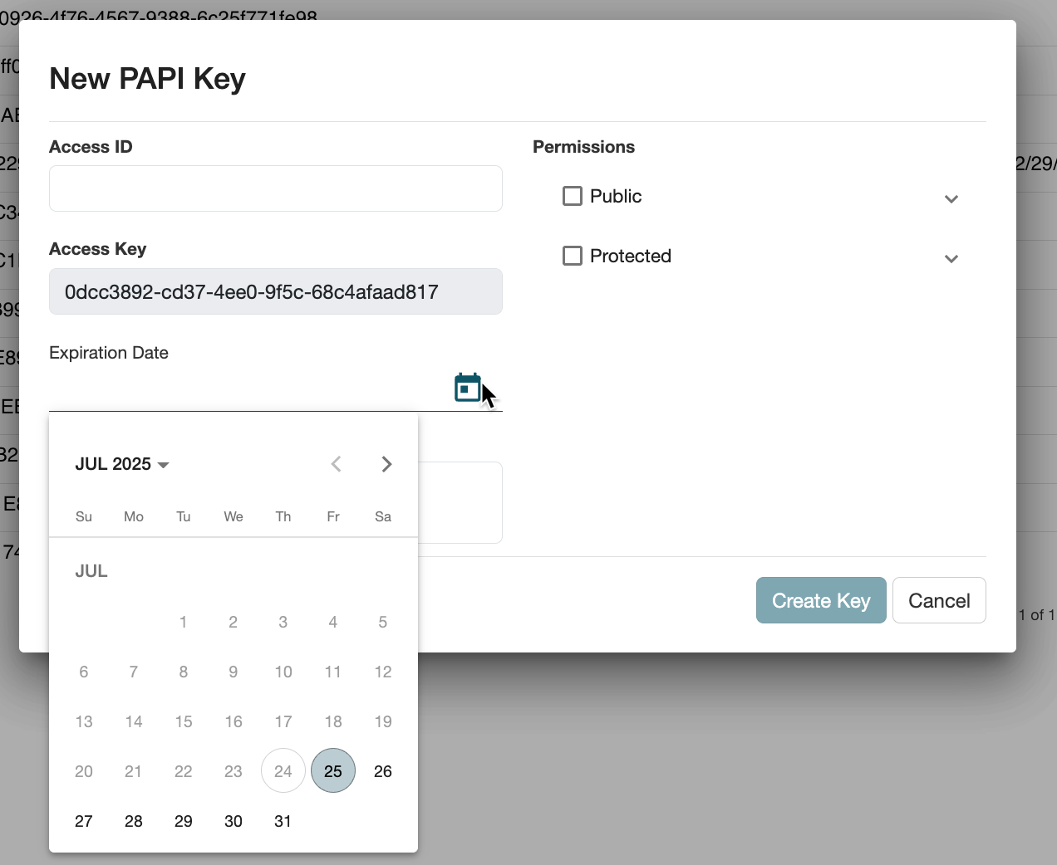
PAPI Keys
Click on +New Key to add a PAPI key.
Click on … to edit or delete.

Slide 33
Client System Administration
Some functionality still resides in the Polaris Staff Client for now.
If you cannot find a setting or table in the web-based System Administration area, it’s good practice to also check in the Staff Client.

Slide 34
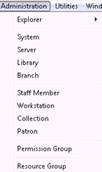
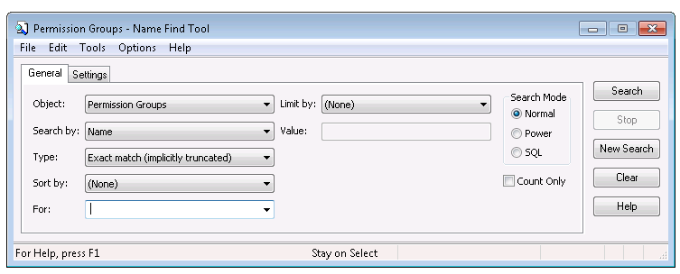
Administration Find Tool
TIP
The Shortcut Bar Administration menu is a good way to reach a Staff Member or Permission Group Find Tool, while the Explorer is a good way to reach a Database Table.
The Explorer may be used to open administration at any level.
A Find Tool opens if any other choice in the dropdown menu is made.

Slide 35
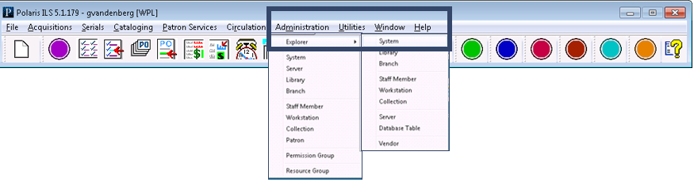
Administration Explorer
TIP
When Explorer is used to open the system level, all other levels of the hierarchy will be available.
Administration Explorer is a hierarchical list of administration records available from the Administration menu on the Shortcut Bar.
Explorer is used to navigate among organizations, staff members, workstations, collections, servers, databases, and to select a record to modify.

Slide 36
Parameters, Profiles, Tables, and Collections
Parameters
Profiles
Setting parameters and profiles
Recognizing changed settings
Policy, database and notification tables

Slide 37
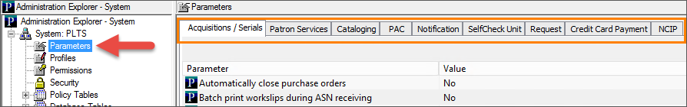
Parameters
Parameters are guidelines for the way Polaris operates.
They are set at the system, library, and branch levels and are organized in the following categories:
Acquistions/Serials
Patron Services
Cataloging
PAC Notification
SelfCheck Unit
Request
Credit Card Payment
NCIP

Slide 38
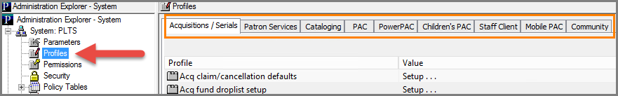
Profiles
Profiles represent library policies in Polaris and define what is displayed in the Staff Client and PAC.
Profiles apply to system, library, branch, workstation, and staff levels and are organized in the following categories:
Acquisitions/Serials
Patron Services
Cataloging
PAC
PowerPAC
Children’s PAC
Staff Client
Staff Client
Mobile PAC
Community

Slide 39
Recognizing Changed Settings
The icon beside a Parameter or Profile setting indicates the level at which it has been set.
Not changed since Polaris was installed.
Belongs to the system organization level. All organizations use the setting unless it is changed at a lower level. If the icon is displayed for settings opened at the library and branch level, then the setting is shared by all other organizations in the Polaris installation. If the setting is changed at the library or branch level, the change applies to the whole system.
Belongs to the server level. All organizations use the setting.
Belongs to the library organization level. If the icon is displayed for settings opened at the branch level, then the setting is shared by all branches in the library.
Belongs to the branch organization level. Each branch in the Polaris installation can have its own setting, different from other branches.
Belongs to the workstation. Each workstation can have its own setting, different from other workstations at the same branch.
Belongs to the staff member. Each staff member record can have its own setting, different from other staff members at the same branch.

Slide 40
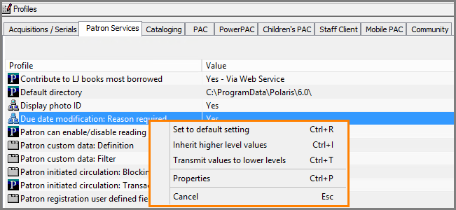
Setting Parameters and Profiles
TIP
Not all settings can be transmitted or inherited. If the up and/or down arrows are available for the selected Parameter or Profile, use the arrows to transmit down or inherit the setting. A right-mouse click will display a context menu where this can also be done.
Parameter and profile settings customize the Polaris staff and public access applications for the specific organizations, workstations, and staff members in your system.
You can set parameters and profiles by any of the following methods:
Going to the level and entering a setting
Giving (transmitting) a setting to multiple lower organizations, workstations, and staff members
Taking (inheriting) the setting from the next level above

Slide 41
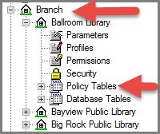

Policy, Database, and Notification Tables
All tables can be opened at the system level, and some may also be opened at the library and branch levels.
Table settings cannot be transmitted or inherited.
For some tables, the settings apply systemwide, while others must be defined specifically for each organization.
To make changes to a table, select it in the left pane and use the following icons on the right pane tool bar:
Add Edit Delete (some table entries are protected from deletion) Reorder entries

Slide 42
Policy, Database, and Notification Tables
For more information, see the documentation at Administration > Editing Parameters, Profiles and Tables > Working with Tables.

Slide 43
Polaris SQL Jobs
Polaris SQL jobs reference
SQL Server Management Studio
SQL Server job run manually

Slide 44

Polaris SQL Jobs Reference
This table is a summary of the SQL jobs that handle Polaris automatic processing operations and can be found at Help > Administration > Polaris SQL Jobs Reference.

Slide 45

SQL Server Management Studio
Display the SQL Server Management Studio window from any in-library client with SQL Server access.
Select the correct Server name and Connect.
Expand the folders on the left to reach SQL Server Agent Jobs.
Double click on a job to open its property view, see when it is scheduled to run, and see when last executed.

Slide 46

SQL Server Run Job Manually
From SQL Server Agent Jobs, right-click the job and select Start Job from the context menu.
In many cases, it is fine for jobs to run automatically (e.g., updating offline files runs automatically each night); however, there may be instances where it is helpful to run a job manually (e.g., you want to start using offline Polaris in the middle of the day and be able to include that morning’s transactions in the offline database).
You may also want to manually run a job when testing certain functionality such as Build Up Compressed Holdings Statement for serials.

Slide 47
Polaris Customer Support
Visit https://support.iii.com/ to:
Search the Knowledge Portal
Use the forums to see what other customers are talking about
Create a new ticket or check the status of your submitted tickets
Find solutions and see enhancements for common issues and problems
Download updates and files
See FAQs
You may need a user ID and password to access certain areas.

Slide 48
Polaris Customer Support
Support is offered 24/7: Support - Innovative Interfaces Inc.
Each Polaris ILS customer has a site manager who is part of a larger team including site engineers responsible for providing application and technical support for all operational Polaris ILS customers.

Slide 49

Innovative Users Group
The Innovative Users Group (IUG) represents the community of Polaris ILS users.
IUG’s activities are coordinated by a Steering Committee elected by the membership.
IUG holds regional and national conferences for its members.

Slide 50


Forename Surname
forename.surname@clarivate.com
+000 000-0000
About Clarivate
Clarivate is a leading global provider of transformative intelligence. We offer enriched data, insights & analytics, workflow solutions and expert services in the areas of Academia & Government, Intellectual Property and Life Sciences & Healthcare. For more information, please visit clarivate.com.
© 2025 Clarivate. All rights reserved
Clarivate and its logo, as well as all other trademarks used herein are trademarks of their respective owners and used under license.

