Slide 1

Polaris Web Admin

Slide 2
WebAdmin
Overview
Permission
Logging into Web Admin

Slide 3
Overview
Web Admin (Language Editor) is a web-based tool that allows staff to customize English and other licensed language strings in many parts of Polaris.
  Staff can compare, add, edit and distribute language strings easily, without editing individual files
  Staff can add or customize language strings at the system, library, and branch levels
Web Admin also provides tools specifically for PAC applications
  This includes a language string identifier for Polaris PowerPAC
  Also includes a Reload tool to clear page caches for Polaris PowerPAC, Polaris PowerPAC Children’s Edition, and Mobile PAC pages

Slide 4
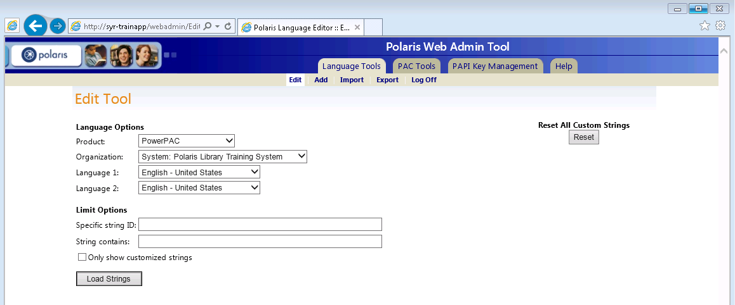
Overview
PowerPAC™, including Community Profiles
ExpressCheck™
Outbound telephony
Inbound telephony
Notices (print, email and text messages)
PAC Inter-library Loan
Polaris® Fusion™
Acquisitions Exchange
MobilePAC™
PAC search results labels (ERMSPortal)
Receipts
ContentXChange
Staff Web Client (Leap)
Staff Client

Slide 5
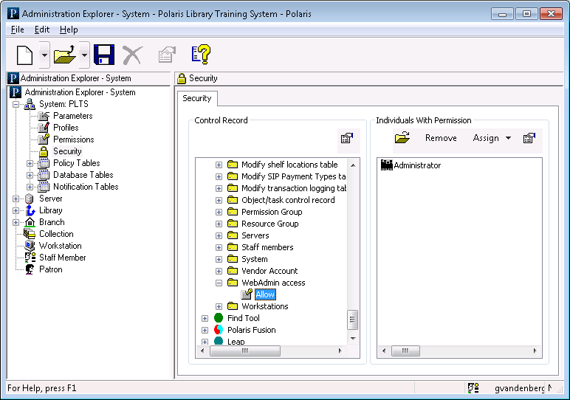
Permission
The staff user must have the System Administration permission WebAdmin access: Allow

Slide 6
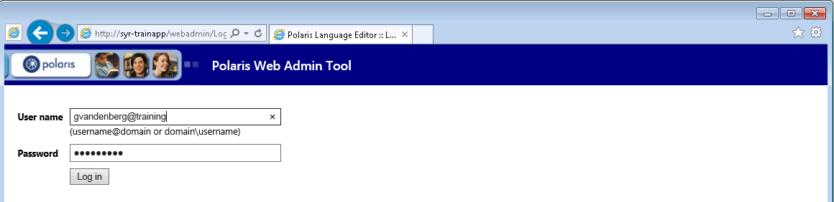
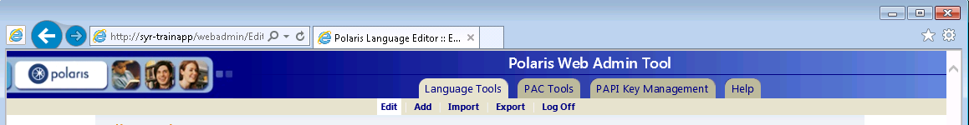
Logging into Web Admin
The URL for Web Admin is typically http://servername/WebAdmin
To log in: Supply your username, domain, and password, then click “Log in”
Log off: It is important to click “Log Off” when done

Slide 7
Working with Language Strings
Compare and edit language strings
Add language strings
Import custom strings for a specific language
Export Language Strings to XML

Slide 8
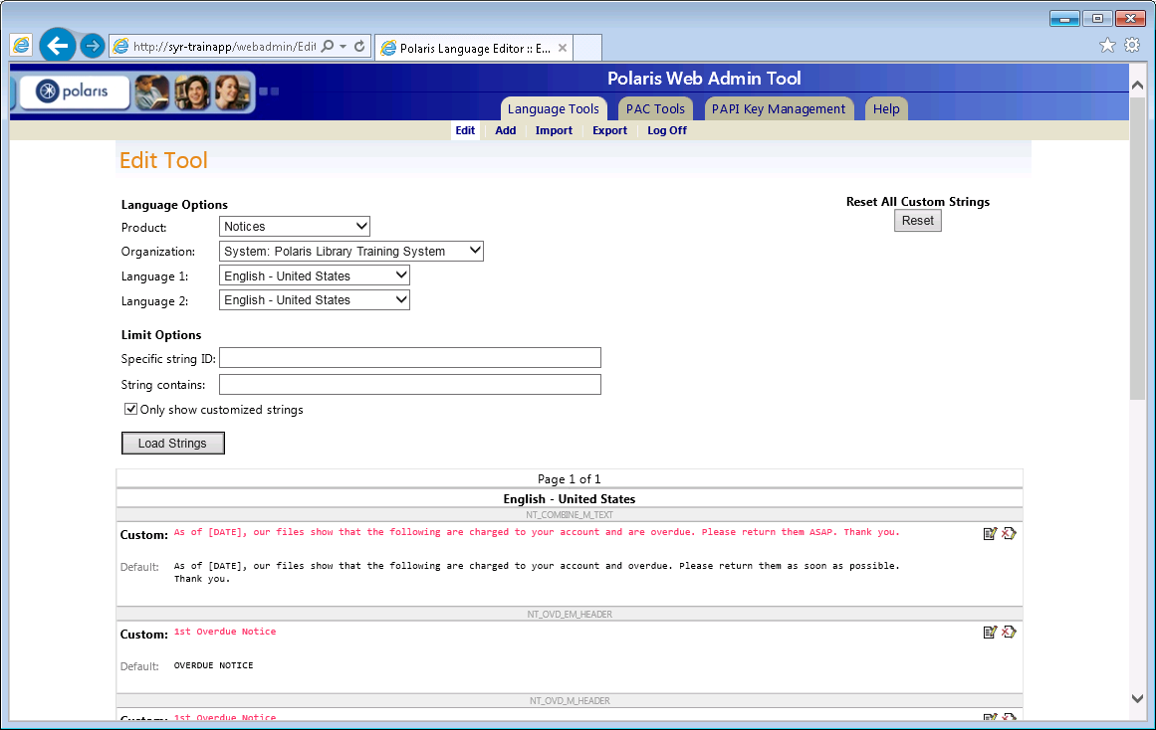
Editing Notice Text

Slide 9
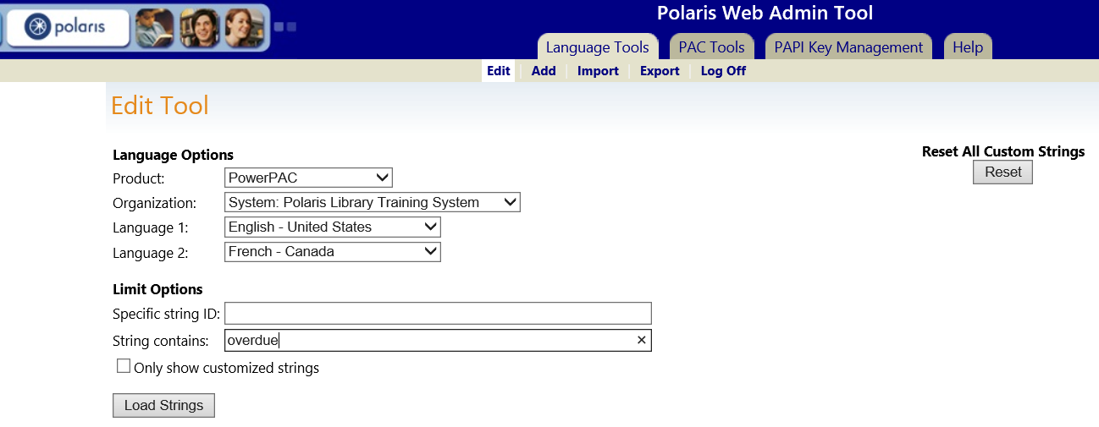
Compare and Edit Language Strings
TIP
Only licensed products are available in the Product box.
After logging in, Web Admin defaults to the Language Tools tab/edit page
In the Language Options dialog:
  Product: Select the product you would like to customize
  Organization: Select the organization for which you are making the change
  Language 1 & 2: Select languages to compare and edit

Slide 10
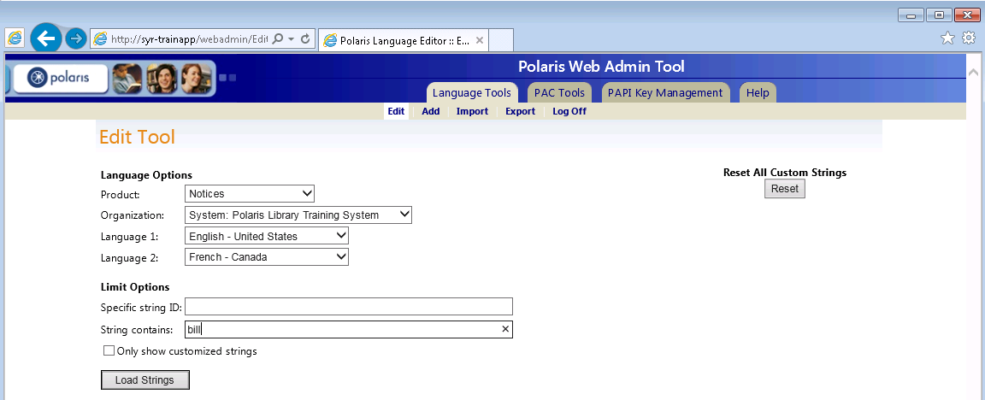
Compare and Edit Language Strings
TIP
If you want to edit only one language, for example English, set both languages to English.
Language string ID references are available in the Web Admin documentation and through the PAC Tools tab
  Limit language strings by:
    Specific string ID
    String contains (a specific word or words)
    Only show customized language strings
  Click the Load Strings button

Slide 11
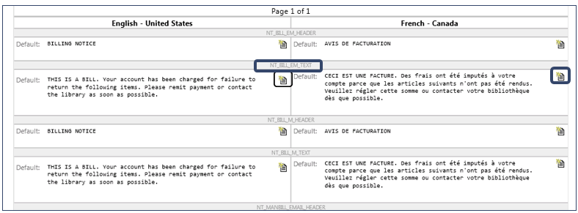
Compare and Edit Language Strings
Once the strings are loaded, if two languages were selected, the first language is on the left and the equivalent string in the second language is on the right
The string ID is displayed above each string for both languages
Click the New Custom String icon to edit each language separately

Slide 12
Compare and Edit Language Strings
Select “Only show customized strings” to load only strings that have been changed
Default string values are also displayed
Click the “Revert to default” icon to revert to the default string

Slide 13
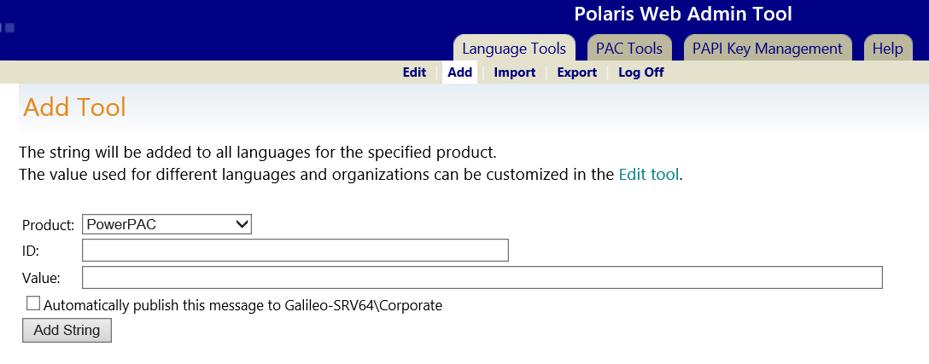
Add Language Strings
TIP
You must edit the HTML code of the PowerPAC files on the Web server to position the
added language strings
You can add your own language strings to the product of your choice instead of replacing default strings
When you add a string, it is added to all licensed languages for the selected product at the system level
You can then edit each organization and each language as needed
To add a string, click on “Add” on the Language Tools tab

Slide 14
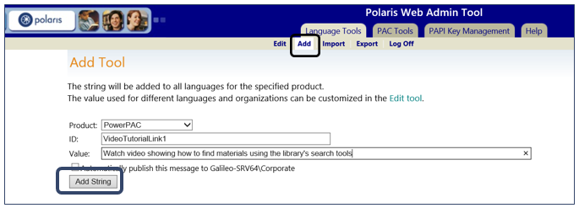
Language Strings
You can import custom strings into the database from an XML file for use in a licensed language in PowerPAC and ExpressCheck
Click on Import on the Language Tools tabs
  Product: Select the product
  Organization: Select the organization—system, library or branch
  File: Browse to select (or type) the path to your file
Click the “Import XML” button

Slide 15
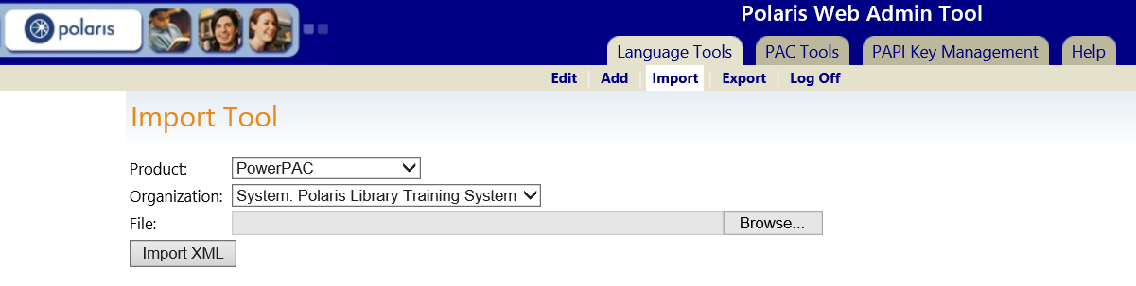
Import Custom Strings for a Specific Language
You can import custom strings into the database from an XML file for use in a licensed language in PowerPAC and ExpressCheck
Click on Import on the Language Tools tabs
  Product: Select the product
  Organization: Select the organization—system, library or branch
  File: Browse to select (or type) the path to your file
Click the “Import XML” button

Slide 16
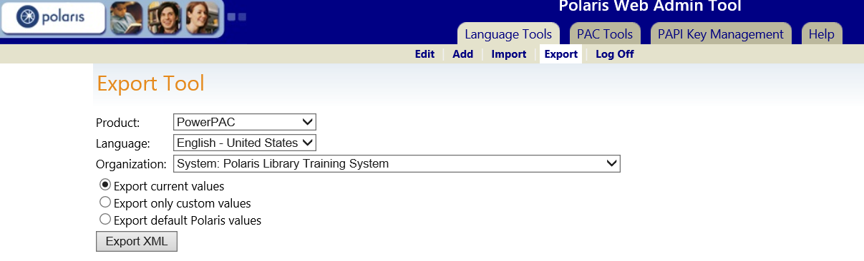
Export Language Strings to XML
Language strings may be exported to an XML file
Click Export on the Language Tools tabbed page
  Product: Select the product
  Language: Select the language to export
  Organization: Select the organization—system, library or branch

Slide 17
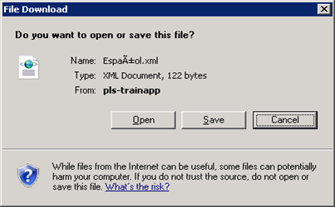

Export Language Strings to XML
Select an export option
Click the Export XML button
A file Download dialog box appears
You can save the file to a chosen location
Export current values
  Exports the current values for the specified product, language, and organization, including any customized strings.
Export custom values
  Exports only the customized strings set for the organization.
Export default Polaris values
  Exports the default language strings that are stored in the default database table; does not include any customized strings.

Slide 18
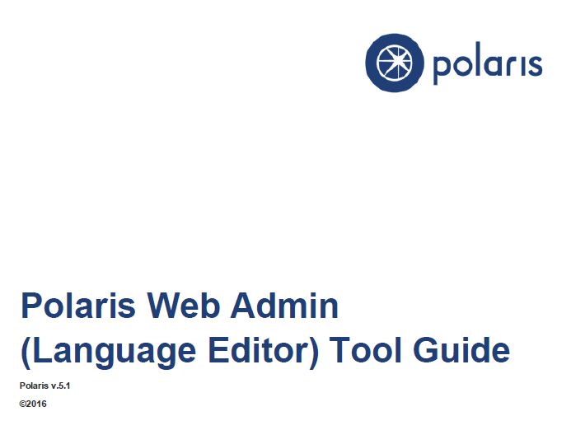
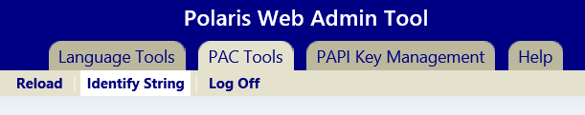
Polaris Web Admin Tool Guide
  The PDF Polaris Web Admin (Language Editor) Tool Guide is accessible via:
    The “Help” tab when logged into Web Admin and requires customer login

Slide 19


Forename Surname
forename.surname@clarivate.com
+000 000-0000
About Clarivate
Clarivate is a leading global provider of transformative intelligence. We offer enriched data,
insights & analytics, workflow solutions and expert services in the areas of Academia & Government, Intellectual Property and Life Sciences & Healthcare. For more information, please visit clarivate.com.
© 2025 Clarivate. All rights reserved
Clarivate and its logo, as well as all other trademarks used herein are trademarks of their respective owners and used under license.

