Slide 1

Polaris Web Admin

Slide 2
WebAdmin
Overview
Permission
Logging into Web Admin

Slide 3
Overview
Web Admin (Language Editor) is a web-based tool that allows staff to customize English and other licensed language strings in many parts of Polaris.
Staff can compare, add, edit and distribute language strings easily, without editing individual files
Staff can add or customize language strings at the system, library, and branch levels
Web Admin also provides tools specifically for PAC applications
This includes a language string identifier for Polaris PowerPAC
Also includes a Reload tool to clear page caches for Polaris PowerPAC, Polaris PowerPAC Children’s Edition, and Mobile PAC pages

Slide 4
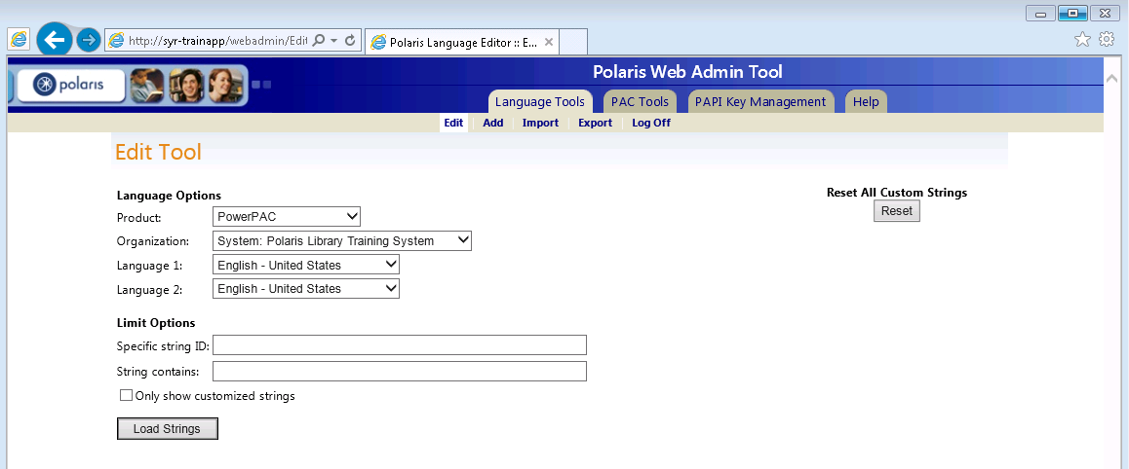
Overview
PowerPAC™, including Community Profiles
ExpressCheck™
Outbound telephony
Inbound telephony
Notices (print, email and text messages)
PAC Inter-library Loan
Polaris® Fusion™
Acquisitions Exchange
MobilePAC™
PAC search results labels (ERMSPortal)
Receipts
ContentXChange
Staff Web Client (Leap)
Staff Client

Slide 5
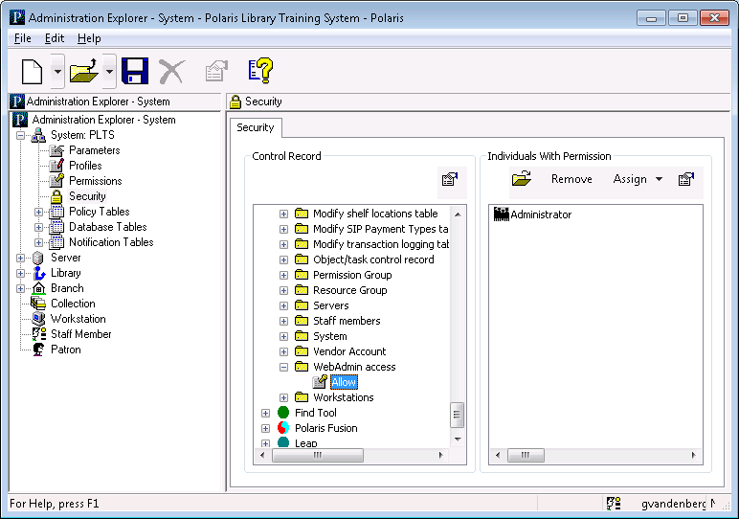
Permission
The staff user must have the System Administration permission WebAdmin access: Allow

Slide 6
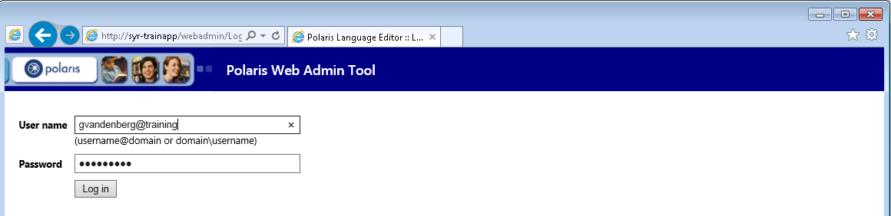
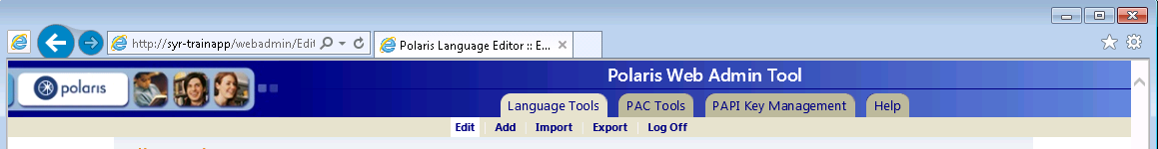
Logging into Web Admin
The URL for Web Admin is typically http://servername/WebAdmin
To log in: Supply your username, domain, and password, then click “Log in”
Log off: It is important to click “Log Off” when done

Slide 7
Working with Language Strings
Compare and edit language strings
Add language strings
Import custom strings for a specific language
Export Language Strings to XML

Slide 8
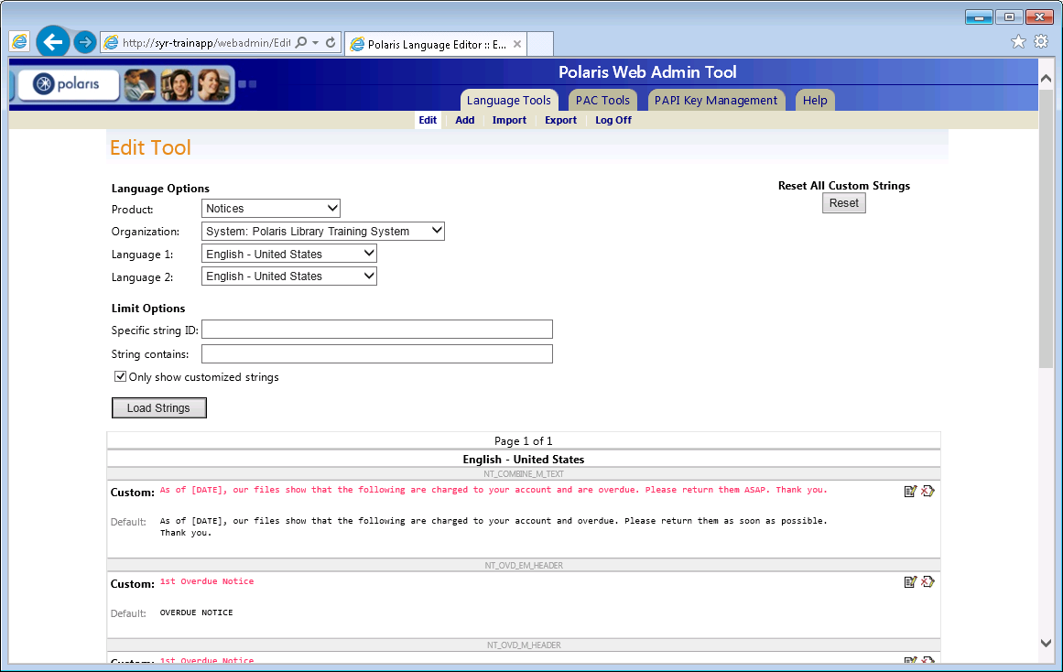
Editing Notice Text

Slide 9
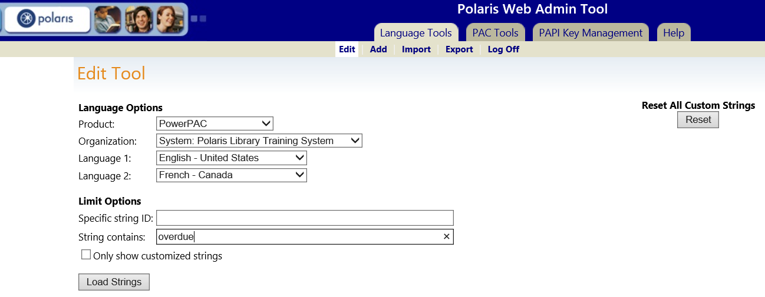
Compare and Edit Language Strings
TIP
Only licensed products are available in the Product box.
After logging in, Web Admin defaults to the Language Tools tab/edit page
In the Language Options dialog:
Product: Select the product you would like to customize
Organization: Select the organization for which you are making the change
Language 1 & 2: Select languages to compare and edit

Slide 10
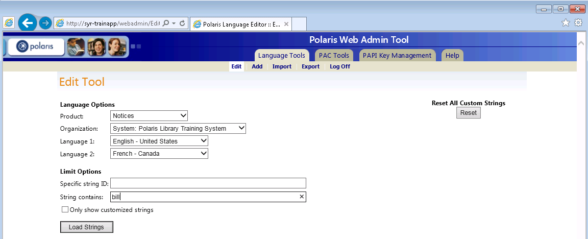
Compare and Edit Language Strings
TIP
If you want to edit only one language, for example English, set both languages to English.
Language string ID references are available in the Web Admin documentation and through the PAC Tools tab
Limit language strings by:
Specific string ID
String contains (a specific word or words)
Only show customized language strings
Click the Load Strings button

Slide 11
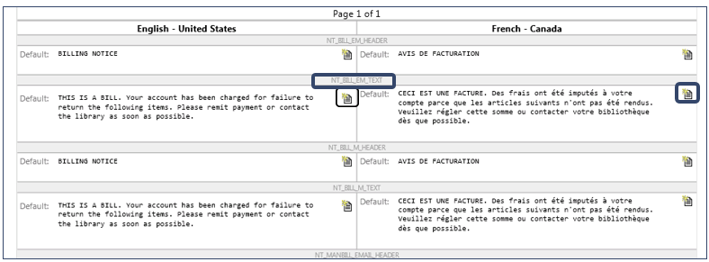
Compare and Edit Language Strings
Once the strings are loaded, if two languages were selected, the first language is on the left and the equivalent string in the second language is on the right
The string ID is displayed above each string for both languages
Click the New Custom String icon to edit each language separately

Slide 12
Compare and Edit Language Strings
Select “Only show customized strings” to load only strings that have been changed
Default string values are also displayed
Click the “Revert to default” icon to revert to the default string

Slide 13
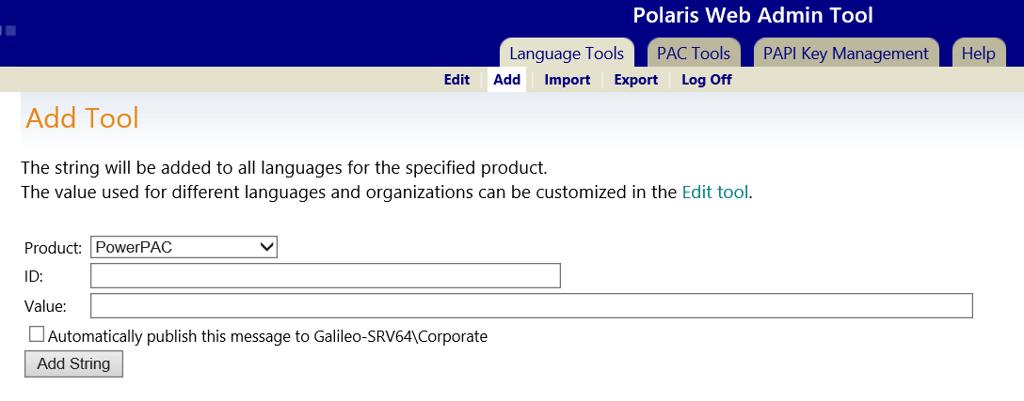
Add Language Strings
TIP
You must edit the HTML code of the PowerPAC files on the Web server to position the
added language strings
You can add your own language strings to the product of your choice instead of replacing default strings
When you add a string, it is added to all licensed languages for the selected product at the system level
You can then edit each organization and each language as needed
To add a string, click on “Add” on the Language Tools tab

Slide 14
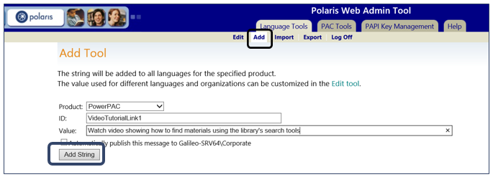
Language Strings
You can import custom strings into the database from an XML file for use in a licensed language in PowerPAC and ExpressCheck
Click on Import on the Language Tools tabs
Product: Select the product
Organization: Select the organization—system, library or branch
File: Browse to select (or type) the path to your file
Click the “Import XML” button

Slide 15
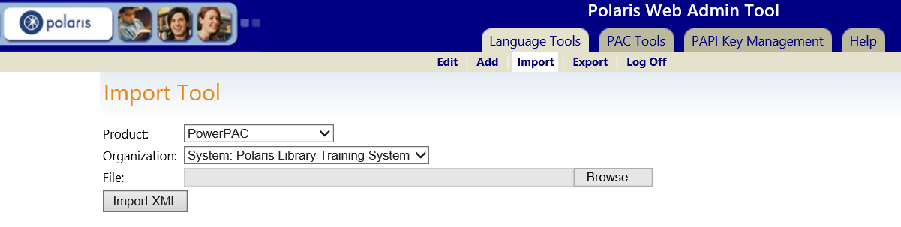
Import Custom Strings for a Specific Language
You can import custom strings into the database from an XML file for use in a licensed language in PowerPAC and ExpressCheck
Click on Import on the Language Tools tabs
Product: Select the product
Organization: Select the organization—system, library or branch
File: Browse to select (or type) the path to your file
Click the “Import XML” button

Slide 16
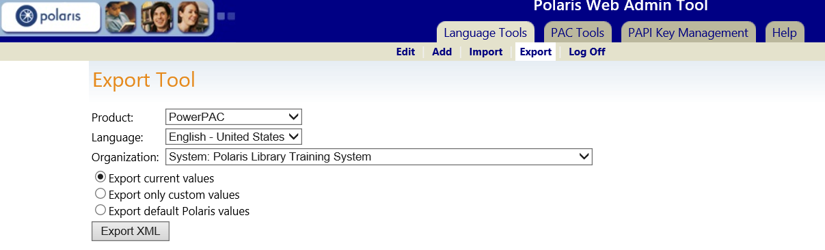
Export Language Strings to XML
Language strings may be exported to an XML file
Click Export on the Language Tools tabbed page
Product: Select the product
Language: Select the language to export
Organization: Select the organization—system, library or branch

Slide 17
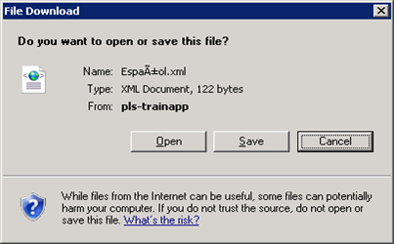

Export Language Strings to XML
Select an export option
Click the Export XML button
A file Download dialog box appears
You can save the file to a chosen location
Export current values
Exports the current values for the specified product, language, and organization, including any customized strings.
Export custom values
Exports only the customized strings set for the organization.
Export default Polaris values
Exports the default language strings that are stored in the default database table; does not include any customized strings.

Slide 18
Working with PowerPAC Tools
Identify PowerPAC language strings by ID
Customize PowerPAC language strings
Ending Sessions
Reload PowerPAC

Slide 19
Identify PowerPAC Language Strings by ID
Web Admin includes a tool that identifies PowerPAC language strings by their unique IDs
You can use the unique string IDs to find and customize specific strings in context
Important Warnings:
This utility starts a live PowerPAC session for the purpose of identifying language strings within the PowerPAC context
Some PowerPAC features may not function correctly within the Web Admin environment
To test and use the changes you’ve made:
End the Identify Strings session
Reload the PowerPAC after making the changes
Log out of the Web Admin
Connect to the PowerPAC and review the changes

Slide 20
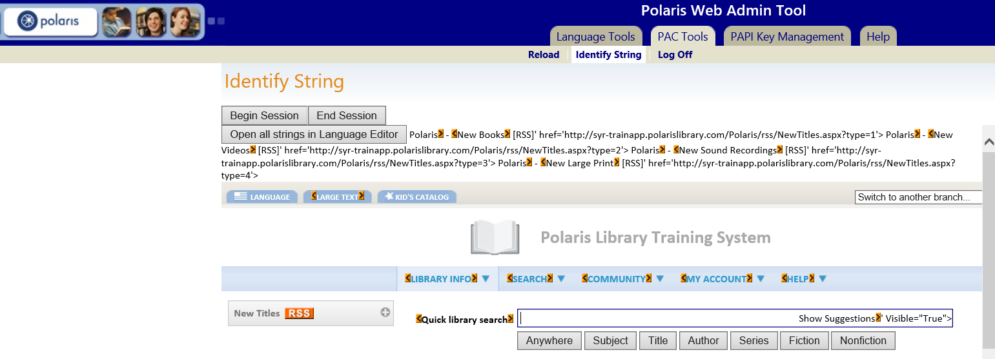

Identify PowerPAC Language Strings by ID
Click the Identify String subtab on the PAC Tools tab
Click the Begin Session button
PowerPAC opens in the Web Admin window
Default language strings are enclosed in orange brackets
Customized strings are enclosed in green brackets

Slide 21
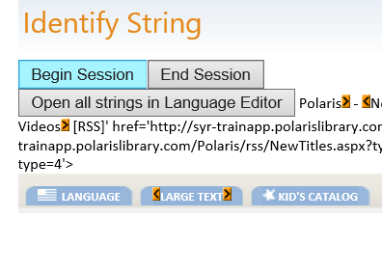

Identify PowerPAC Language Strings by ID
Hover your mouse over any of the highlighted brackets to show the string ID in a tooltip
To customize a string, click a highlighted bracket to open the editor for that string

Slide 22
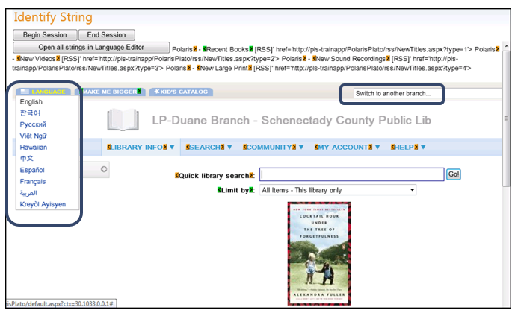
Identify PowerPAC Language Strings by ID
Select the language you would like to edit
In the “Switch to another branch” drop-down, select the organization whose strings you want to display

Slide 23
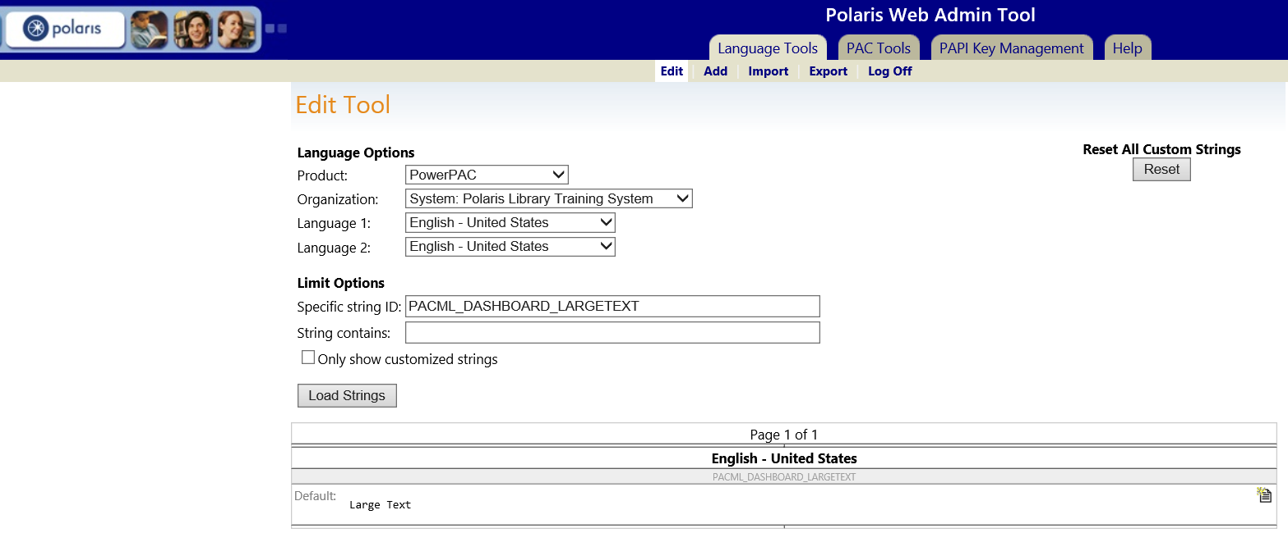
Customize PowerPAC Language Strings
The Edit page opens with the organization and language already selected to match your PowerPAC choices

Slide 24
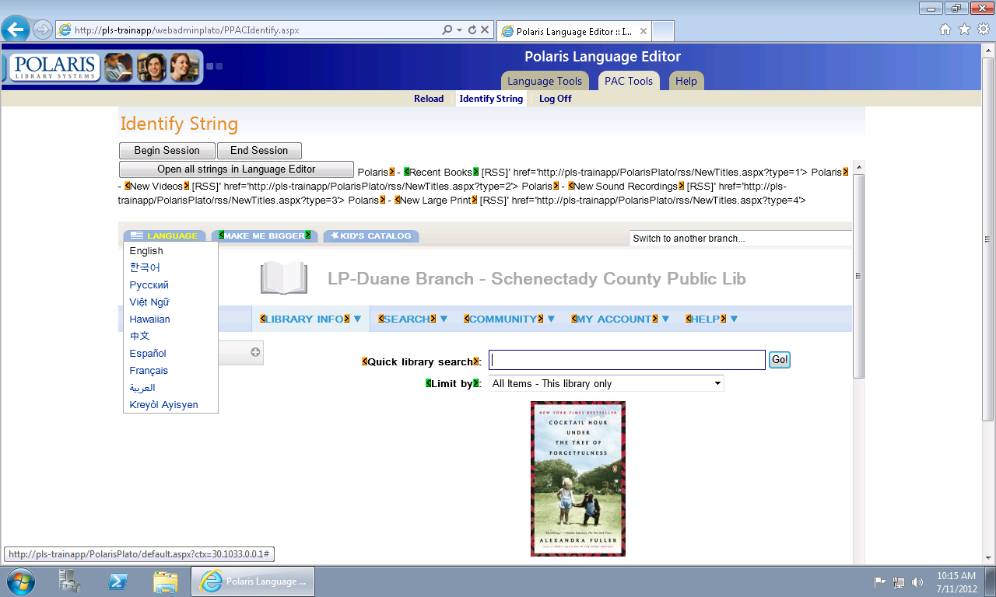
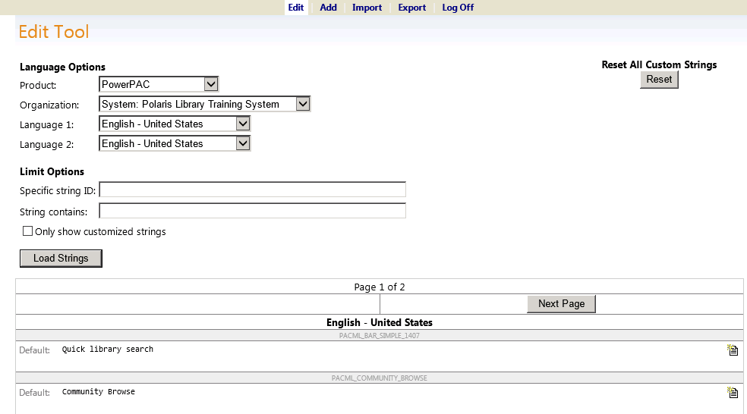
Customize PowerPAC Language Strings
Clicking “Open all strings in Language Editor” opens all default and custom language strings in the Edit Tool.

Slide 25
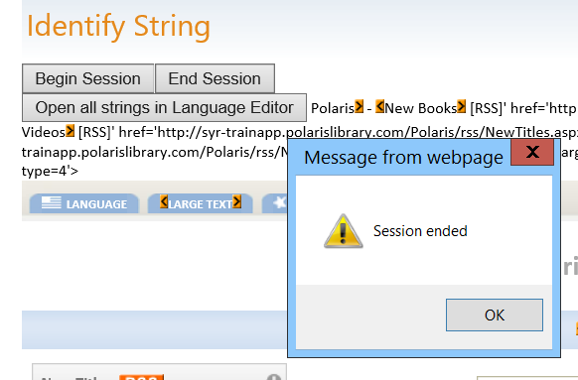
Ending Sessions
TIP The PowerPAC session is live. If you do not select End Session, the coloredbrackets may continue to display to all PowerPACusers.
It is best to do PowerPAC editing during non-public hours and remember to click the End Session button on the PAC Tools/Identify String tabbed page when done
Click “OK” at the prompt to completely end the session.

Slide 26
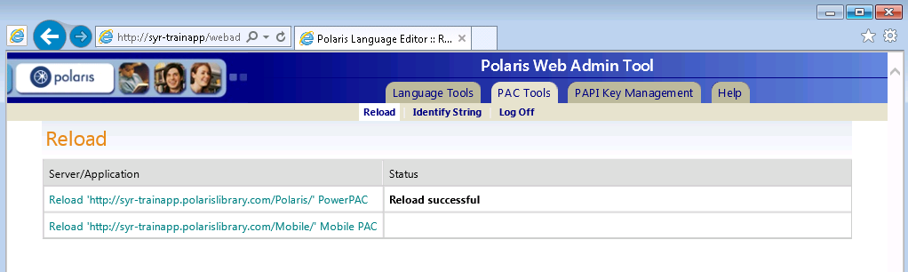
Reload PowerPAC
When settings have been changed in System Administration or you have customized language strings using Web Admin, you must update page caches to see the results of your changes
On the PAC Tools tab:
Click Reload
Click the Reload [PowerPAC URL] link
After a few moments a confirmation message will be displayed in Status
Some changes will require an ISS reset on the PAC server itself

Slide 27
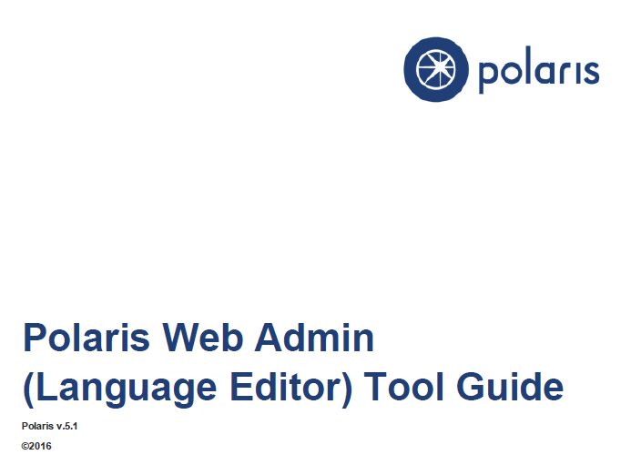
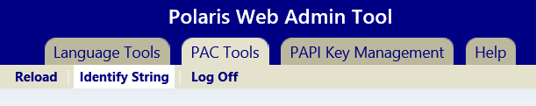
Polaris Web Admin Tool Guide
The PDF Polaris Web Admin (Language Editor) Tool Guide is accessible via:
The “Help” tab when logged into Web Admin and requires customer login

Slide 28


Forename Surname
forename.surname@clarivate.com
+000 000-0000
About Clarivate
Clarivate is a leading global provider of transformative intelligence. We offer enriched data, insights & analytics, workflow solutions and expert services in the areas of Academia & Government, Intellectual Property and Life Sciences & Healthcare. For more information, please visit clarivate.com.
© 2025 Clarivate. All rights reserved
Clarivate and its logo, as well as all other trademarks used herein are trademarks of their respective owners and used under license.

