Slide 1

Polaris Web-Based System Administration

Slide 2
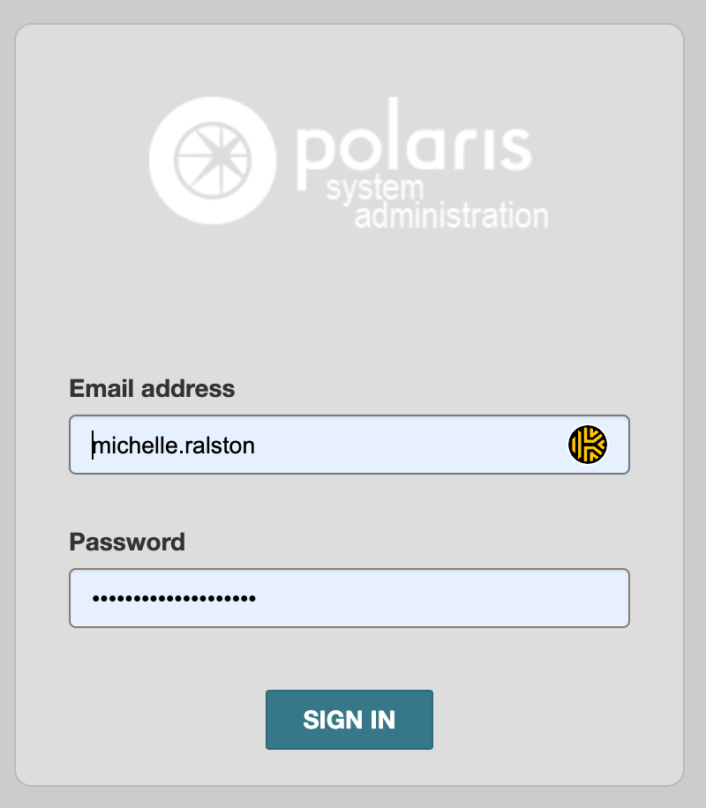
Accessing Web-Based System Administration
https://[severname].polarislibrary.com/PolarisAdmin
Same username/password as Polaris Leap (must have admin permissions to access System Admin)

Slide 3
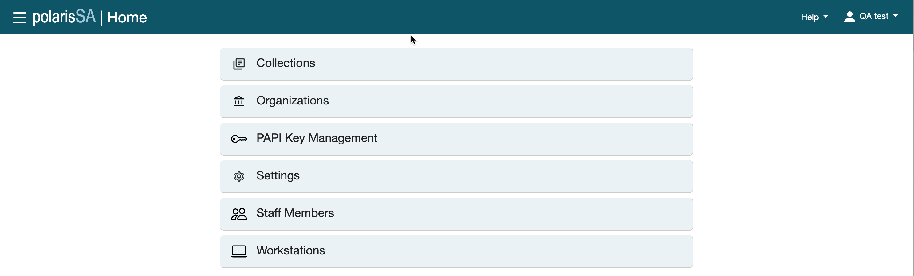
What’s Available Now
System Admin functionality is moving into Web-Based System Admin; the Staff Client will be needed until all everything is switched over.

Slide 4
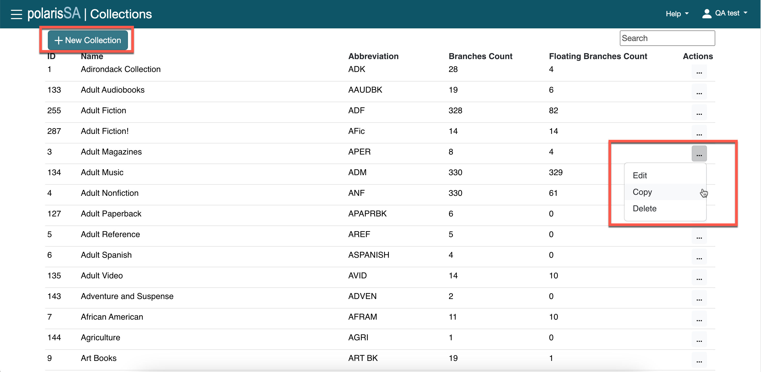
Collections
Collections can be fully managed (i.e., adding, editing, coping and deleting).

Slide 5
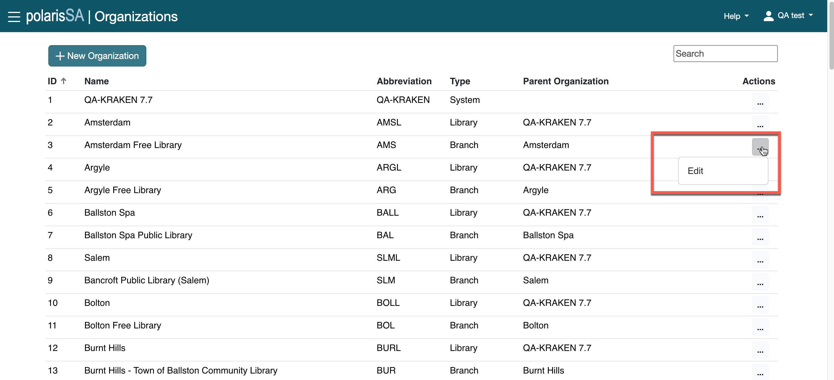
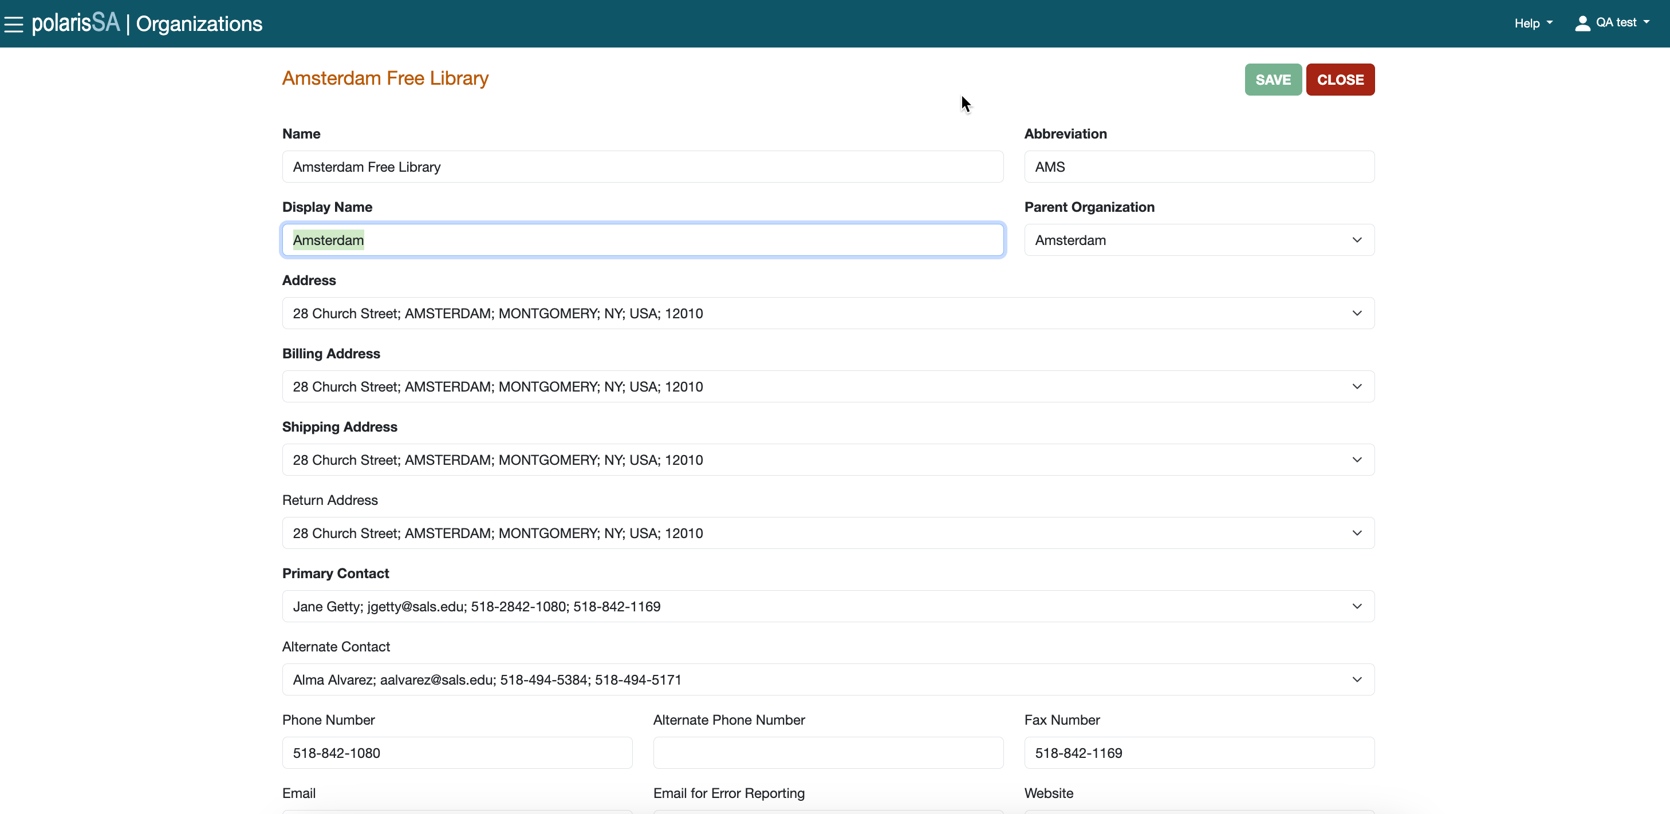
Organization Records

Slide 6
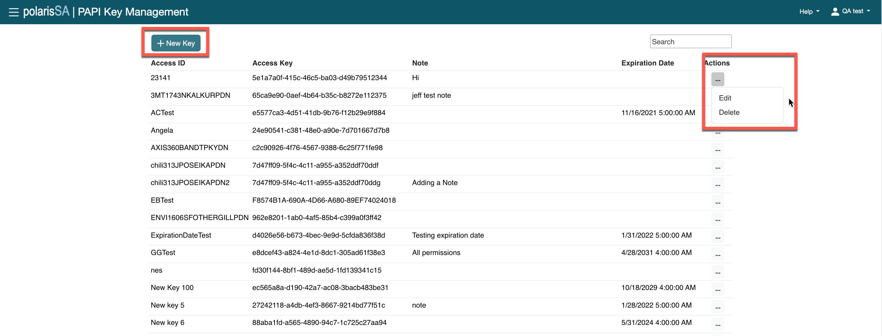
PAPI Key Management
Add a new key.
Edit or delete a current key.

Slide 7
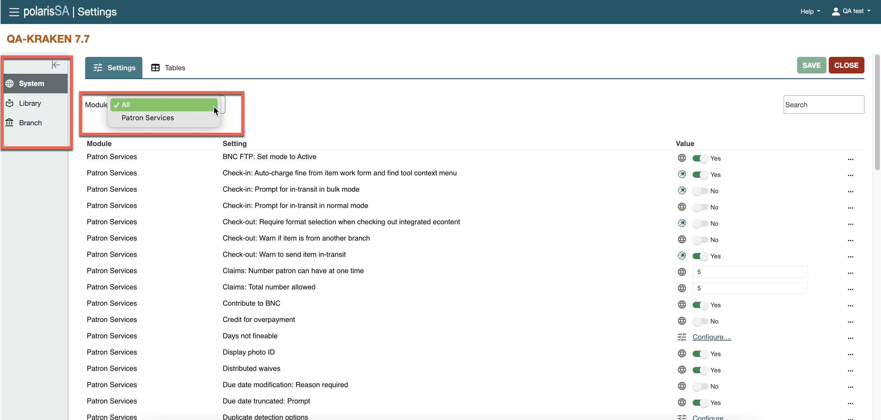
Settings
Settings can be set at system, library or branch level.

Slide 8
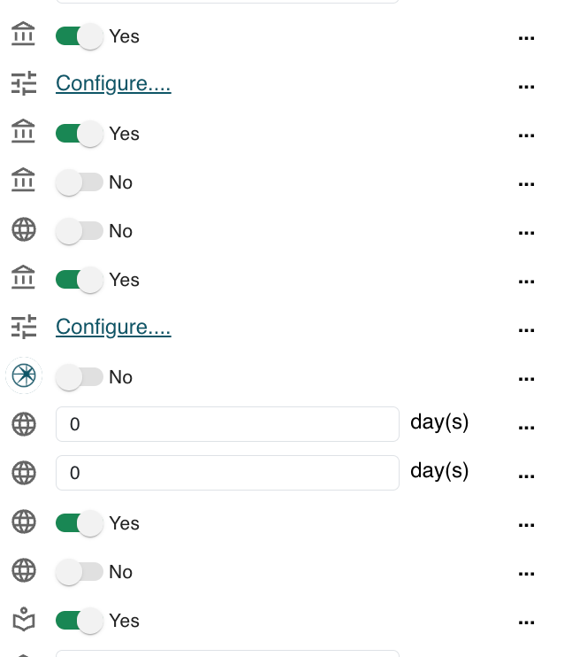
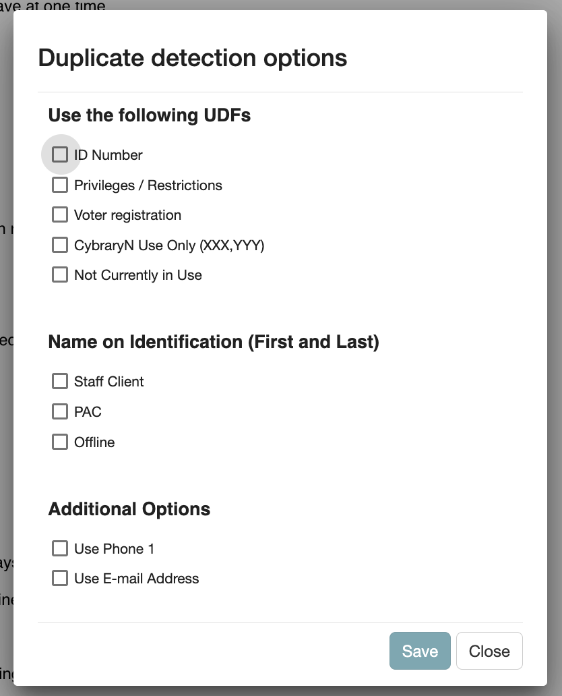
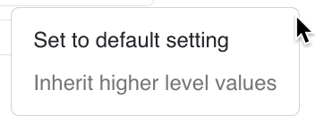

Settings
New icons for system, library and branch level

Slide 9
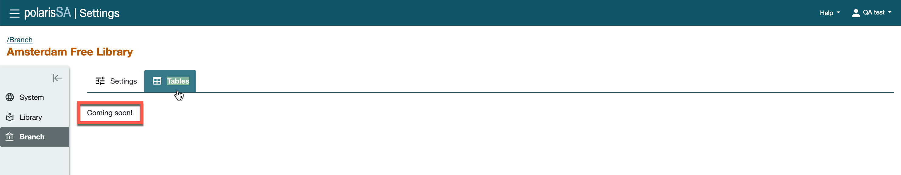
Tables – More Information Coming Soon

Slide 10
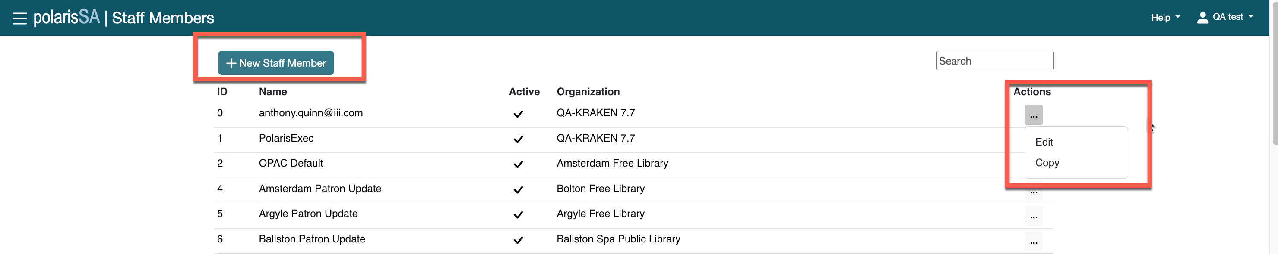
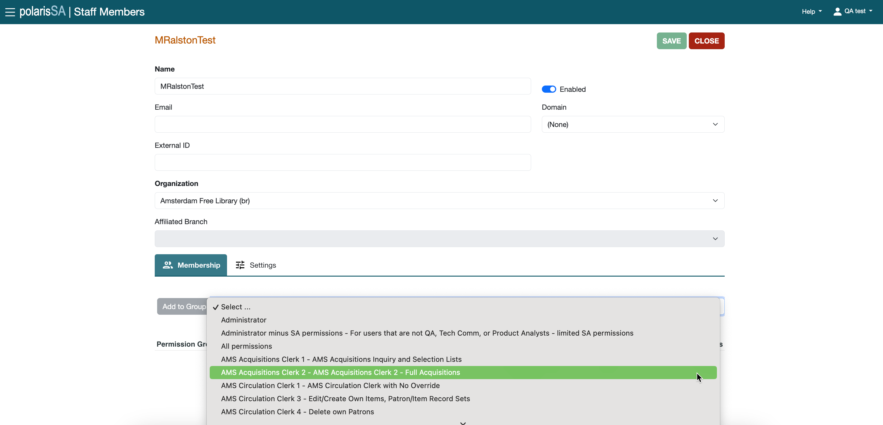
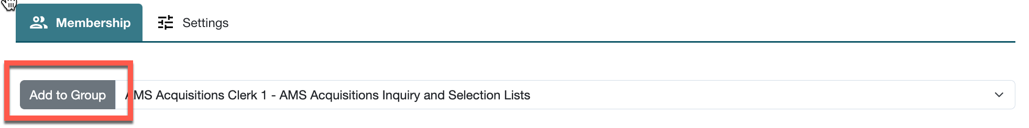
Staff Members
Add new staff; edit or copy current staff.
Assign staff to permission groups.

Slide 11
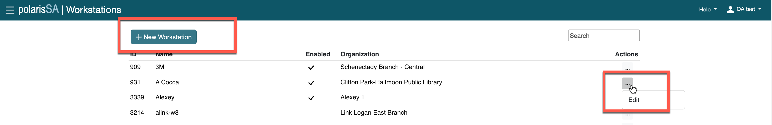
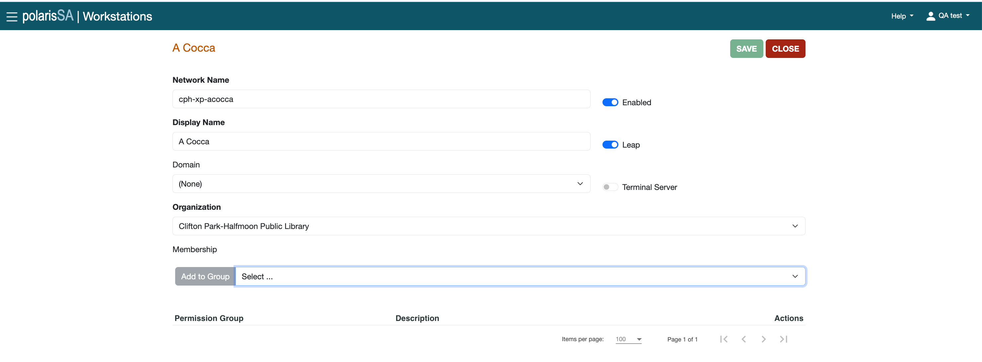
Workstations
If you are creating permissions for a main functionality, the group method is the best strategy.

Slide 12


Forename Surname
forename.surname@clarivate.com
+000 0000 0000
About Clarivate
Clarivate is a leading global provider of transformative intelligence. We offer enriched data, insights & analytics, workflow solutions and expert services in the areas of Academia & Government, Intellectual Property and Life Sciences & Healthcare. For more information, please visit clarivate.com.
© 2025 Clarivate. All rights reserved
Clarivate and its logo, as well as all other trademarks used herein are trademarks of their respective owners and used under license.

